Slide 1
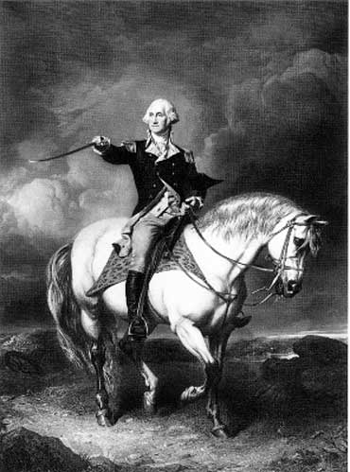
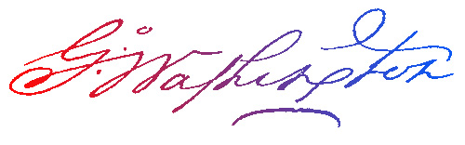
George Washington
The Model Citizen
Part 2
Aim: Why are setting precedents important to a president?
Do Now: How many times were you the first to do something or you are the first person about to do something? What was or is it?

Slide 2
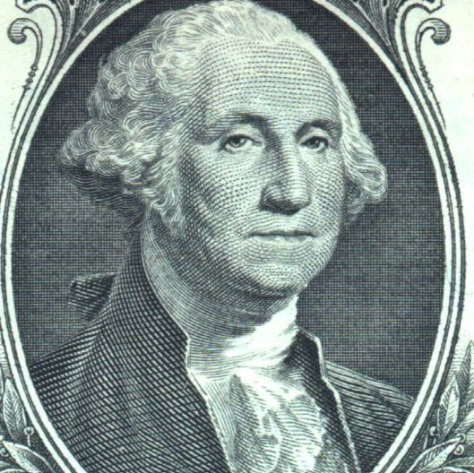
What is a precedent?
An act , rule or procedure used by a President that may be used by other Presidents.

Slide 3
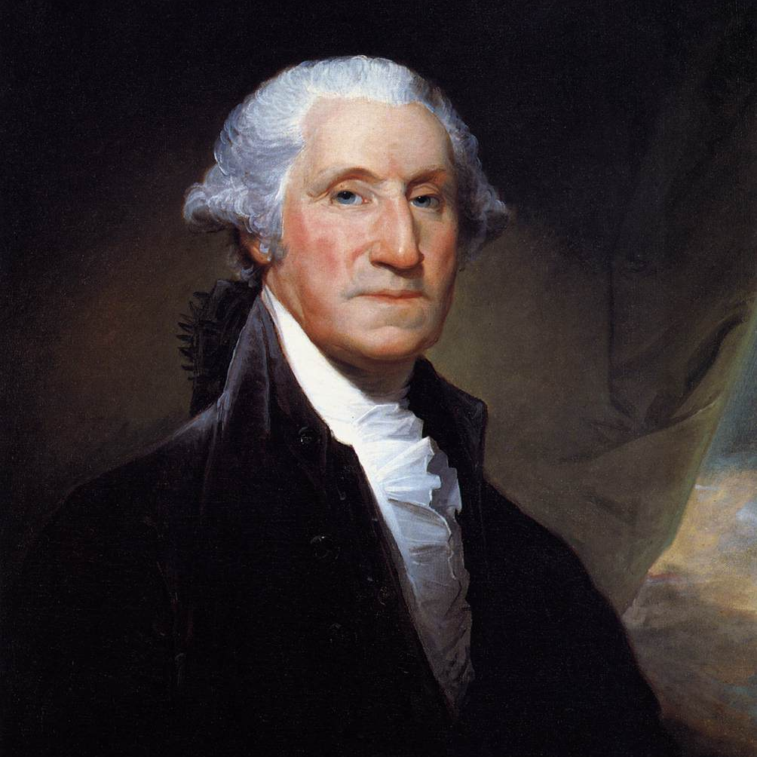
How did George Washington set the course for future presidents?
CABINET
INAUGARATION SPEECH
# OF TERMS IN OFFICE
COMMANDER-IN-CHEIF
Notes:
As President, Washington respected the idea of separation of powers. He carefully tread in dealing with Congress and the Supreme Court. He also tried to avoid political parties, though by 1796 two had already arisen. However, foreign policy became a major concern for President Washington. The French Revolution was destabilizing Europe and led to war between France and Great Britain. Washington listened to his advisors, yet made his own decision on America’s involvement on the international stage. He believed that to protect the interests of the young country, America remain neutral in international affairs.
President Washington set countless precedents for future presidents: like creating a cabinet of advisors, sending the troops out to quell insurrections like the Whiskey Rebellion, no President ever visited the Senate again, a President only served only two terms until 1940, giving a Farewell Address, among countless other principles and procedures.
Introduce the concept of “precedent” by asking students what the word means. Ask students to explain how precedents are used in our government. After a few minutes, elicit student responses to this point.
Critical Thinking Questions:
What were the circumstances that led to the establishment of the precedents during the Washington presidency?
What are the short and long term impacts of the precedents?

Slide 4
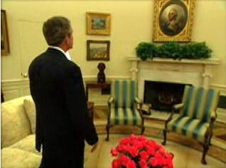
aNOTHER precedent?
(Almost)
Washington did not want to get paid to be President, but Congress insisted.
"I walk on untrodden ground. There is scarcely any part of my conduct which may not hereafter be drawn into precedent.“ – G. Washington

Slide 5
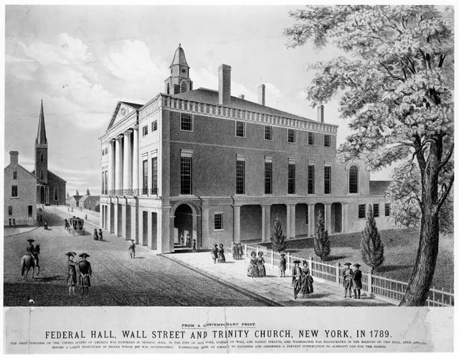
What were his presidential accomplishments?
New York City, New York: March 4, 1789 to
December 5, 1790
New York City, New York: May 15, 1800 to
November 16, 1800
Notes:
As President, Washington respected the idea of separation of powers. He carefully tread in dealing with Congress and the Supreme Court. He also tried to avoid political parties, though by 1796 two had already arisen. However, foreign policy became a major concern for President Washington. The French Revolution was destabilizing Europe and led to war between France and Great Britain. Washington listened to his advisors, yet made his own decision on America’s involvement on the international stage. He believed that to protect the interests of the young country, America remain neutral in international affairs.
President Washington set countless precedents for future presidents: like creating a cabinet of advisors, sending the troops out to quell insurrections like the Whiskey Rebellion, no President ever visited the Senate again, a President only served only two terms until 1940, giving a Farewell Address, among countless other principles and procedures.
Introduce the concept of “precedent” by asking students what the word means. Ask students to explain how precedents are used in our government. After a few minutes, elicit student responses to this point.
Critical Thinking Questions:
What were the circumstances that led to the establishment of the precedents during the Washington presidency?
What are the short and long term impacts of the precedents?

Slide 6
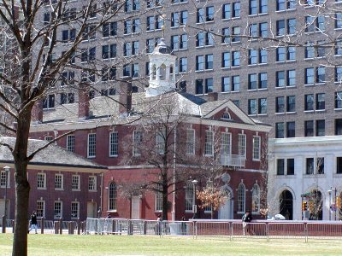
Philadelphia, Pennsylvania: December 6, 1790 to May 14, 1800
Notes:
As President, Washington respected the idea of separation of powers. He carefully tread in dealing with Congress and the Supreme Court. He also tried to avoid political parties, though by 1796 two had already arisen. However, foreign policy became a major concern for President Washington. The French Revolution was destabilizing Europe and led to war between France and Great Britain. Washington listened to his advisors, yet made his own decision on America’s involvement on the international stage. He believed that to protect the interests of the young country, America remain neutral in international affairs.
President Washington set countless precedents for future presidents: like creating a cabinet of advisors, sending the troops out to quell insurrections like the Whiskey Rebellion, no President ever visited the Senate again, a President only served only two terms until 1940, giving a Farewell Address, among countless other principles and procedures.
Introduce the concept of “precedent” by asking students what the word means. Ask students to explain how precedents are used in our government. After a few minutes, elicit student responses to this point.
Critical Thinking Questions:
What were the circumstances that led to the establishment of the precedents during the Washington presidency?
What are the short and long term impacts of the precedents?

Slide 7
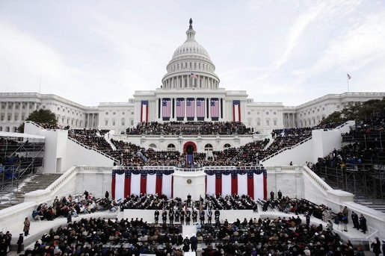
Inauguration speech
Washing gave a speech at his inauguration. Since then mostly every President has given a speech at their inauguration.
Five presidents never gave an address: Tyler, Fillmore, Andrew Johnson, Arthur, and Ford.

Slide 8
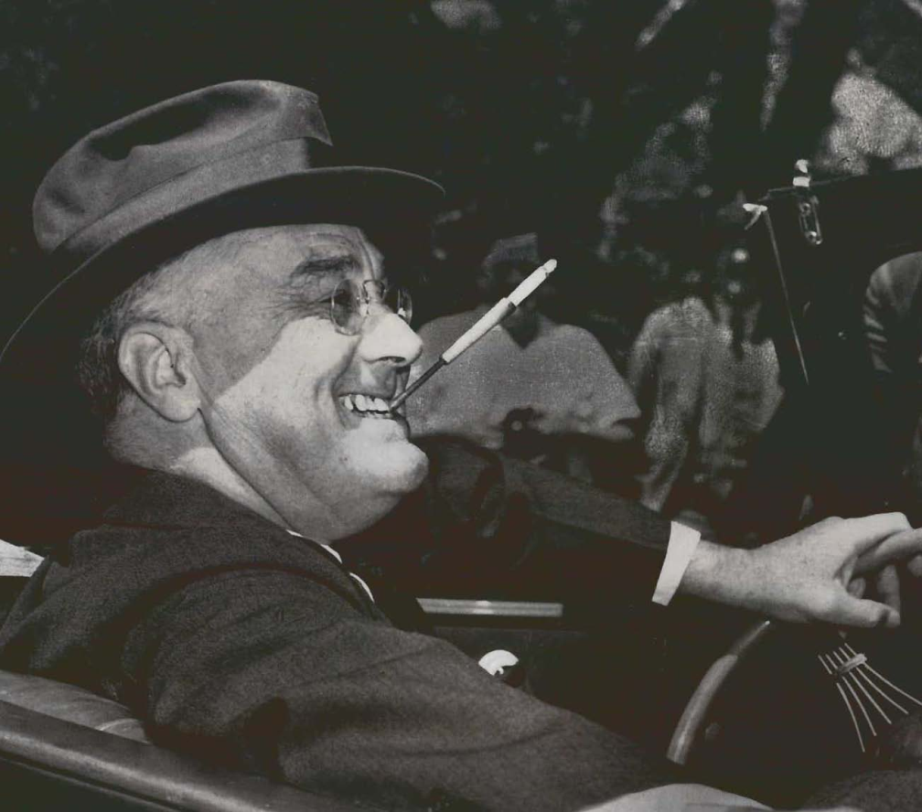
# of Terms in Office
Washington only chose to serve (2) terms in office.
Followed by every President except FDR in 1933-1945.
22nd Amendment 1951 – 2 Terms

Slide 9
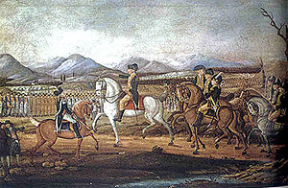
Commander-in-chief
Washington led the army against an uprising over taxes on Whiskey.

Slide 10
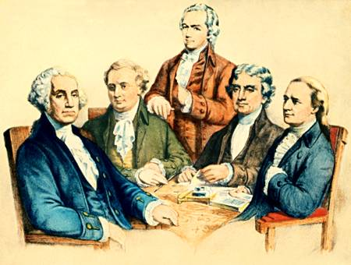
cabinet
Not in your kitchen!
A group of advisors to the President
Secretary is a Department Head of the Executive Branch
War Department - Secretary of War – Henry Knox
Treasury Department- Secretary of Treasury – Alexander Hamilton
State Department - Secretary of State – Thomas Jefferson
Attorney General - Chief Prosecutor
Postmaster General - You’ve Got Mail!

Slide 11
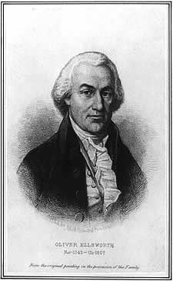
The judicial system
Signed the Judicial Act of 1789 to set up the Federal Court System and Created the Position of Attorney General
Selected & Appointed ALL of the Justices to the Supreme Court – 1O in All

Slide 12
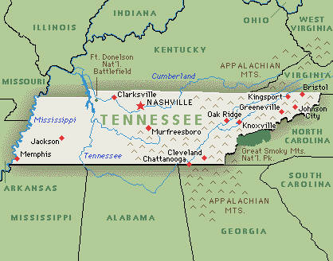
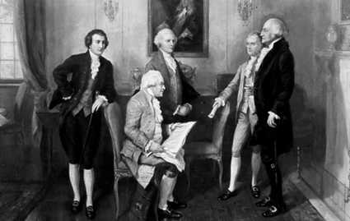
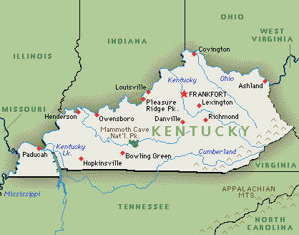
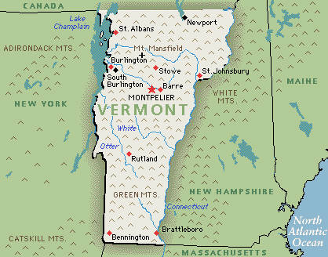
Executive offices
Set Up a Cabinet of Advisors
Set Up Various Government Department to Manage the Affairs of the Government
Vermont (1791), Kentucky (1792), and Tennessee (1796) Become States
16

Slide 13
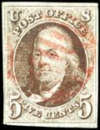
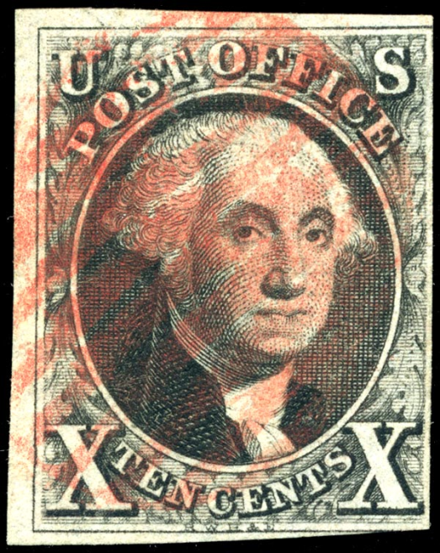
The POST OFFICE
Appointed a Postmaster General and Created the U.S. Post Office System

