Slide 1

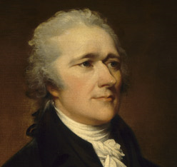
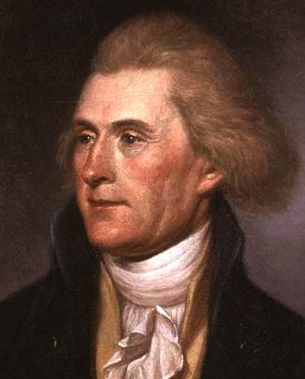
AIM: How were Hamilton and Jefferson Different?
Verses
Thomas Jefferson
Alexander Hamilton

Slide 2
Inventing the United States meant not only creating a government, but imagining the future. Thomas Jefferson embodied his vision in the inspiring words, "We hold these
truths to be self-evident: That all men are created equal; that they are endowed by their Creator with certain unalienable rights; that among these are life, liberty, and the pursuit of happiness; that to secure these rights, governments are instituted among men."
Thomas Jefferson

Slide 3
But actions also embody visions. When George Washington chose Alexander Hamilton, self-made man and war hero, as the nation's first secretary of the treasury, along with Thomas Jefferson as secretary of state, he put in power two brilliant men with radically different notions of what the United States ought to become, and different plans for how to reach their goals. While Jefferson cared most about political ideals, Hamilton focused his energy on creating the institutions that would make America a world power.
Alexander Hamilton

Slide 4
Activity Instructions:
We will be reading about Alexander Hamilton and Thomas Jefferson
There are two signs on each side of the room. One for Jefferson, and One for Hamilton.
After each reading, I would like you to decide who had a better vision for America. YOU MUST CHOOSE A SIDE
After we are done you will vote for either Jefferson or Hamilton.

Slide 5
People who believed in the ideas or ideology of Thomas Jefferson were called:
Jeffersonians
Thomas Jefferson

Slide 6
People who believed in the ideas or ideology of Alexander Hamilton
were called:
Hamiltonians
Alexander Hamilton

Slide 7
What if you knew that Jefferson trusted the people to act wisely, and thought that governments should leave citizens as free as possible to act as they wished?
Thomas Jefferson

Slide 8
What if you knew that Alexander Hamilton had a bleak view of human nature, and worried that too much democracy might unleash the worst in people?
Alexander Hamilton

Slide 9
Choose a Side
OR
Thomas Jefferson
Alexander Hamilton
Jeffersonians
Hamiltonians

Slide 10
On the Virtue of the People
"I am persuaded myself that the good sense of the people will always be found to be the best army. . . . They may be led astray for a moment, but will soon correct themselves."
-- Thomas Jefferson to Edward Carrington, 1787
Thomas Jefferson

Slide 11
On the Virtue of the People
"Has it not. . . invariably been found that momentary passions, and immediate interests, have a more active and imperious control over human conduct than general or remote considerations of policy, utility and justice?"
-- Alexander Hamilton,
Federalist #6
Alexander Hamilton

Slide 12
Do You Want to Switch Sides?
OR
Thomas Jefferson
Alexander Hamilton
Jeffersonians
Hamiltonians

Slide 13
What if you knew that Jefferson trusted the people to act wisely, and thought that governments should leave citizens as free as possible to act as they wished?
Thomas Jefferson
Do You Want to
Switch Sides?

Slide 14
What if you knew that Alexander Hamilton had a bleak view of human nature, and worried that too much democracy might unleash the worst in people?
Do You Want to
Switch Sides?
Alexander Hamilton

Slide 15
On the Role of Government
Jefferson was a philosopher who argued from principle. Outraged by Congress's passage of the repressive Alien and Sedition Acts in 1798 and 1799, Jefferson secretly drafted resolutions passed by the Kentucky legislature that claimed that states had the right to "nullify" federal laws they found obnoxious. Indeed, Jefferson wrote James Madison, states might even find themselves driven to secede "from that union which we so value, rather than give up the rights of self-government which we have reserved."
Thomas Jefferson

Slide 16
On the Role of Government
Hamilton was a practical man and a problem-solver. As secretary of the treasury, he proposed programs to tie the interests of the rich to the government. His enemies accused him of handing out favors to his wealthy friends, but Hamilton insisted that the new nation needed the support of the rich, who would not be patriotic unless they could make money doing so.
Alexander Hamilton

Slide 17
Do You Want to Switch Sides?
OR
Thomas Jefferson
Alexander Hamilton
Jeffersonians
Hamiltonians

Slide 18
What if you knew that Thomas Jefferson never freed his slaves, and died owing so much money that most of those slaves had to be sold to pay his debts?
Thomas Jefferson
Do You Want to
Switch Sides?

Slide 19
What if you knew that Alexander Hamilton publicly opposed slavery, while vocally insisting that there would always be social inequality?
Do You Want to
Switch Sides?
Alexander Hamilton

Slide 20
On Slavery
Jefferson declared, in deathless words, that the United States had been "conceived in liberty," and that all men possessed "unalienable rights" including life, liberty, and the pursuit of happiness. And yet he died owning hundreds of slaves, freeing in his will only a few. Again and again he declared his hatred of slavery. But just as often, he refused to associate himself with abolitionist groups.
"Those whom I serve have never been in a position to lift up their voices against slavery... I am an American and a Virginian, and, though I esteem your aims, I cannot affiliate myself with your association."
Thomas Jefferson
-- Thomas Jefferson to French abolitionist J. P. Brissot de Warville, c. 1788

Slide 21
Hamilton's conscience was far more troubled by slavery. He served as president of New York's Society for the Promotion of the Manumission (freeing by owner) of Slaves at a time when many of that state's leading families were slaveholding planters. Hamilton declared that though some people might imagine slaves as property,
"they are persons known to the municipal laws of the states which they inhabit, as well as the laws of nature.“ -- Alexander Hamilton to the New York Ratifying Convention, 1788
On Slavery
Alexander Hamilton was no egalitarian. He was comfortable with the prospect of a gap between rich and poor, a society of plenty for the few and misery for the many.
"... an inequality would exist as long as liberty existed, and . . . it would unavoidably result from that very liberty itself."
-- Alexander Hamilton to the Constitutional Convention, 1787
Alexander Hamilton

Slide 22
Do You Want to Switch Sides?
OR
Thomas Jefferson
Alexander Hamilton
Jeffersonians
Hamiltonians

Slide 23
What if you knew that Thomas Jefferson envisioned a nation of independent, yeoman (free men owing land) farmers, despite the importance of cities to national greatness?
Thomas Jefferson
Do You Want to
Switch Sides?

Slide 24
Do You Want to
Switch Sides?
What if you knew that Alexander Hamilton wanted to promote the growth of cities, at whatever cost to rural (countryside) America?
Alexander Hamilton

Slide 25
Alexander Hamilton thought that the nation should encourage the growth of cities and the development of manufacturing. His 1791 Report on Manufactures proposed government subsidies to the nation's "infant industries," encouragement of inventions and discoveries, and high import taxes (or tariffs). For Hamilton, agricultural societies were doomed to backwardness. Manufacturing, he said, would give inventors outlets for their genius, open up entrepreneurial opportunities, generate markets for farmers' products, and create jobs for the idle, including women and children.
The Place of Cities
Alexander Hamilton

Slide 26
The Place of Cities
Thomas Jefferson believed that the future of the republic depended on nurturing farm life and low-density living. He wrote in his 1785 Notes on the State of Virginia that "The mobs of great cities add just so much to the support of pure government, as sores do to the strength of the human body." Farmers, by contrast, embodied American virtue. "Put a question to a professor and a plowman," he said, and you'd get the better answer from the plowman.
Thomas Jefferson

Slide 27
Do You Want to Switch Sides?
OR
Thomas Jefferson
Alexander Hamilton
Jeffersonians
Hamiltonians

Slide 28

Time to Vote
OR
Thomas Jefferson
Alexander Hamilton
Jeffersonians
Hamiltonians

Slide 29
Hamilton | Jefferson
Led the Federalists | Led the Anti-Federalists

Slide 30
Hamilton | Jefferson
Led the Federalists Favored a strong central government | Led the Anti-Federalists Favored strong state government (weak central gov)

Slide 31
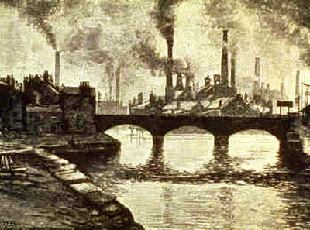

Hamilton | Jefferson
Led the Federalists Favored a strong central government Represented views of northern businessmen and merchants | Led the Anti-Federalists Favored strong state government (weak central gov) Represented rural, southern, farming interests

Slide 32

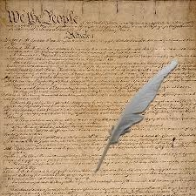
Hamilton | Jefferson
Proposed a national bank | Opposed a national bank

Slide 33
Hamilton | Jefferson
Proposed a national bank Believed in loose interpretation of the Constitution. | Opposed a national bank Believed in strict interpretation of the Constitution.

