Slide 1
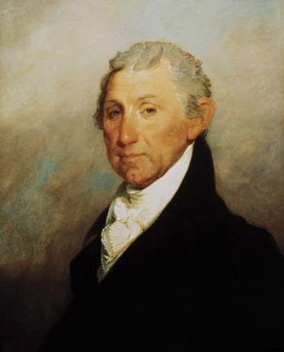
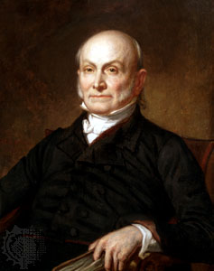
Presidents:
Monroe and Adams
The Era of Good Feeling
AIM: What were the social, political, economic results of the War of 1812?
Do Now: What was the vision of Thomas Jefferson for America? Alexander Hamilton?

Slide 2
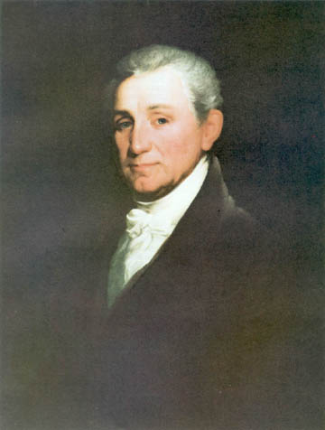
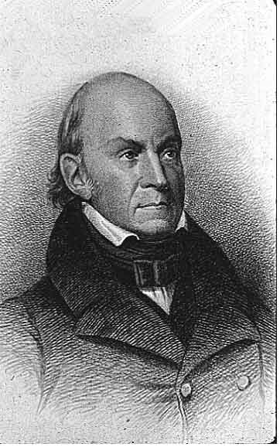
Politics: “ERA OF GOOD FEELINGS”
“Era of Good Feelings”
  James Monroe - President (1817-1825)
  John Quincy Adams
Nationalism
Sectionalism
Pride & Devotion to One’s Country
Separation of regions (North, South, West)
Based upon economics, culture
President James Monroe
Sec. of State J.Q. Adams
Notes:
Pojer; http://www.wadsworth.com/history_d/special_features/image_bank_US/1804_1840.html

Slide 3
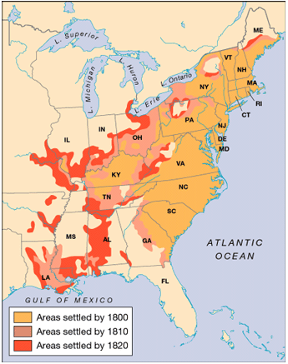
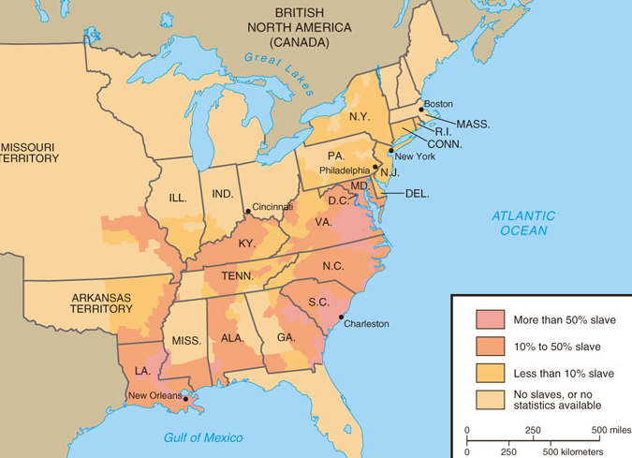
ECONOMIC & DEMOGRAPHIC EXPANSION
Great Migration Westward
  Old Northwest
  Old Southwest
Spread of Settlement: Westward Surge, 1800–1820
Concentration of Slavery, 1820
Notes:
Settlement: Faragher, Out of Many, 3rd Ed.; http://wps.prenhall.com/hss_faragher_outofmany_ap
Slavery: Divine, America Past & Present

Slide 4
Presidency of James Monroe (1817-1825)
Farmer/Planter
Revolutionary War Soldier
Continental Congress
Senator from Virginia
Governor
Secretary of State
  Negotiated the Louisiana Purchase (1803)
Secretary of War
President
  Elected for 2 terms

Slide 5
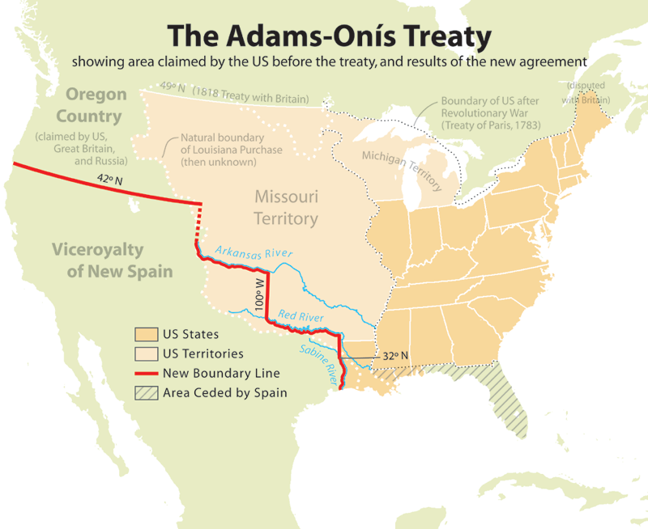
1819

Slide 6
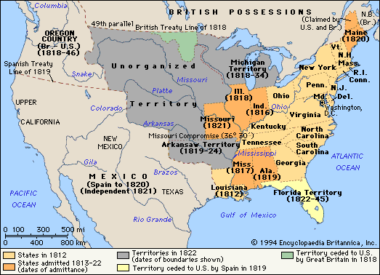

Slide 7
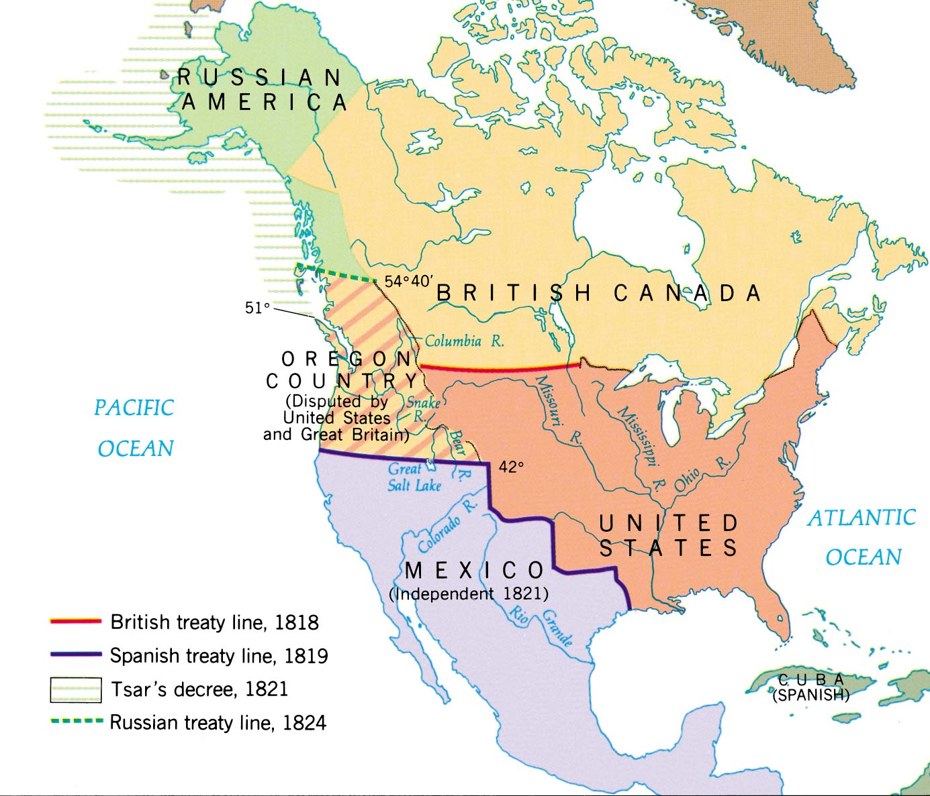

Slide 8
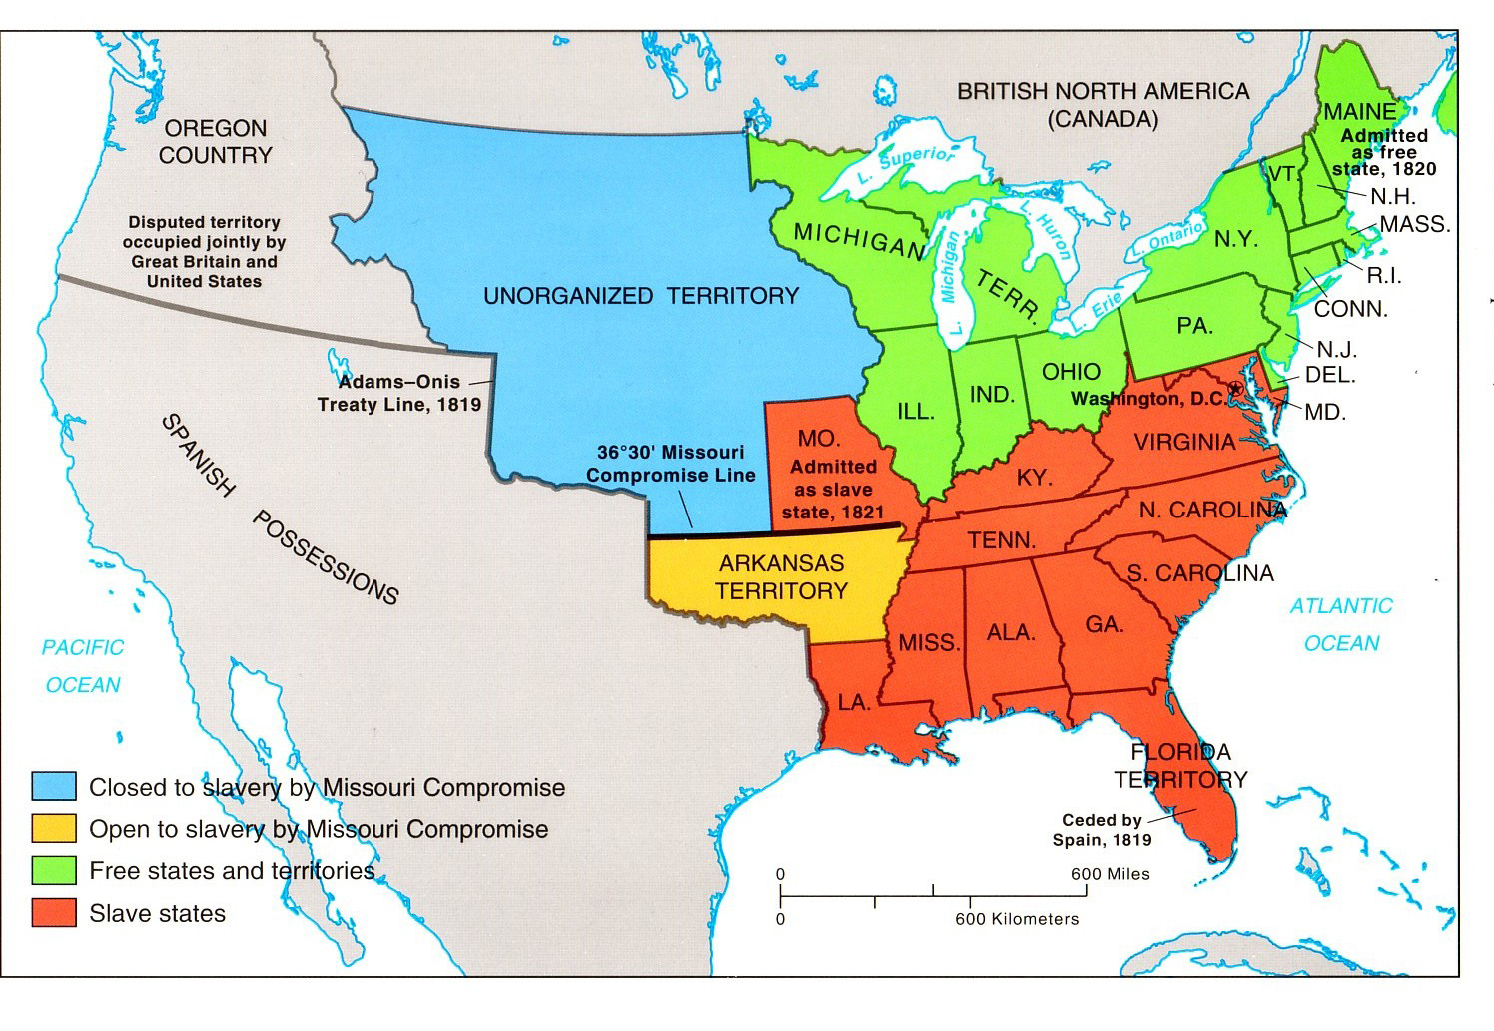
Missouri Compromise of 1820
It prohibited slavery in the former Louisiana Territory north of the parallel 36°30' north except within the boundaries of the proposed state of Missouri
The United States in 1820. The Missouri Compromise prohibited slavery in the Unorganized territory of the Great Plains (dark green) and permitted it in Missouri (yellow) and the Arkansas Territory (lower blue area).

Slide 9
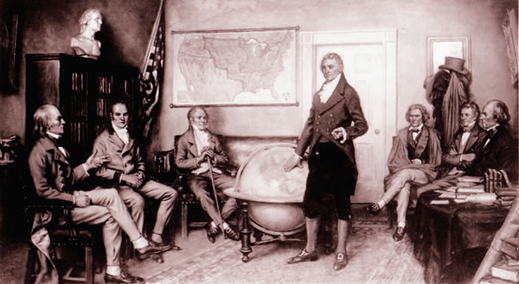
What is the Monroe Doctrine?
President Monroe discussing the
Monroe Doctrine with his Advisors

Slide 10
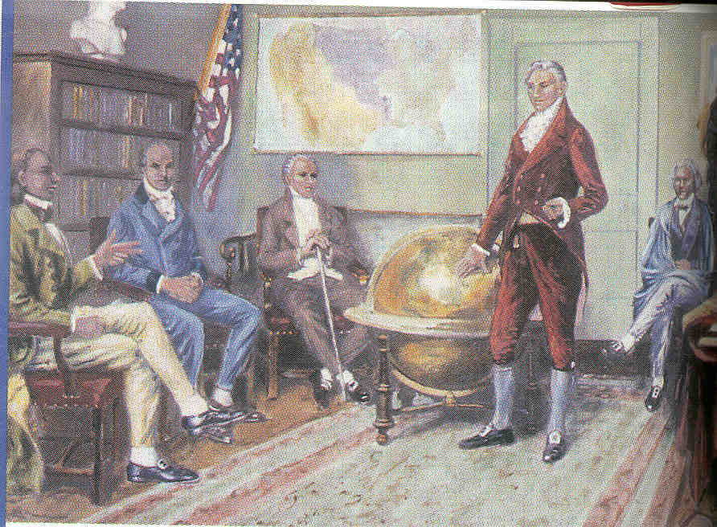
NATIONALISM IN FOREIGN AFFAIRS
The Monroe Doctrine (1823)
The US to declare the Americas
off-limits to Europe.
A continuation of the neutrality
and isolationist policies
established by Washington.
US will recognize existing European Colonies
US will not meddle in European affairs
US will protect the Americas---new countries which formed in Central and South America
No European Colonization in the Americas
Monroe Doctrine
Notes:
Pojer

Slide 11
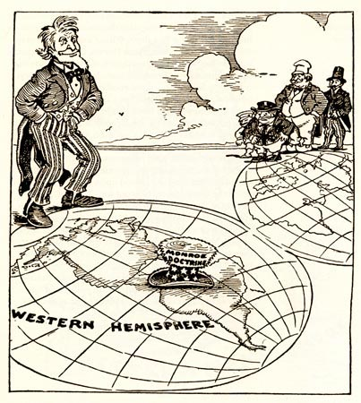
Monroe Doctrine
1823
European Countries were to no longer colonize or interfere with new independent Nations of the Americas.
The U.S. would stay Neutral in wars between Europe & their Colonies.
If any of the above occurred the U.S. would consider it an hostile act.

Slide 12
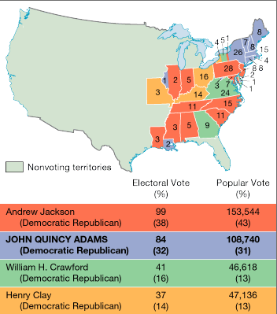
END OF THE “ERA”
Election of 1824 - Era Breaks Down
electoral changes - elections based much more on popular support
“Corrupt Bargain” (according to whom???)
Notes:
Faragher, Out of Many, 3rd Ed.; http://wps.prenhall.com/hss_faragher_outofmany_ap/

Slide 13
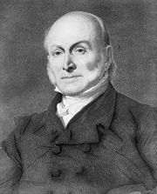
John Quincy Adams (1825-1829)
Elected by House of Representatives in 1824
Andrew Jackson called it a
Corrupt Bargain
After Presidency Became a Congressman for
17 Years
Was an Abolitionist

Slide 14
Review of Presidents
George Washington (1789-1797) no party Virginia
John Adams (1797-1801) Federalist Mass.
Thomas Jefferson (1801-1809) Democratic – Republican Virginia
James Madison (1809-1817) Democratic - Republican Virginia
James Monroe (1817-1825) Democratic – Republican Virginia
John Quincy Adams (1825-1829) Democratic - Republican Mass.

