Slide 1
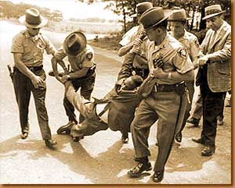
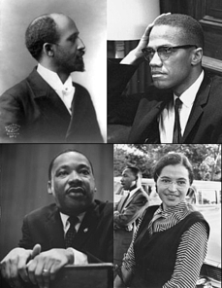
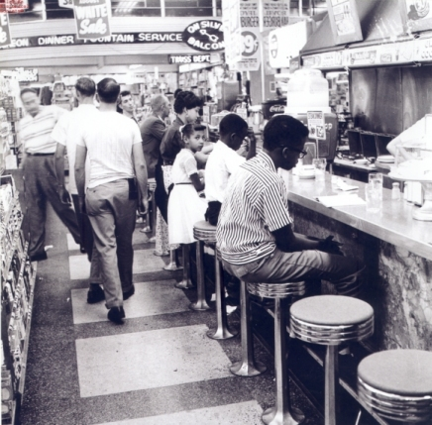
The Civil Rights Movement
AIM: What were the causes & effects of the Civil Rights Movement?
DAY #1
Do Now: Review Quiz

Slide 2
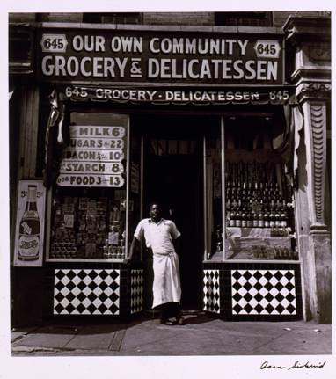
Harlem Renaissance
The Harlem Renaissance was an African American cultural movement of the 1920s and early 1930s centered around the Harlem neighborhood of New York City.
[Grocery store, Harlem, 1940]
Library of Congress Prints and Photographs Division Washington, D.C.; LC-USZC4-4737

Slide 3
Segregation
The civil rights movement was a political, legal, and social struggle to gain full citizenship rights for African Americans.
The civil rights movement was first and foremost a challenge to segregation, the system of laws and customs separating African Americans and whites.
Segregation was often called the Jim Crow.
The system of segregation also included the denial of voting rights, known as disenfranchisement.

Slide 4
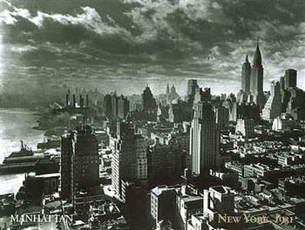
Segregation
Perhaps the most difficult part of Northern life was the economic discrimination against African Americans. They had to compete with large numbers of recent European immigrants for job opportunities, and they almost always lost because of their race.

Slide 5
Segregation
In the late 1800s, African Americans sued to stop separate seating in railroad cars, states’ disfranchisement of voters, and denial of access to schools and restaurants.
One of the cases against segregated rail travel was Plessy v. Ferguson (1896), in which the Supreme Court of the United States ruled that “separate but equal” accommodations were constitutional.

Slide 6
Segregation
In order to protest segregation, African Americans created national organizations.
The National Afro-American League was formed in 1890; W.E.B. Du Bois helped create the Niagara Movement in 1905 and the National Association for the Advancement of Colored People (NAACP) in 1909.

Slide 7
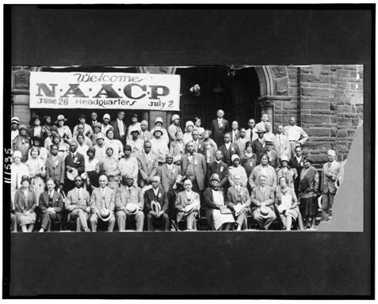
Segregation
The NAACP became one of the most important African American organizations of the twentieth century. It relied mainly on legal strategies that challenged segregation and discrimination in the courts.
20th Annual session of the N.A.A.C.P., 6-26-29, Cleveland, Ohio
Library of Congress Prints and Photographs Division Washington, D.C.; LC-USZ62-111535

Slide 8
The Civil Rights Movement
AIM: What were the causes & effects of the Civil Rights Movement?
DAY #2
Do Now: Review Quiz

Slide 9
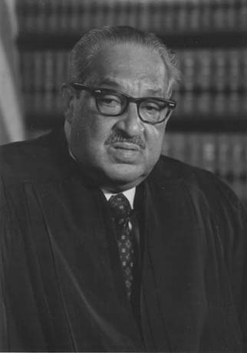
School Desegregation
After World War II, the NAACP’s campaign for civil rights continued to proceed.
Led by Thurgood Marshall, the NAACP Legal Defense Fund challenged and overturned many forms of discrimination.
Thurgood Marshall

Slide 10
School Desegregation
The main focus of the NAACP turned to equal educational opportunities.
Marshall and the Defense Fund worked with Southern plaintiffs to challenge the Plessy decision, arguing that separate was inherently unequal.
The Supreme Court of the United States heard arguments on five cases that challenged elementary and secondary school segregation.

Slide 11
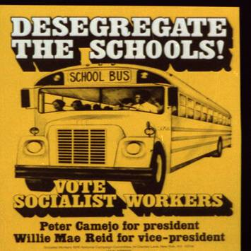
School Desegregation
In May 1954, the Court issued its landmark ruling in Brown v. Board of Education of Topeka, stating racially segregated education was unconstitutional and overturning the Plessy decision.
White Southerners were shocked by the Brown decision.
Desegregate the schools! Vote Socialist Workers : Peter Camejo for president, Willie Mae Reid for vice-president.
Library of Congress Prints and Photographs Division Washington, D.C.; LC-USZ62-101452

Slide 12
School Desegregation
By 1955, white opposition in the South had grown into massive resistance, using a strategy to persuade all whites to resist compliance with the desegregation orders.
Tactics included firing school employees who showed willingness to seek integration, closing public schools rather than desegregating, and boycotting all public education that was integrated.

Slide 13
School Desegregation
Virtually no schools in the South segregated their schools in the first years following the Brown decision.
In Virginia, one county actually closed its public schools.
In 1957, Governor Orval Faubus defied a federal court order to admit nine African American students to Central High School in Little Rock, Arkansas.
President Dwight Eisenhower sent federal troops to enforce desegregation.

Slide 14
School Desegregation
The event was covered by the national media, and the fate of the nine students attempting to integrate the school gripped the nation.
Not all school desegregation was as dramatic as Little Rock schools gradually desegregated.
Often, schools were desegregated only in theory because racially segregated neighborhoods led to segregated schools.
To overcome the problem, some school districts began busing students to schools outside their neighborhoods in the 1970s.

Slide 15
School Desegregation
As desegregation continued, the membership of the Ku Klux Klan (KKK) grew.
The KKK used violence or threats against anyone who was suspected of favoring desegregation or African American civil rights.
Ku Klux Klan terror, including intimidation and murder, was widespread in the South during the 1950s and 1960s, though Klan activities were not always reported in the media.

Slide 16
The Civil Rights Movement
AIM: What were the causes & effects of the Civil Rights Movement?
DAY #3
Do Now: Review Quiz

Slide 17
The Montgomery Bus Boycott
Despite threats and violence, the civil rights movement quickly moved beyond school desegregation to challenge segregation in other areas.
In December 1955, Rosa Parks, a member of the Montgomery, Alabama, branch of the NAACP, was told to give up her seat on a city bus to a white person.

Slide 18
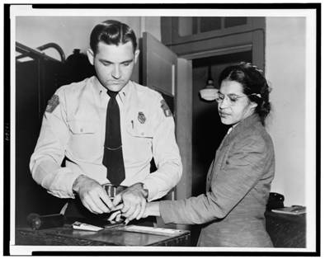
The Montgomery Bus Boycott
When Parks refused to move, she was arrested.
The local NAACP, led by Edgar D. Nixon, recognized that the arrest of Parks might rally local African Americans to protest segregated buses.
Woman fingerprinted. Mrs. Rosa Parks, Negro seamstress, whose refusal to move to the back of a bus touched off the bus boycott in Montgomery, Ala.
Library of Congress Prints and Photographs Division Washington, D.C.; LC-USZ62-109643

Slide 19
The Montgomery Bus Boycott
Montgomery’s African American community had long been angry about their mistreatment on city buses where white drivers were rude and abusive.
The community had previously considered a boycott of the buses and overnight one was organized.
The bus boycott was an immediate success, with almost unanimous support from the African Americans in Montgomery.

Slide 20
The Montgomery Bus Boycott
The boycott lasted for more than a year, expressing to the nation the determination of African Americans in the South to end segregation.
In November 1956, a federal court ordered Montgomery’s buses desegregated and the boycott ended in victory.

Slide 21
The Montgomery Bus Boycott
A Baptist minister named Martin Luther King, Jr., was president of the Montgomery Improvement Association, the organization that directed the boycott.
His involvement in the protest made him a national figure. Through his eloquent appeals to Christian brotherhood and American idealism he attracted people both inside and outside the South.

Slide 22
The Montgomery Bus Boycott
King became the president of the Southern Christian Leadership Conference (SCLC) when it was founded in 1957.
The SCLC complemented the NAACP’s legal strategy by encouraging the use of nonviolent, direct action to protest segregation. These activities included marches, demonstrations, and boycotts.
The harsh white response to African Americans’ direct action eventually forced the federal government to confront the issue of racism in the South.

Slide 23
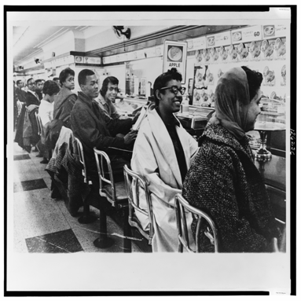
Sit-Ins
On February 1, 1960, four African American college students from North Carolina A&T University began protesting racial segregation in restaurants by sitting at “White Only” lunch counters and waiting to be served.
Sit-ins in a Nashville store
Library of Congress Prints and Photographs Division Washington, D.C.; LC-USZ62-126236

Slide 24
Sit-Ins
This was not a new form of protest, but the response to the sit-ins spread throughout North Carolina, and within weeks sit-ins were taking place in cities across the South.
Many restaurants were desegregated in response to the sit-ins.
This form of protest demonstrated clearly to African Americans and whites alike that young African Americans were determined to reject segregation.

Slide 25
Sit-Ins
In April 1960, the Student Nonviolent Coordinating Committee (SNCC) was founded in Raleigh, North Carolina, to help organize and direct the student sit-in movement.
King encouraged SNCC’s creation, but the most important early advisor to the students was Ella Baker, who worked for both the NAACP and SCLC.

Slide 26
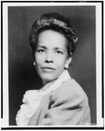
Sit-Ins
Baker believed that SNCC civil rights activities should be based in individual African American communities.
SNCC adopted Baker’s approach and focused on making changes in local communities, rather than striving for national change.
[Ella Baker, head-and-shoulders portrait, facing slightly left]
Library of Congress Prints and Photographs Division Washington, D.C.; LC-USZ62-110575

Slide 27
Freedom Riders
After the sit-in movement, some SNCC members participated in the 1961 Freedom Rides organized by CORE.
The Freedom Riders, both African American and white, traveled around the South in buses to test the effectiveness of a 1960 U.S. Supreme Court decision declaring segregation illegal in bus stations open to interstate travel.

Slide 28
Freedom Riders
The Freedom Rides began in Washington, D.C. Except for some violence in Rock Hill, South Carolina, the trip was peaceful until the buses reached Alabama, where violence erupted.
In Anniston, Alabama, one bus was burned and some riders were beaten.
In Birmingham, a mob attacked the riders when they got off the bus.
The riders suffered even more severe beatings in Montgomery.

Slide 29
Freedom Riders
The violence brought national attention to the Freedom Riders and fierce condemnation of Alabama officials for allowing the brutality to occur.
The administration of President John F. Kennedy stepped in to protect the Freedom Riders when it was clear that Alabama officials would not guarantee their safe travel.

Slide 30
Freedom Riders
The riders continued on to Jackson, Mississippi, where they were arrested and imprisoned at the state penitentiary, ending the protest.
The Freedom Rides did result in the desegregation of some bus stations, but more importantly they caught the attention of the American public.

Slide 31
The Civil Rights Movement
AIM: What were the causes & effects of the Civil Rights Movement?
DAY #4
Do Now: Review Quiz

Slide 32
The March on Washington
National civil rights leaders decided to keep pressure on both the Kennedy administration and Congress to pass the civil rights legislation. The leaders planned a March on Washington to take place in August 1963.
This idea was a revival of A. Phillip Randolph’s planned 1941 march, which had resulted in a commitment to fair employment during World War II.

Slide 33
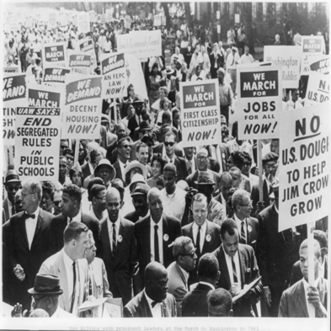
The March on Washington
Randolph was present at the march in 1963, along with the leaders of the NAACP, CORE, SCLC, the Urban League, and SNCC.
Roy Wilkins with a few of the 250,000 participants on the Mall heading for the Lincoln Memorial in the NAACP march on Washington on August 28, 1963]
Library of Congress Prints and Photographs Division Washington, D.C.; LC-USZ62-77160

Slide 34
The March on Washington
Martin Luther King, Jr., delivered a moving address to an audience of more than 200,000 people.
His “I Have a Dream” speech—delivered in front of the giant statue of Abraham Lincoln—became famous for the way in which it expressed the ideals of the civil rights movement.
After President Kennedy was assassinated in November 1963, the new president, Lyndon Johnson, strongly urged the passage of the civil rights legislation as a tribute to Kennedy’s memory.

Slide 35
The March on Washington
Over fierce opposition from Southern legislators, Johnson pushed the Civil Rights Act of 1964 through Congress.
It prohibited segregation in public accommodations and discrimination in education and employment. It also gave the executive branch of government the power to enforce the act’s provisions.

Slide 36
The End of the Movement
For many people the civil rights movement ended with the death of Martin Luther King, Jr. in 1968.
Others believe it was over after the Selma March, because there have not been any significant changes since then.
Still others argue the movement continues today because the goal of full equality has not yet been achieved.

