Slide 1
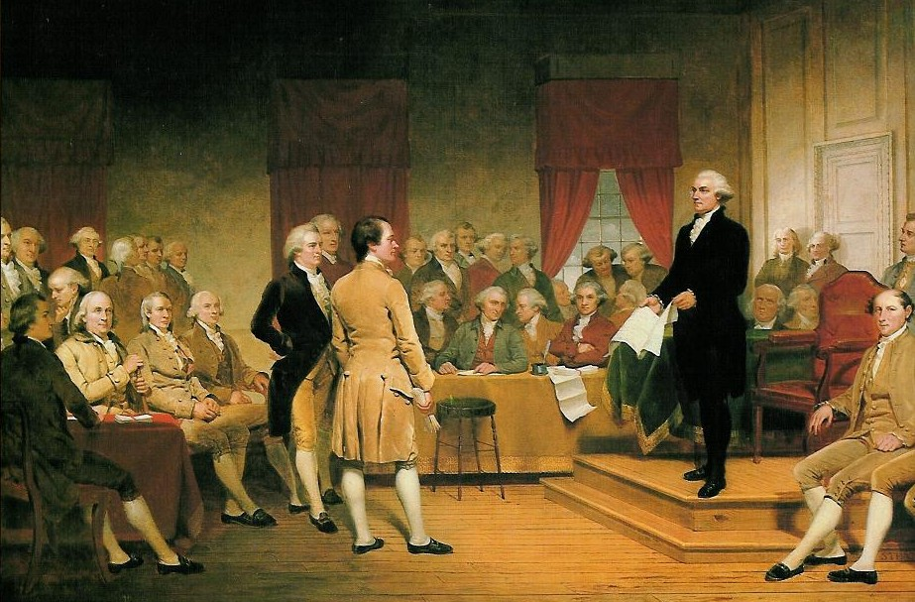
Constitutional Convention
Members
Plans, Agreements, and compromises
AIM: What were the different competing plans and compromises made at the Constitutional Convention in 1787?
Do Now: On the index card provided
Write your name
State two reasons why the Articles of Confederation did not work – You may use your notes

Slide 2
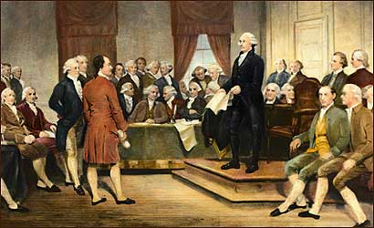
Members
55 delegates
White
Males
Statesmen,
lawyers, planters,
bankers, businessmen
Most under age 50

Slide 3
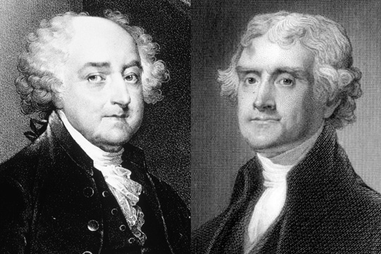
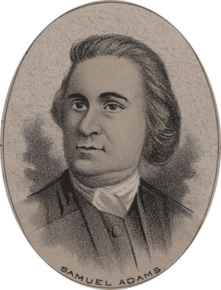
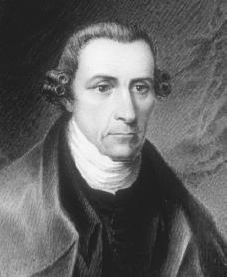
Absent
John Adams- ambassador to England
Thomas Jefferson- ambassador to France
Patrick Henry- “smelled a rat”
Sam Adams- not chosen by state to be part of the delegation

Slide 4
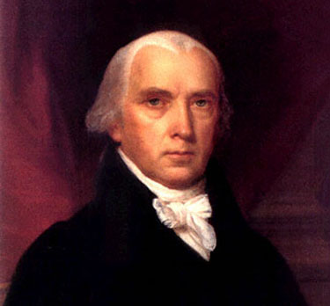
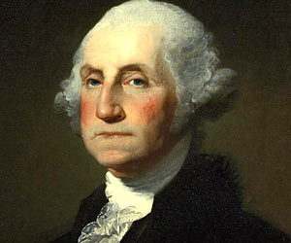
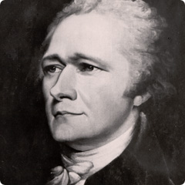
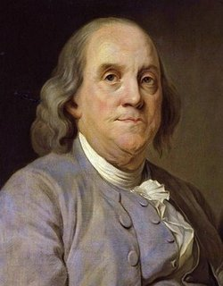
Famous Members
Alexander Hamilton- leader of strong government
George Washington- chairman of the convention
James Madison- ‘father of the Constitution’
Benjamin Franklin- oldest member at 81 was also at the 2nd Continental Congress

Slide 5
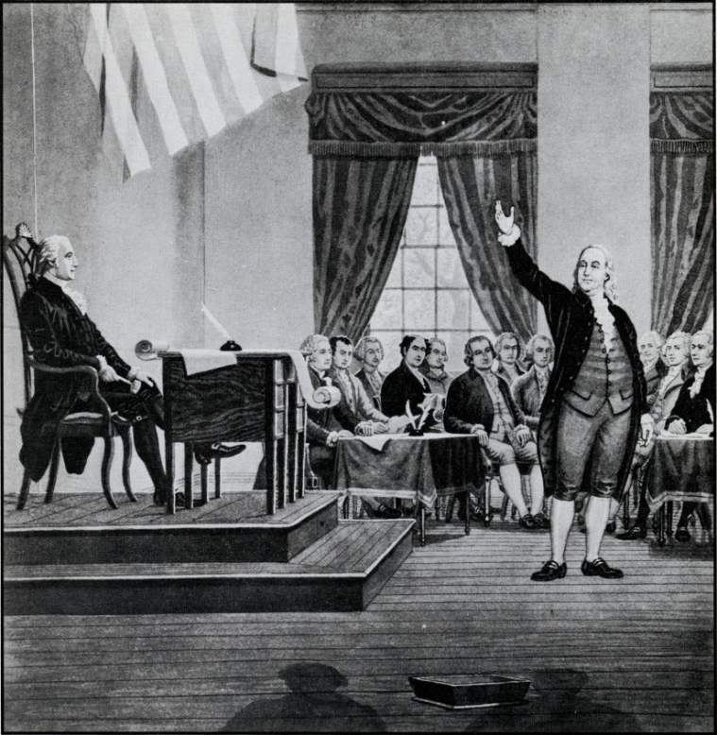
Basic Agreements
Right to Vote
All agreed that rights to property should be protected.
Ben Franklin proposed universal suffrage for all males, but most wanted only those with land to vote
Most delegates favored a bicameral (2 house) legislature
2
Italian for Room
Latin for Law
To Propose

Slide 6
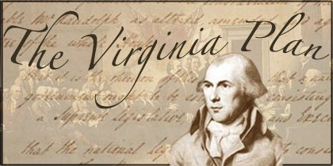
Plan #1 – Virginia Plan
Favored by large states
  Proposed by James Randolph
  Written by James Madison
  Endorsed by Alexander Hamilton
Government with a bicameral legislature
  Large house elected by popular vote
  Smaller house chosen by lager house members from nominees chosen by state legislatures
  Number of Representatives based on wealth

Slide 7
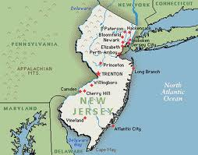
Plan #1 – New Jersey Plan
New Jersey Plan- favored by small states
  Proposed by William Paterson
  Unicameral house
  Each state one vote
  Did not require a strong central government

Slide 8
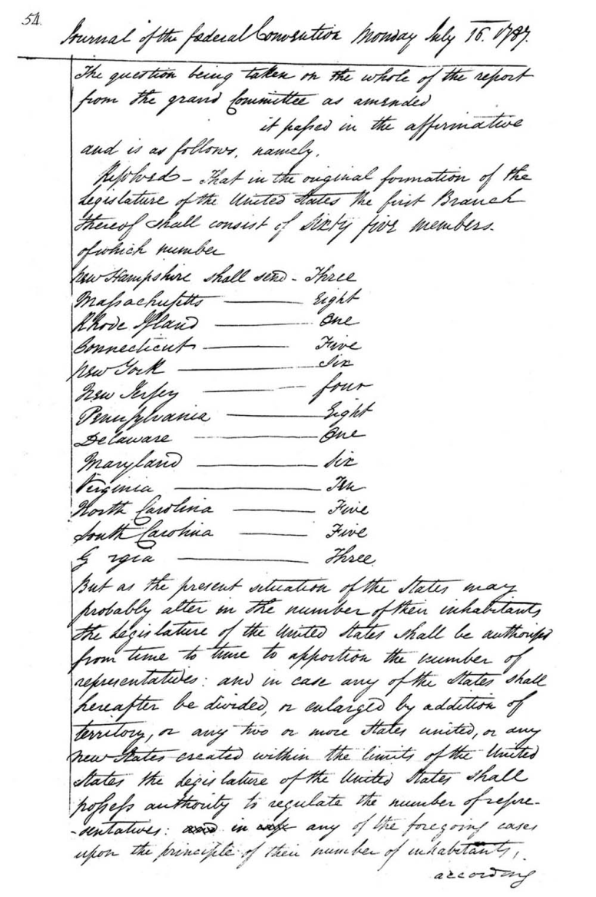
The Great Compromise
Aka: Connecticut Compromise
Bicameral house- benefit all states
  One house called Senate
    Members chosen by the state legislatures
    Each state gets one vote
  One house called House of Representatives
    Members chosen by population
    Number of members based on population

Slide 9
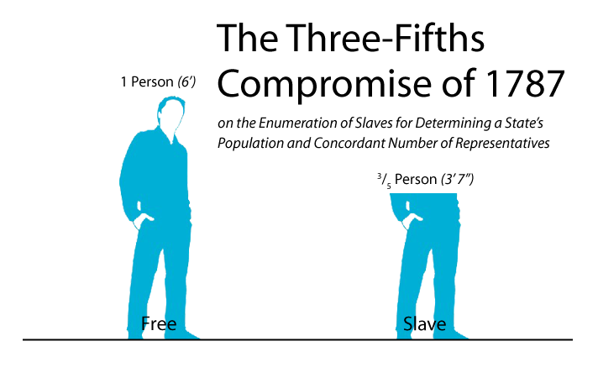
Agreements and Compromises
Three-fifths clause
  Favors Southern states
  All slaves would be counted in the census for representation in the House as 3/5ths of a person
What is a Census?
WHY?

Slide 10
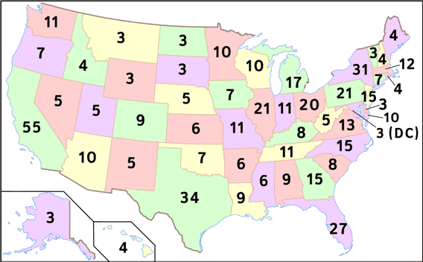
Agreements and Compromises
Electoral College
  People chosen by the state legislatures
  Vote for president and vice-president
  Supposed to reflect the will of the people

Slide 11
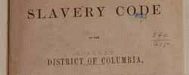
Agreements and Compromises
Slave and trade compromise
  Benefits both North and South
  No taxes on exports
  No interference with the slave trade for 20 years

Slide 12
Agreements and Compromises
Amendment compromise
  2/3 vote of each house of Congress and ratified by ¾ of the state legislatures
  2/3 vote of both houses and ratified by state conventions of ¾ of the states (used 21st amendment)
  Proposed by a national constitutional convention requested by 2/3 state legislatures and ratified by ¾ state legislatures (never used)
  Proposed by the national constitutional convention and ratified by ¾ of the specially formed state conventions

Slide 13
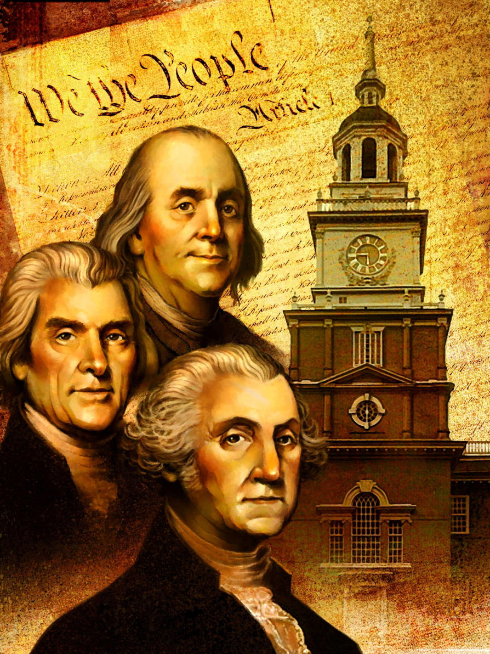
Agreements and Compromises
Informal Amendments - broad language allows for interpretation as things and events change our country
  Legislature- Commerce clause (art. 1 sec. 8)
    Legislation dealing with many things not even thought of when the Constitution was written.

Slide 14
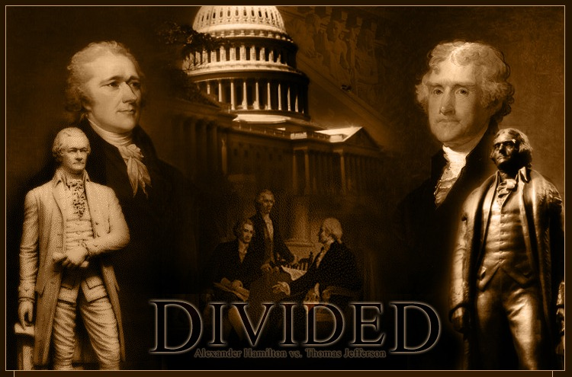
Criticism of Constitution
Does not protect the rights of the individual
Does not protect states rights
Gives a central authority (Federal Gov’t) too much power

Slide 15
Class Activity
Write a paragraph that includes the following:
Name two (2) differences between the Virginia and New Jersey Plans
Discuss and Define two (2) of the Compromises made at the Convention

