Slide 1

English
Constitutional
Monarchy Part I
The Magna Carta
Aim: How did Limited Monarchy develop in England?
Do Now: What prevents the police from coming into your apartment/house in the middle of the night, pulling you out of your bed and executing you in the street?

Slide 2
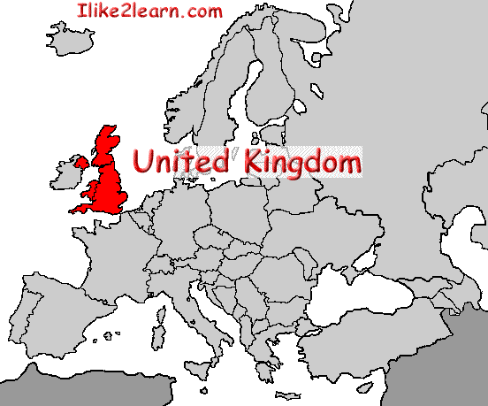
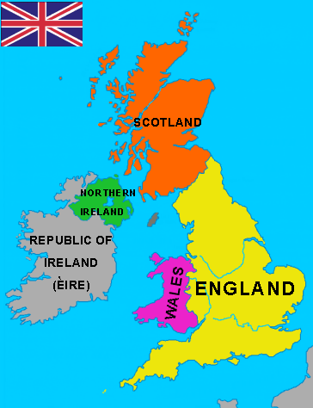
Geography
England, Scotland, Wales, Northern Ireland = United Kingdom (1803)
Island Nation – Protected by Rough Seas and English Channel from European Continent

Slide 3
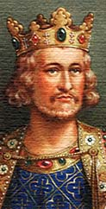
Could the rich control the king?
Around the picture below, you can read some of the qualities which medieval people expected their king to have!
Which three are the most important for a medieval king?
A good judge of character
Rich – but not greedy!
Fit and strong
A good soldier
God fearing
Inspiring!
Brave
Hardworking
Wise
Firm – but fair!

Slide 4
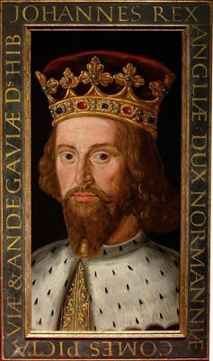
King John
He is famous as Prince John in make believe stories of Robin Hood.
In the stories he
is a wicked and foolish prince who taxes the people of England unfairly.

Slide 5
King John ruled England from 1199 to 1216.
He faced the following problems:
CHURCH
John disagreed with the Pope about how to run the Church. From 1208 until 1213, the Pope banned all church services in England and English people feared that they would all go to HELL! Some Church leaders blamed John for the trouble
LOST WARS
John went to war twice against the French king. His army was badly beaten both times. He lost almost all the land that his father had gained in France!
RAISED TAXES
John raised taxes in England to pay for the wars. This upset his BARONS! He ordered them to pay far more tax than earlier kings had done!

Slide 6
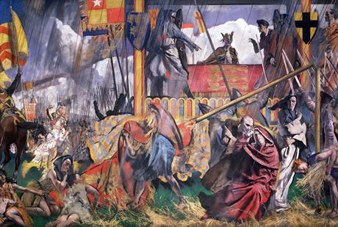
In 1214 many barons rebelled against John. They believed that he could not rule the country properly and was treating them unfairly.
In 1215, they
surrounded
the King’s Army
on a field
at Runnymede & forced him to sign the Magna Carta.

Slide 7
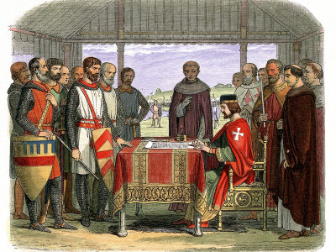
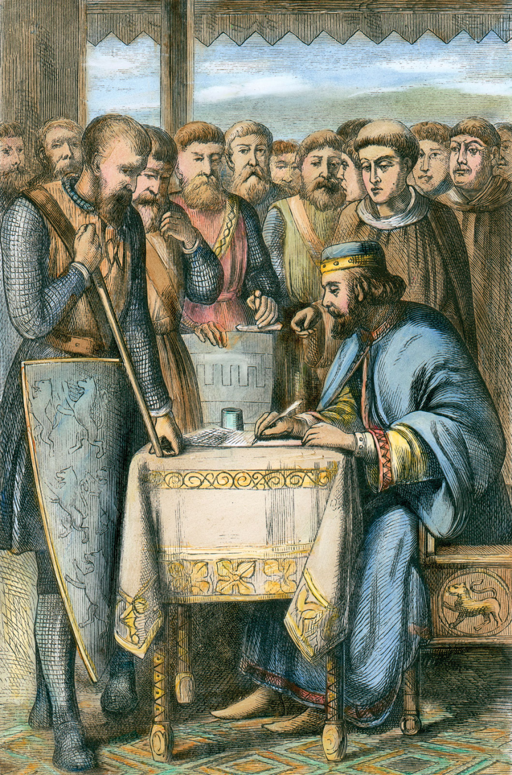
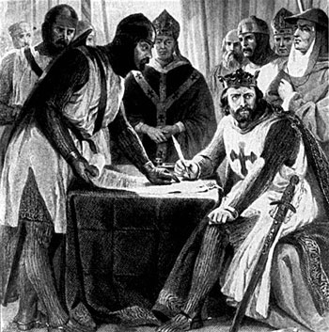

Slide 8
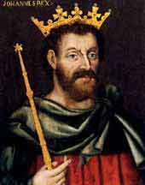
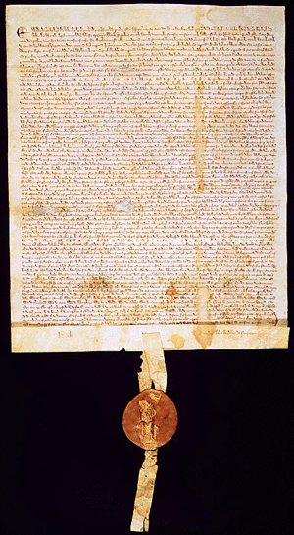
Magna Carta, 1215
King John I forced to accept it.
A list of demands made by the nobility.
Created a CONTRACT between the king and the aristocracy.
Established principles which limited the power of the king:
  Not to imprison nobles without trial
  That trials must be in courts: trial by jury with peers; not held in secret by King
  To have fair taxation for the nobles
  To let freemen travel wherever they like
  Not to interfere in Church matters
  Not to seize crops without paying for them

