Slide 1





Do Now Timer
Notes:
Using this PowerPoint break timer
This PowerPoint slide uses images, custom animation, and timing to provide a countdown timer that you can use in any presentation. When you open the template, you’ll notice that the timer is set at 00:00. However, when you start the slide show, the timer will start at the correct time and count down by 1-minute intervals until it gets to 1 minute. At that point, it will count down in two 30-seconds intervals to 00:00.
To insert this slide into your presentation
Save this template as a presentation (.ppt file) on your computer.
Open the presentation that will contain the timer.
On the Slides tab, place your insertion point after the slide that will precede the timer. (Make sure you don't select a slide. Your insertion point should be between the slides.)
On the Insert menu, click Slides from Files.
In the Slide Finder dialog box, click the Find Presentation tab.
Click Browse, locate and select the timer presentation, and then click Open.
In the Slides from Files dialog box, select the timer slide.
Select the Keep source formatting check box. If you do not select this check box, the copied slide will inherit the design of the slide that precedes it in the presentation.
Click Insert.
Click Close.

Slide 2

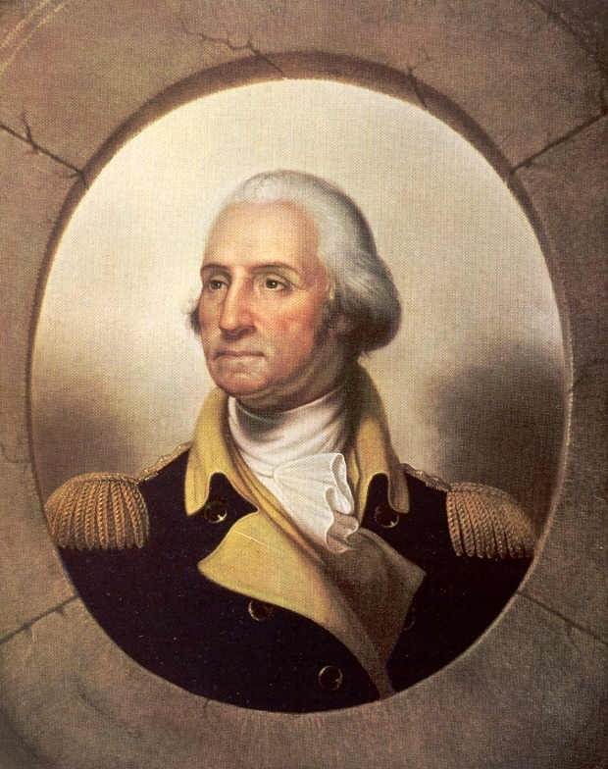
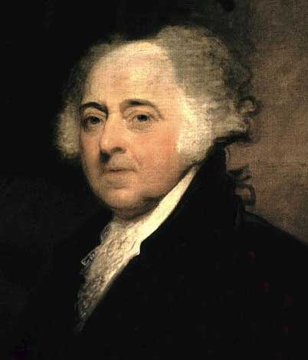
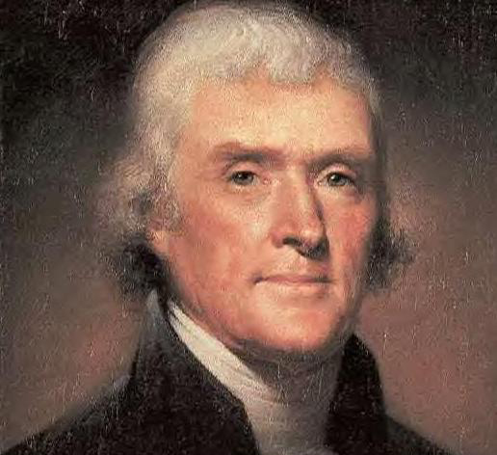
The electoral college
THE ELECTION OF A PRESIDENT
George Washington
John Adams
Thomas Jefferson

Slide 3

The Electoral College
The 12th Amendment to the United States Constitution outlines the process for electing the President/Vice President of the United States.
This is process is called the Electoral College
Article II, Section 1, Clause 3

Slide 4
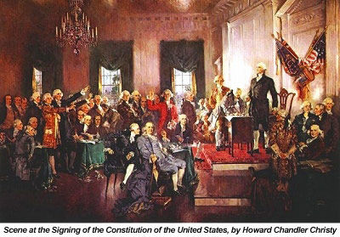
The Electoral College
The Framers of the Constitution believed that the public were not educated enough to make such an huge political decision.
Who could Vote?
White Men over 21 years of age who owned property.
Also could have a voting requirement: Example belong to a church.
1 out of 15 Americans were able to vote with these rules.

Slide 5
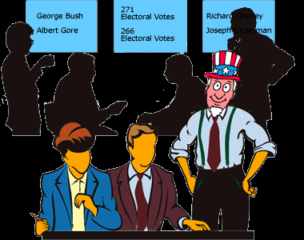
The Electoral College
What is an Elector?
An Elector is a person who votes in the electoral college for President & Vice President.
So this person may represent 10,000 to over a million people.
When we vote we are really voting for the person who will vote for the person we chose.

Slide 6
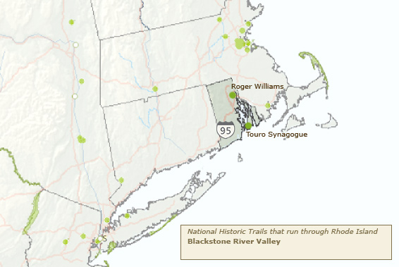
The Electoral College
Why This System?
It allowed smaller states to be represented in electing a president verses the larger states who would in a direct vote system control the election and favor their candidate.

Slide 7
The Electoral College
# of Representatives
# of Senators (2)
# of Electors
How many Electors are there in each State?
2 Year Term in Congress
6 Year Term in Congress

Slide 8
The Electoral College
# of Representatives
# of Senators (2)
# of Electors
How many Representatives are there in each State?
6 Year Term in Congress
2 Year Term in Congress

Slide 9

The Electoral College

Slide 10
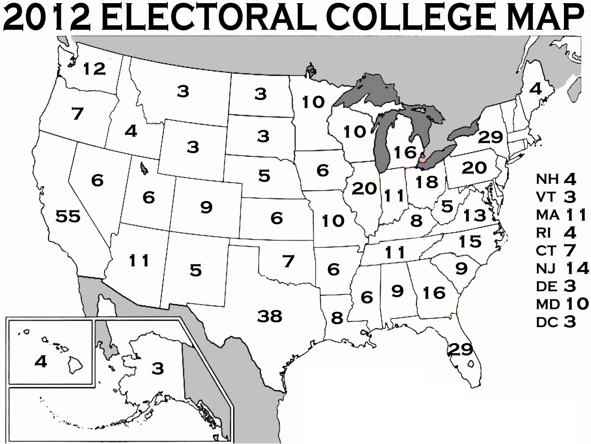
The Electoral College Map
How Many Electoral Votes are there?
538
How Many Electoral Votes Needed to Win?
270 Needed to WIN

Slide 11
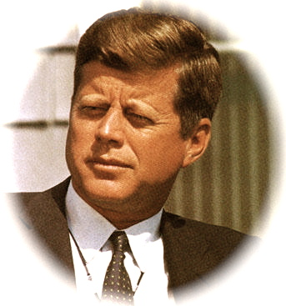
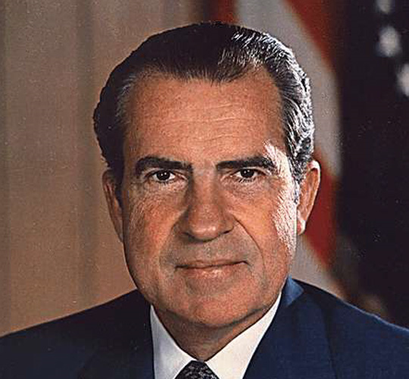
The Electoral College
So… A citizen of the U.S. does not directly elect the President/Vice President!
A Citizen Votes for President in their State
That Vote is made for an Elector Who Represents Many Citizens Voting for the same choice
If a State’s Popular Vote goes for Presidential Candidate that States Slate of Electors pledges to vote for the same Candidate
Notes:
On November 4, 2008, Voters cast their ballots for a block of electors who, in turn, will vote for a certain presidential candidate. The winner of the popular vote in each state receives the state's entire number* of Electoral College votes.
For example, if a Democratic presidential candidate receives the most votes in Texas, the 34 Democratic electors become the voting block representing the Lone Star state. Therefore, the Democratic presidential candidate receives 34 of the 538 total votes in the Electoral College. The winner of the 2008 Presidential Election is the candidate who collects 270 votes, the majority.
Each state's block of electors (members of the winning candidate's party) assembles in their respective state capitol on December 13, 2008. At this meeting, the electors sign the 'Certificate of Vote,' which is sealed and delivered to the Office of the President of the United States Senate.
A special joint session of the U.S. Congress convenes on January 6, 2009. At this meeting, the President of the Senate reads the Certificates of Votes and declares the official winner.
* The exceptions are Maine and Nebraska, where a proportional method for allocating votes is used.

Slide 12
The Electoral College
Activity
Calculate the Election results for the Presidential Election assigned

Slide 13
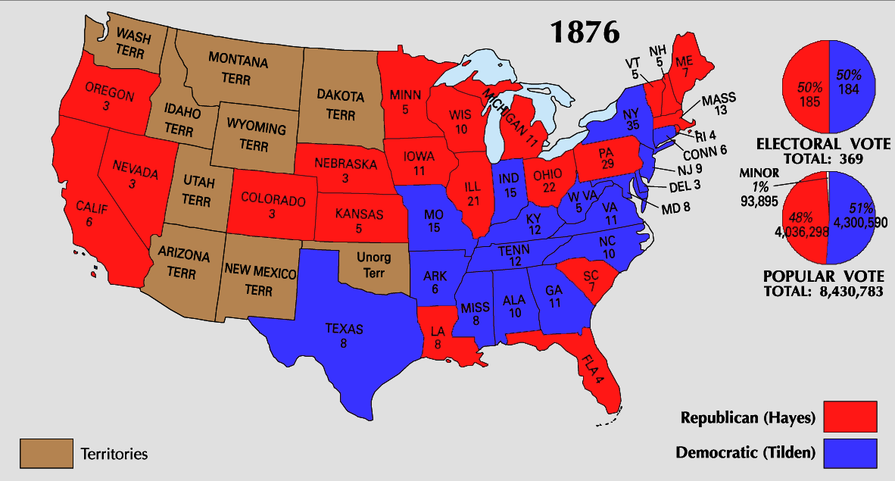
The Electoral College

Slide 14
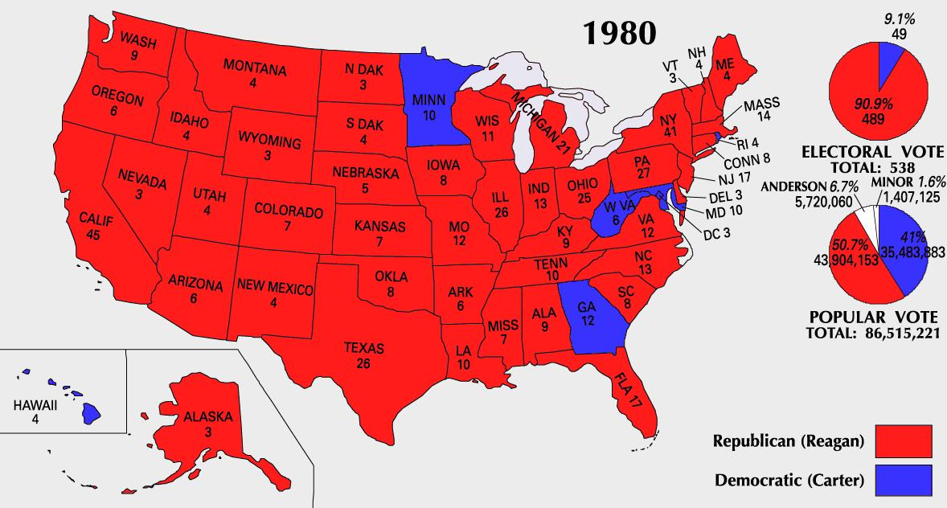
The Electoral College

Slide 15
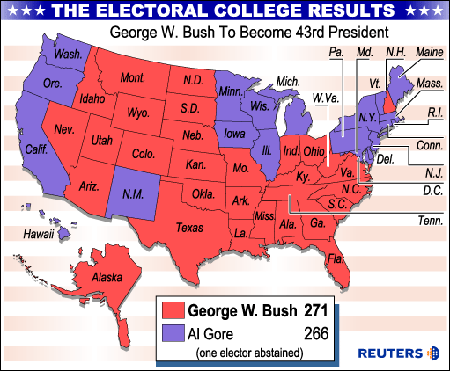
The Electoral College

Slide 16
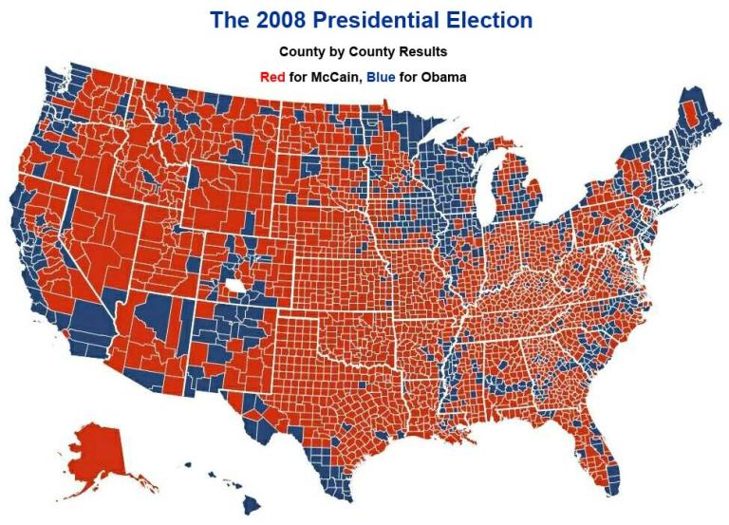
The Electoral College

Slide 17

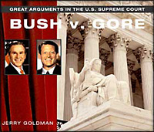
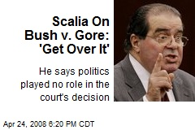
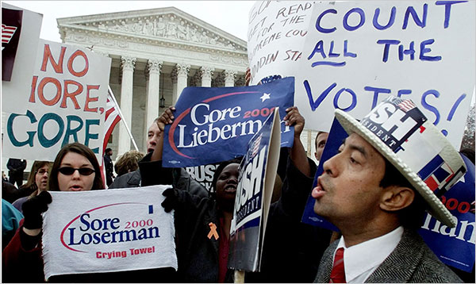
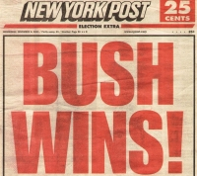
The Electoral College

Slide 18
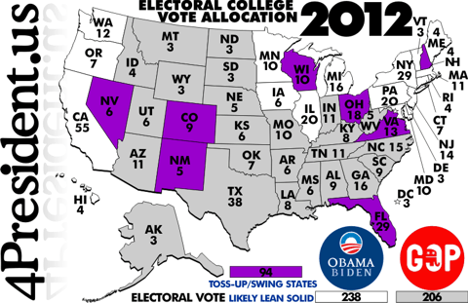
The Electoral College

Slide 19
The Electoral College
Now you’re the Candidate
The activity is a strategy game to see if you can win an election.
Turn on your computers.
Open Internet Explorer
Enter www.myelementaryteacher.com/election
Press Enter

