Slide 1
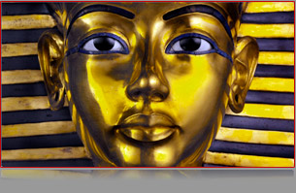
Land of the Pharaohs
AIM: What was the significance of Geography on Egypt?
Egyptian Civilization
DO NOW: Do Now Worksheet

Slide 2
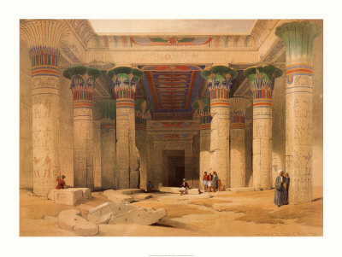
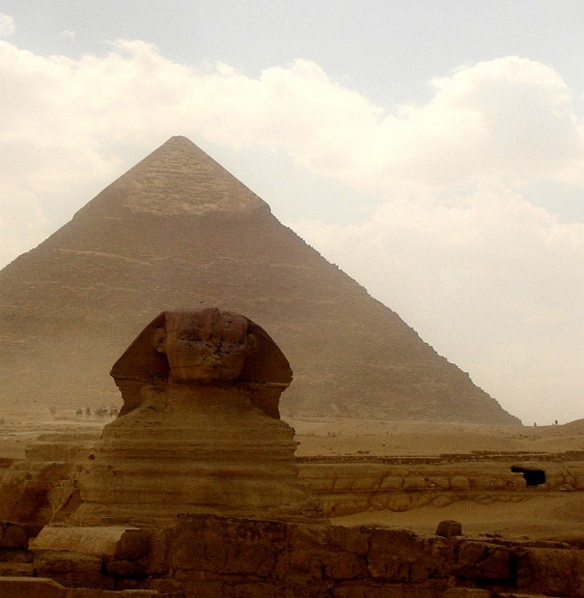
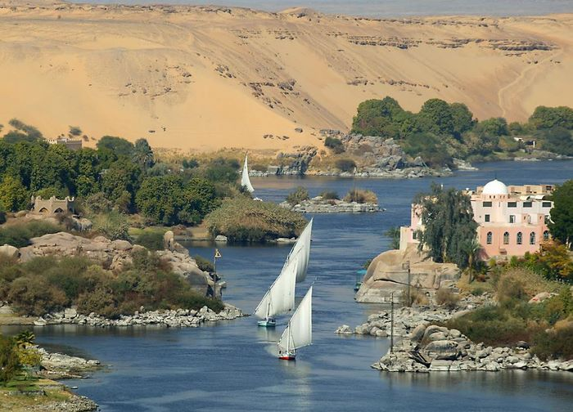
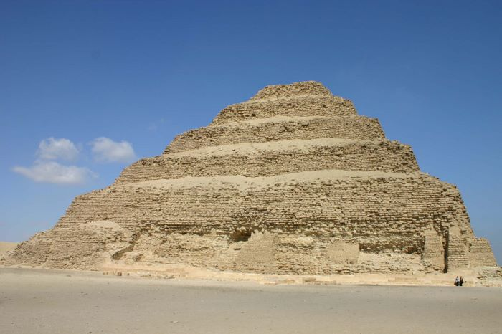
Ancient Egypt
GEOGRAPHY

Slide 3
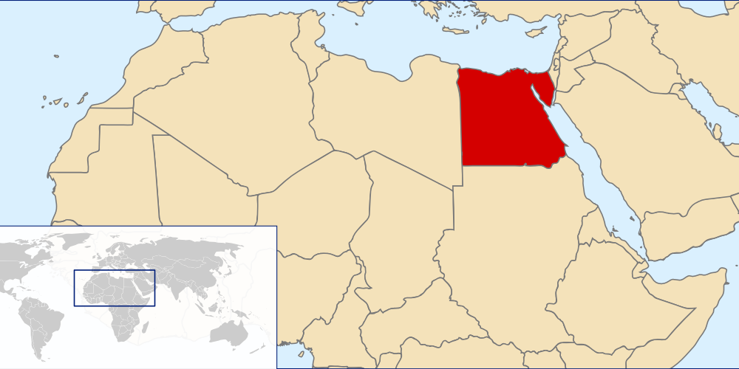

Where in the world is Egypt?
Continent:
Africa
Location:
Northeast Corner

Slide 4
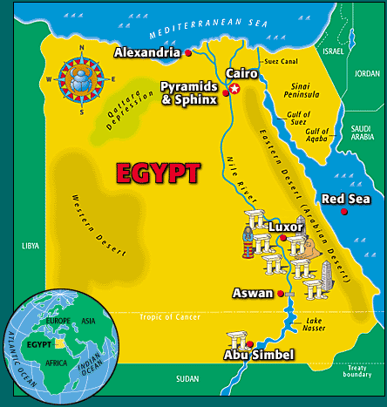

Slide 5
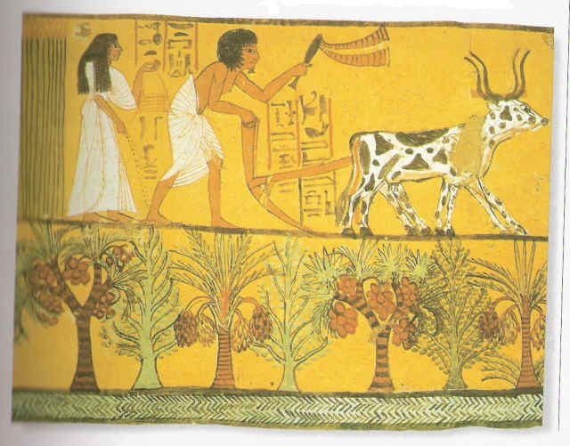
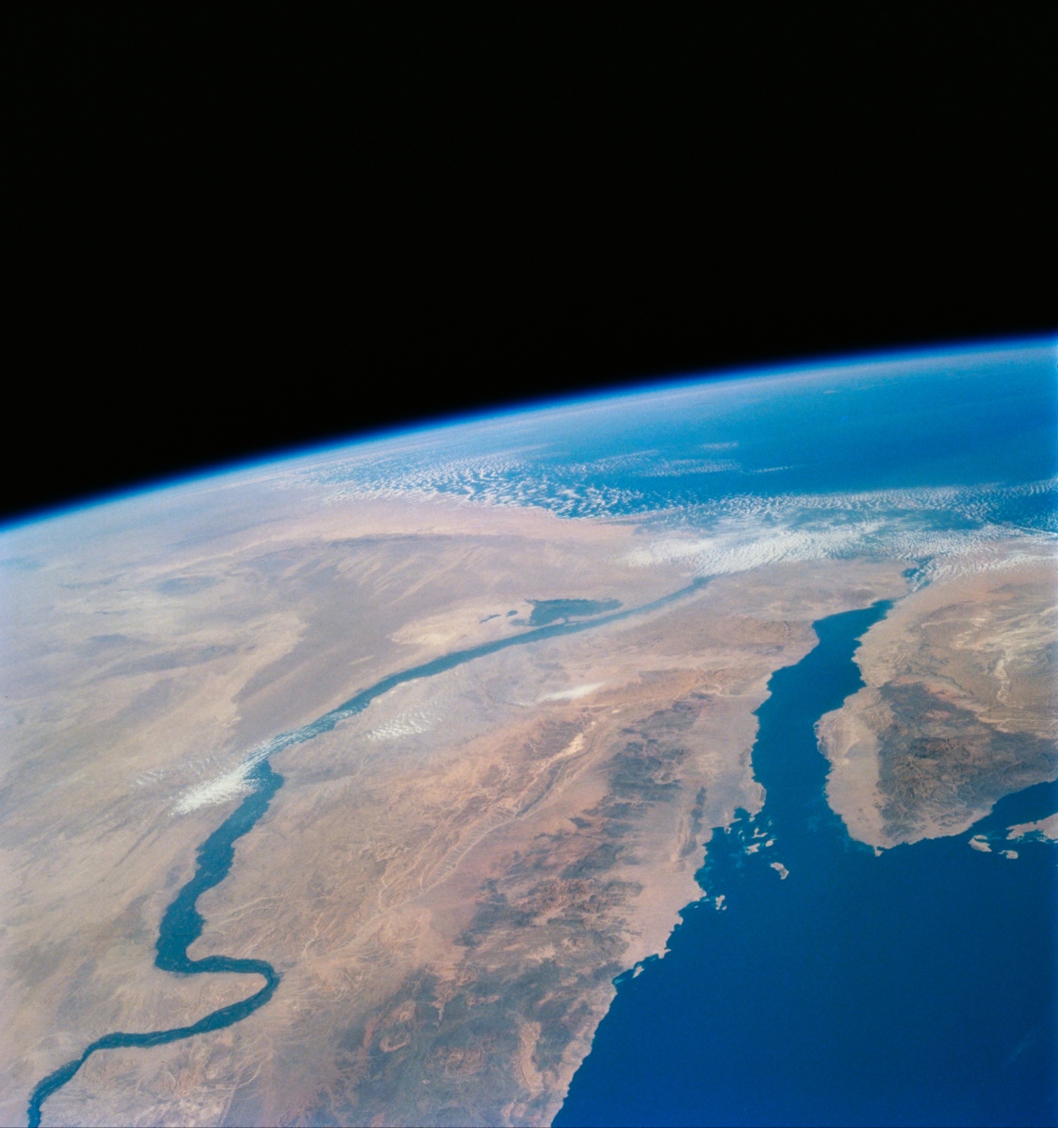
What is Egypt’s most visible & Important Geographic feature?
The Nile River
It is
also the lifeblood of Egypt.
Why?

Slide 6
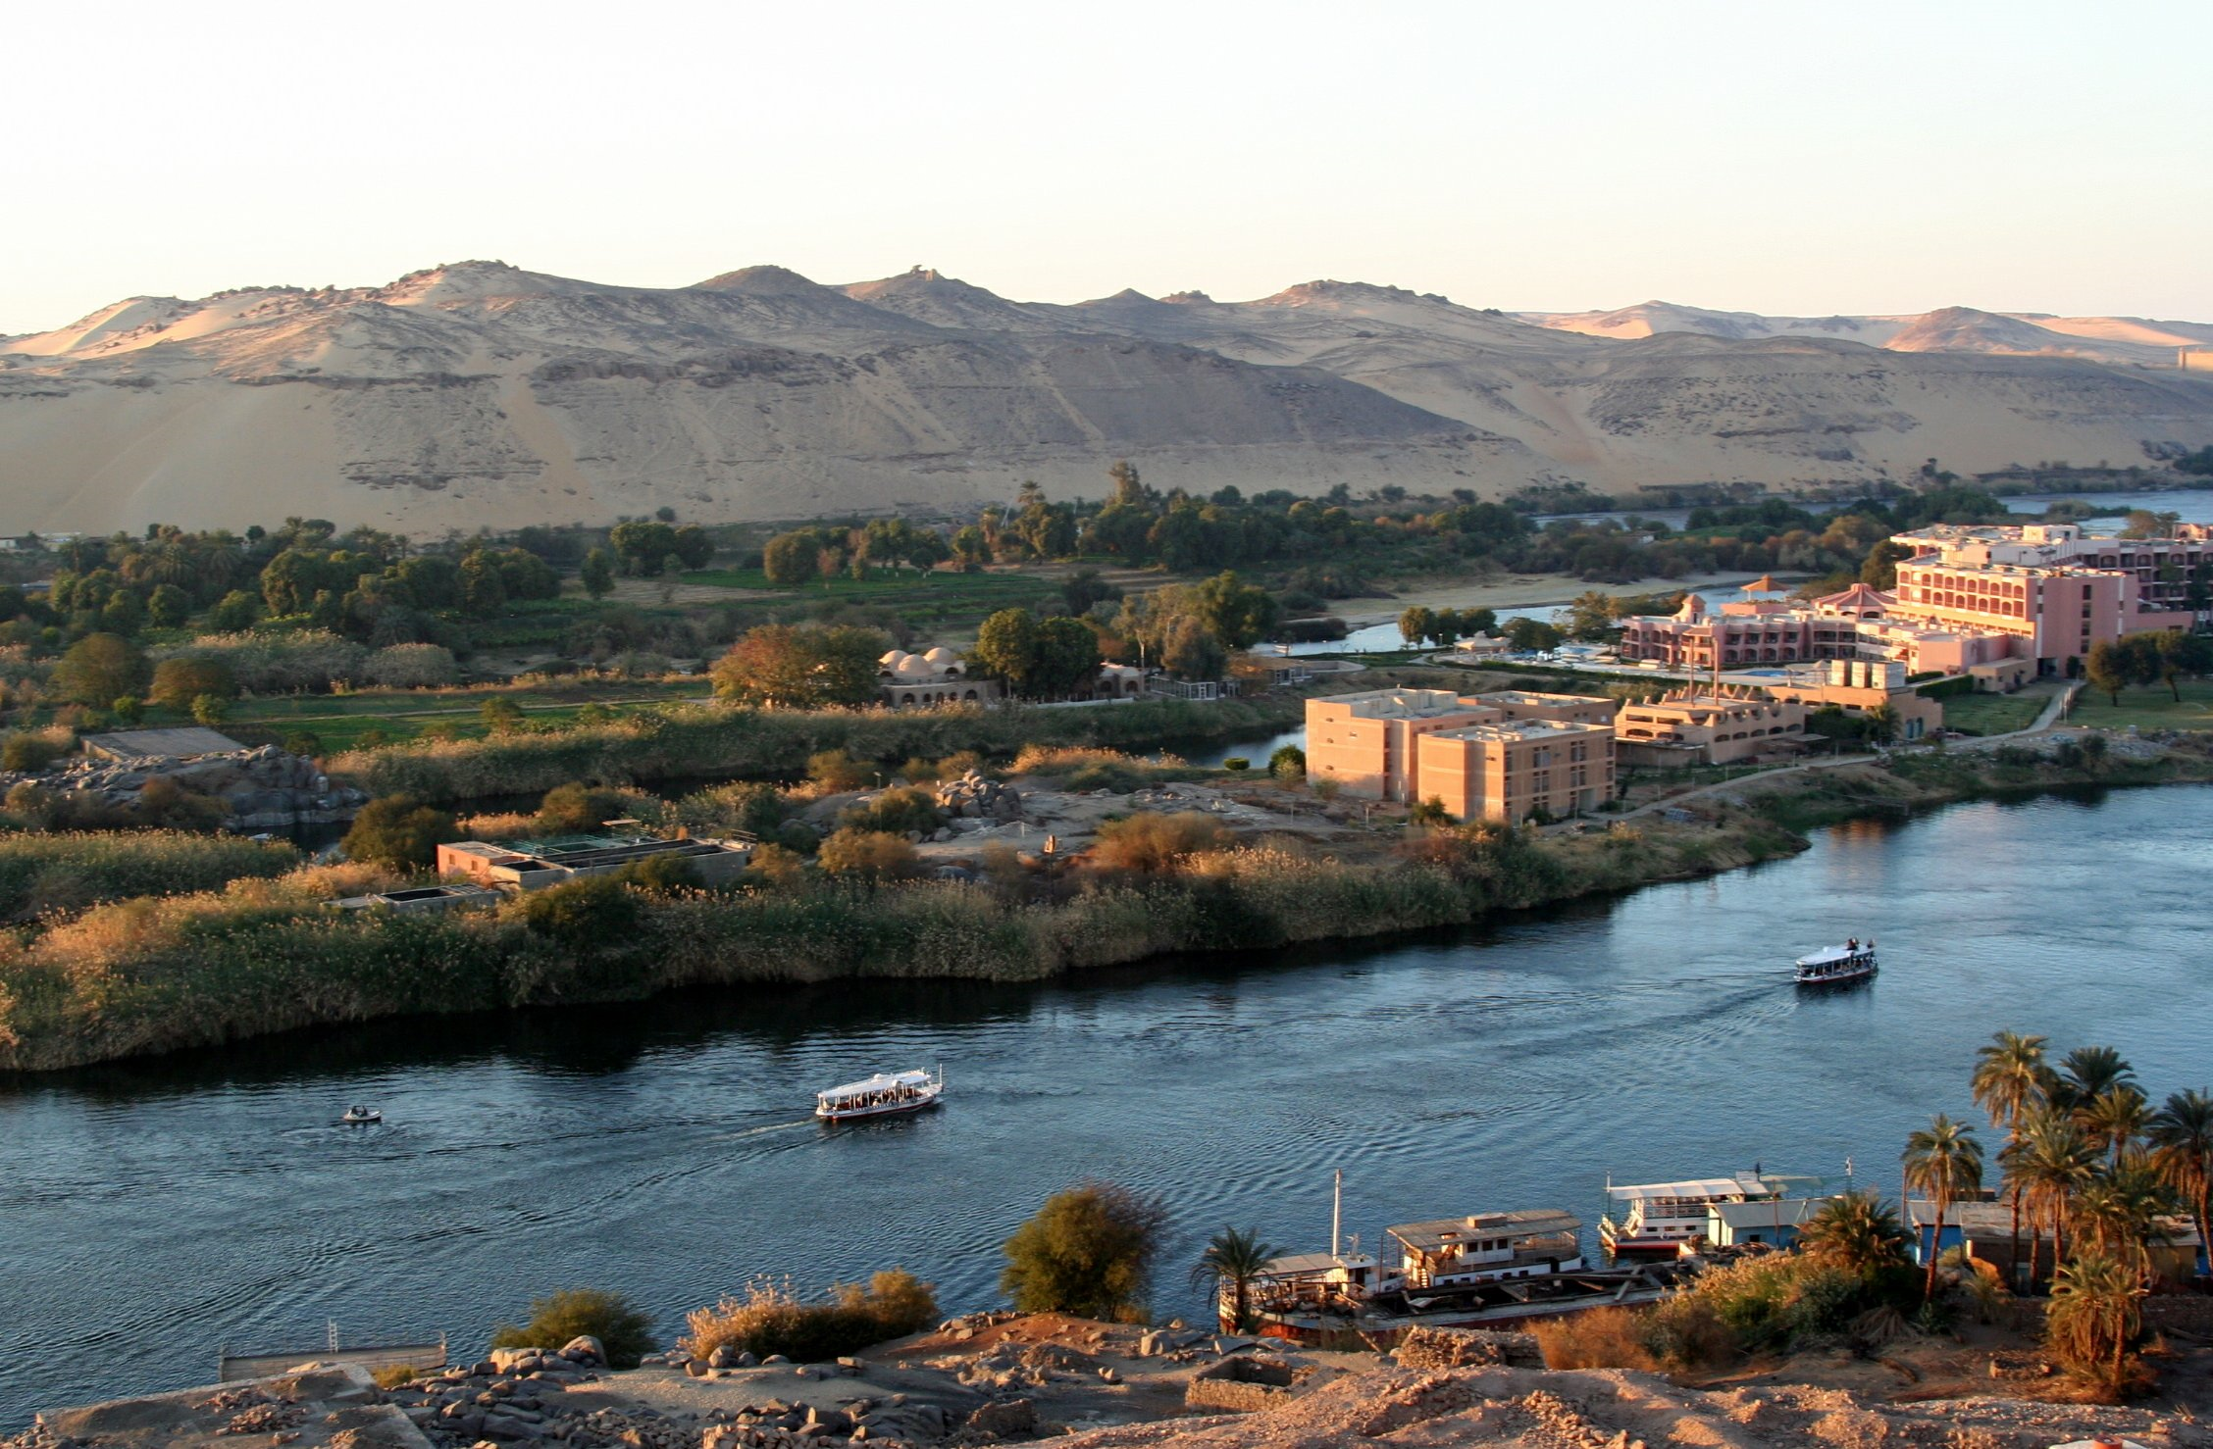

Slide 7
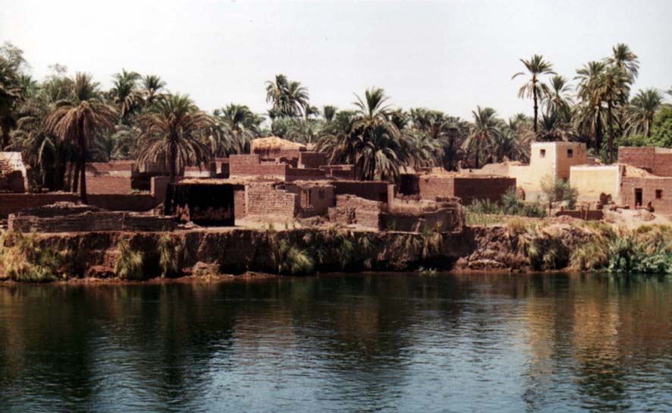

Slide 8
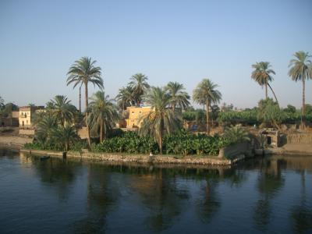

Slide 9
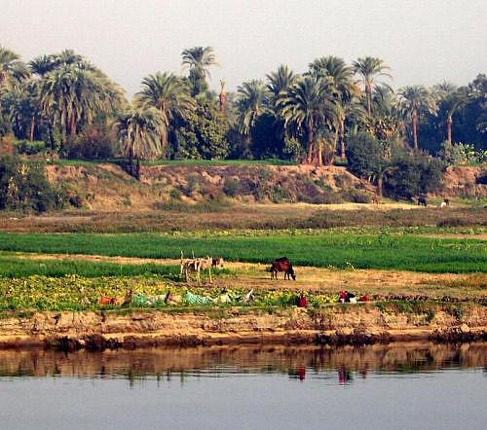

Slide 10
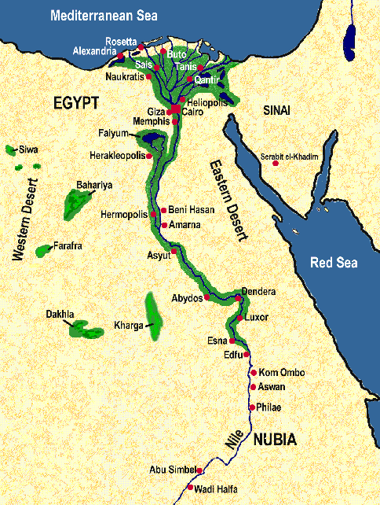

By looking at the map which way do you think the Nile river flows?
(From what direction to what direction?)
From South to North
Lower Egypt
Upper Egypt

Slide 11
The Egypt is divided into
two (2) parts.
What are
they called?
Lower Egypt
_____________
2. _____________
Upper Egypt
Where on the map are they located?

Slide 12
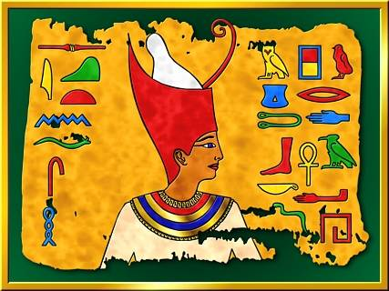
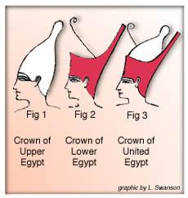
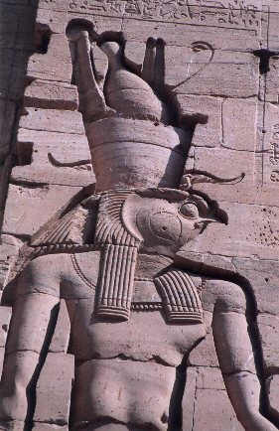
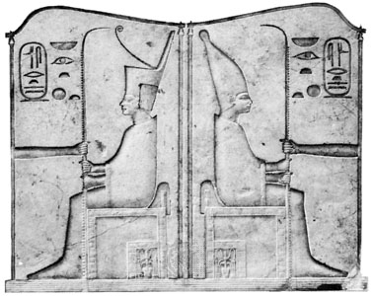
The rulers of Lower & Upper Egypt had crowns to wear.
Why would a ruler wear both crowns at the same time?

Slide 13
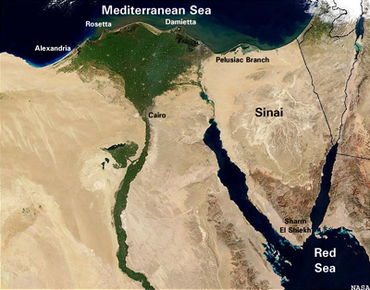

What is the wide part of the
Nile River called?
Why do you think we call it a delta?
A Delta or
The Nile Delta
GREEK LETTER
DELTA
The letter for our “D”

Slide 14
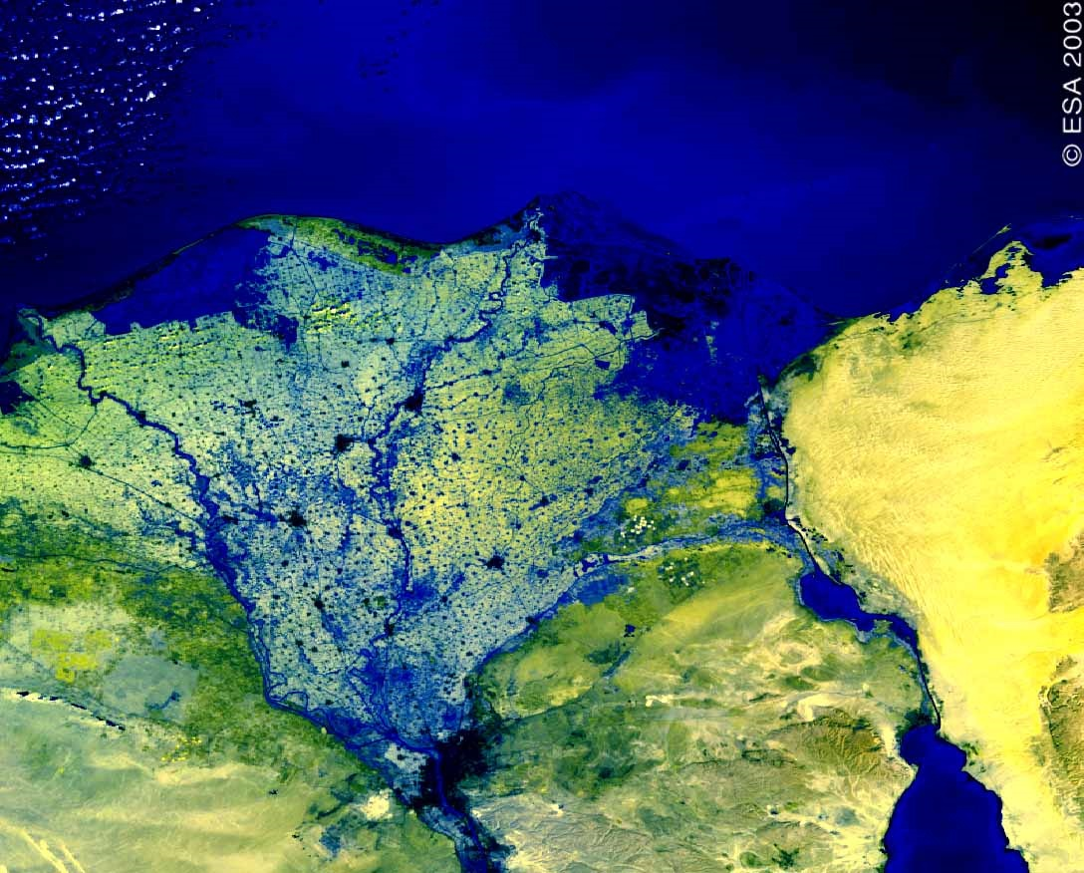
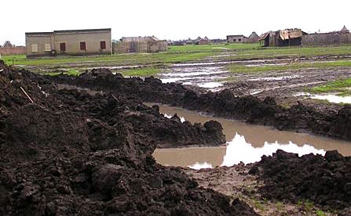
Because the Nile flows into the Mediterranean Sea
it dumps this into the
Nile Delta?
Silt
A tiny mixture of soil and rock.

Slide 15
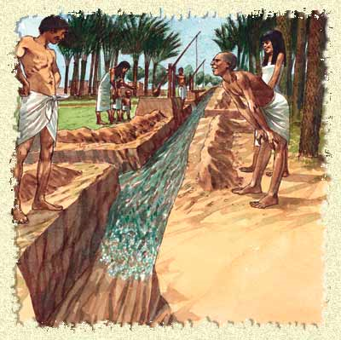
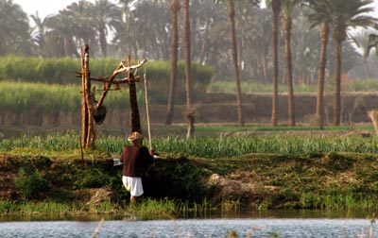
How do you think the Ancient Egyptian Farmer watered their fields?
What technology was used?
The watering of land by canals or pipes.
irrigation
Notes:
Shadouf
Most irrigation in the Nile Valley is done by gas-powered or diesel-powered pumps nowadays -- but every so often we saw someone using a shadouf. This ancient irrigation technique is a bucket on a long, counter-weighted arm that the farmer swings down into the water and over to the field.

Slide 16

Why the Nile matters to Egyptians

Slide 17


Slide 18
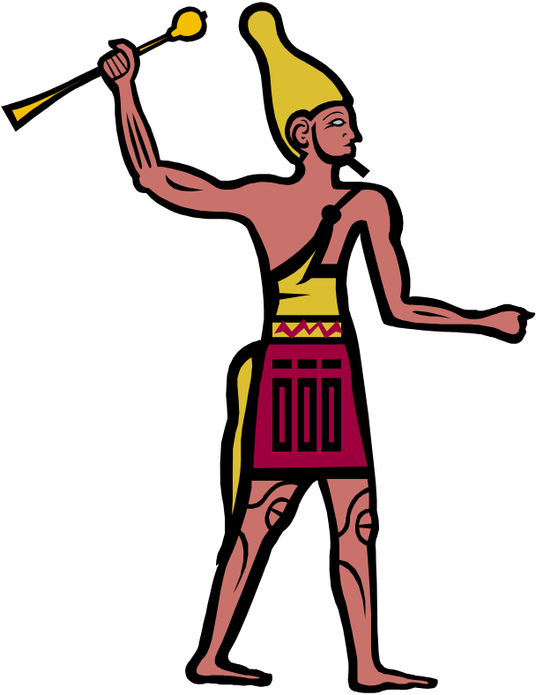
What is a Pharaoh?
A ruler of Egypt
What is unification?
Joining of separate parts into one
Name some ways a Pharaoh could
unify Egypt?

Slide 19
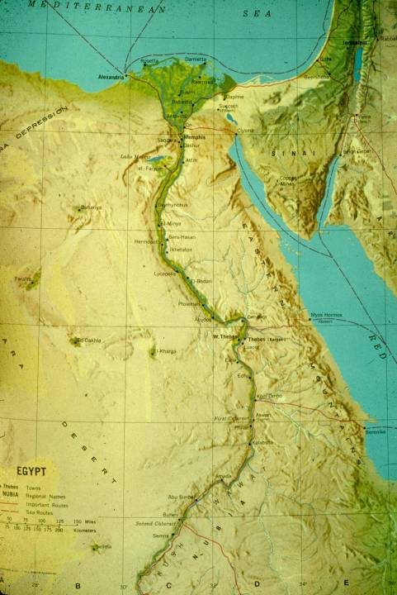
The Unification of Upper and Lower Egypt was regarded as the beginning of Egyptian history by the Egyptians themselves.

Slide 20
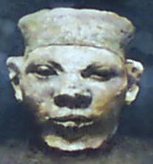
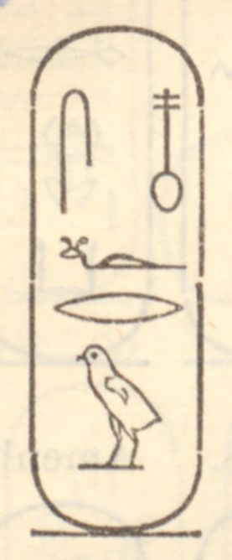
Egypt’s First Pharaoh
3100 BC
Menes
(King of Upper Egypt)
Defeats King of Lower Egypt
Unification of Upper & Lower
Egypt as told by the Egyptians.
Early Dynastic Period – Egypt’s 1st Unified Kingdom(s)
Notes:
Menes is also credited with the foundation of Memphis, which he established as the Egyptian capital. According to Manetho,
Menes reigned for 62 years and was killed by a hippopotamus.

Slide 21
Life Under Pharaoh
Administration, Taxes, Judges
Government
Religion
Economy
Child of Sun God Ra
He Gives Life to Egypt
Domestication
Agriculture – Farming
Surplus
Specialization
Trade

Slide 22
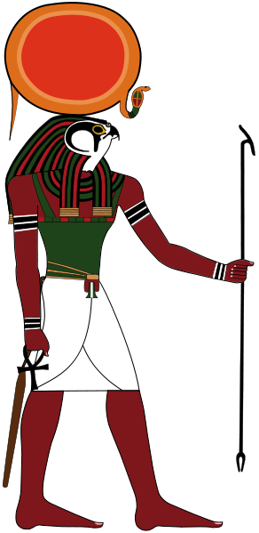
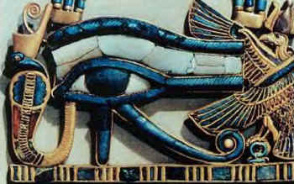
Religion
Ra – Pharaoh was his son
The sun god – one of the creator gods
Pharaoh was Ra on Earth
Later called Amun-Ra

Slide 23
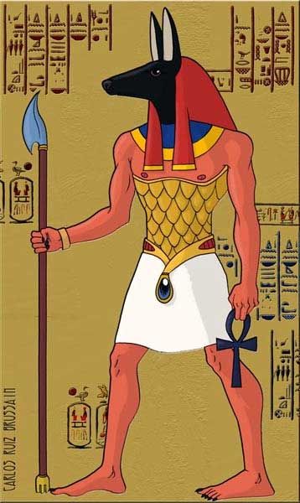
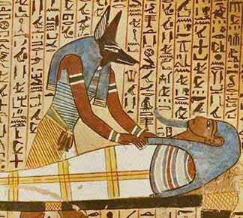
Religion
Anubis – Jackal/Dog Man
Tomb-caretaker god.
Watches over the dead.

Slide 24
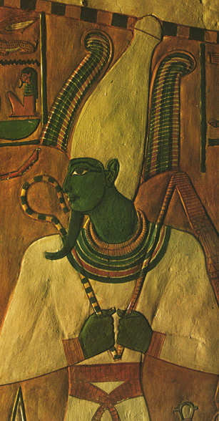
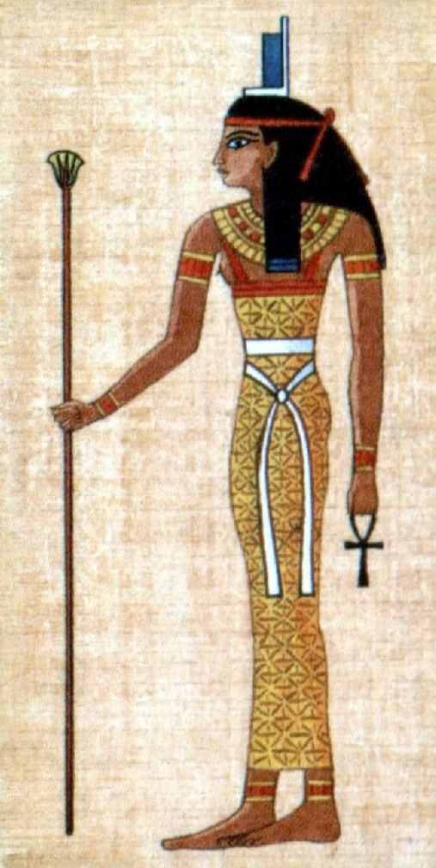
Religion
Osiris – as a man
Watches the underworld.
Husband of Isis.
Isis – as a woman
Goddess of magical power and healing. Wife of Osiris.

Slide 25
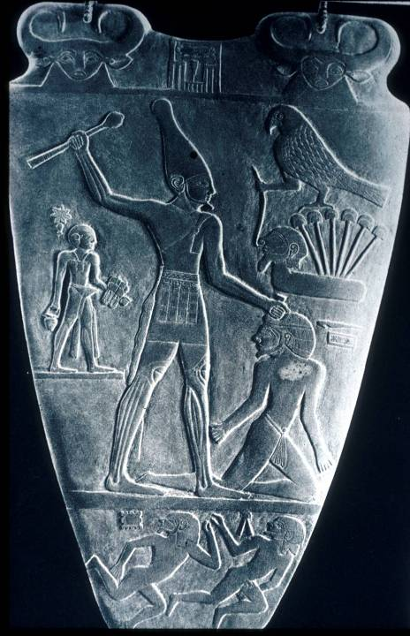
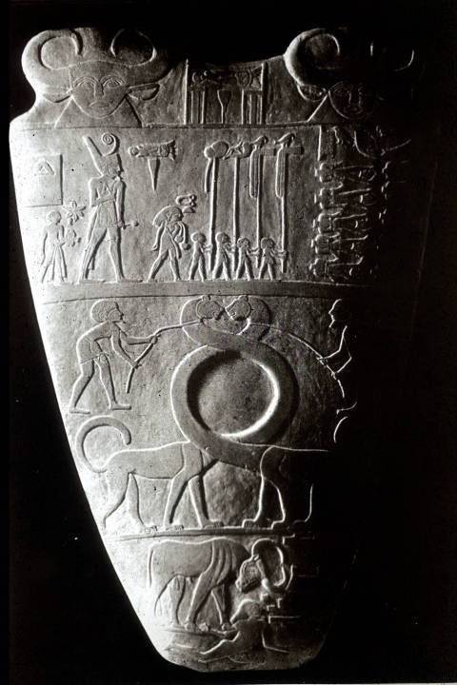
Narmer
1st Unified King?

Slide 26
Chronology of Ancient Egypt
Early Dynastic Period (c. 3100 BC – c.2686 BC) – Menes
500 Years of Kings ruling both Lower & Upper Egypt, Memphis founded), Hieroglyphic writing.
Old Kingdom (c. 2868 BC – c.2181 BC)
Age of Pyramids, Pyramids at Giza
Middle Kingdom (c. 2040 BC - c. 1640 BC)
Rulers could not keep control of all of Egypt, and had capital at Thebes.
New Kingdom (c.1570–c.1070 BC) Hyksos (foreign rulers) invade take over Lower Egypt, control most of Egypt. Ahmose expels the Hyksos (foreign rulers) Hatshepsut (woman) rules as Pharaoh, Expedition to Land of Punt Akhenaton - Makes worship of all of the gods illegal except one (Sun Disk or the Aten) Tutankhamun rules as a boy king from age of 11 to age 20. Rameses II greatest Pharaoh is Egyptian history rules and builds many monuments that bear his name.
TIME

