Slide 1
Political Spectrum
Do Now: Take a Political Spectrum Survey.
You have 5 minutes.
More Gov’t
Less Freedom
Government
Less Gov’t
More Freedom
SCORING
10 = Ultra Conservative
15 = Conservative
20 = Moderate
25 = Liberal
30 = Ultra Liberal
Totalitarian
Total Gov’t
Control
Anarchy
No Gov’t
Control
Center
Moderate
Little of Both
Left/Right
Center
Left
Center
Right
Today’s Liberal
Today’s Conservative
Left
Right
Today’s Democrat
Today’s Republican
Population of United States
Radical Change
Radical Change

Slide 2
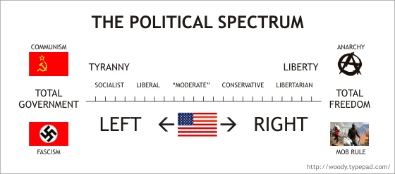
Today’s Political Spectrum
Sec. Hillary Clinton
Gov. Mitt Romney
President Obama
President Bush
Rep. Ron Paul

Slide 3
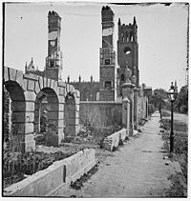
Reconstruction
What or Whom was the government trying to reconstruct? Why?
Do Now: If you were a parent and your children ran away, how would you treat them when they returned?
What is meant to reconstruct something?
(1865-1877)
Aim: What was the goals of political reconstruction?

Slide 4
Key Questions
1. How do we
bring the South
back into the
Union?
4. What branch
of government
should control
the process of
Reconstruction?
2. How do we
rebuild the
South after its
destruction
during the war?
3. How do we
integrate and
protect newly-
emancipated
black freedmen?

Slide 5
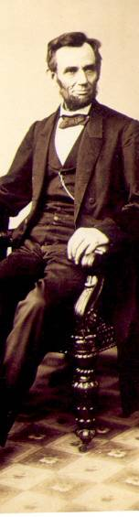
President Lincoln’s Plan
10% Plan
  Proclamation of Amnesty and Reconstruction (December 8, 1863)
  Replace majority rule with “loyal rule” in the South.
  He didn’t consult Congress regarding Reconstruction.
  Pardon to all but the highest ranking military and civilian Confederate officers.
  When 10% of the voting population in the 1860 election had taken an oath of loyalty and established a government, it would be recognized.

Slide 6
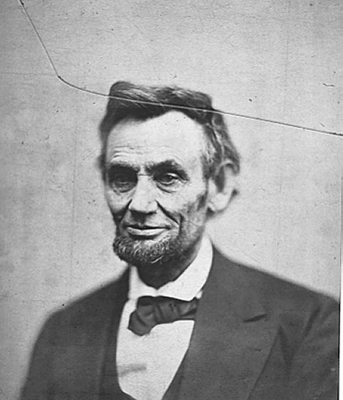
President Lincoln’s Plan
1864 → “Lincoln Governments” formed in LA, TN, AR
  “loyal assemblies (legislatures)”
  They were weak and
  dependent on the
  Northern army for
  their survival.

Slide 7
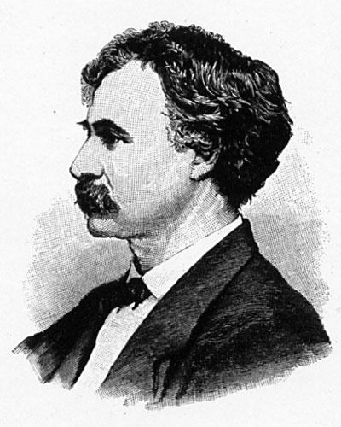
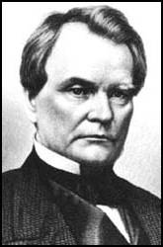
Wade-Davis Bill (1864)
Congress wants a new plan, not Lincoln’s.
Required 50% of the number of 1860 voters to take an “iron clad” oath of allegiance (swearing they had never voluntarily aided the rebellion ).
Required a state constitutional convention before the election of state officials.
Enacted specific safeguards of freedmen’s liberties.
Senator
Benjamin
Wade
(R-OH)
Congressman
Henry
W. Davis
(R-MD)
Pocket
Veto
President
Lincoln
Wade-Davis
Bill

Slide 8
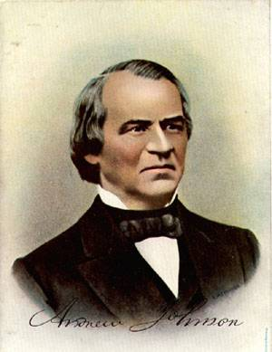
President Andrew Johnson
Jacksonian Democrat.
Anti-Aristocrat.
White Supremacist.
Agreed with Lincoln
that states had never
legally left the Union.
Damn the negroes! I am fighting these traitorous aristocrats, their masters!

Slide 9
President Johnson’s Plan (10%+)
Offered amnesty upon simple oath to all except
Confederate civil and military officers and those with property over $20,000 (they could apply directly to Johnson)
In new constitutions, they must accept minimum
conditions repudiating slavery, secession and state debts.
Named provisional governors in Confederate states and called them to oversee elections for constitutional conventions.
1. Disenfranchised certain leading Confederates.
EFFECTS?
2. Pardoned planter aristocrats brought them back
to political power to control state organizations.
3. Republicans were outraged that planter elite
were back in power in the South!

Slide 10
Growing Northern Alarm!
Many Southern state constitutions fell short of minimum requirements.
Johnson granted 13,500 special pardons.
Revival of southern defiance.
BLACK CODES

