Slide 1
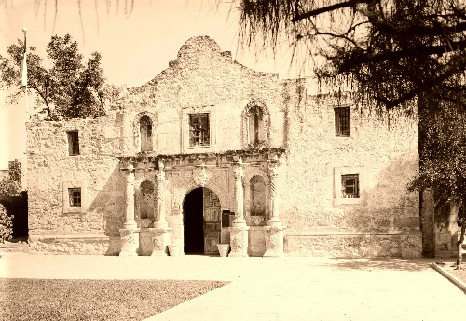
The Alamo &
The Mexican War

Slide 2
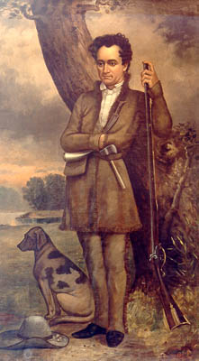
Who Were Moses & Stephen Austin?
1821 - Moses Austin Settled 300 Families in Texas with Permission from Spain.
1821 – Mexico gains Independence from Spain
Moses dies
Left Everything to his son Stephen Austin

Slide 3
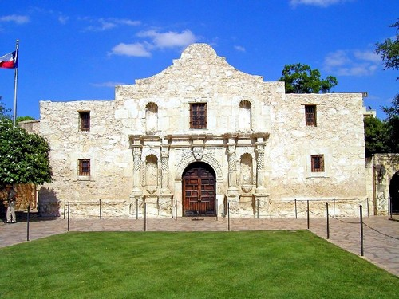
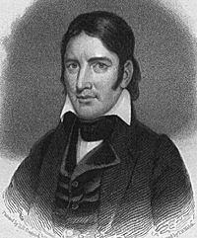
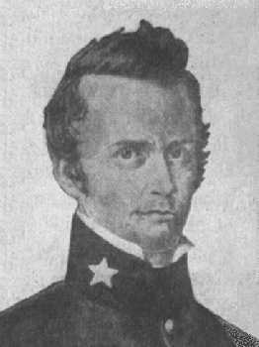
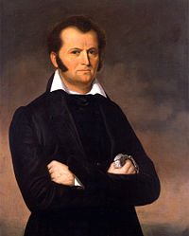
THE DEFENDERS
The Alamo
13 Days – Feb-Mar 1836
Davey Crockett
Age: 49
Politician – Tenn
Frontiersman
Soldier
William Travis
Age: 26
Commander
of
the Alamo
Jim Bowie
Age: 39
Frontiersman
Soldier

Slide 4
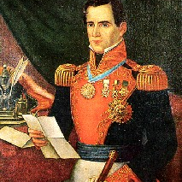
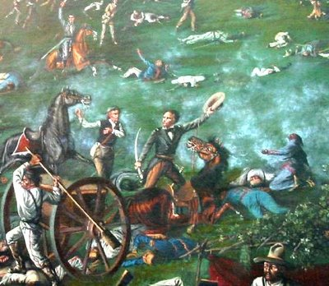
The Attacker
Remember
the Alamo!
General Antonio Lopez De Santa Anna
Sam Houston
Defeats Santa Anna @ Battle of
San Jacinto

Slide 5
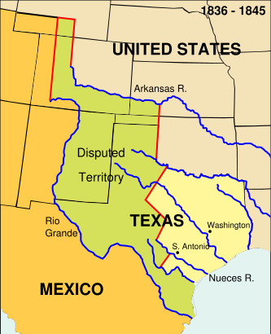
The Mexican War (1846-1848)
Caused by America’s Manifest Destiny
Texas Independent Since 1836
Border in Dispute
Texas Becomes a State 1845
1846 Congress Declares War on Mexico
1848 Americans Win
Treaty of
Guadalupe-Hidalgo

Slide 6
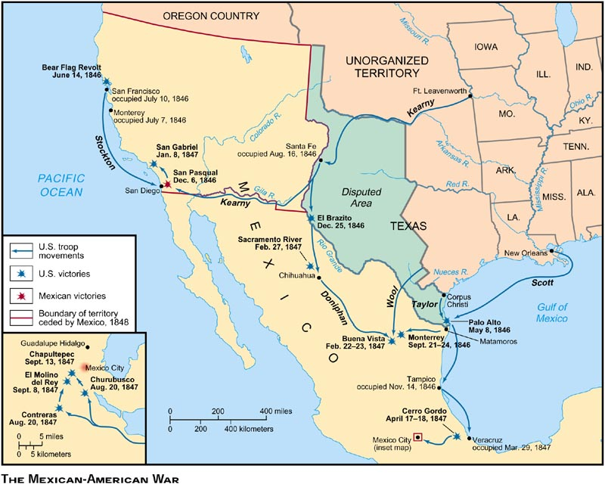

Slide 7
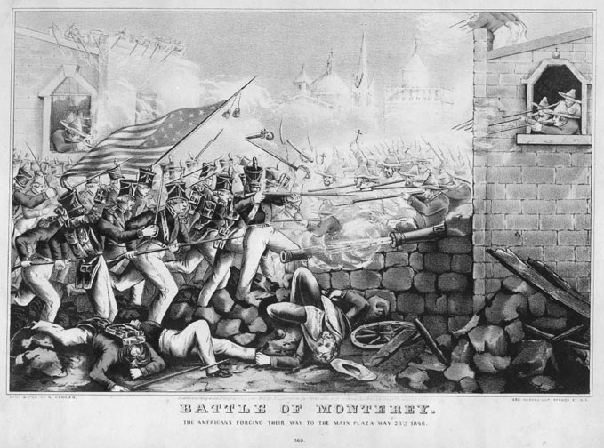

Slide 8
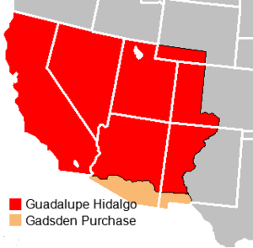
Results of Mexican American War
Mexico Sells Mexican Western Territory to U.S.
1853

Slide 9
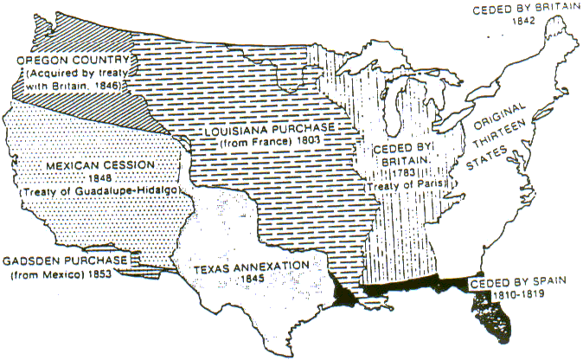
The U.S. Completes its Manifest Destiny

