Slide 1
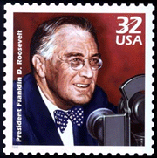
Franklin D. Roosevelt and the New Deal
Aim: What were the causes & effects of FDR’s Presidency and the New Deal?
Do Now: Take a Quiz – You have 5-7 Minutes
Redefined Democracy:
Political Rights  Economic
Security  Social Justice

Slide 2
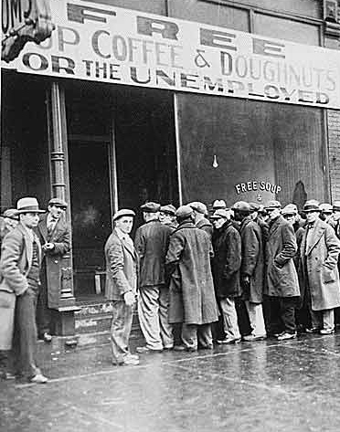
Causes of the Great Depression
Agricultural overproduction
Industrial overproduction
Unequal distribution of wealth
Over-extension of credit
International economic situation

Slide 3
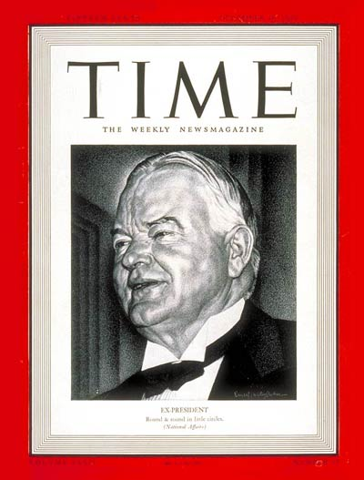
How Herbert Hoover Dealt with the Crisis
He played the game of confidence economics and just kept saying: “Prosperity is right around the corner.”

Slide 4
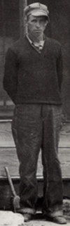
Voluntary Measures
Hoover eventually established two privately-funded organizations:
  The National Credit Association provided $1/2 billion to businesses for emergency loans, but it was too under-funded to do much good.
  The Organization for Unemployment Relief was a clearing house for relief agencies. However, state and local governments were already in too much debt to benefit from it.

Slide 5
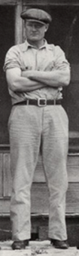
Limited Government Intervention
In the end, Hoover resorted to government intervention:
  The Reconstruction Finance Corp gave $1-1/2 billion in federal loans to banks, insurance companies, and industry to prevent bankruptcies, but it was too little, too late.
  The Home Loan Bank Act provided federal loans to homeowners to prevent foreclosures, but got bogged down in red tape.

Slide 6
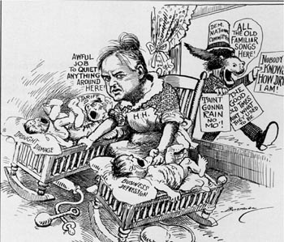
Reasons for Ineffectiveness
Hoover thought business should be self-regulating.
He had a mania for a balanced budget.
He lacked political finesse.

Slide 7
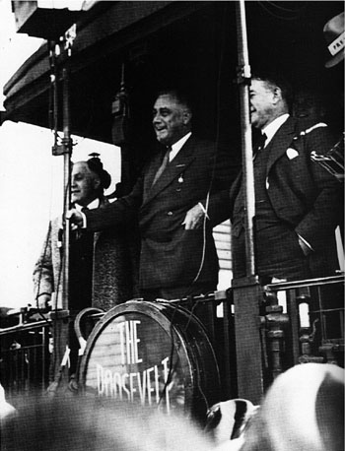
Franklin D. Roosevelt’s Appeal
In 1932 presidential election, FDR was perceived as a man of action.
Hoover was viewed as a “do-nothing president.”
Norman Thomas, the Socialist candidate, was viewed as a radical.
Results: a landslide for Democrats and a mandate to use government as an agency for human welfare.

Slide 8
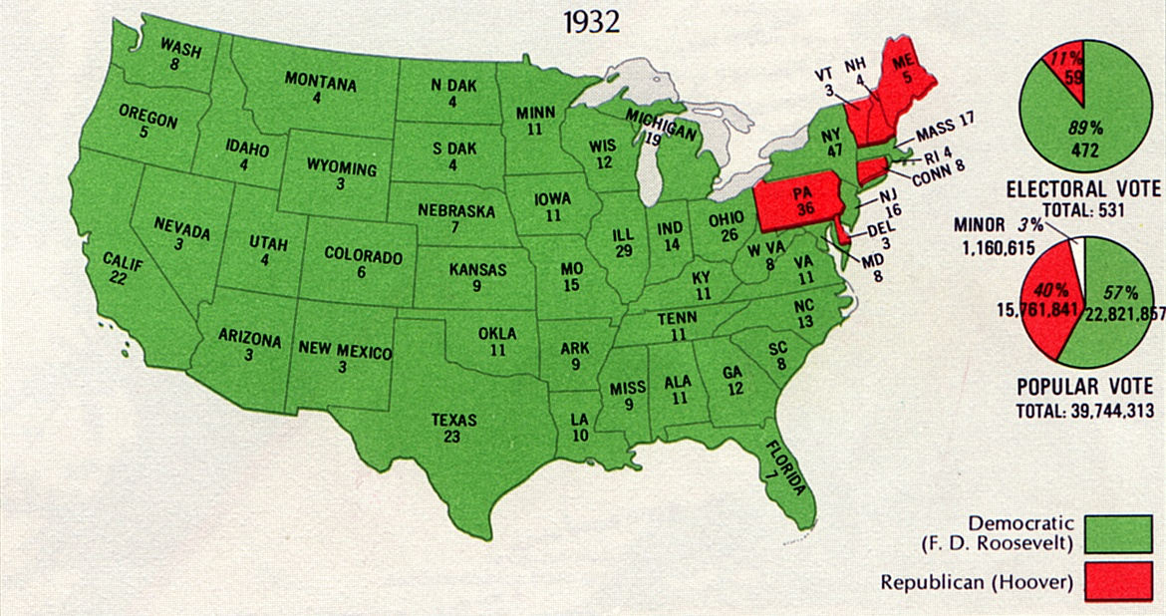

Slide 9
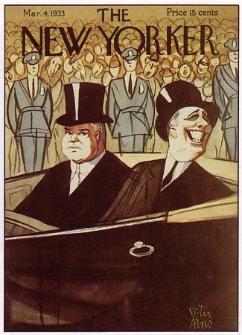
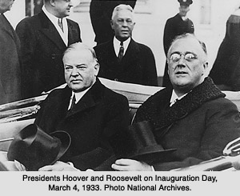
Situation When FDR Entered Office
In March 1933, the country was virtually leaderless and the banking system had collapsed.

Slide 10
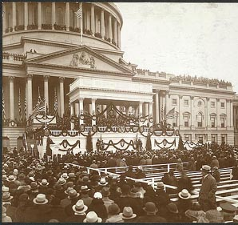
FDR Restored Confidence
In his inaugural address, he said “The only thing we have to fear is fear itself….”
He promised vigorous leadership and bold action, called for discipline and cooperation, expressed his faith in democracy, and asked for divine protection and guidance.

Slide 11
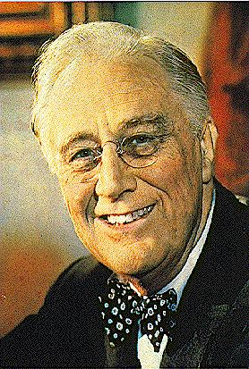
FDR’s Personal Qualities
He was a practical politician who practiced the art of the possible.
He was a charismatic person who exhibited a warmth and understanding of people.
He knew how to handle press by focusing attention on Washington.
He provided dynamic leadership in a time of crisis.
He was willing to experiment

Slide 12
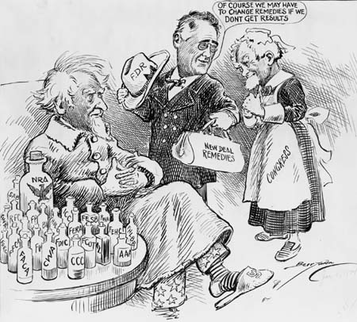
Purposes of the New Deal
Relief: to provide jobs for the unemployed and to protect farmers from foreclosure
Recovery: to get the economy back into high gear, “priming the pump”
Reform: To regulate banks, to abolish child labor, and to conserve farm lands
Overall objective: to save capitalism

Slide 13
New Deal – Project Start – Day 1
This project will consists of:
FDR & New Deal Worksheets (20pts) - Classwork
New Deal Programs Chart (100pts) - Classwork
Thematic Essay on the New Deal (100pts) – Test
(100pts) - Homework
Complete the three (3) Worksheets as classwork.
When completed ask for a New Deal Program Chart to transfer some of your answers to the chart.

