Slide 1
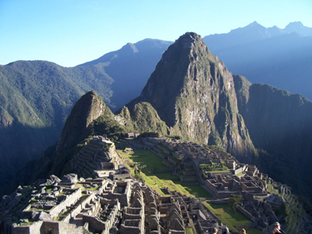
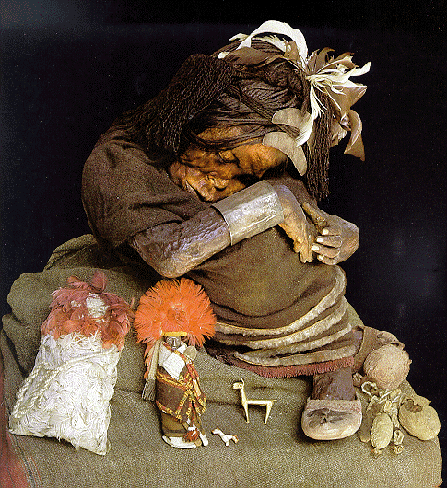
Civilizations of the America’s
Inca
Do Now: Name and Define "The 4G's & a T" of the Age of Exploration
AIM: Why was the Incan and Mesoamerican civilizations a target for European conquest?

Slide 2
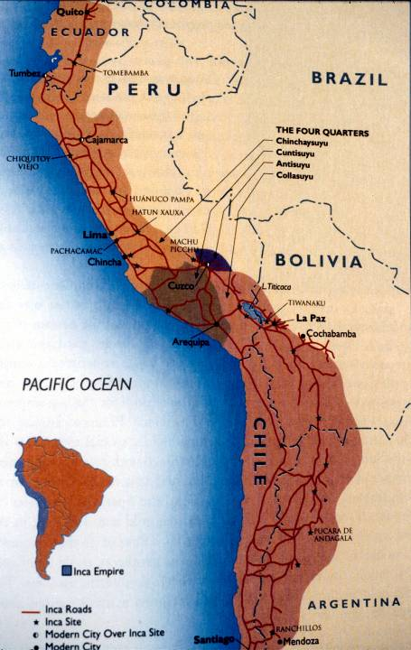
Geography
INCA
South America

Slide 3
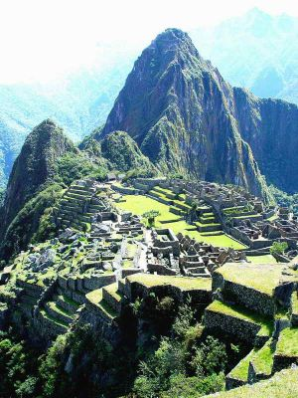
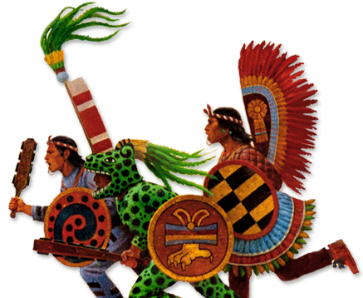
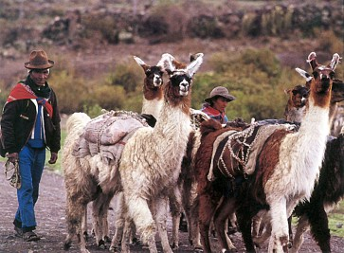
Incas
Step-Farming Agriculture
Animal Herding
Social Hierarchy
Rulers
Aristocrats
Priests
Bureaucrats
Peasant cultivators
of common birth
  llamas and alpacas for meat, wool, hides, and dung (used as fuel)
  Chief crop was the potato

Slide 4
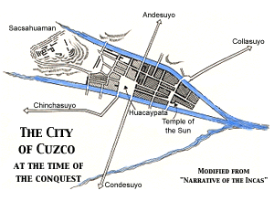
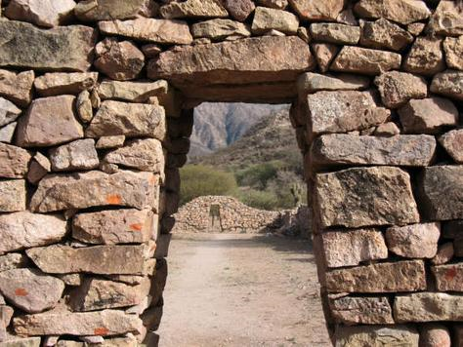
Cities: Cuzco
Administrative, religious, and ceremonial center of the empire
May have supported 300,000 residents
Tremendous system of roads emanated from Cuzco

Slide 5
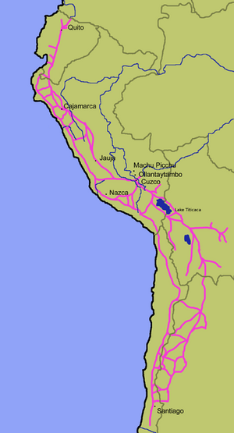
New Technologies
Built an all-weather highway system of over 16,000 miles
Major Roads of the Inca Empire

Slide 6
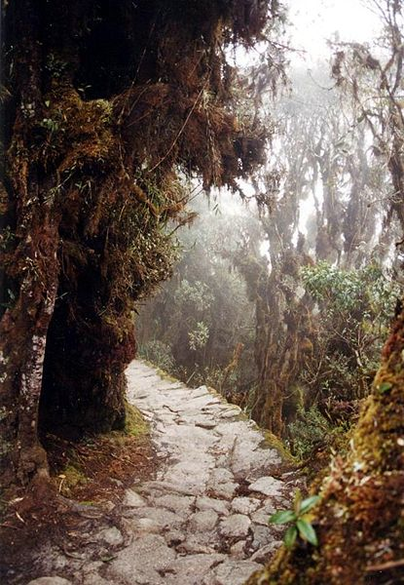
New Technologies: Roads
Allowed the Inca government to maintain centralized control by moving military forces around the empire quickly, transporting food supplies where needed, and tying the widespread territories together
Rest stations were built a day’s walk apart
Runners were positioned at convenient intervals to deliver government messages

Slide 7
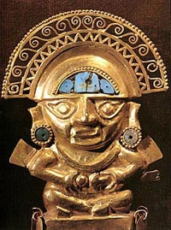
Economic Exchange
Gold, the Inca’s most valuable commodity, proved to be their undoing when Spanish conquistadors destroyed much of the empire in the early 1500s in search of gold
The Spanish melted down almost all the gold so few works of art remain

Slide 8
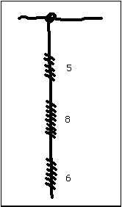
Art and Writing
The Inca had no writing
Instead they kept records using a quipu
  A array of small cords of various colors and lengths, all suspended from a thick cord
  By tying knots in the small cords, Inca could record statistical information
586 on a quipu

Slide 9
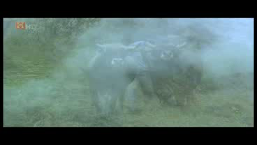

Slide 10


