Slide 1
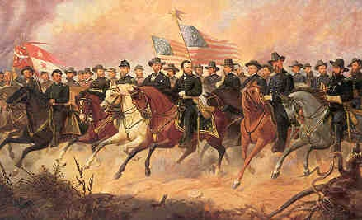
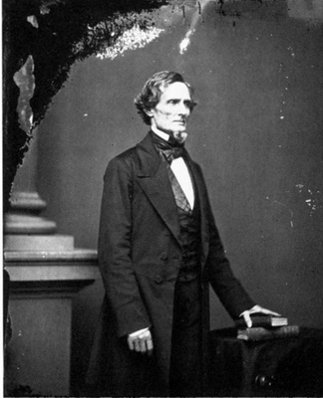
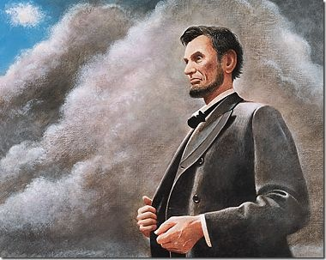
The Road to Civil War
Aim: What were the social
Political, economic causes
Of the Civil War?
Do Now: What is Sectionalism?
A Nation Divided

Slide 2
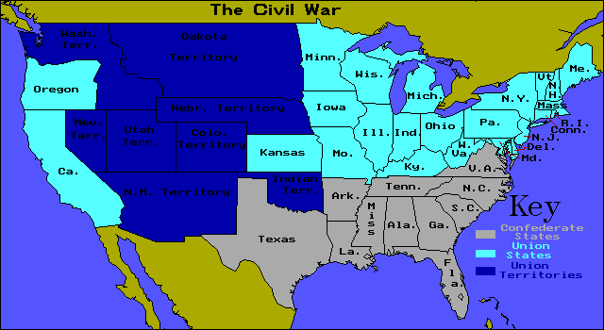
The Road to Civil War
  Secession:
  to withdraw formally from a union or alliance
Southern individual states nullified their
ratification of the U.S. constitution

Slide 3
Sectionalism
Missouri Compromise 1820
Election 1860
Democrats vs. Republicans
Dred Scott
Decision
1857 – Supreme Court Rules Slaves Property “Congress could not ban slavery from territories” -Chief Justice Roger Taney
Compromise of 1850
Kansas-Nebraska Act 1854
Slave vs. Free States
Lincoln vs. Stephen Douglass
The Road to Civil War

Slide 4
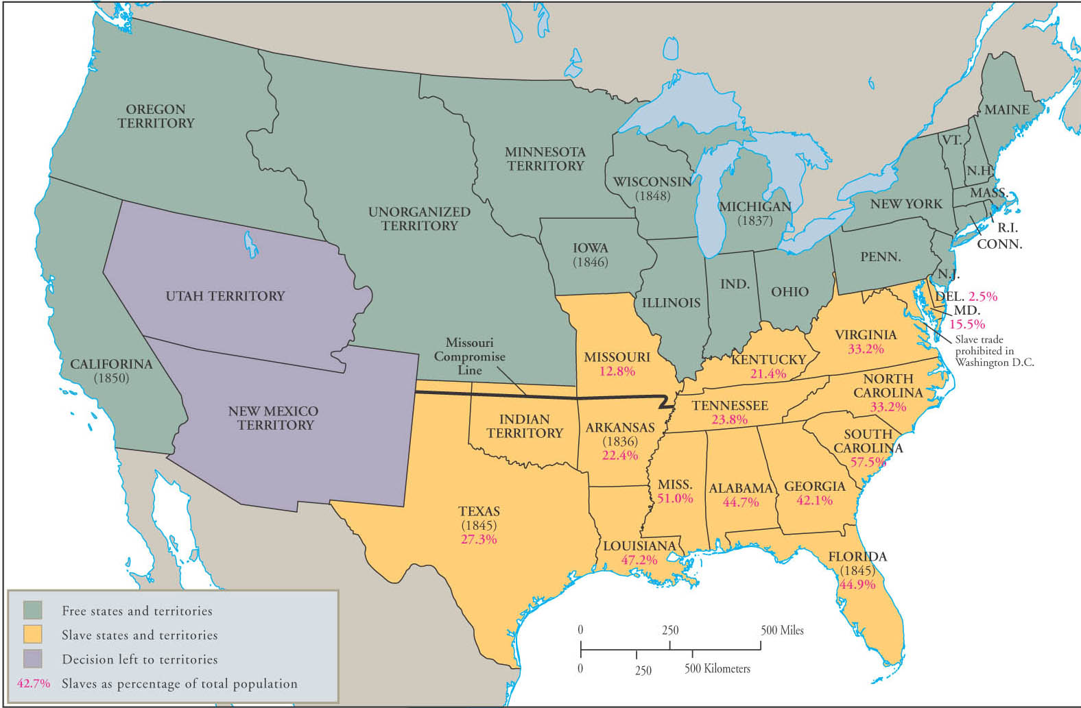
Slave and Free Territories Under the Compromise of 1850

Slide 5
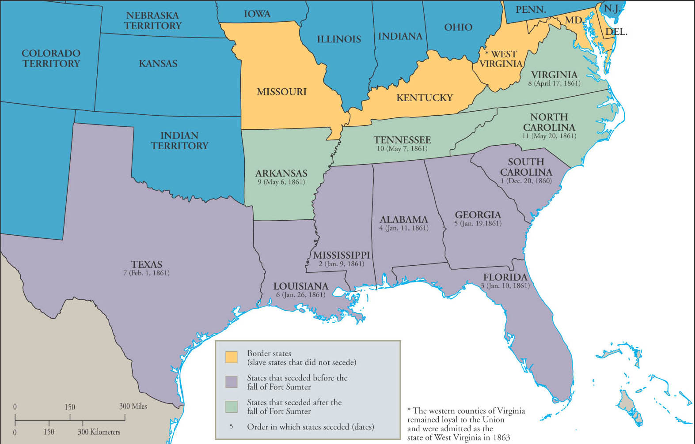
The Process of Secession

Slide 6
The Road to Civil War
1. Economic
2. Conspiracy
3.Constitutional
(States-Rights)
4. Slavery

Slide 7
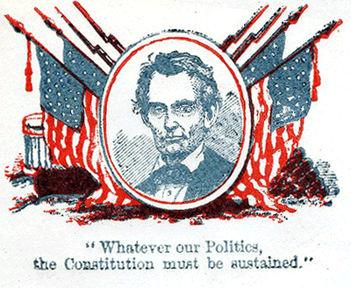
The Road to Civil War
  Conspiracy
Each side felt the other was conspiring against the other
Congress was controlled
by north
Each side didn't trust each other for economic or political reasons
“Whatever our Politics, the Constitution must be sustained”
Back

Slide 8
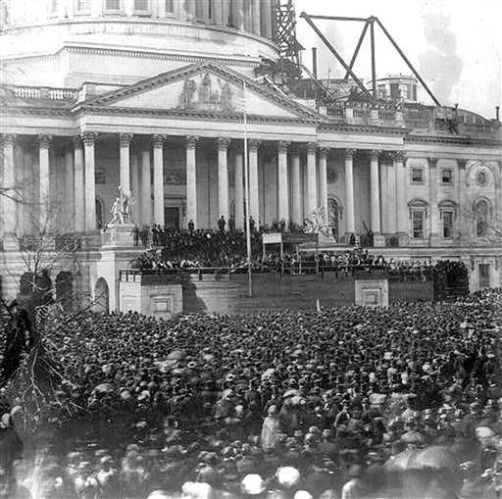
The Road to Civil War
Constitutional
United States vs. States United
A More
Perfect Union?
South
“Separate Individual States Formed the Union in 1787”
So, they can opt out!
North
“The union created the states by the Constitution” So, if the Union is Dissolved there is Nothing!
Back

Slide 9
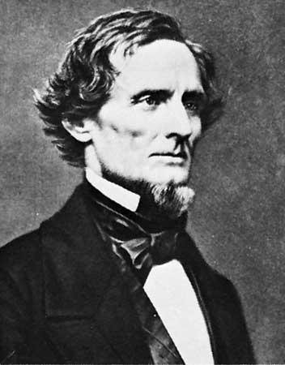
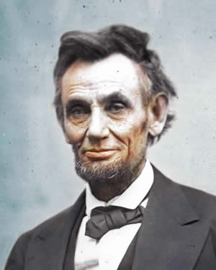
The Road to Civil War
Slavery
South -“The Blacks have a better condition under the superior White race”
Jefferson Davis
Abraham Lincoln
South – 4 Million Slaves
25 % Slave Owners
17% = 1-9 / 7% = 10-99
.1 % = 100+
Small Southern Minority Controlled Southern Society
Lincoln was a product
of his own culture
The Freeing of slaves was
not a matter of equality!!!
Yet, he was against
the concept of slavery
SAVE THE UNION!
North – “ I’m not in favor of bringing about the social or economic equality of Negroes” - “There must be the position of inferior/superior”
Back

Slide 10
The Road to Civil War
Economic
North
Paid Labor
Against Free Labor
For High Tariffs to Protect Their Products
19 Free States
South
Free Labor
Against High Tariffs Wanted to Export & Import to/from
Europe
15 Slave States
Back

