Slide 1
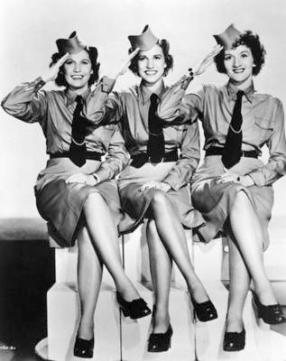
America on the Homefront
Preparing for and
Fighting in WWII
AIM: What was life in America like before and during the war?
Do Now: Take a Quiz - You have 5 Minutes
Mr. Ott @ BETA 2011-12

Slide 2
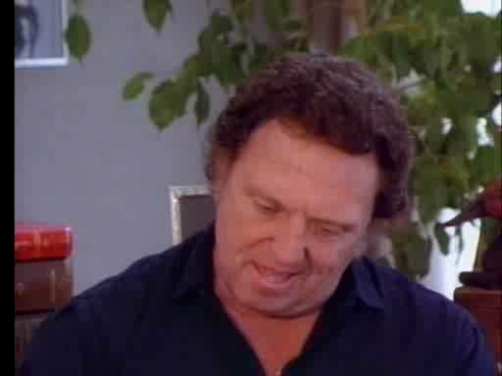

Slide 3
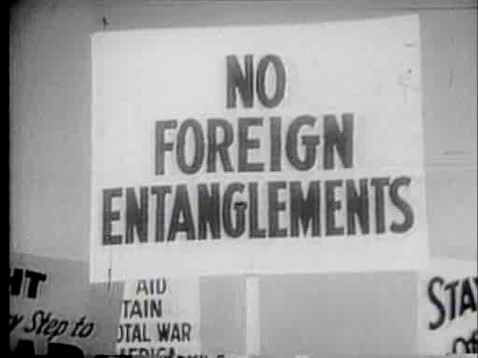

Slide 4
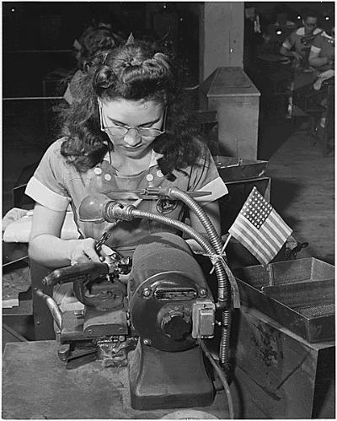
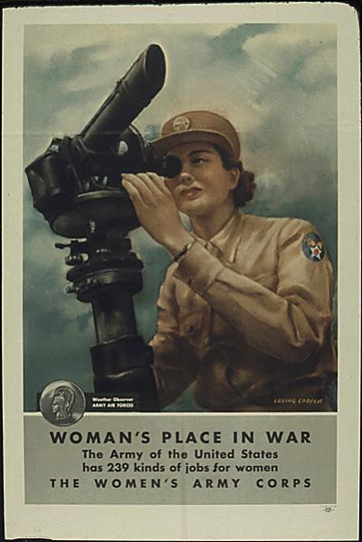
American Women During WWII
“If you can drive a car, you can run a machine.”
“Why do we need women workers? You can’t build ships, planes, and guns without them.”

Slide 5
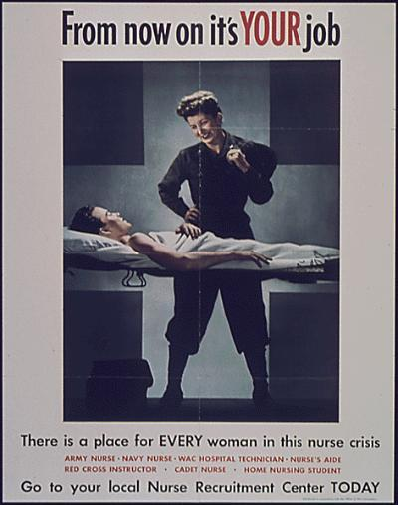
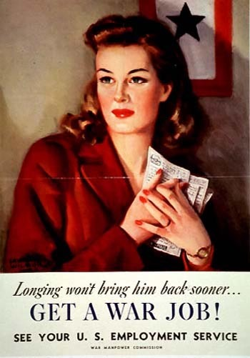

Slide 6
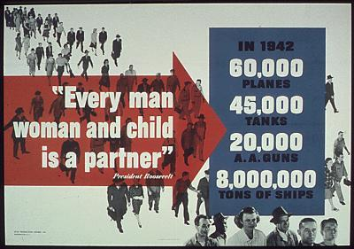

Slide 7
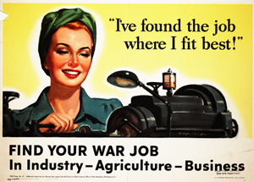

Slide 8
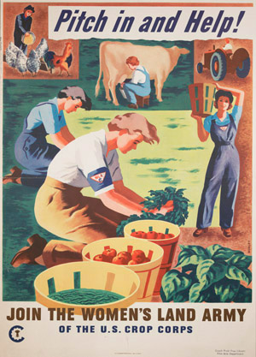
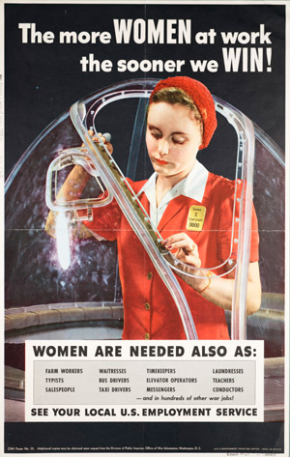

Slide 9
Women were badly needed in industry and therefore were able to get better jobs, better pay and better working conditions than ever before
Fashion also changed for women, they began to wear overalls, scarves in their hair, pants and trousers instead of skirts
The war also gave women a new opinion of themselves:
  “I never could handle the simplest can openers, or drive a nail without getting hurt, and now I put in half my nights armed with hammers and wrenches handling the insides of giant machines.” -A woman worker

Slide 10
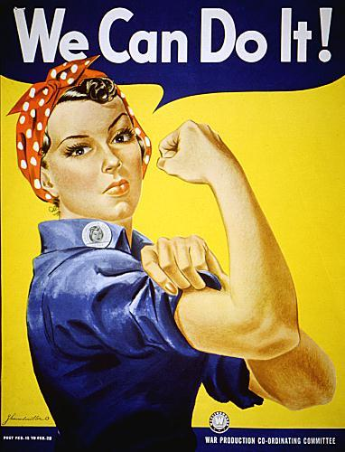
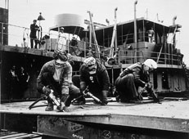
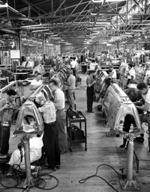

Slide 11
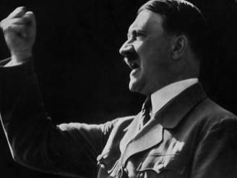
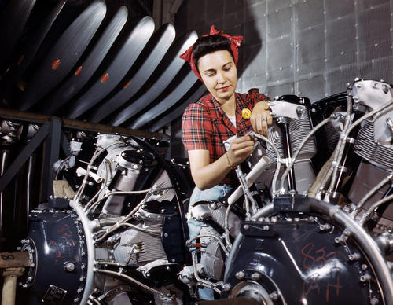
When the U.S. entered the war, Nazi leaders would mock Americans saying, “Americans can’t build planes, only electric iceboxes and razor blades.”
He was wrong.
In 1942, Americans produced more than 60,000 planes and shipped more than 8 million tons of goods.

Slide 12

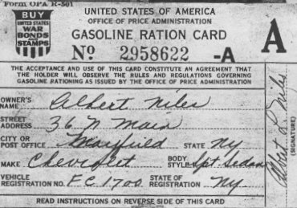
People were given ration coupons for goods such as gas, coffee, sugar, tires, and meats.
People planted “victory gardens” to help combat the food shortages.

Slide 13
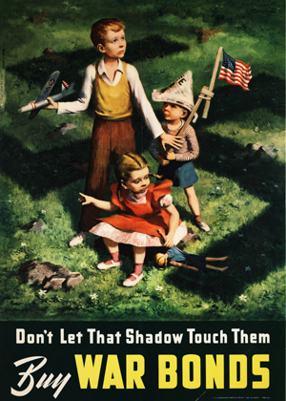
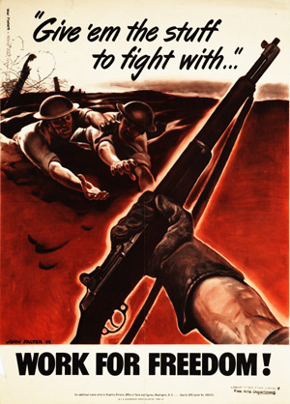

Slide 14
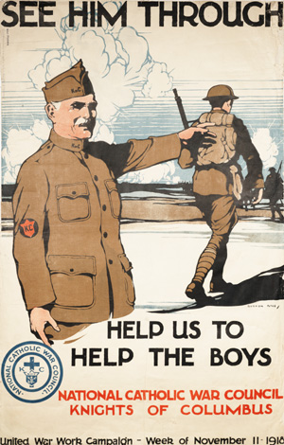
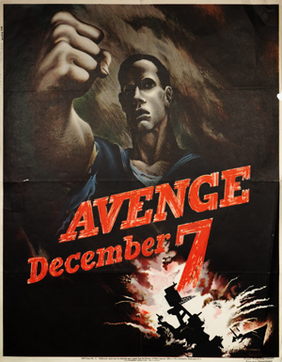
The government also sold war bonds to Americans in order to raise money

Slide 15
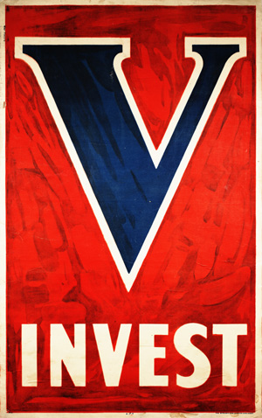
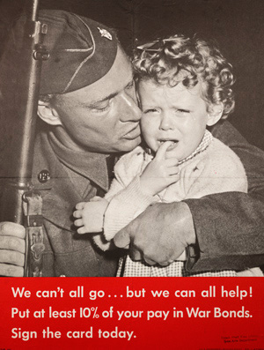

Slide 16
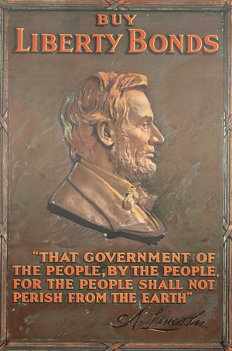
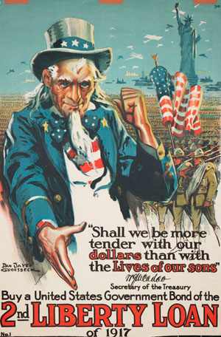

Slide 17
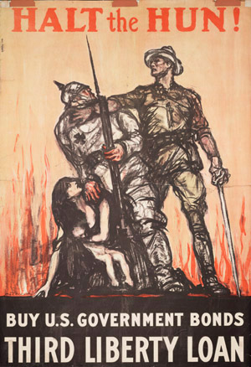

Slide 18
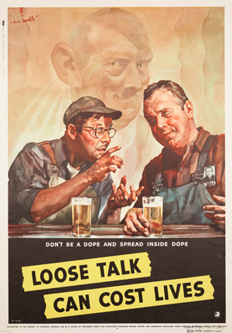
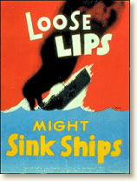

Slide 19
More Rights for Blacks
When the need for workers began to arise, most industries would not hire blacks.
A. Philip Randolph, head of the Brotherhood of Sleeping Car Porters called for a protest march on Washington.
FDR made an agreement with Randolph and forced companies to hire blacks.
Black employment doubled during WWII

Slide 20
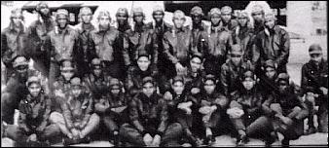
Blacks were still forced to fight in all black units during WWII.
The Tuskegee Airmen were black fighter pilots who destroyed 400 enemy aircraft by the end of the war.

Slide 21
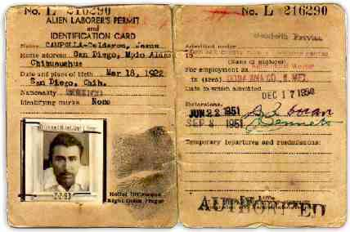
The U.S. needed farm laborers during the war. The government allowed Mexicans to travel over the border and work on American farms. These workers were called braceros.
Many Mexican Americans also fought for the U.S. during WWII

Slide 22
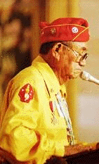
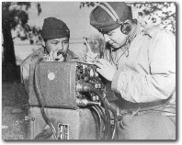
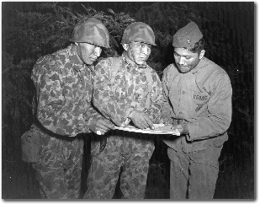
Native Americans in WWII
1 out of 3 Native Americans served in WWII
Many of them became part of the group, the Navajo Code-Talkers
The Code-Talkers used their own languages to communicate messages across enemy lines
Even though these messages were often intercepted, no one was ever able to interpret them

Slide 23
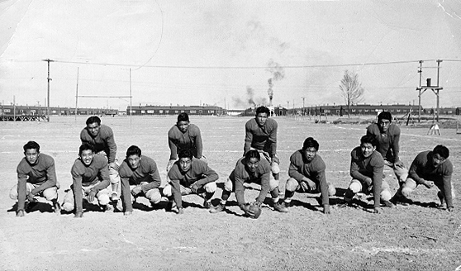
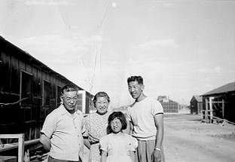
Tragedy for Japanese Americans
After the Japanese attacked Pearl Harbor, Americans questioned the loyalty of Japanese Americans
Japanese were forced to sell their homes and businesses and were sent to “relocation camps”

