Slide 1
The Russian Revolution
-Key Concepts-

Slide 2
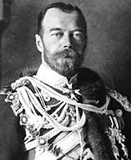
Pre-Revolutionary Russia
Only true autocracy left in Europe
No type of representative political institutions
Nicholas II became Tsar in 1884
Believed he was the absolute ruler anointed by God
Revolution broke out in 1905
--Russo-Japanese War (1904)

Slide 3
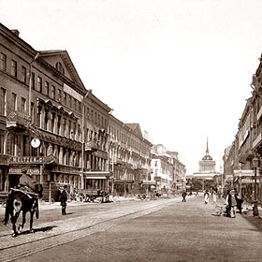
The Revolution of 1905
The creation of a discontented working class
Vast majority of workers concentrated in St. Petersburg and Moscow
Help from the countryside: poor peasants
No individual land ownership

Slide 4
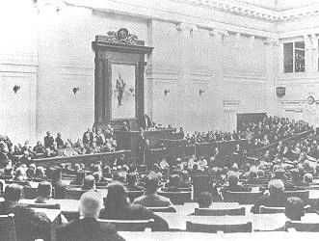
Revolution of 1905 (cont)
Russia industrialized on the backs of the peasants
Tremendous historic land hunger among peasants
Real winners of the 1905 Revolution: Middle Class
--Constitutional Democratic Party (Cadets)
--Duma

Slide 5
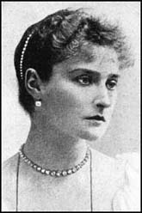
Conservatism Continues:
1905-1917
Tsar paid no attention to the Duma
Duma harassed and political parties suppressed
Nicholas was personally a very weak man
Tsar became increasingly remote as a ruler

Slide 6
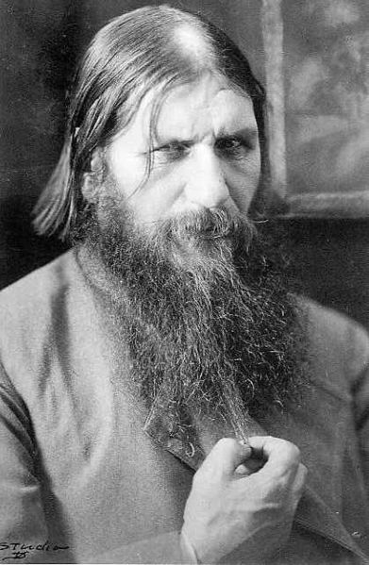
Alexandra: The Power Behind the Throne
Even more blindly committed to autocracy than her husband
The influence of Rasputin over Alexandra
Origins of Rasputin’s power
Scandals surrounding Rasputin served to discredit the monarchy

Slide 7
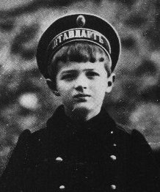
Alexandra’s Son with Hemophilia

Slide 8
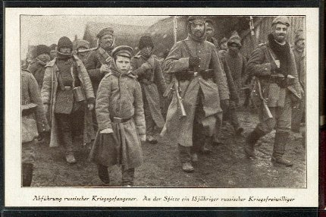
World War I: “The Last Straw”
War revealed the ineptitude and arrogance of the country’s aristocratic elite
The Russian “Steam Roller”
Corrupt military leadership and contempt for ordinary Russian people
Average peasant has very little invested in the War

Slide 9
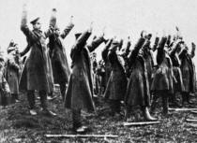
World War I (cont)
Poorly supplied troops
Result: Chaos and Disintegration of the Russian Army
--Battle of Tannenberg (August, 1914)
Spreading Discontent

Slide 10
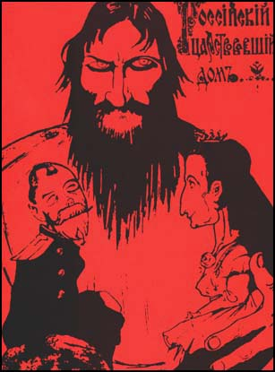
The Collapse of the Imperial Government
Nicholas leaves for the Front—September, 1915
Alexandra and Rasputin throw the government into chaos
Alexandra and other high government officials accused of treason

Slide 11
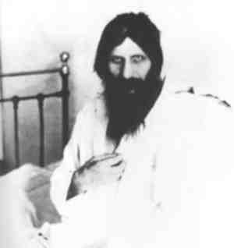
The Collapse of the Imperial Government (cont)
Rasputin assassinated in December of 1916
Refusal to receive assistance of the Russian Middle Class
Complete mismanagement of the wartime economy

Slide 12
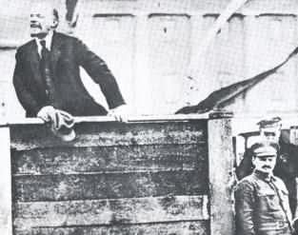
The Two Revolutions of 1917
The March Revolution (March 12)
The November Revolution (November 6)

Slide 13
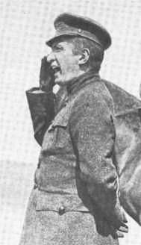
The March Revolution
Origins: Food riots and strikes
Duma declared itself a Provisional Government on March12th
Tsar abdicated on March 17th
Composition of the Provisional Government
--Alexander Kerensky
Very Popular Revolution
The Petrograd Soviet
--Order #1

Slide 14
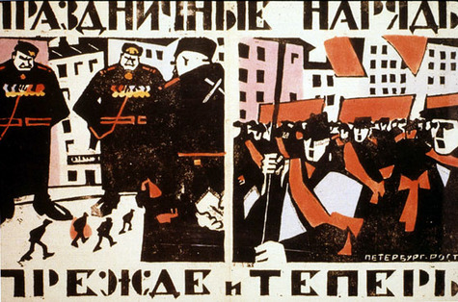
Soviet Political Ideology
More radical and revolutionary than the Provisional Government
Most influenced by Marxist socialism
Emulated western socialism
Two Factions
-- “Mensheviks”
-- “Bolsheviks”

Slide 15
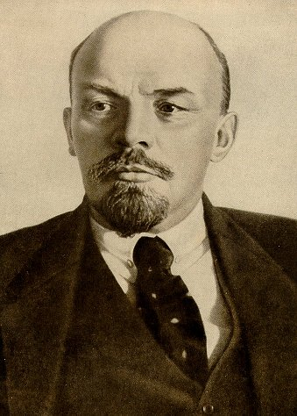
Founder of Bolshevism:
Vladimir Lenin
His Early Years
--Exiled to Siberia in 1897
Committed to Class Struggle and Revolution
Moved to London in 1902 and befriended Leon Trotsky
What is to be Done? Tract

Slide 16
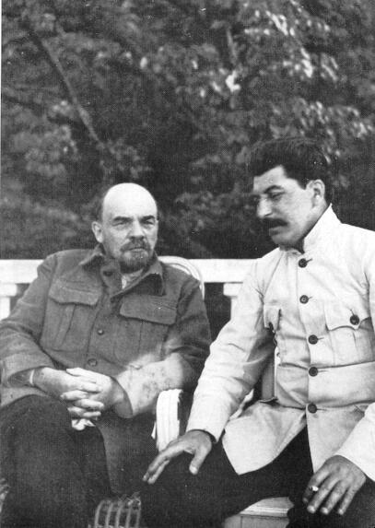
Lenin (cont)
Key role of the Party in the revolution
-- “Dictatorship of the Proletariat”
Bolsheviks split from the Russian Socialist Party in 1912
Character of the Bolshevik Party
--Joseph Stalin
--Pravda

Slide 17
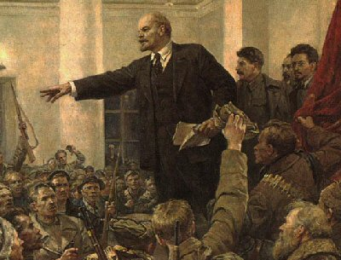
Vacuum of Leadership in Russia
Petrograd Soviet dominated by Mensheviks
Failure of the Provisional Government
Workers refusing to work and soldiers refusing to fight
Peasants were expropriating the land outright
Power was literally lying in the streets of Petrograd

Slide 18
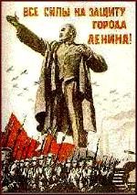
Lenin Steps into This Vacuum
Amnesty granted to all political prisoners in March of 1917
Lenin’s arrival in Petrograd
A tremendously charismatic personality
“Peace, Land, Bread”
“All Power to the Soviets”
Bolshevik party membership exploded
Consolidation of Bolshevik power

Slide 19
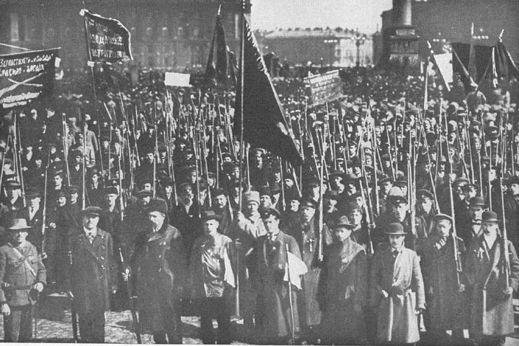
The November Revolution
The events of November 6
Council of People’s Commissars
All private property of wealthy was abolished and divided among the peasantry
Largest industrial enterprises nationalized

Slide 20
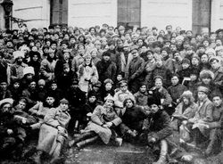
November Revolution (cont)
Political Police organized: CHEKA
Revolutionary army created with Trotsky in charge
-- “Red Army”
Bolshevik Party renamed Communist Party in March of 1918
The Treaty of Brest-Litovsk negotiated with the Germans
Terms of the Treaty

Slide 21
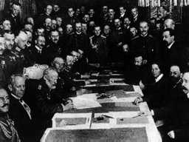
November Revolution (cont)
Humiliating Treaty would be nullified since all of the west was on the verge of revolution
Civil War fought between 1917-1920
-- “Reds” versus “Whites”
Complete breakdown of Russian economy and society

Slide 22
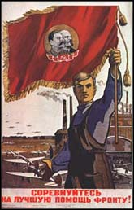
Revolution
The official Marxist Interpretation
--The importance of a permanent international revolution
Function of Russian History and Culture
Imposed Revolution on an unwilling victim
A Social Revolution

