Slide 1
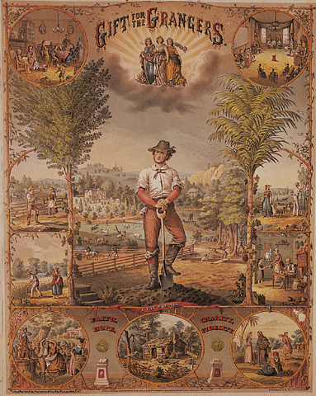
Aim: How did the Grange Movement & Populism effect the U.S. ?
Do Now: What is a political party? Who warned us about them?
Populism
& the
Election
of 1896
Mr. Ott – BETA 2011-12

Slide 2
Populism:
An Agrarian
Revolt

Slide 3
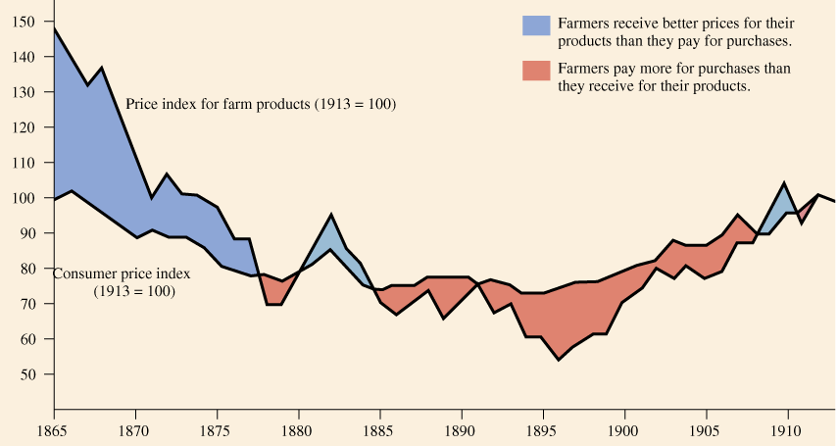
Price Indexes for Consumer & Farm Products: 1865-1913

Slide 4
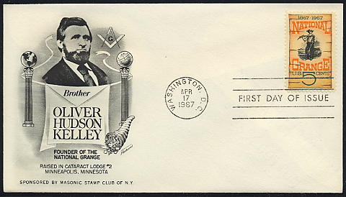
Founder of the National Grange of the Patrons of Husbandry (1867)

Slide 5
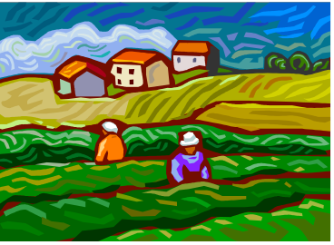
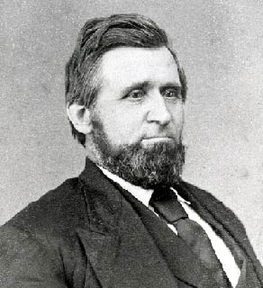
GRANGE MOVEMENT
The act or practice of cultivating crops and breeding and raising livestock
Joining with other interested individuals in 1867, Oliver Kelley formed the National Grange of the Patrons of Husbandry
Local affiliates were known as "granges" and the members as "grangers."
After the Panic of 1873, the Grange spread rapidly throughout the farms of the Midwest, since farmers in all areas were plagued by low prices for their products, growing indebtedness and discriminatory treatment by the railroads.
Very strong in Illinois, Minnesota, Wisconsin, & Iowa (big farm states)

Slide 6
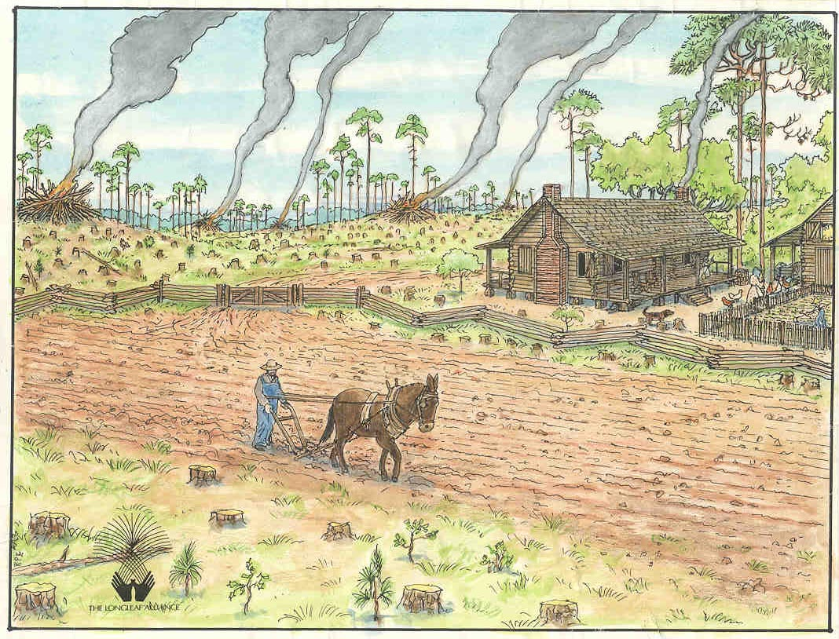
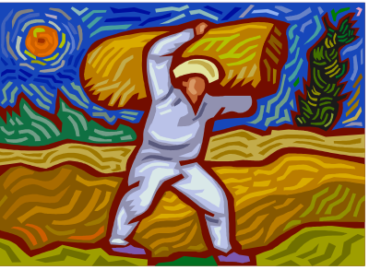
GRANGE MOVEMENT
The Grange played an important role by demonstrating that farmers were capable of organizing and advocating a political agenda
Many of their ideas and plans were taken up by other political organizations, most notably the Populist Party of the 1890s
Lecturers went from town to town
Membership grew to 4 million
Most members in South and West

Slide 7
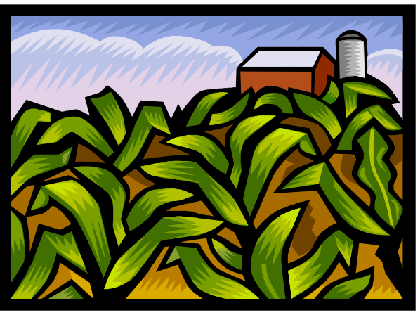
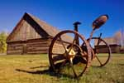
GRANGE MOVEMENT
Common Message: They wanted…
    Lower interest rates
    Government control of railroads
    Government control of banks
    Increase in money supply
    High tariffs to protect farmers
    from foreign competition
    Eventually gave rise to Farmer’s
    Alliances, which gave rise to the
    Populist party!!!!!
http://www.chrisharrisimages.com/farm-images.html

Slide 8

Causes of the 1893 Panic
Begun 10 days after Cleveland took office.
  Several major corps. went bankrupt.
    Over 16,000 businesses disappeared.
    Triggered a stock market crash.
    Over-extended investments.
  Bank failures followed causing a contraction
  of credit [nearly 500 banks closed].
  By 1895, unemployment reached 3 million.
Americans cried out for relief, but the Govt.
continued its laissez faire policies.

Slide 9
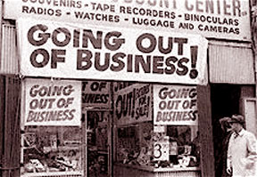
PANIC OF 1873
RESULT?
The New York Stock Exchange was closed for 10 days.
Credit dried up, foreclosures were common and banks failed.
Factories closed their doors, costing thousands of workers' jobs.
Volume of destitute people soon overwhelmed the abilities of charities to function.
Most of the major railroads failed
By 1875, 18,000 companies had folded!

Slide 10
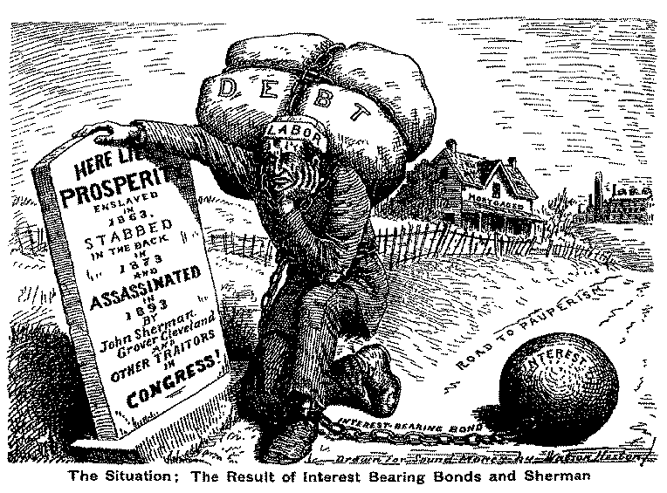
Here Lies Prosperity

Slide 11
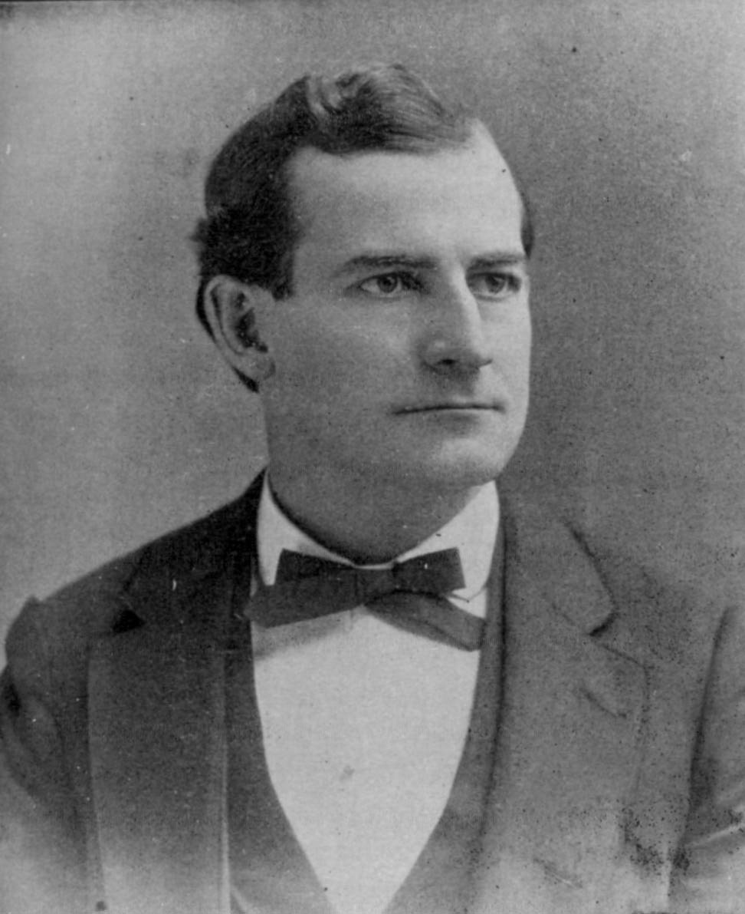
POPULIST PARTY
“MOVEMENT OF THE PEOPLE”
FOUNDED IN 1892
DEMANDED REFORMS TO LIFT THE BURDEN OF DEBT FROM FARMERS AND OTHER WORKERS
GIVE PEOPLE GREATER “VOICE”
POPULIST HERO, WILLIAM J. BRYAN

Slide 12
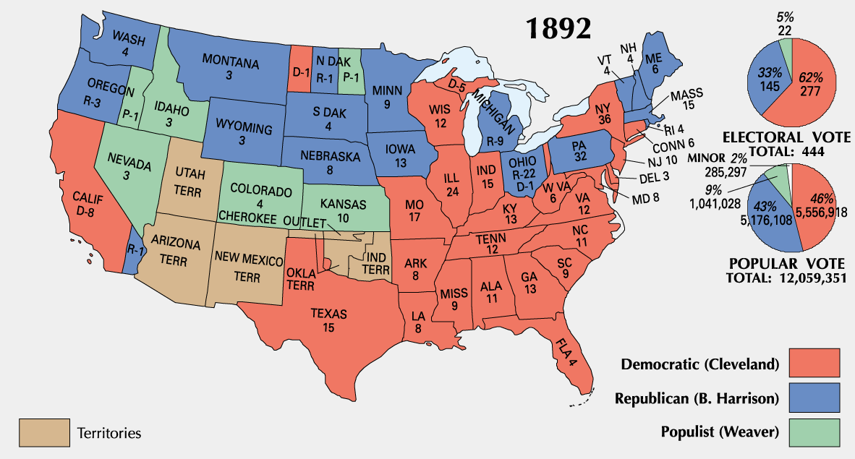
1892 Election

Slide 13
Written by a Farmer at the End of the 19c
When the banker says he's broke
And the merchant’s up in smoke,
They forget that it's the farmer
who feeds them all.
It would put them to the test
If the farmer took a rest;
Then they'd know that it's the farmer
feeds them all.

Slide 14
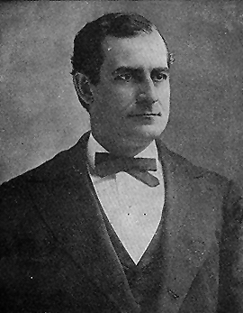
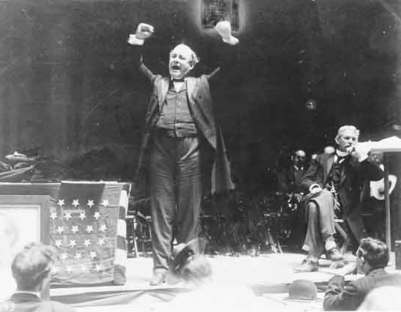
William Jennings Bryan
(1860-1925)
Revivalist style of oratory.
The “Great Commoner”

Slide 15
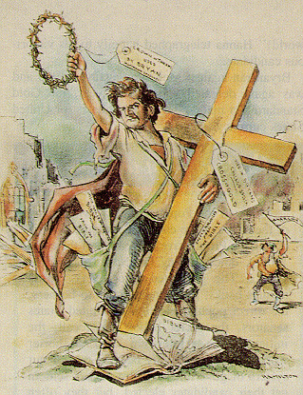
Bryant’s
“Cross of Gold” Speech
You shall not press down upon the brow of labor this crown of thorns; you shall not crucify mankind upon a cross of gold!

Slide 16
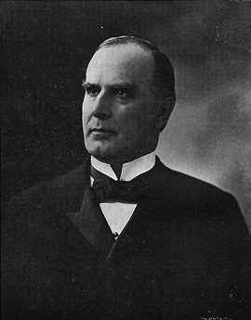
William McKinley (1843-1901)

Slide 17
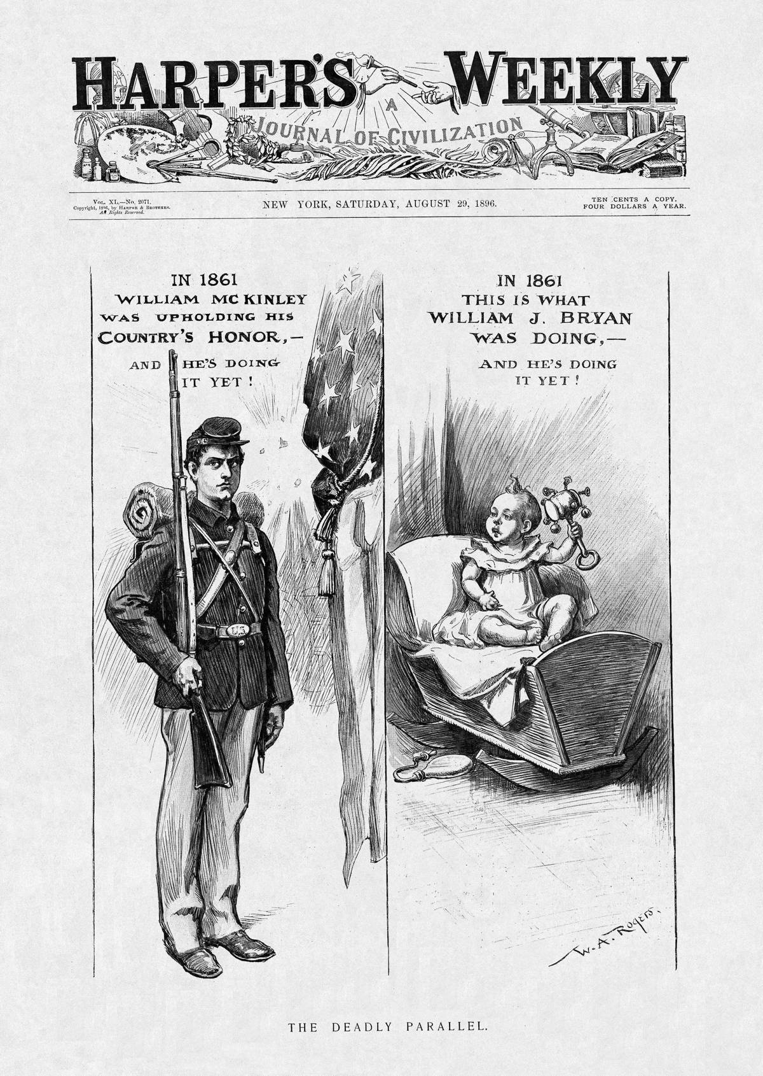
The Seasoned Politician
vs.
The “Young” Newcomer

Slide 18
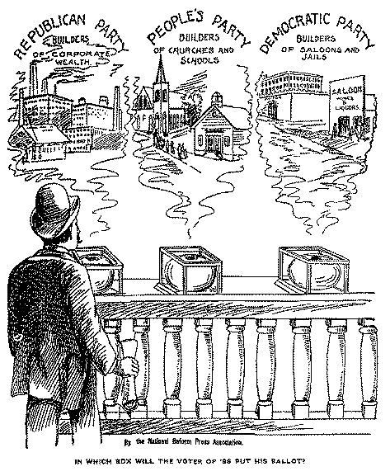
Into Which Box Will the Voter
of ’96 Place His Ballot?

Slide 19
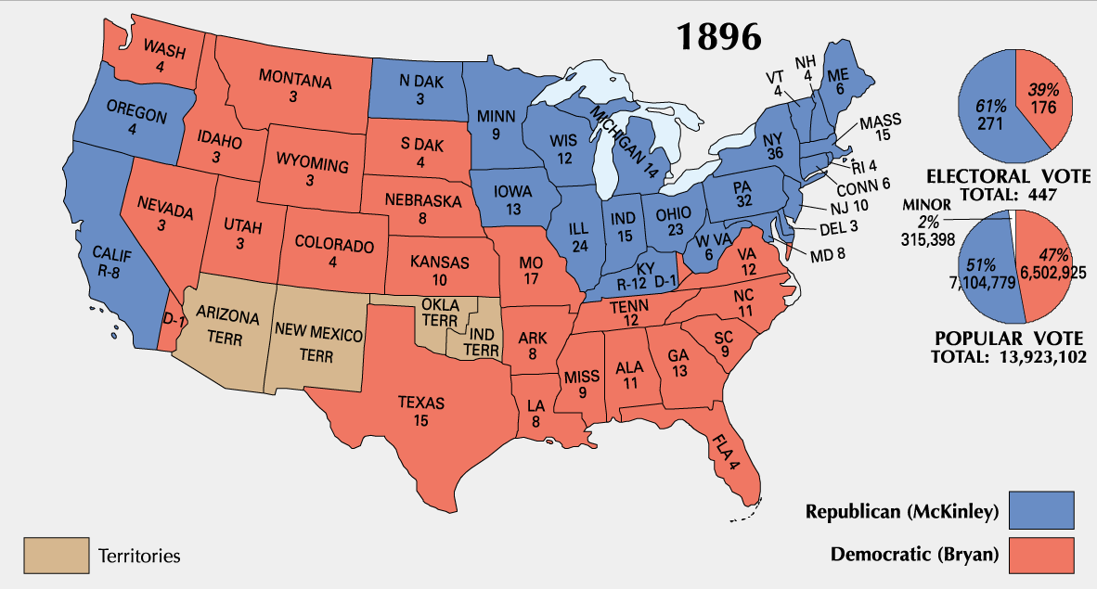
1896 Election Results

Slide 20
Why Did Bryan Loose?
His focus on silver undermined
efforts to build bridges to urban
voters.
He did not form alliances with
other groups.
McKinley’s campaign was well-
organized and highly funded.

Slide 21
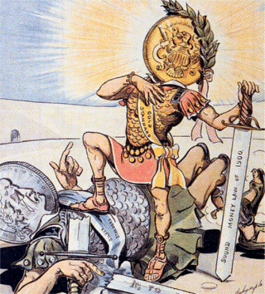
Gold Triumphs Over Silver
1900 → Gold
Standard Act
confirmed the
nation’s
commitment to
the gold standard.
A victory for the
forces of
conservatism.

Slide 22
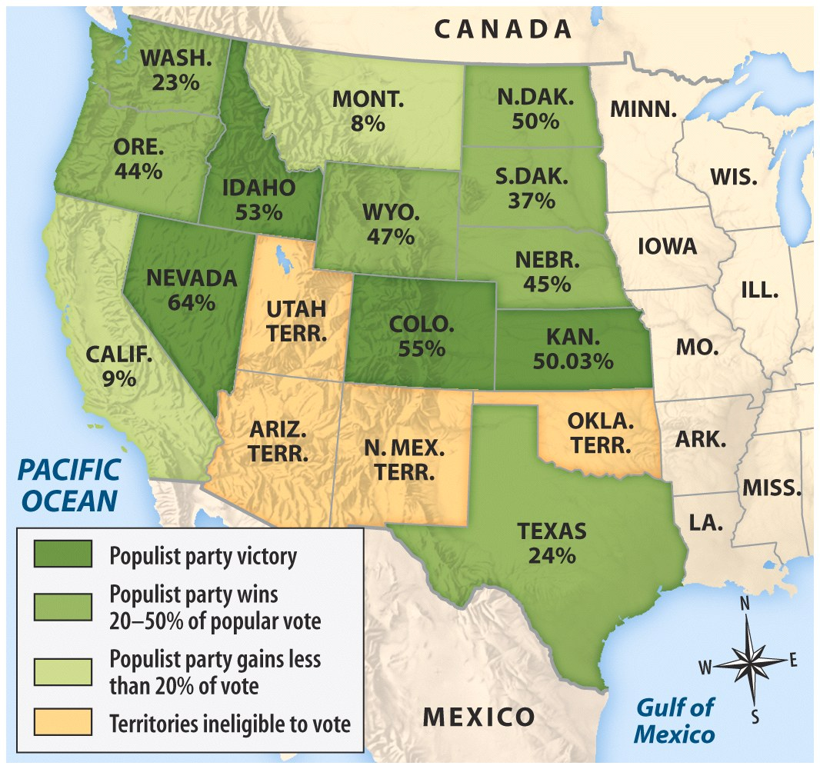
Heyday of Western Populism

Slide 23
Why Did Populism Decline?
The economy experienced rapid change.
The era of small producers and
farmers was fading away.
Race divided the Populist Party,
especially in the South.
The Populists were not able to break
existing party loyalties.
Most of their agenda was co-opted by
the Democratic Party.

