Slide 1
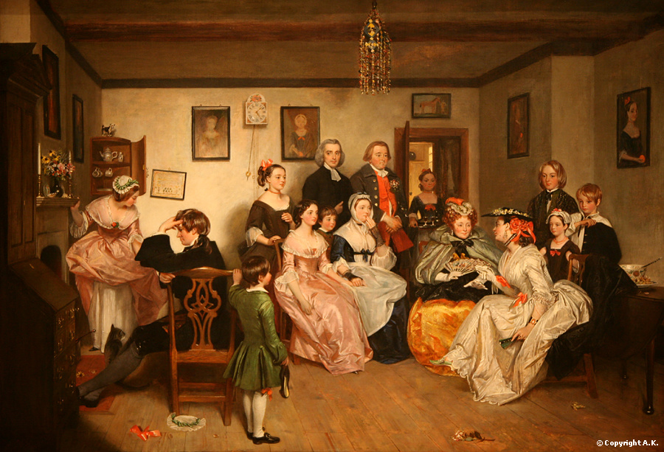
The Victorian Age
1830-1901
AIM: What effect did Britain have on the world during the Age of Victoria?
Do Now:
Put them in order:
French Revolution
Industrial Revolution
Congress of Vienna
Napoleonic Age
The World in 1750

Slide 2
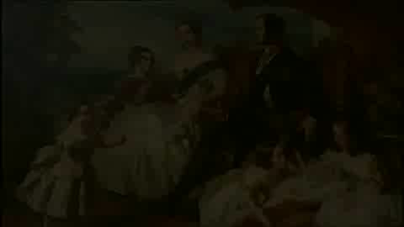

Slide 3
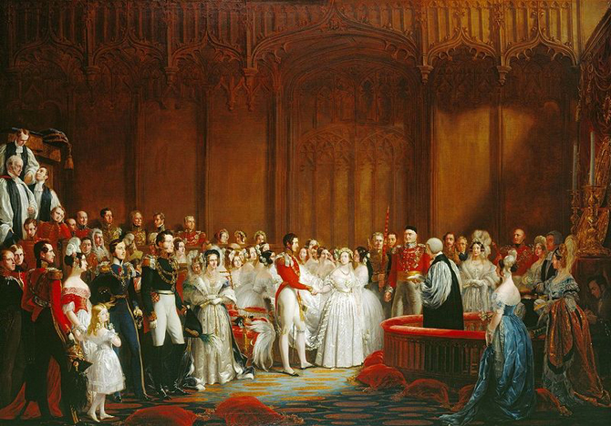
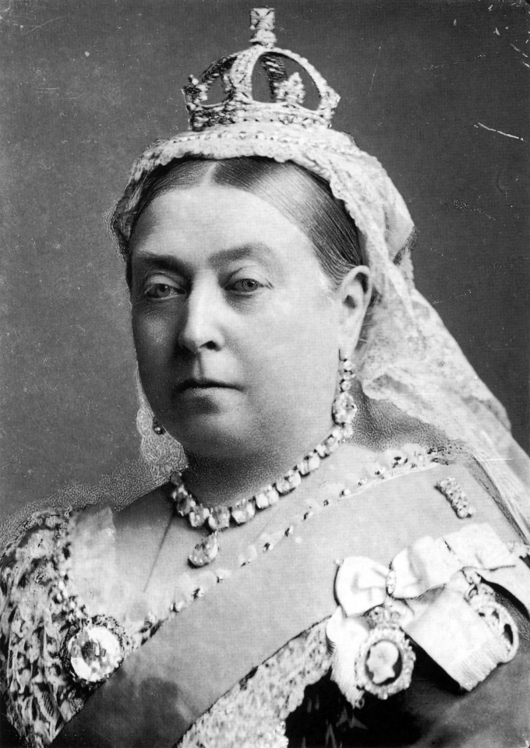
Queen Victoria (r. 1837-1901)
Her Majesty Victoria, by the Grace of God, of the United Kingdom of Great Britain and Ireland Queen, Defender of the Faith, Empress of India
Reigned for 63ys 7 mos (2nd Longest)
Empire was at the greatest extent
Industrial Revolution at height
Imperialism at it’s highest point of Empire
Married Prince Albert has 9 children
Albert dies in 1861 @ 42 yrs old
(mourns for rest of her life)

Slide 4
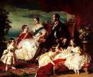
Queen Victoria’s & Prince Albert’s children
Many of their children and grand children married heirs to thrones of Spain, Russia, Sweden, Norway, and Romania. Because this, Victoria became known as the "Grandmother of Europe.“
Victoria, Princess Royal (November 21, 1840 - August 5, 1901)
Albert Edward, Prince of Wales (later, Edward VII)
(November 9, 1841 - May 6, 1910)
Alice (April 25, 1843 - December 14, 1878)
Alfred (August 6, 1844 - July 31, 1900)
Helena (May 25, 1846 - June 9, 1923)
Louise (March 18, 1848 - December 3, 1939)
Arthur (May 1, 1850 - January 16, 1942)
Leopold (April 7, 1853 - March 28, 1884)
Beatrice (April 14, 1857 - October 26, 1944)

Slide 5
Early Victorian (1837 to 1850)
Mid-Victorian (1851 to 1879)
Late Victorian (1880 to 1901)
()
socially and politically unsettled period
(1851 to 1879)
distinctive mixture of prosperity, domestic prudery, and complacency vs. decades of quiet politics and roaring prosperity
(from 1880 to 1901)
new waves of aestheticism (being beautiful rather than having a deeper meaning) and imperialism

Slide 6
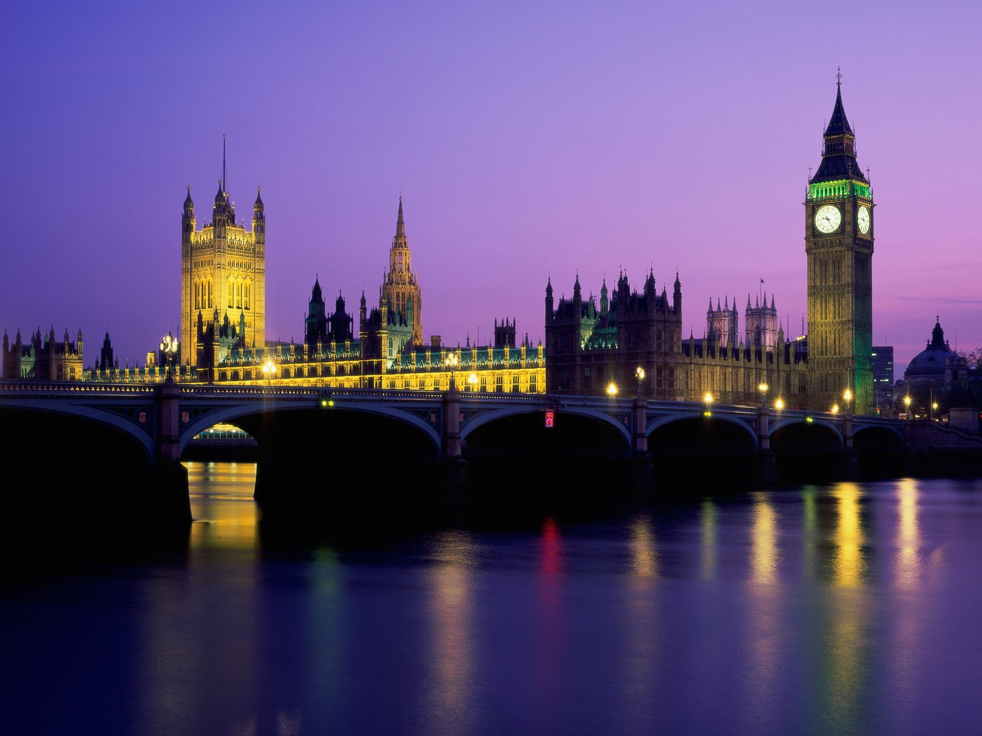
A Time of Change
Mid-Victorian (1851 to 1879)
London becomes most important city in Europe
From a city of 2 million to 6 million people
Shift from ownership of land to modern urban economy
Impact of industrialism & an increase in wealth
World’s foremost imperial power

Slide 7
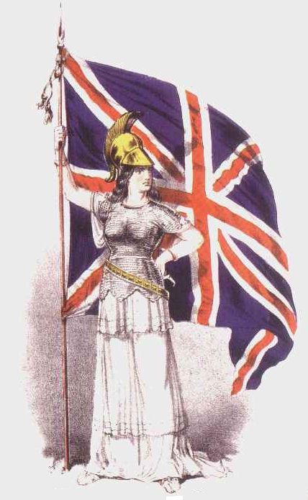
“The sun never sets on the
British Empire.”
During Victoria’s reign, 25% of the world’s population, was part of the British Empire
England was a imperial nation gaining control of countries around the world.

Slide 8
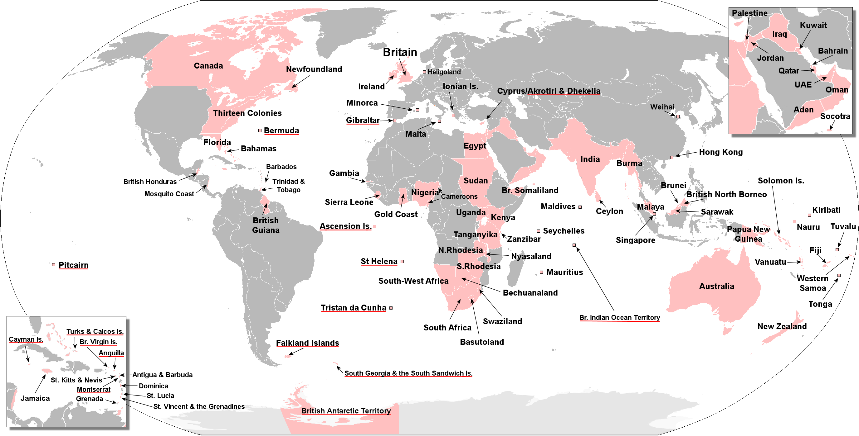

Slide 9
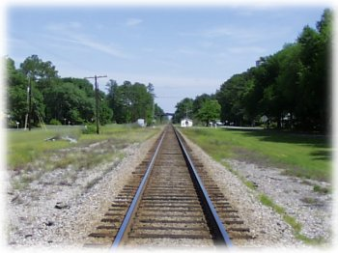
The Early Victorian Period (1830-1848)
In 1830, the Liverpool and Manchester Railway opened, the first public railway line in the world.
By 1850, railway lines connected England’s major cities.
By 1900 , England had 15,195 lines of railroad and an underground rail system beneath London.
The train transformed England’s landscape, supported the growth of commerce, and shrank the distance between cities.

Slide 10
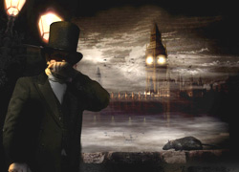
The Time of Troubles (1830’s and 1840’s)
Unemployment
Poverty
Rioting
Slums in large
cities
Working
conditions for women and children were terrible
The “Great Stink” London (1858)

Slide 11
Social and Political Reform
1832-First Reform Act-extended the vote to most middle-class men
1833-Britain abolished slavery/Factory Act-regulated child labor in factories
1834-Poor Law-Amendment applied a system of workhouses for poor people
1871-Trade Union Act-made it legal for laborers to organize to protect their rights

Slide 12
Society – Lower classes
  The working and unemployed poor (day laborers)
  Blacks, Irish, colonized poor
Prejudice
  Childlike, Dirty
  Criminal, immoral and superstitious
  Disrespectful and unreasonable
  “Scientifically” less intelligent
Conditions
  Poor quality of housing and food
  Unclean water supply
  Little fresh/clean air
  Little or no education
  Very low pay
  Child labor

Slide 13
Society – Middle Class
Almost entirely white British
White-collar work (i.e. in offices, shopkeepers, doctors, lawyers, clerks)
Some education – university for men
Upwardly mobile
Concerned with maintaining image and respectability

Slide 14
Society – Upper Classes / Aristocracy
British nobility (lords, royalty)
Luxurious homes
Education – university for men, tutoring for women
Travel – the Grand Tour
Careers in politics, investments,landownership
Noblesse oblige – duty of the upper class to take care of the lower class

Slide 15
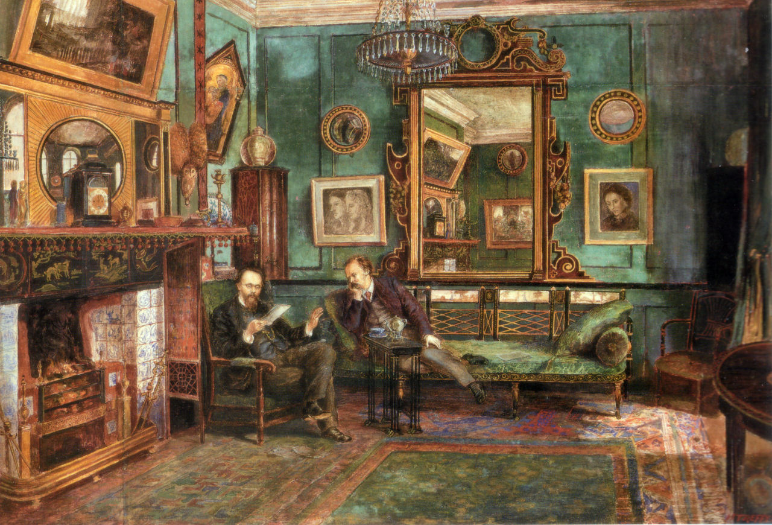

Slide 16
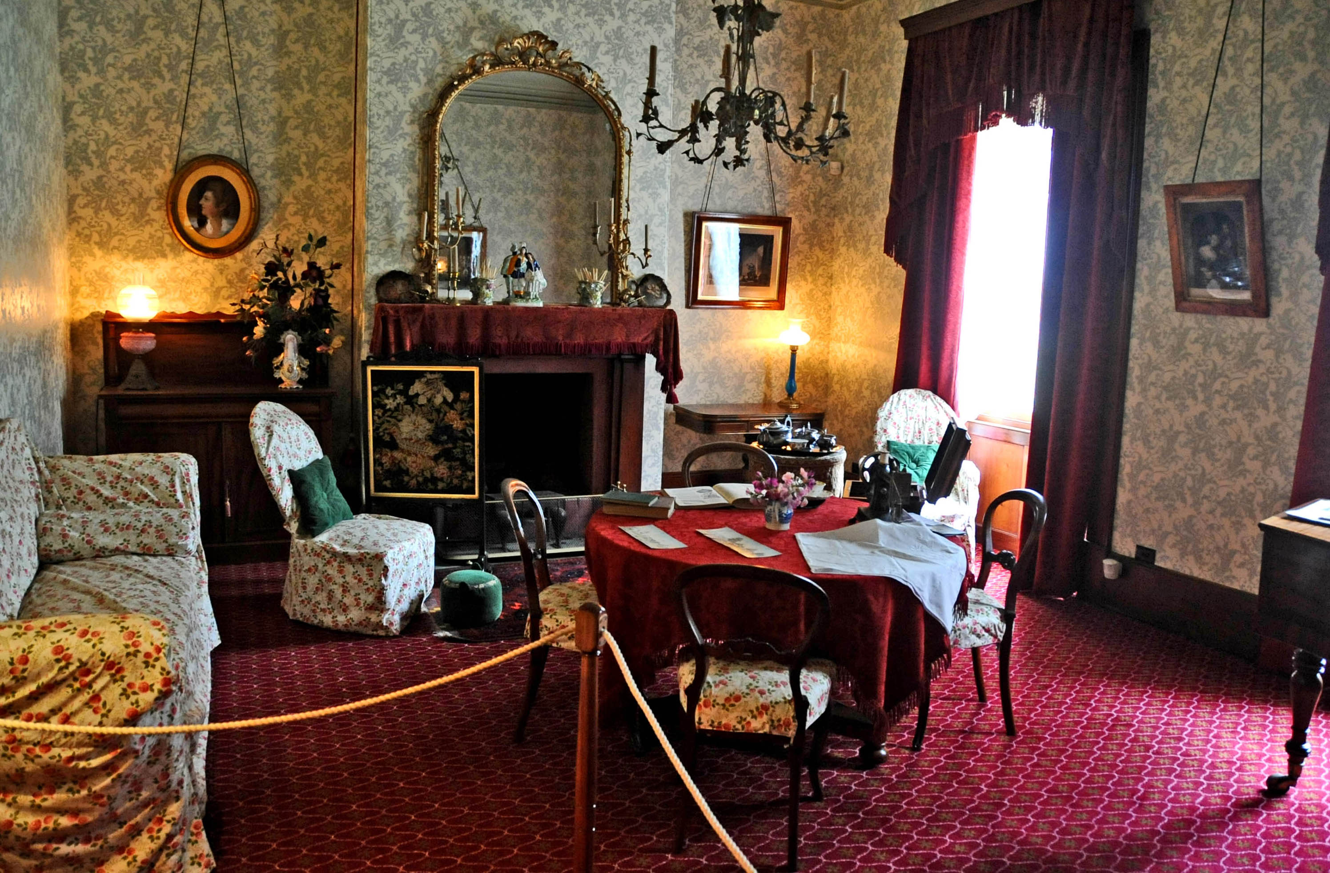

Slide 17
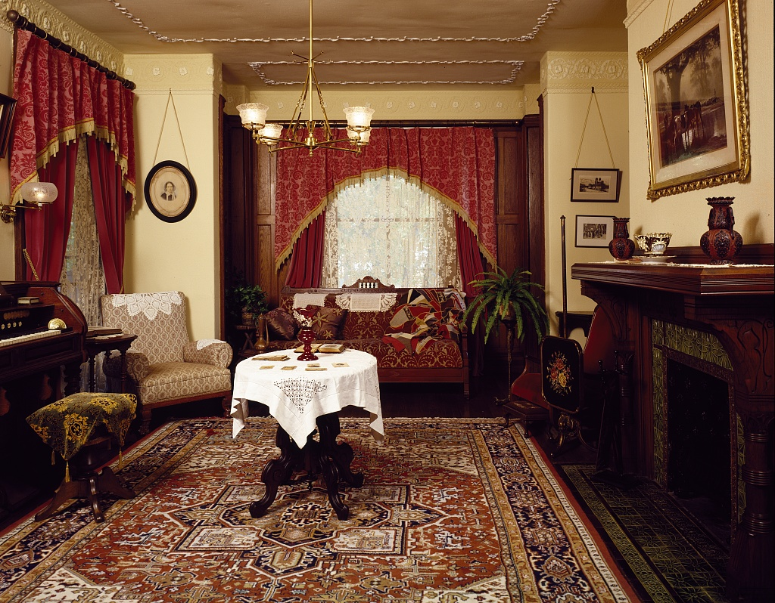

Slide 18
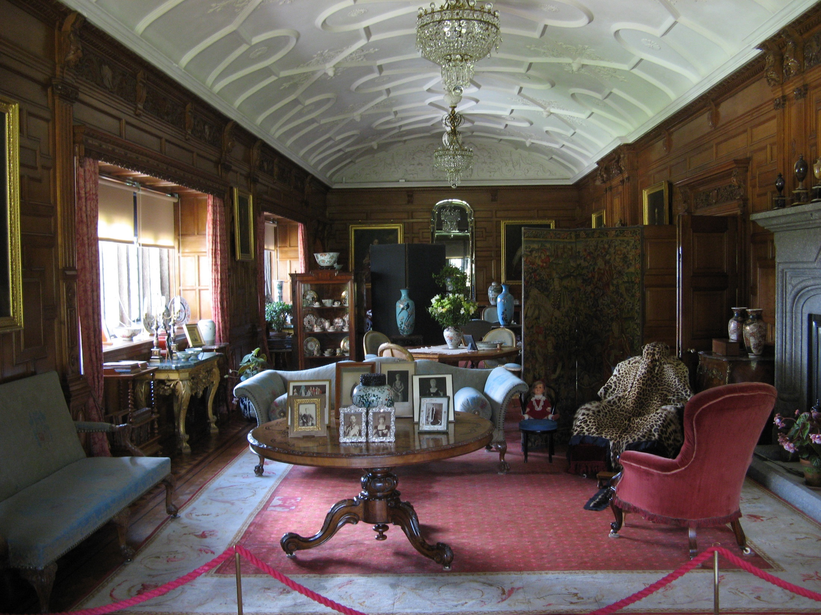

Slide 19
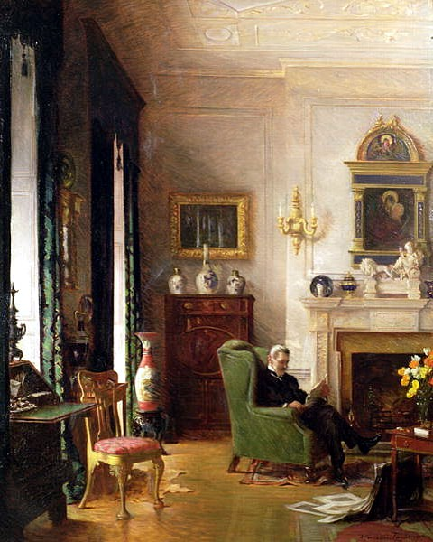

Slide 20
Women
Separate Spheres – “The Angel in the House”
Coverture (married women – femme couverte)
  Property, wealth, income
  Children
  Divorce
Respectability and morality
Sexual purity
Fashion

Slide 21
1890s fashion
Women
  High necks / collars
  Leg o’mutton sleeves
  Long corsets
  “wasp” waist / hourglass figure
  Hats with exotic feathers / plumes
Men
  Suits with blazers and waistcoats
  Tuxedos and dinner jackets for formal events
  Ties
  Top hats and bowlers

Slide 22
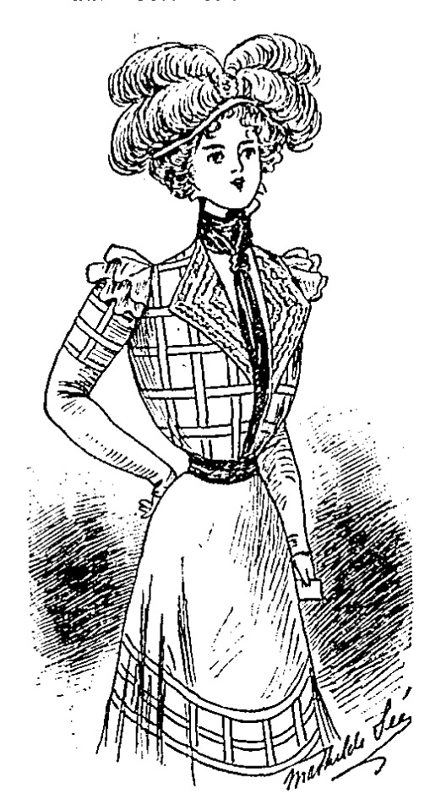
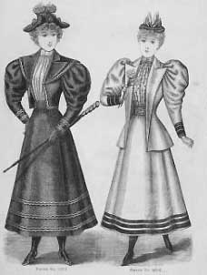

Slide 23
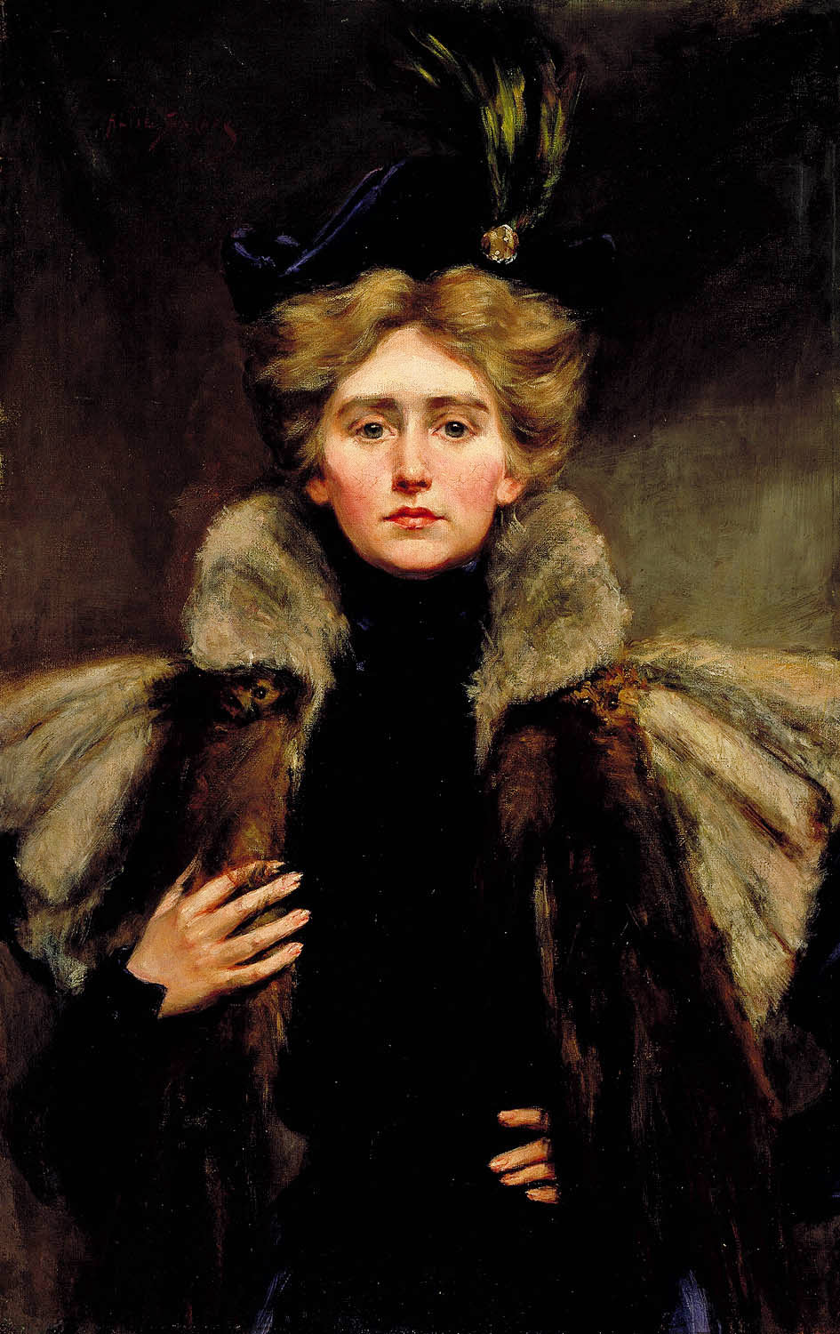
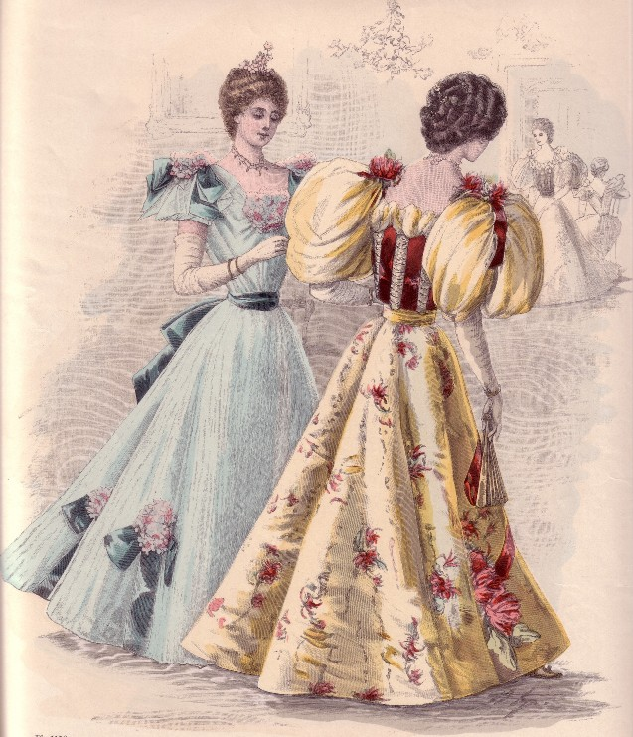

Slide 24
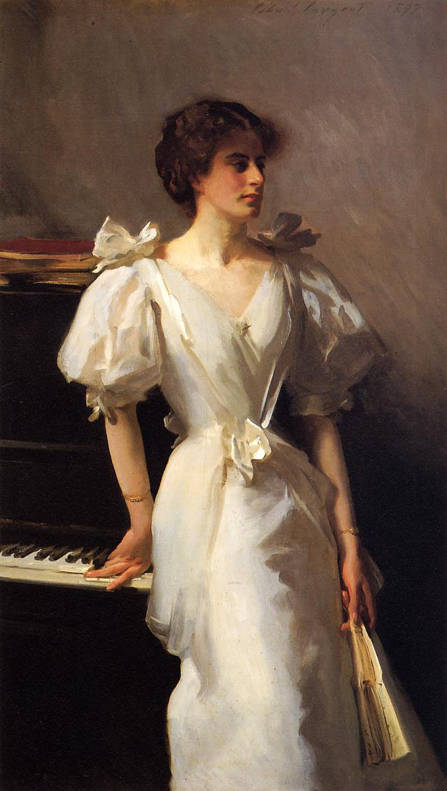
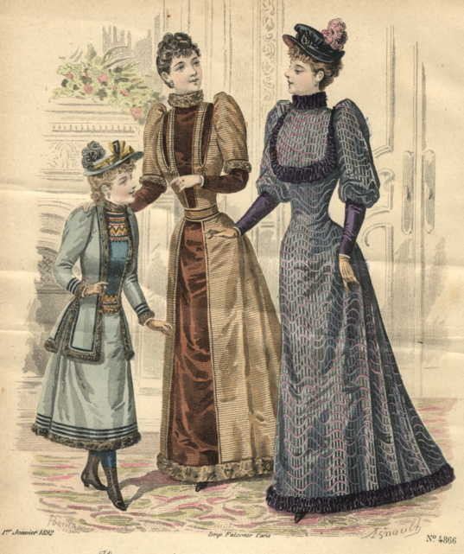

Slide 25
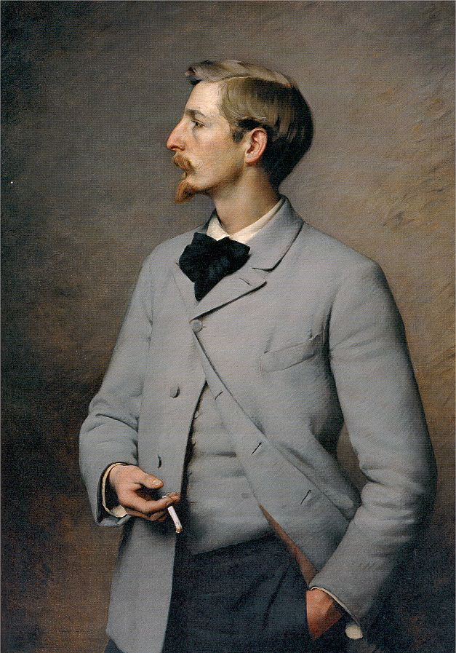
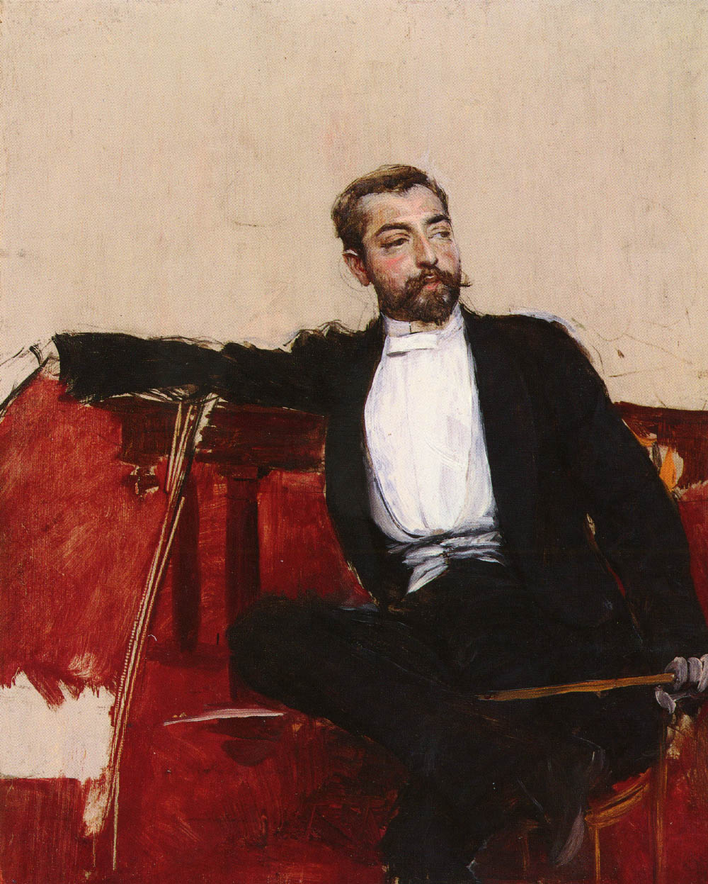
Attitudes

Slide 26
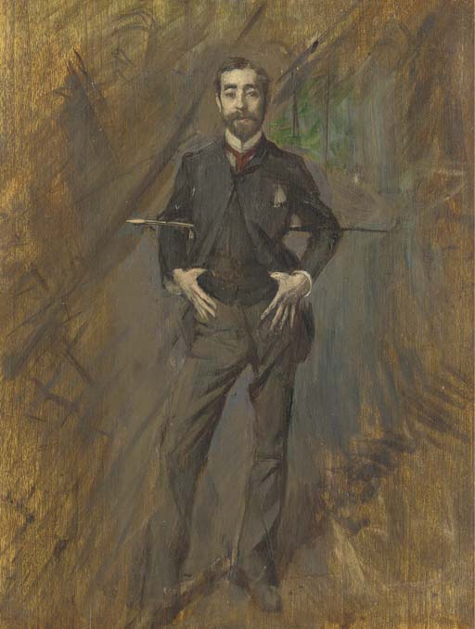
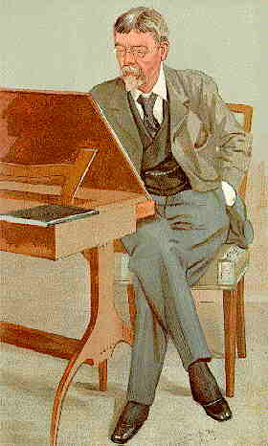

Slide 27
Etiquette
Don’t mention anything controversial in front of the servants, lest they gossip.
Ladies should never offer their hand to a man they do not know or are not close to.
Men and women should avoid touching each other, unless married, related, or in an emergency. He also should not touch the chair she is sitting in.
Ladies do not smoke.
Stand up when someone enters the room, especially if they are older or higher status. (Servants don’t count.)
Men should take off their hat when entering a room where ladies are present.
Wear appropriate clothing for each meal or event.
Dress according to your class / position.

Slide 28
A single man and a single woman should never be left alone in a room together – they must always be chaperoned.
A mutual friend must make introductions for any gentleman who wishes to become acquainted with a single lady.
Small talk is all that is necessary for polite conversation. Serious discussion is for more private settings.
Kissing is limited to the hand, or perhaps the forehead, or even the cheek for married couples, in public.
Don’t mention body parts, anything connected with sex or pregnancy, foul language, upsetting or disgusting topics.
Be humble – do not boast or brag.
Ladies do not ask men to dance.
Control your emotions.

Slide 29
The Time of Reforms

Slide 30

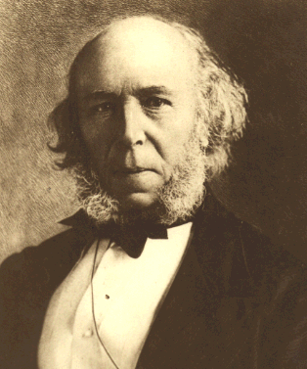
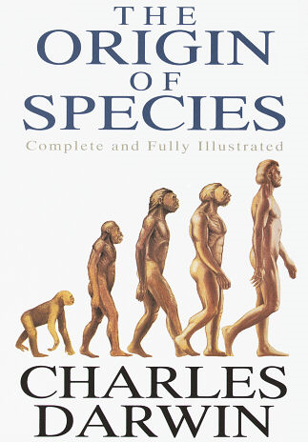
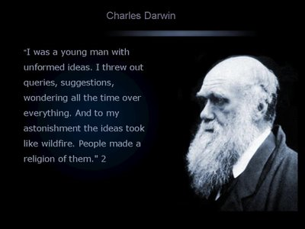
Social Changes
Herbert Spencer

Slide 31
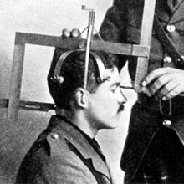
Using Darwinism to fix Social Problems?
Herbert Spencer Applied Darwinism to human society
As in nature, survival properly belongs to the fittest, those most able to survive.
Social Darwinism was used by many Victorians to justify social inequalities based on race, social or economic class, or gender
“survival of the fittest”

Slide 32
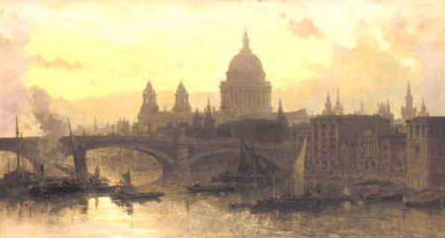
The Mid-Victorian Period (1848-1870)
A time of prosperity
A time of improvement (more reforms)
A time of stability
A time of optimism

Slide 33
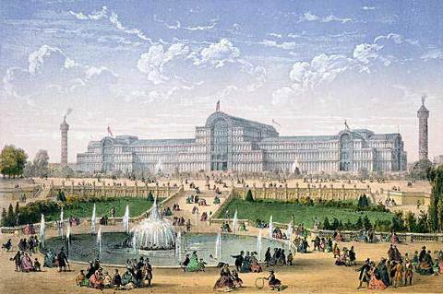
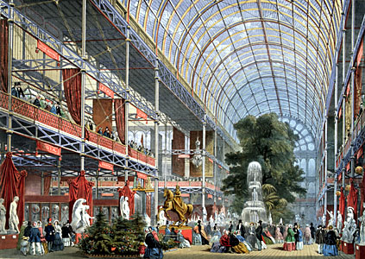
The Crystal Palace
Erected to display the exhibits of modern industry and science
at the 1851 Great Exhibition
The building symbolized the triumphs of Victorian industry

Slide 34
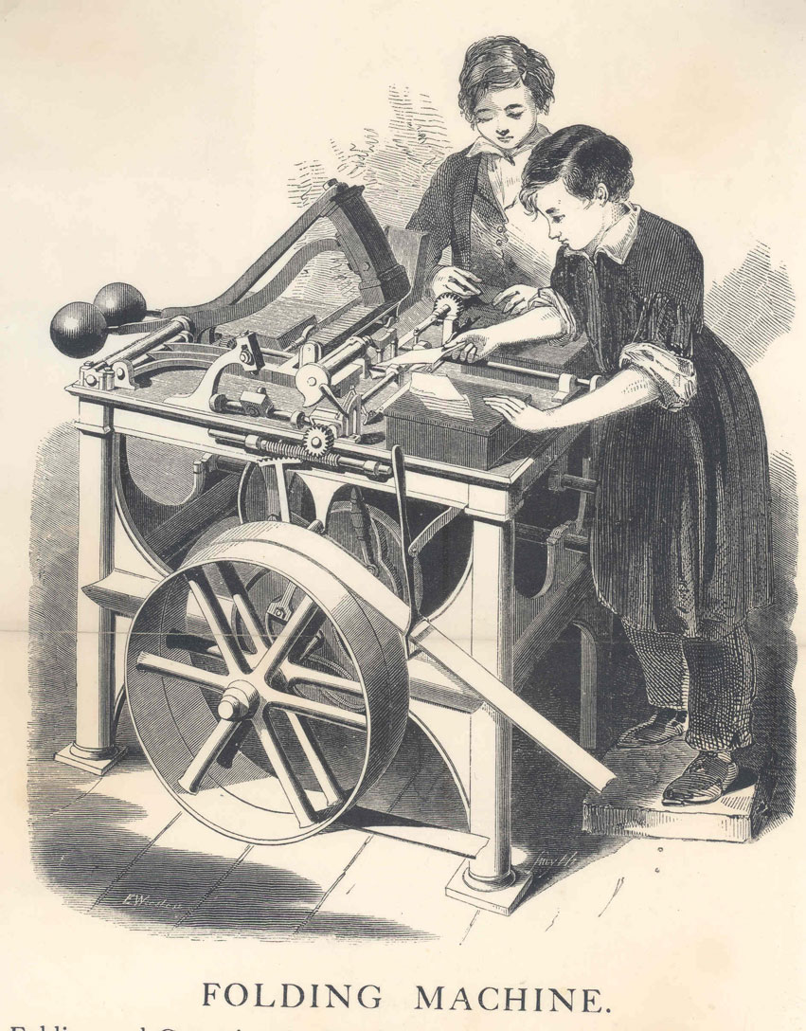
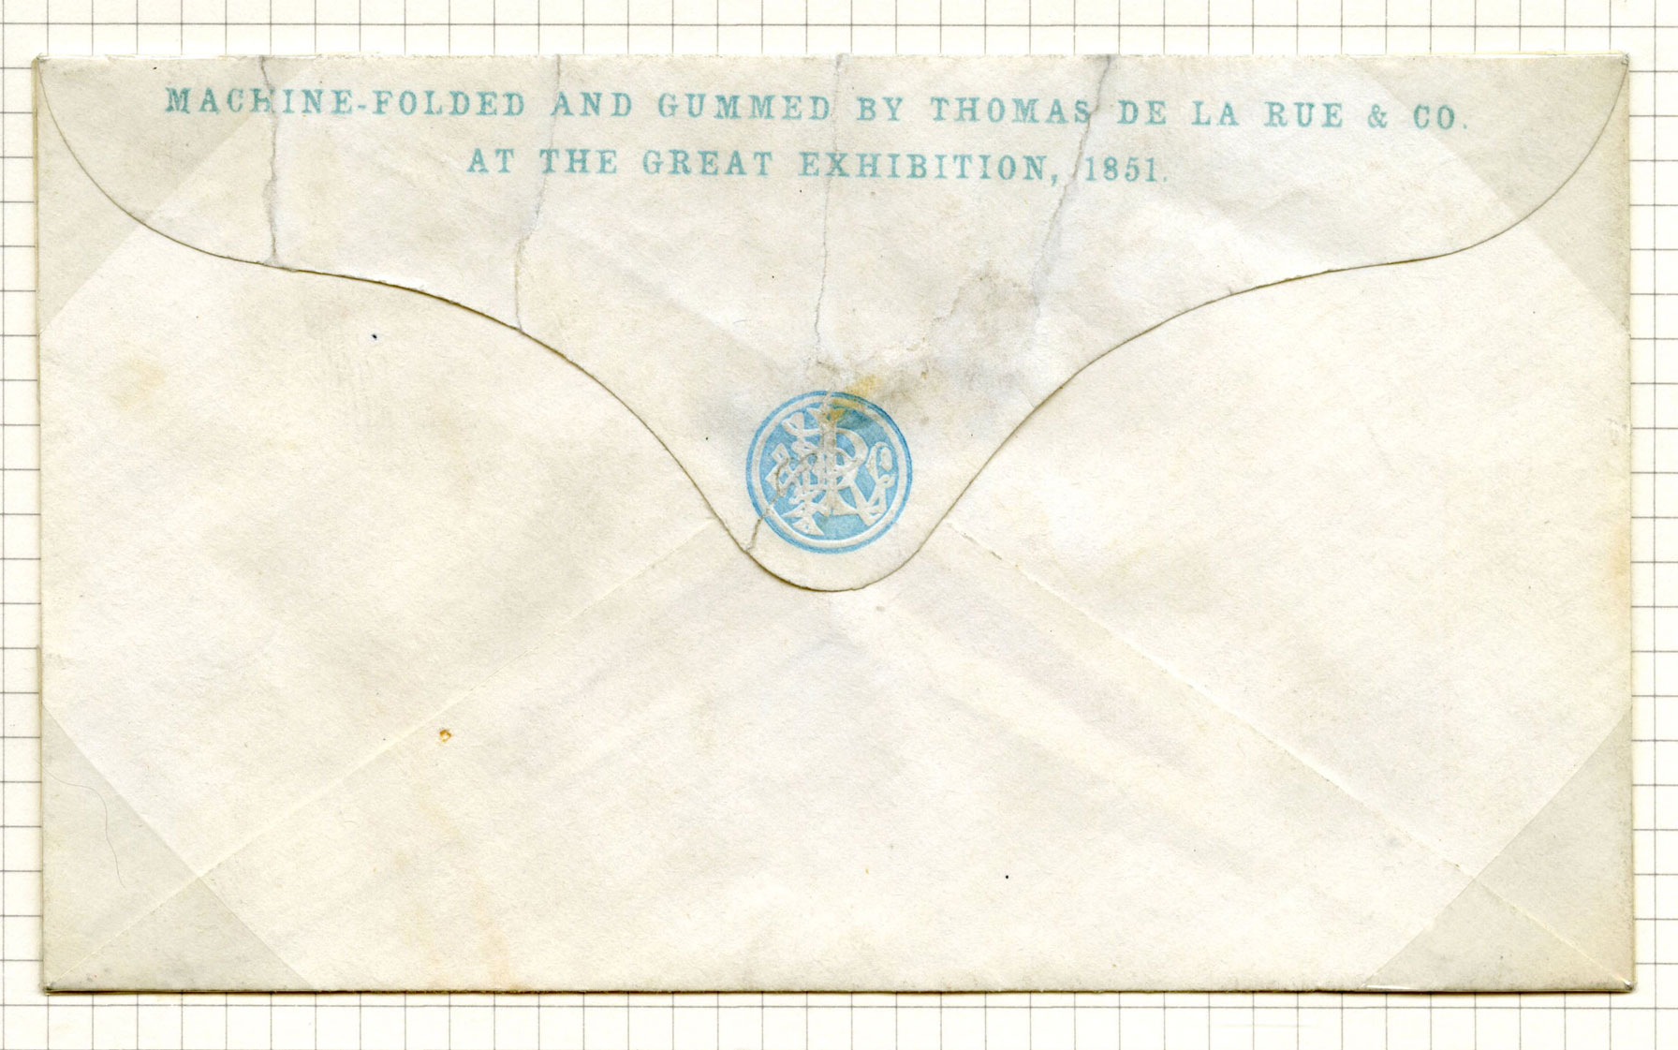
“It is a very remarkable thing in itself; but to have so very large a building continually crammed down one’s throat, and to find it a new page in ‘The Whole Duty of Man’ to go there, is a little more than even I (and you know how amiable I am) can endure,” Dickens wrote.

Slide 35
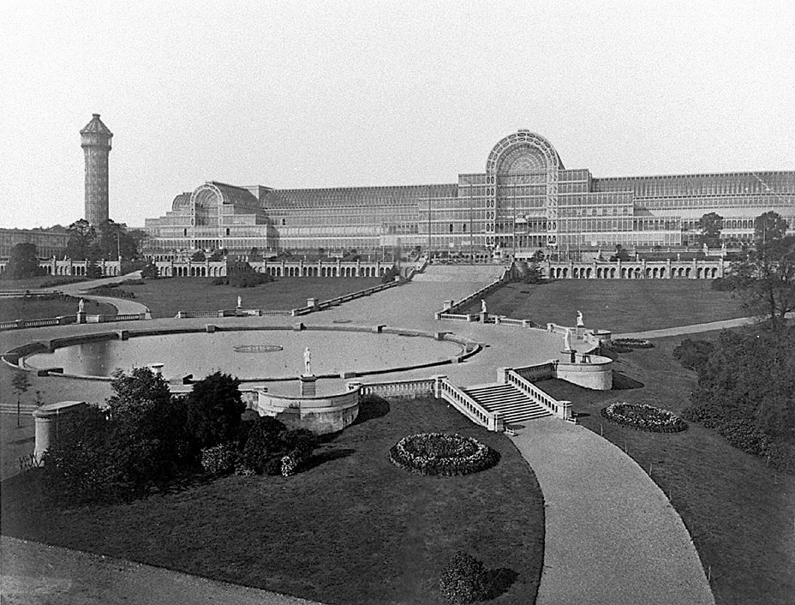

Slide 36
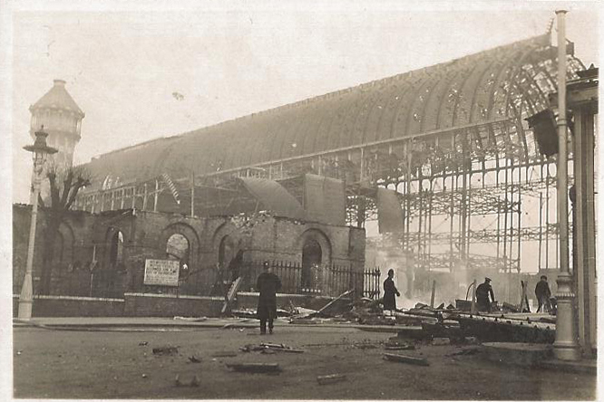

Slide 37
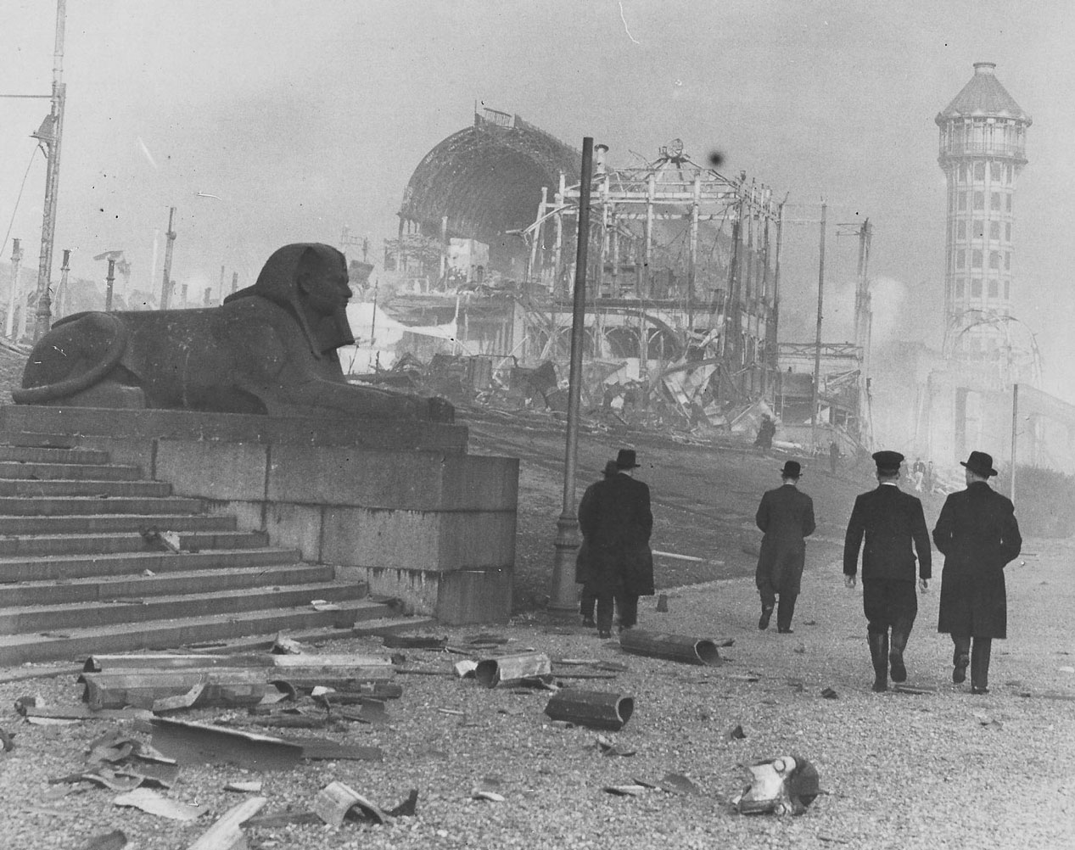

Slide 38
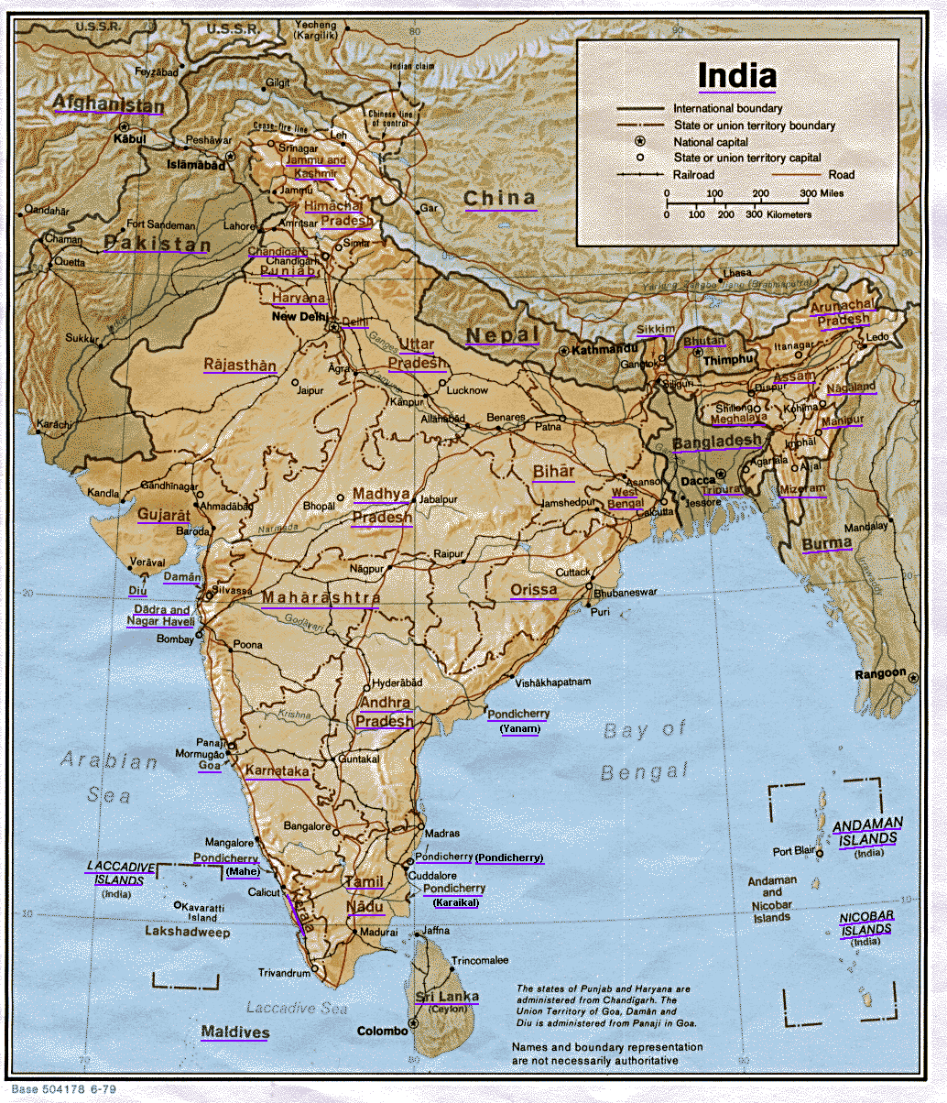
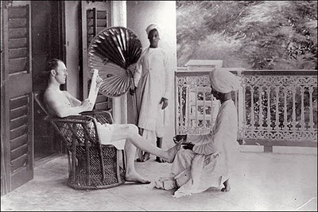
The British Empire
Many British
people saw the expansion of
empire as a
moral
responsibility to
civilize the world.
Missionaries spread Christianity in India,
Asia, and Africa.
“White Man’s Burden”

Slide 39
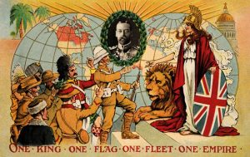

Slide 40
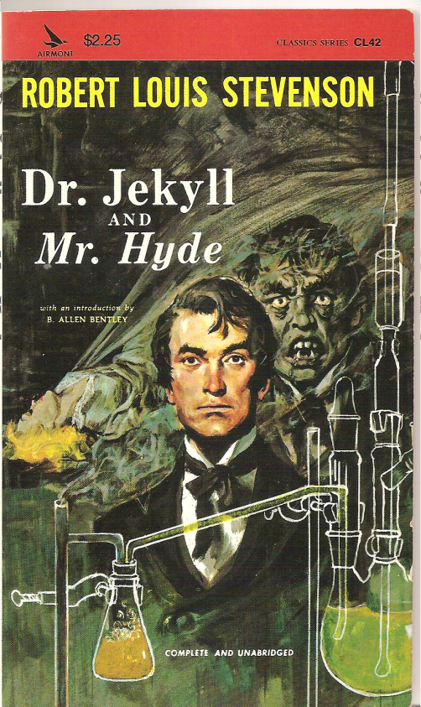
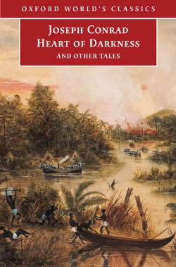


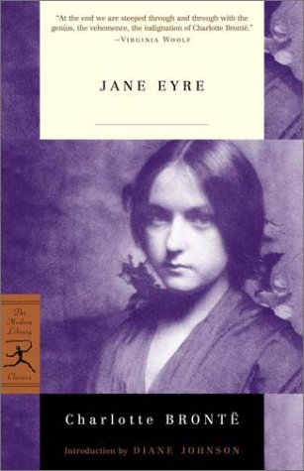
The Victorian Novel
1899
1886
The novel was the dominant form in Victorian literature
Some dealt with
the social anxieties of the day.
(technology, work, social class, welfare)
1848
1838

Slide 41
