Slide 1
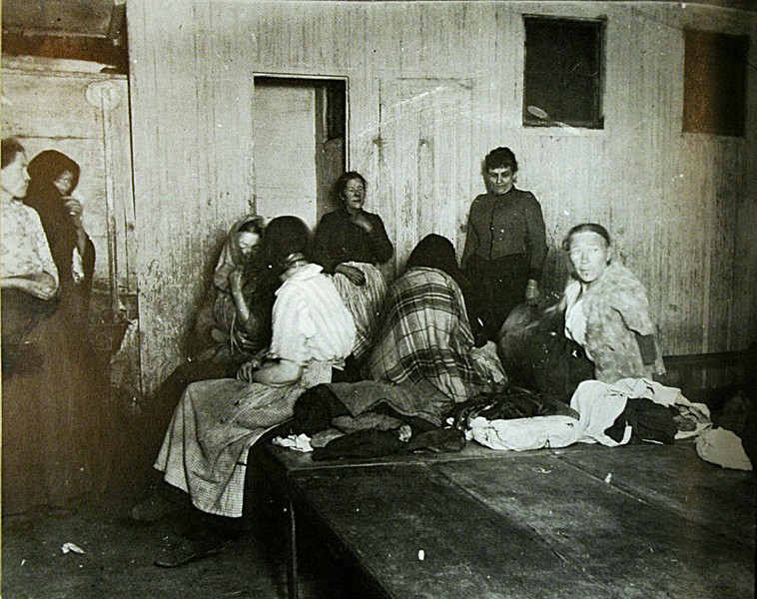
Late 1800s to
Early 1900s
The Progressive Era
Attempting to Fix
America's Problems
AIM: What were the beginning ideas of the Progressive Era?
Do Now: Take a quiz. You have 5-7 Minutes

Slide 2

Progressives
Sought to solve problems created by industrial and urban growth
Many were part of a growing middle class (had time and money)
Looked to solve social problems and injustices.

Slide 3
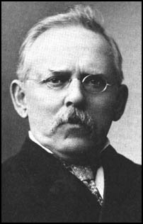
Muckrakers
Journalists who wrote or photographed problems in society
Wanted to “stir the muck”
so people noticed it
Jacob Riis Took pictures of tenements – broken down apartment buildings
Wrote: How the Other Half Lives Focused on poor families living conditions
Jacob Riis

Slide 4
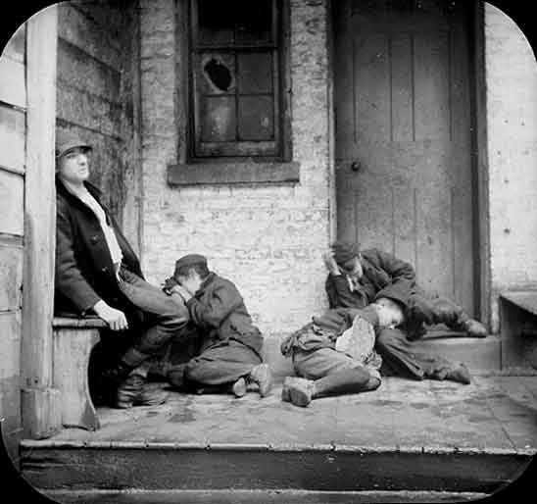

Slide 5
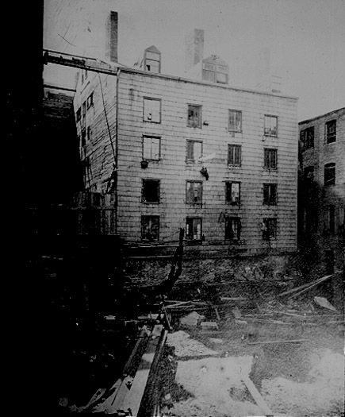

Slide 6
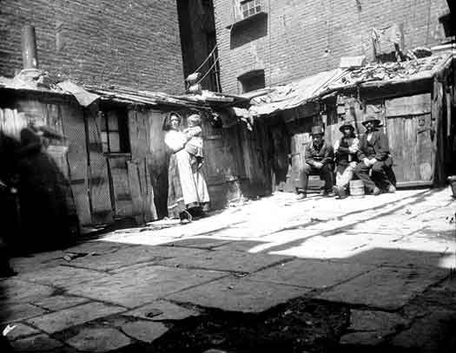

Slide 7
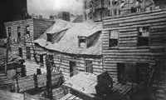

Slide 8
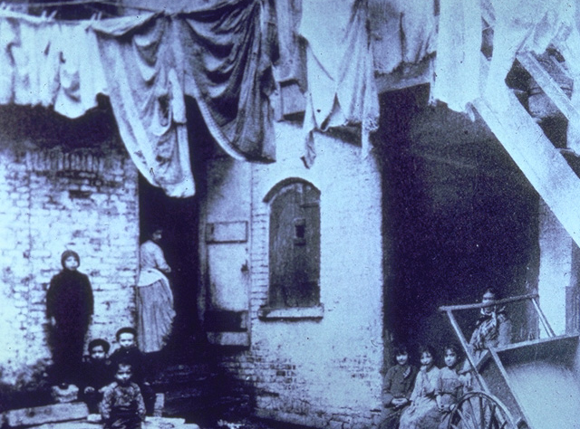

Slide 9
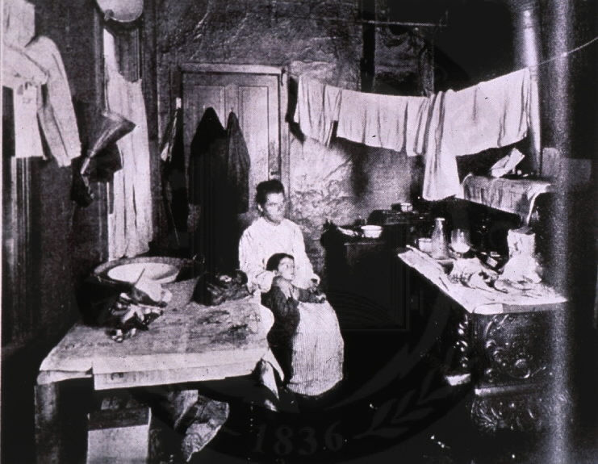

Slide 10
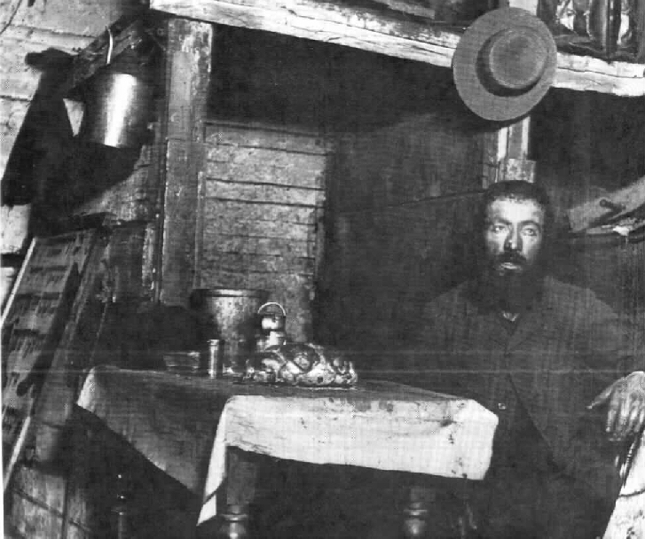

Slide 11
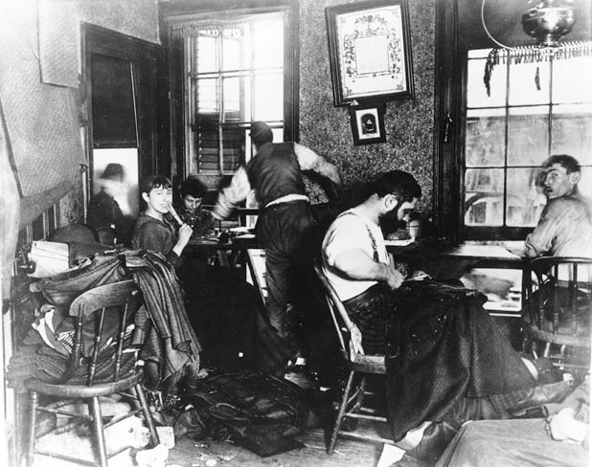

Slide 12
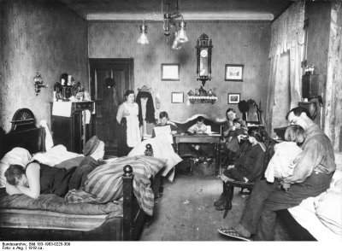

Slide 13
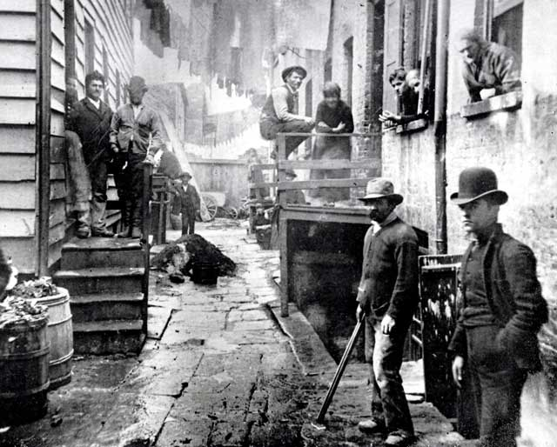

Slide 14
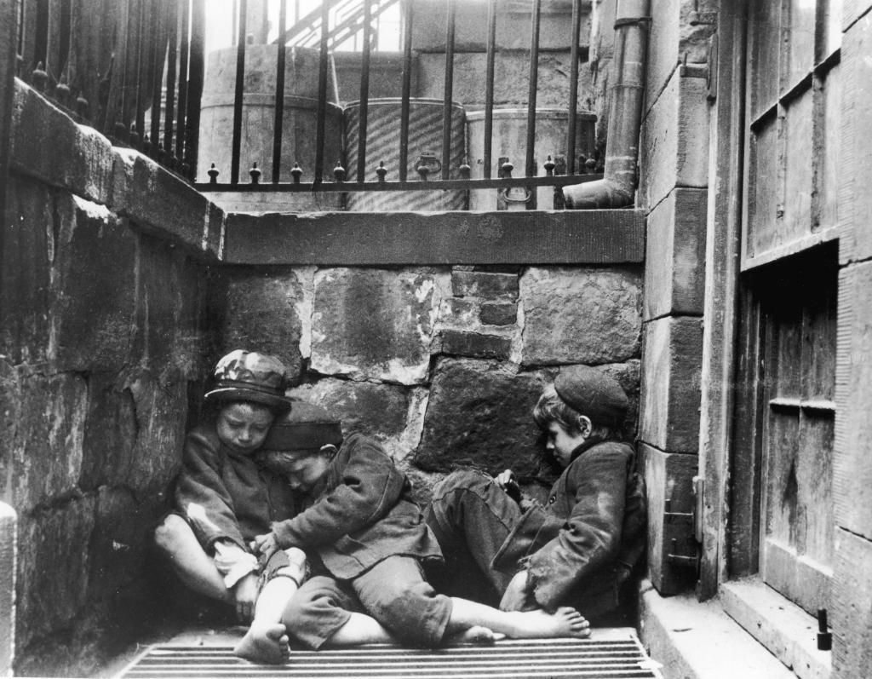

Slide 15
