Slide 1
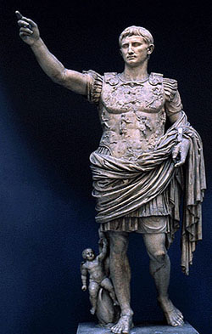
The Fall of the Roman Empire
AIM: How did the greatest civilization on Earth (at the time) come to an end? Or did it?
Do Now: What is a barbarian?
Mr. Ott @ BETA - 2010

Slide 2
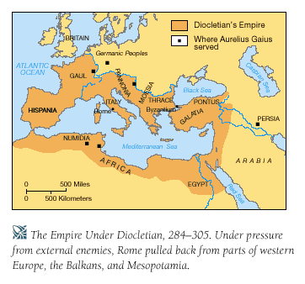
The Roman Empire at its Height
The Roman Empire became huge
It covered most of Europe, North Africa, and some of Asia
The Empire reached its height under Emperor Diocletian (284-305 CE)

Slide 3

Expansion: Good or Bad?
What are some problems that an empire or country might have by being stretched out too far?

Slide 4
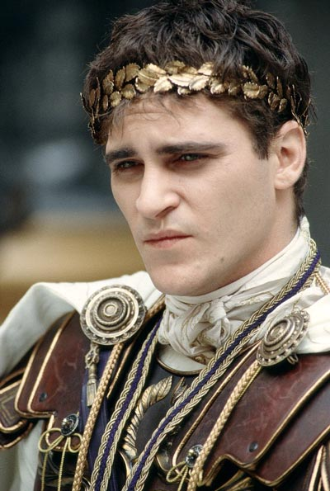
The Decline Begins
180 CE Marcus Aurelius died
His son, Commodus, took control of Rome
Commodus was a poor leader, killed by his bodyguard
Time of disarray follows
Commodus from the
movie Gladiator

Slide 5

Political Problems
Poor leaders weakened the government
Frequent fights for power
Many officials took bribes
Talented people chose not to serve due to dangers of government life

Slide 6
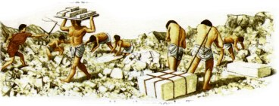
Social Problems
Taxes were too great, many rich people stopped paying
People stopped attending school
Large number of people enslaved
Plague (disease) spread throughout Rome, killing 1 in 10
Famine: There was not enough food to feed people

Slide 7
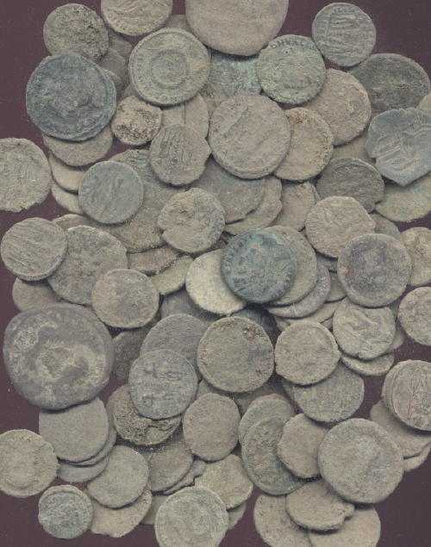
Economic Problems
Farmers lost land, unable to grow and sell crops, out of work (and famine)
People bought fewer goods, shops closed
Inflation occurred: Rapidly rising prices. Money lost value because fewer taxes paid.
Coins lost value: Less gold put in, people found out (caused inflation)
Bartering grew: sell goods without using money
No taxes, no money

Slide 8
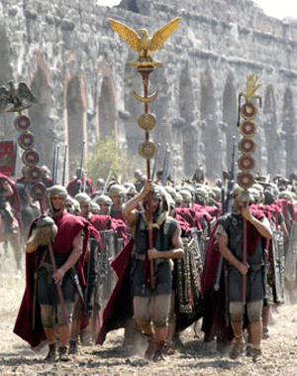
Military Problems
Military only in it for money (mercenaries)
No money to pay military = weak military
Constant threat of invaders on empire’s borders
Weak military, unable to stop border invasions

Slide 9
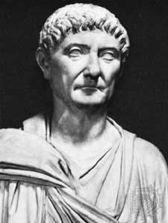
Diocletian
284 CE, Diocletian became emperor
Tried reforms (political changes)
Set price limits (if a person went beyond limits, put to death) and ordered workers to stay in jobs to death

Slide 10
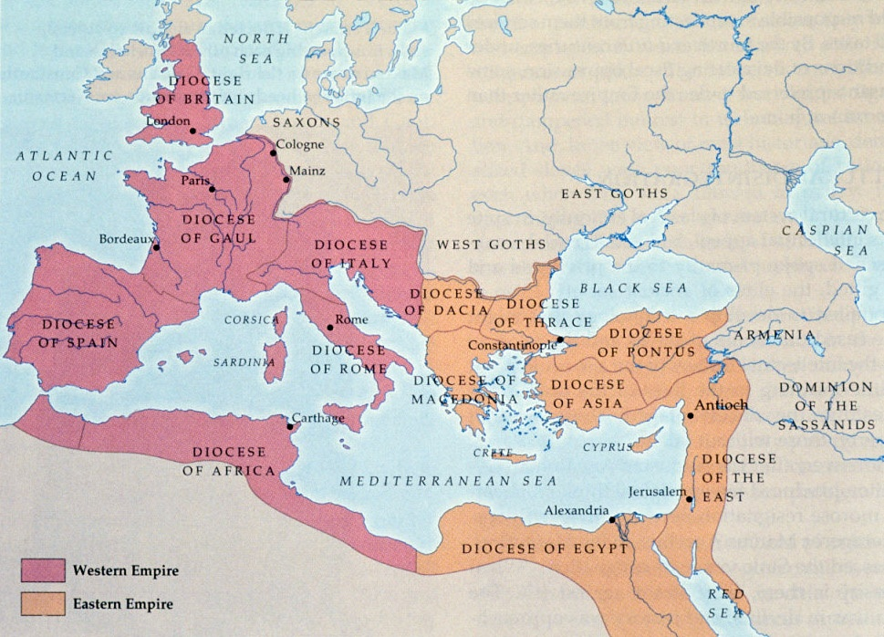
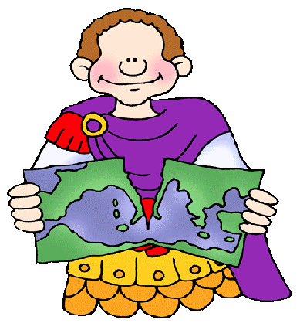
Dividing the Empire
Diocletian felt that the only way to save the empire was to divide it in half
Created two empires: Western and Eastern
Western Empire: Europe/ North Africa and city of Rome
Eastern Empire: Turkey/ Asia and city of Byzantium
Two emperors, emperor in charge of Rome was senior

Slide 11
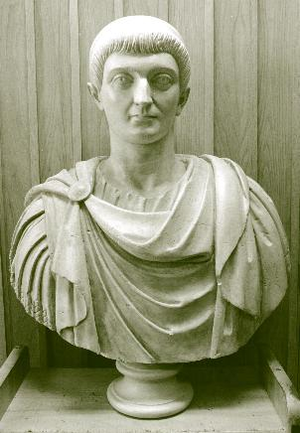
Constantine
Diocletian retired and Constantine took his place as emperor
Constantine (312 CE) united the empire again under one ruler
First Christian emperor
Edict of Milan?
Attempted reforms
Main reform: sons had to follow fathers’ trade

Slide 12
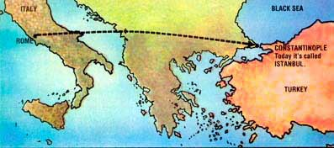
Constantinople
Rome continued to decline
Constantine moved the capital from Rome to city of Byzantium
City name changed to Constantinople (today is Istanbul)

Slide 13
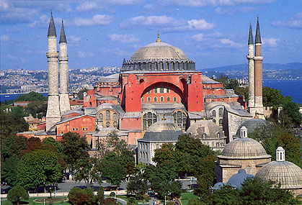
Current Day

Slide 14


Slide 15
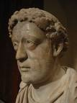
Theodosius
Constantine died in 337 CE, replaced by Theodosius
Theodosius could not rule the empire, divided in two again
Western Roman Empire with capital in Rome
Eastern Rome Empire with capital in Constantinople

Slide 16
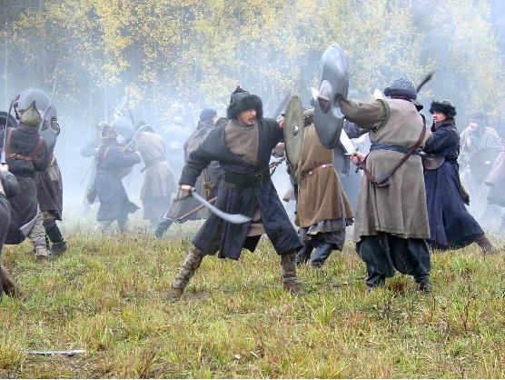
Rome invaded
Western Empire unable to hold off German tribes on its borders
Ostrogoths, Visigoths, Franks, Vandals, Saxons
German tribes wanted warmer area, Roman riches, and to flee the Huns

Slide 17
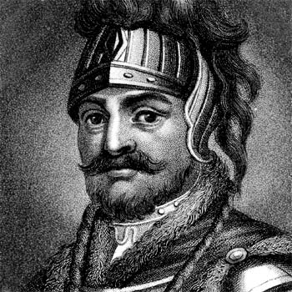
Visigoths
Rome agreed to allow the Visigoths to live inside of Roman boundaries
Romans treated Visigoths badly
Visigoths rebelled and defeated the Romans
Visigoth leader, Alaric, captured Rome in 410 CE

Slide 18
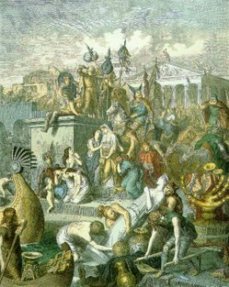
Vandals
Vandals followed Visigoths and spent 12 days stripping Rome of valuables (vandalism)
Many more German invaders followed
Finally, a German general named Odoacer defeated the western emperor Romulus Augustulus (14 years old, little Augustus)

Slide 19
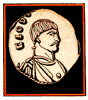
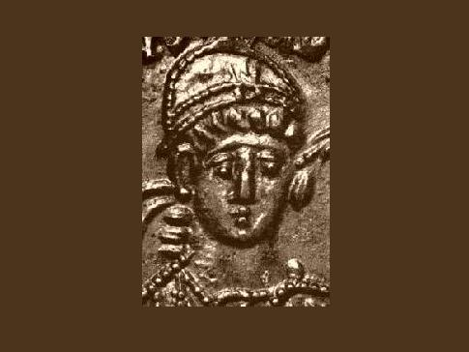
The Fall
Augustulus was defeated in 476 CE
For this reason, this date is given as the fall of the Western Roman Empire
Western Empire was divided into many kingdoms that adopted many of the customs of Rome

Slide 20
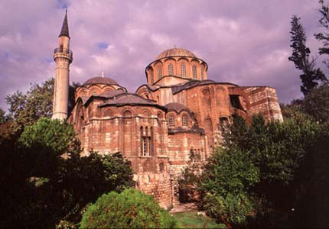
Eastern Roman Empire
Although the Western Empire fell in 476 CE, the Eastern Roman Empire continued to prosper for 1,000 more years
Became known as the Byzantine Empire

