Slide 1
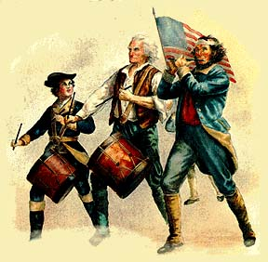
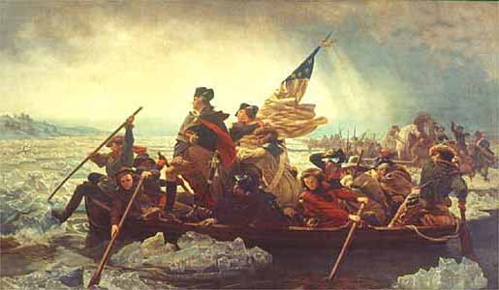
Causes of the
American Revolution
Aim: Why did the 13 Colonies want Independence?
Do Now: Map Quiz #1

Slide 2
Review & Background
The popular idea of the time was that colonies existed for the benefit of the Mother Country. The American colonists could be compared to tenants who were expected to 'pay rent', i.e., provide materials for export to Britain. Britain's goal was to have a greater number of exports than imports allowing them to store up wealth in the form of gold.
This economic plan was called?
According to this idea, the wealth of the world was fixed. To increase wealth a country had two options: explore or make war. By colonizing America, Britain greatly increased its base of wealth.
Mercantilism

Slide 3
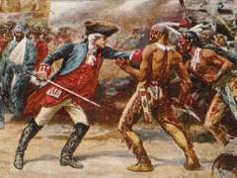
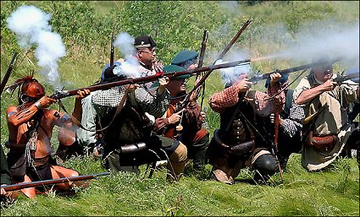
Cause: French & Indian War
This war between Britain and France lasted from 1754-1763.
The victorious British ended the war deeply in debt and demanded more revenue from the colonies.
With the defeat of the French, the colonies became less dependant on Britain for protection.

Slide 4

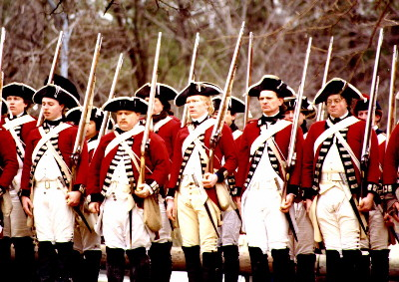
Causes: Parliament Acts
Sugar Act of 1764
This act passed to raise revenue by increasing duties on foreign sugar imported from the West
Indies.
Quartering Act of 1765
Britain ordered that colonists were to house and feed British soldiers if necessary.
Stamp Act
This required tax stamps on many different trade items and documents including playing cards, legal papers, newspapers and marriage licenses. Prime Minister George Grenville stated that this direct tax was intended for the colonies to pay for defense. Previous taxes imposed by Britain had been indirect, or hidden.

Slide 5
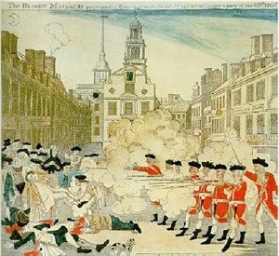
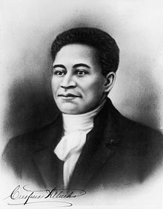
Cause: Boston Massacre
Boston Massacre
The colonists and British soldiers openly clashed on Boston green. This event was used by the colonists as an example of British cruelty despite questions about how it actually occurred. March 5, 1770.
Crispus Attucks
He was the first person shot to death by British redcoats during the Boston Massacre, in Boston, Massachusetts. He has been called the first martyr
of the revolution.

Slide 6
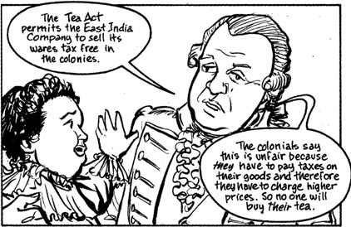
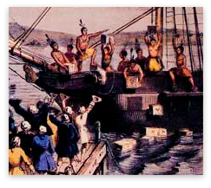
Causes: Tea Act & Boston Tea Party
Tea Act of 1773
To assist the failing British East India Company, the Company was given a monopoly to trade tea
in America.
Boston Tea Party
A group of colonists disguised as Indians dumped the tea overboard from three tea ships in Boston Harbor on December 16, 1773.

Slide 7
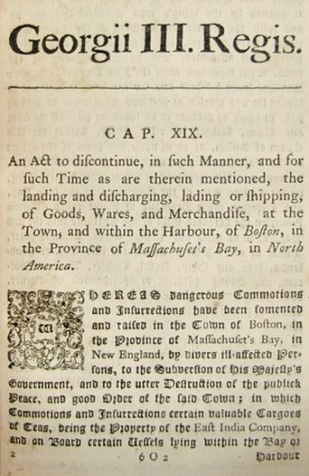
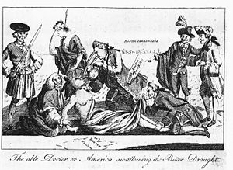
Cause: Intolerable/Coercive Acts
Intolerable/Coercive Acts(1774)
The Intolerable Acts were passed in response to the Boston Tea Party and placed numerous restrictions on the colonists including outlawing town meetings and the closing of Boston Harbor.

Slide 8
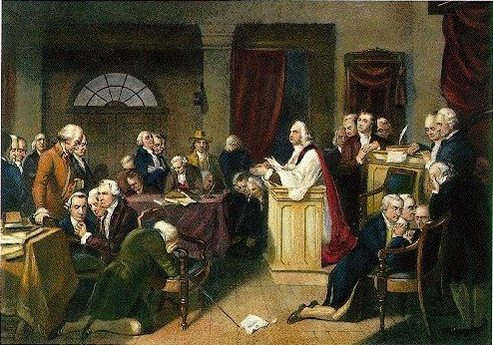
Cause: First Continental Congress
In response to the Intolerable Acts, 12 of the 13 colonies met in Philadelphia from
September-October, 1774. One of the main results of this was the creation of
The Association
calling for a boycott of British goods.

Slide 9
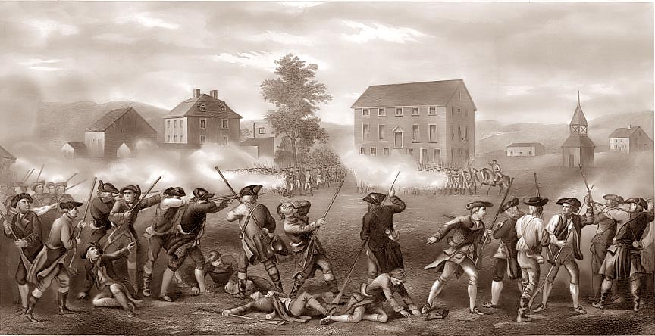
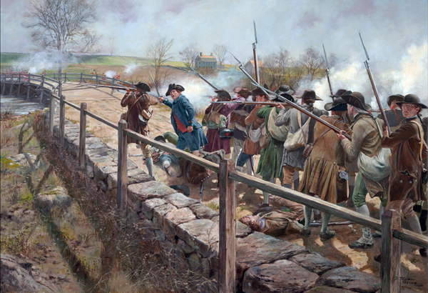
Cause: Lexington and Concord
In April, 1775, British troops were ordered to Lexington and Concord to seize stores of colonial gunpowder and to capture Samuel Adams and John Hancock.
At Lexington, open conflict occurred and eight Americans were killed. At Concord, the British troops were forced to retreat with the loss of 70 men. This was the first event of open warfare.

Slide 10
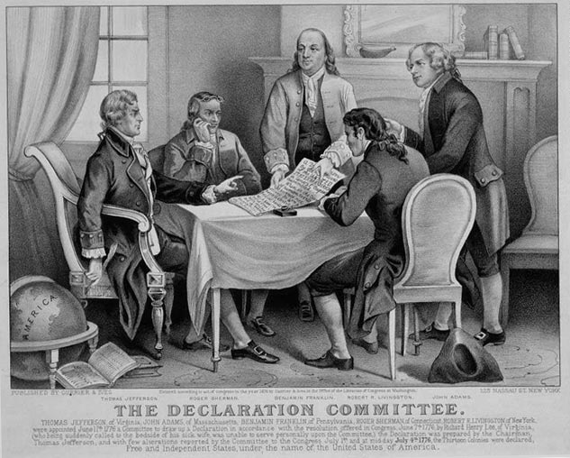
Cause: Second Continental Congress
All 13 colonies were represented at this meeting in Philadelphia beginning May, 1775. The colonists still hoped that their grievances would be met by King George III. George Washington was named head of the Continental Army.
The second Congress managed the colonial war effort, and moved incrementally towards independence, adopting the United States Declaration of Independence on July 4, 1776. By raising armies, directing strategy, appointing diplomats, and making formal treaties, the Congress acted as the de facto national government of what became the United States.

Slide 11
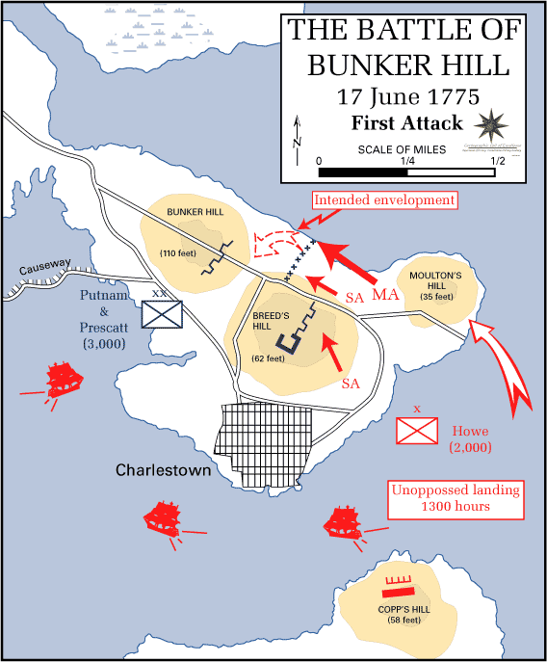
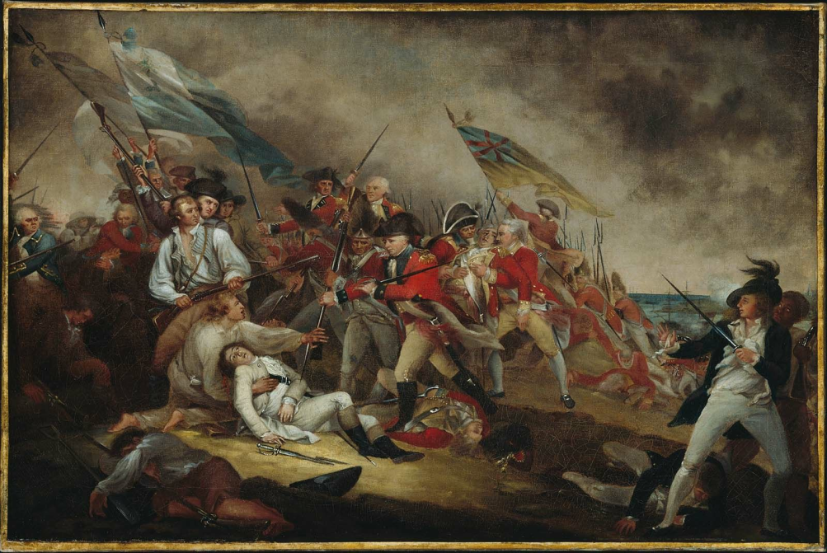
Cause: Bunker Hill
This major victory for the Colonists resulted in George III proclaiming the colonies in rebellion.

Slide 12
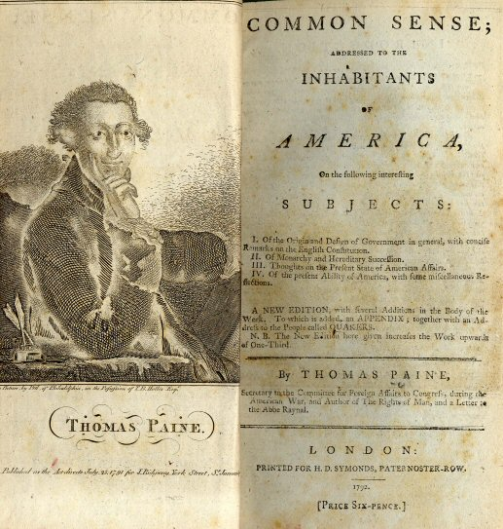
Cause: Thomas Paine's "Common Sense"
Thomas Paine wrote one of the most influential pamphlets ever. Up until then, the colonists had been fighting Britain with the hope of reconciling their differences. Paine argued that America should control itself and become independent.

Slide 13

Revolutionary War in 2 Minutes

