Slide 1
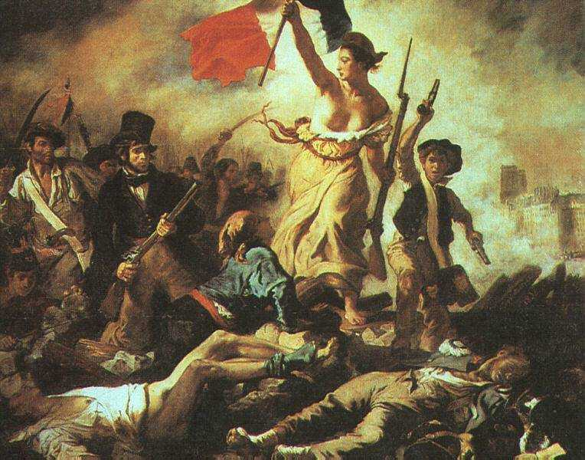
French Revolution
AIM: What were the causes of the French Revolution?
Do Now:
Describe the conditions in France that led to the French Revolution
"Liberty Leading the People“
(Eugene Delacroix, 1830).

Slide 2
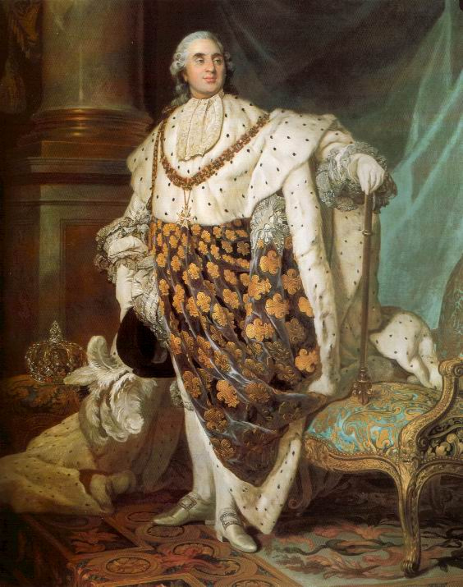
Causes and Attitudes
The Enlightenment
The American Revolution
French system’s lack of change
  Louis XVI clung to Absolutism
  King’s response to the poor
  Class resentment
  Economic problems

Slide 3
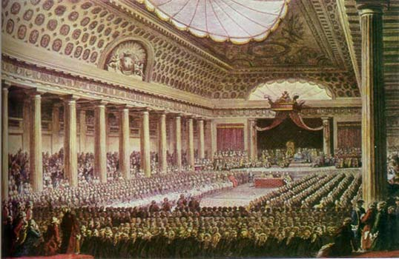
First Stage (1789-1793)
King desired new tax to stabilize economy
King called the Estates General
(3 estates – 3 Classes)
  Not met for 175 years
  Election for representative to meeting in early 1789
Finally met in Spring 1789
  3rd Estate walked out

Slide 4
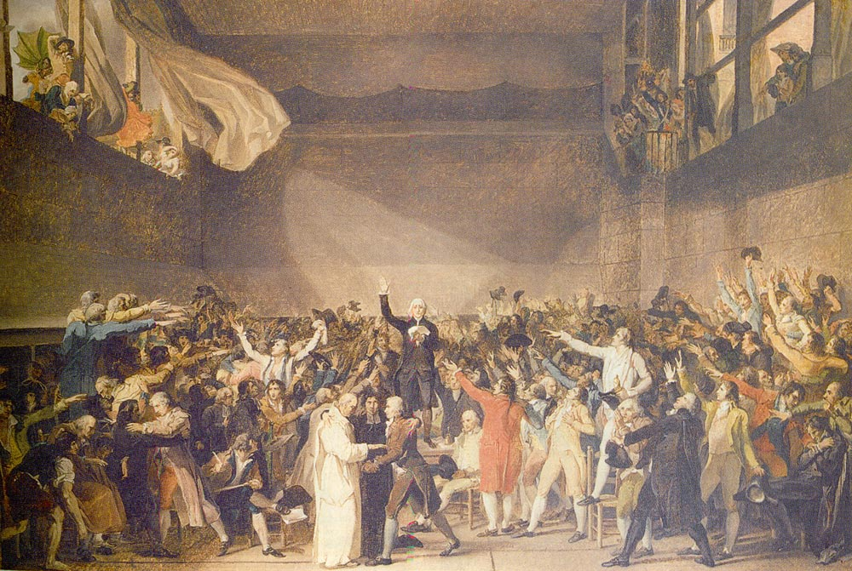
First Stage
National Assembly (1789-1793)
  3rd estate met in indoor tennis court
  Resolved to stay in session until constitution could be written
  Formed municipal (city) government

Slide 5
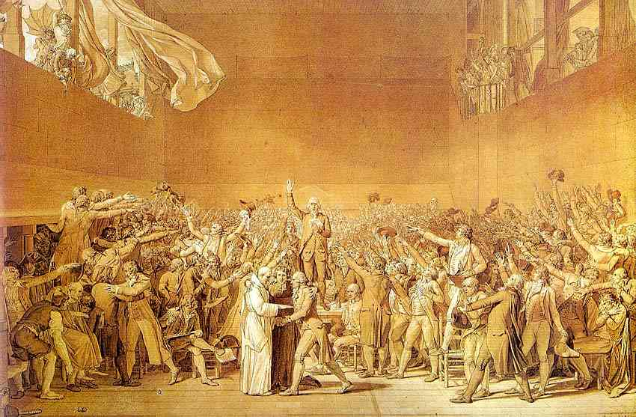

Slide 6
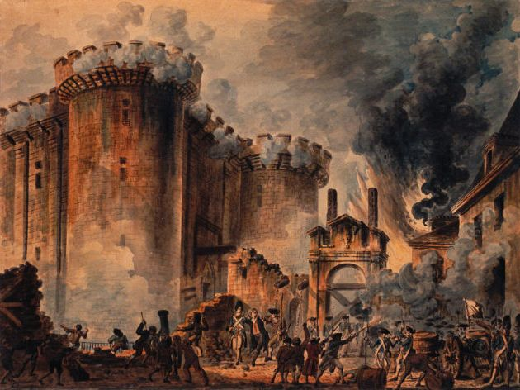
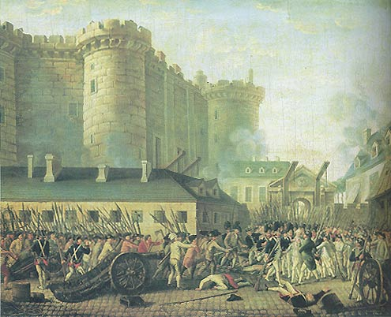
First Stage
Events at Bastille
Prison
  July 14, 1789
  Municipal government trying to get arms
  Only 7 prisoners inside!
Revolts in the countryside

Slide 7
Actions of the
National Assembly
Destruction of privilege (nobility)
Declaration of the Rights of Man
Secularization of the church
New Constitution

Slide 8
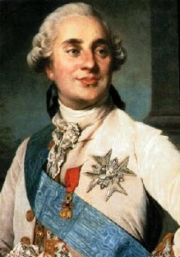
Class Debate
Write a short paragraph on the causes of the French Revolution and how King Louis XVI could have responded to avoid the Revolution.

