Slide 1
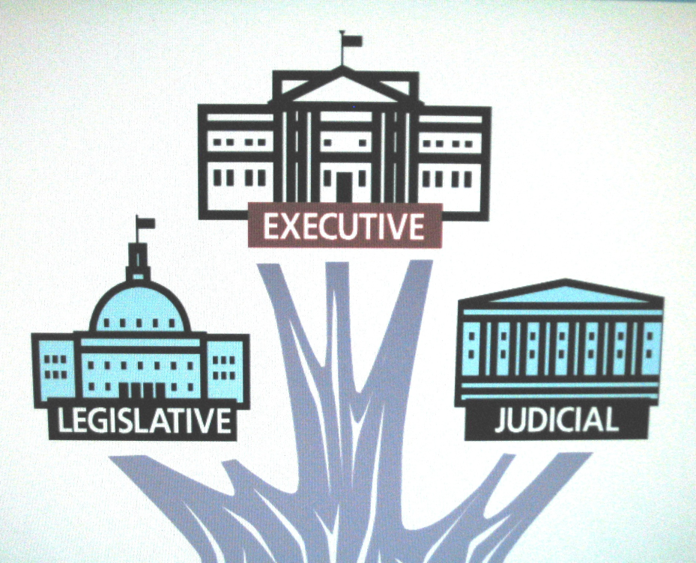
The Three (3) Branches of Government in the U.S. Constitution
AIM: What are the three (3) branches of government in the U.S. Constitution?
Do Now: Name the six (6) Principles of the U.S. Constitution?

Slide 2
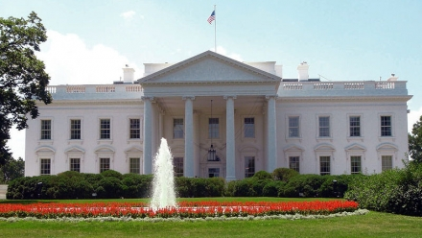
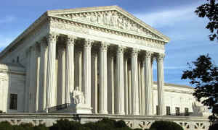
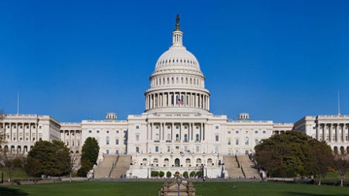
Separation of Powers
No one branch holds “too much” power
Legislative branch makes the laws
Executive branch carries out the laws
Judicial branch interprets the laws

Slide 3
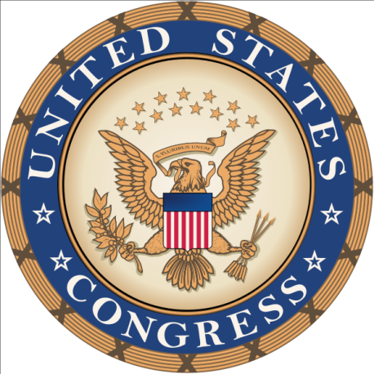
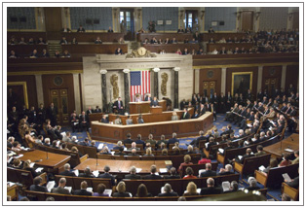
Legislative Branch
Called
U.S. Congress
Senate and House of Representatives
Make our laws
Appropriate Money
Regulate Immigration
Establish Post Offices and Roads
Regulate Interstate Commerce and Transportation
Declare War

Slide 4
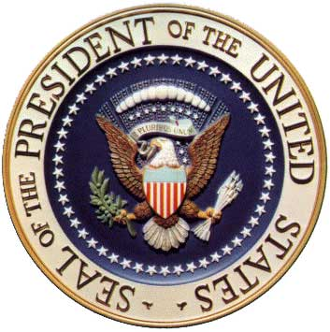
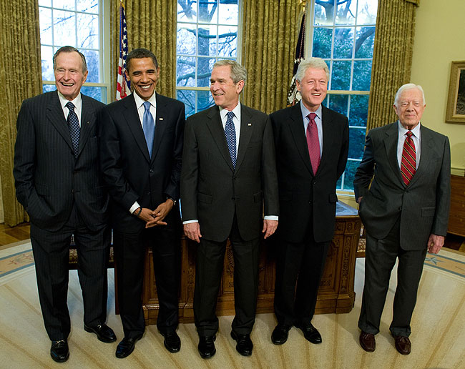
Executive Branch
The President
of the United States
Chief Executive
Chief of State
Chief Legislator
  Signs Bill into Law or
  Veto (Rejects) Bill
Commander in Chief
of the Armed Forces

Slide 5
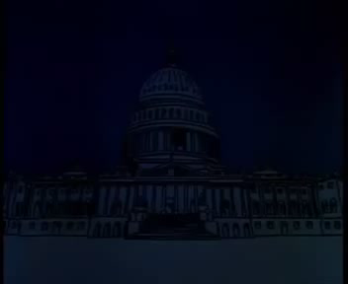

Slide 6
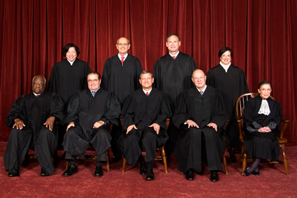
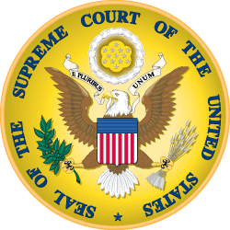
Judicial
Branch
Supreme Court and other Federal Courts
Preserve and protect the rights guaranteed by the Constitution
Considers cases involving national laws
Declares laws and acts “unconstitutional”

Slide 7
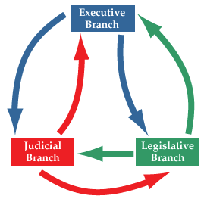
Checks and Balances
Prevents the abuse of power in government
Each branch can check each other branch

Slide 8

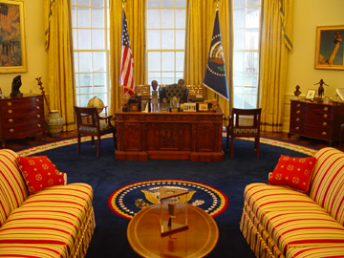
Executive Checks
Propose laws to Congress
Veto laws made by Congress
Negotiate foreign treaties
Appoint federal judges
Grant pardons to federal offenders

Slide 9
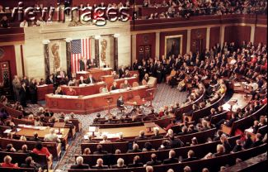
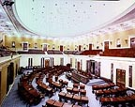
Legislative Checks
Override president’s veto
Ratify treaties
Confirm executive appointments
Impeach federal officers and judges
Create and dissolve lower federal courts

Slide 10
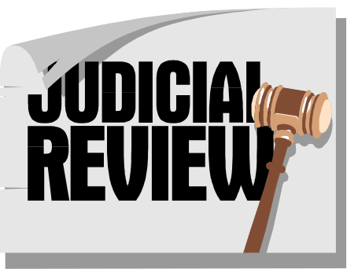
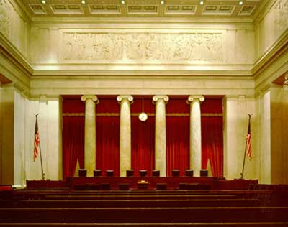
Judicial Checks
Declare executive acts unconstitutional
Declare laws unconstitutional
Declare acts of Congress unconstitutional
The Supreme Court holds the final check

