Slide 1
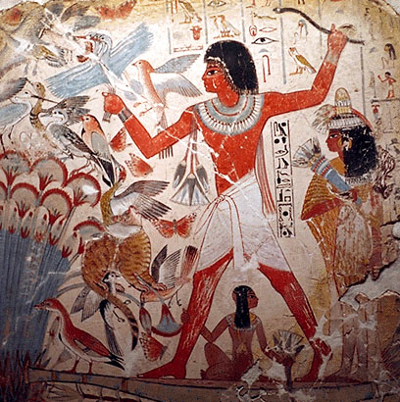
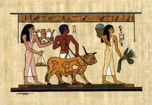
Do Now: Worksheet
AIM: What was life like in Ancient Egypt?

Slide 2
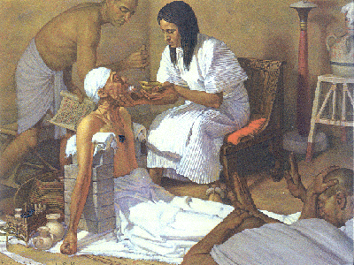
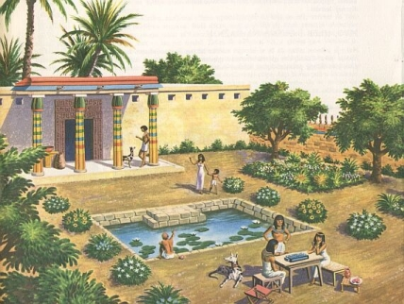
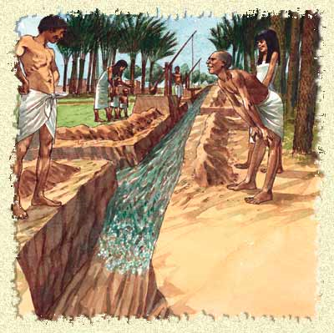
Daily Life In Egypt
The Social Pyramid

Slide 3
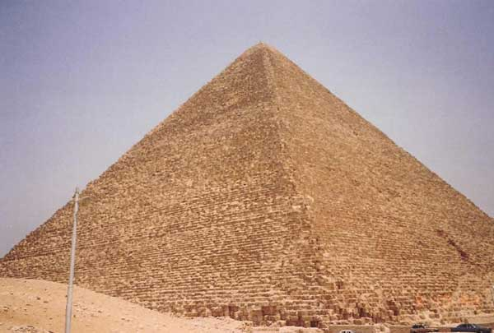
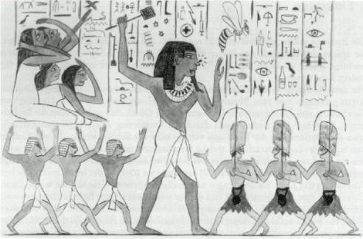
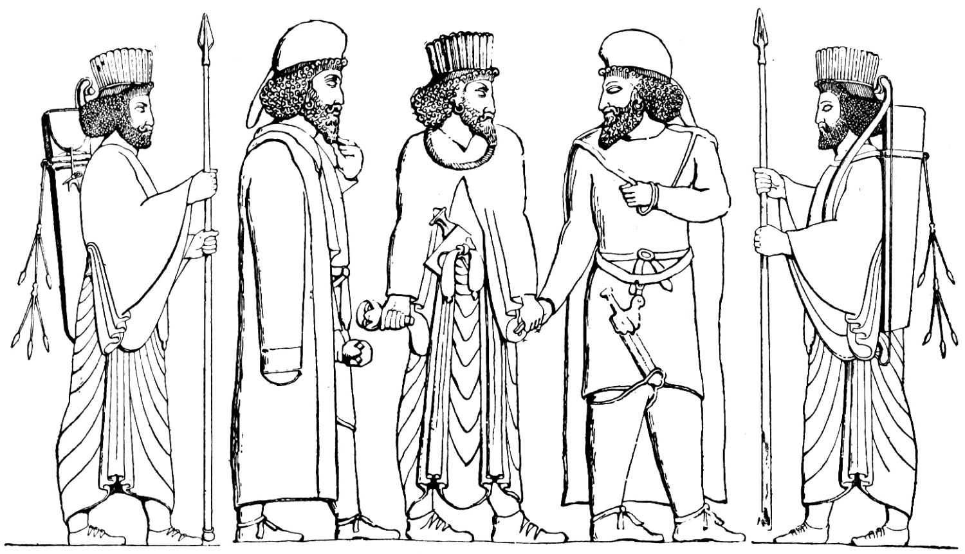
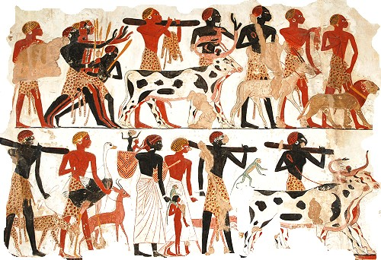
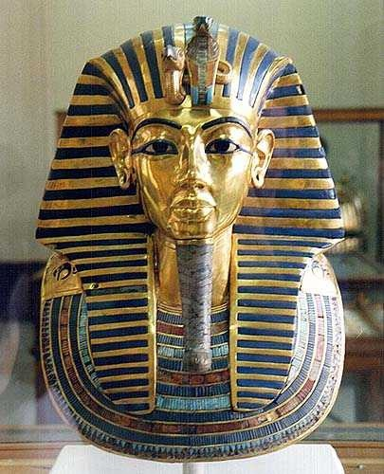
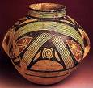

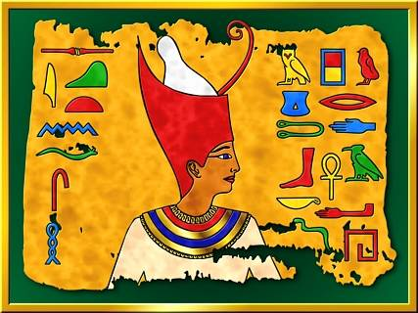
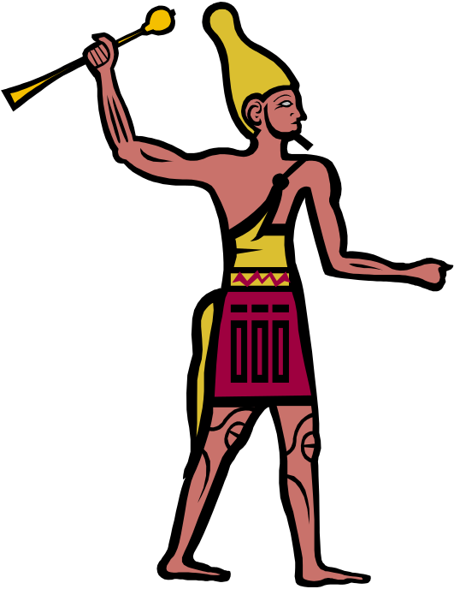
Pharaoh
Government Officials
Soldiers
Scribes
Merchants
Artisans
Farmers
Slaves

Slide 4
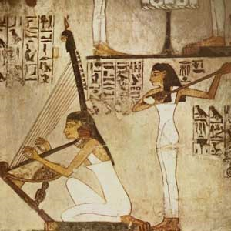
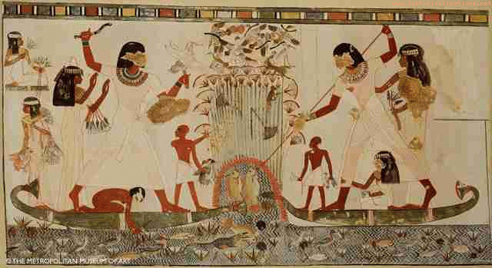
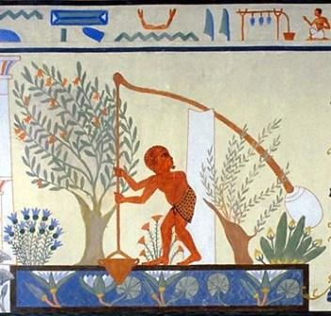
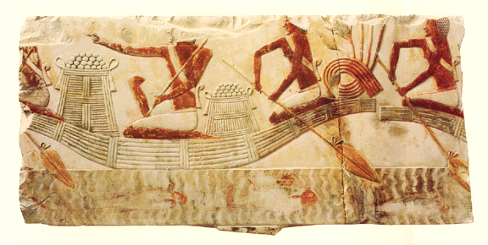

Slide 5
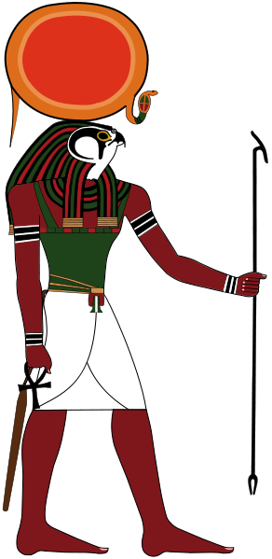
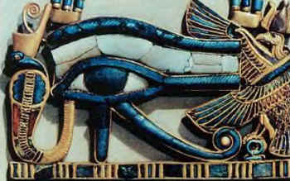
Religion
Ra – Pharaoh was his son
The sun god – one of the creator gods
Pharaoh was Ra on Earth
Later called Amun-Ra

Slide 6
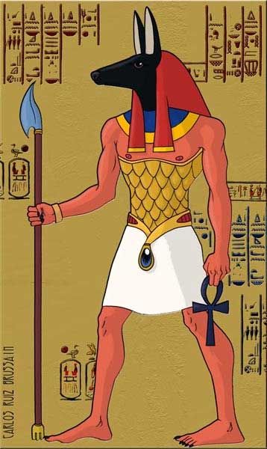
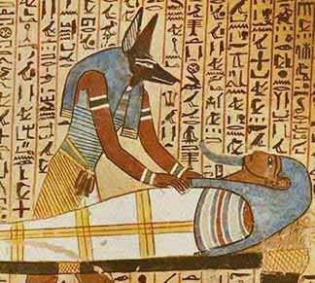
Religion
Anubis – Jackal/Dog Man
Tomb-caretaker god.
Watches over the dead.

Slide 7
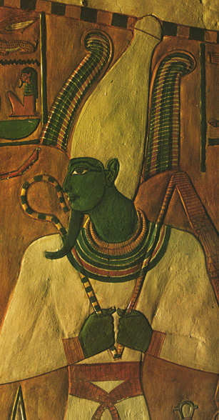
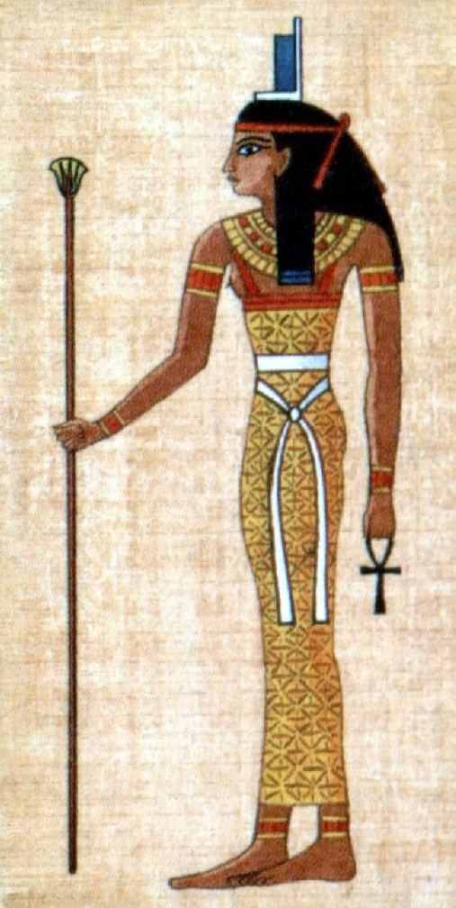
Religion
Osiris – as a man
Watches the underworld.
Husband of Isis.
Isis – as a woman
Goddess of magical power and healing. Wife of Osiris.

Slide 8
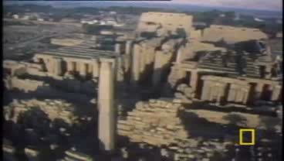

Slide 9
Chronology of Ancient Egypt
Early Dynastic Period (c. 3100 BC – c.2686 BC) – Menes
500 Years of Kings ruling both Lower & Upper Egypt, Memphis founded), Hieroglyphic writing.
Old Kingdom (c. 2868 BC – c.2181 BC)
Age of Pyramids, Pyramids at Giza
Middle Kingdom (c. 2040 BC - c. 1640 BC)
Rulers could not keep control of all of Egypt, and had capital at Thebes.
New Kingdom (c.1570–c.1070 BC) Hyksos (foreign rulers) invade take over Lower Egypt, control most of Egypt. Ahmose expels the Hyksos (foreign rulers) Hatshepsut (woman) rules as Pharaoh, Expedition to Land of Punt Akhenaton - Makes worship of all of the gods illegal except one (Sun Disk or the Aten) Tutankhamun rules as a boy king from age of 11 to age 20. Rameses II greatest Pharaoh is Egyptian history rules and builds many monuments that bear his name.
TIME

