Slide 1
The Progressive Era:
Government & Election Reform
AIM: Why would the Progressive Movement focus on government as a center for change?
Do Now: Take a Quiz.
You have 5 Minutes
Mr. Ott @ BETA 2011-12

Slide 2
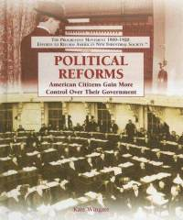
The Assault on Political Parties
Reformers agreed the only way to carry out most of the progressive goals and successfully counter the powerful interest groups that threatened the nation would be through governmental intervention

Slide 3
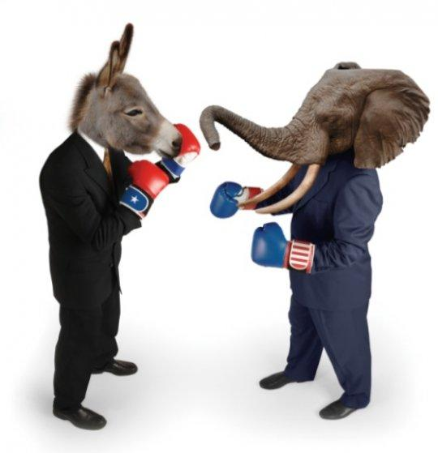
Why the urge to Reform Government
Progressives believed that every level of government (national, state, & local governments) were outmoded, inefficient, and corrupt
Progressives believed the two dominant political parties (the Democratic & Republican Parties) were corrupt, undemocratic, and reactionary

Slide 4
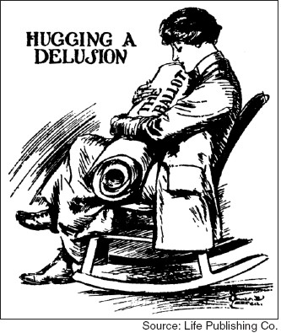
Political Reforms
Tried to put more power into the hands of the people
Innovative changes in city government
--city managers and commission model
The Direct Primary
Initiative, Referendum and Recall
The Secret Ballot
Direct Election of Senators and the Vote for Women

Slide 5
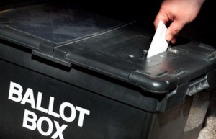
Voting
1880s-1890s—most states adopted the “Secret Ballot System,” known as the Australian Ballot.
Prior to this time, Party Bosses could monitor and shape voting practices because they were the ones to distribute voting “tickets”

Slide 6
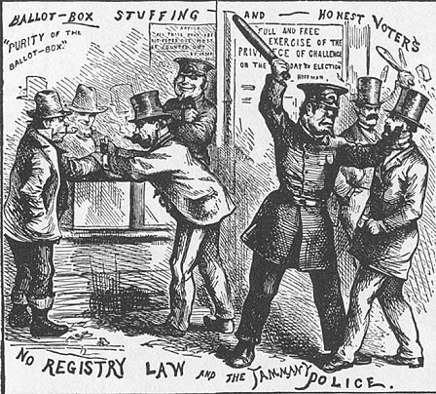
Notes:
This cartoon contrasts police inactivity in countering the electoral fraud of the Tammany machine with police activity in voter intimidation.

Slide 7
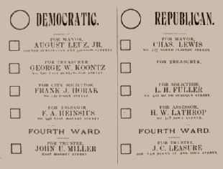
The Advantages &
Significance of the Secret Ballot
  Ballots were printed by the government
  Voters filled out/cast ballots in secrecy
  Significance—chipped away at the power of political bosses and political parties and increased the power of the voter.

Slide 8
Political Machines
Political Machines were powerful organizations linked to political parties. These groups controlled local government in many cities.
These groups were controlled by a Political Boss. They gained votes for their parties by doing favors for people.
They would offer turkey dinners and summer boat rides, and offer jobs to immigrants in return for votes.
Many political bosses were dishonest

Slide 9
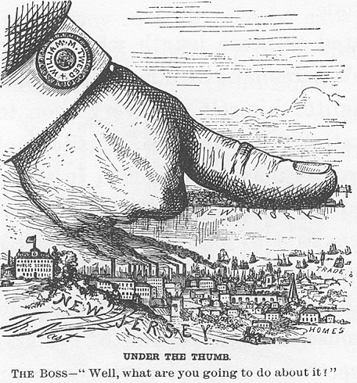
Corruption in the Cities: The Political Boss
Notes:
In 1869 New York City was under the control of William Marcy Tweed (1823-1878. Tweed, a chair-maker and popular volunteer fireman, began his career in politics when he unsuccessfully ran for New York City assistant alderman in 1850. He ran again in 1851, and was elected. In 1852 he was elected to the US Congress. When Tweed was defeated in his bid for re-election he then became a leader (Sachem) of Tammany Hall, a social organization which was highly influential in the New York State Democratic Party. In 1857 he became a member of the New York County Board of Supervisors and in 1868, while still holding that position, he was elected to the state senate.

Slide 10
Mob Mentality
Corrupt politicians found numerous ways to make money.
They received Kickbacks.
Sometimes contractors would overcharge for a project and give the extra money to the political boss
EXAMPLE: At times people in city governments would gain knowledge of land to be used for highways, buy the land before the public knew about it, and sell it back to receive a higher profit.

Slide 11
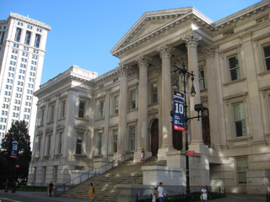
Boss Tweed
Boss Tweed headed New York City’s political machine in the 1860’s and 1870’s.
Tweed was so powerful he controlled the police, courts, and some newspapers.
He collected millions of dollars in illegal payments.
Political Cartoonist Thomas Nast exposed Tweed’s operations in his newspaper, Harpers Weekly.
Tweed was sentenced to prison
In addition to housing the Department of Education's headquarters, Tweed Courthouse also has six classrooms on its ground floor.

Slide 12
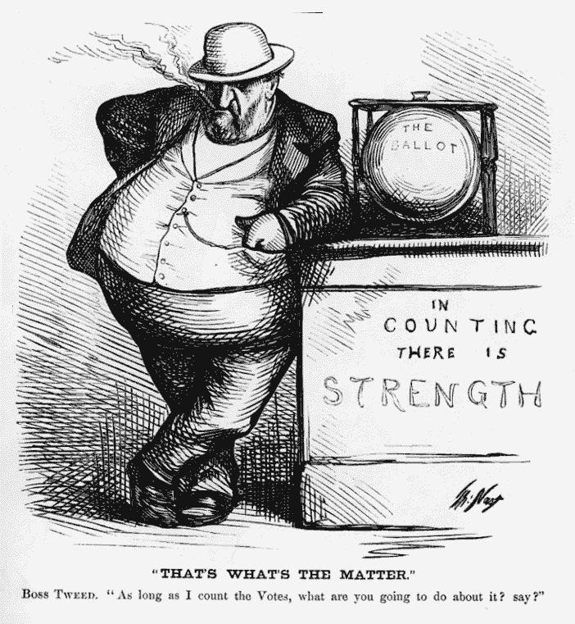

Slide 13
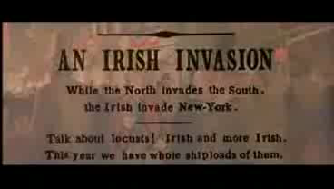

Slide 14
Spoils System
The Spoils System (Patronage)– rewarding political supporters with jobs and favors. Was common since Andrew Jackson.
President Rutherford B. Hayes and James Garfield tried to change the spoils system, and supported Civil Service- the body of no elected government workers.
Garfield believed people should be appointed to jobs based on qualifications, not on who supported who.

Slide 15
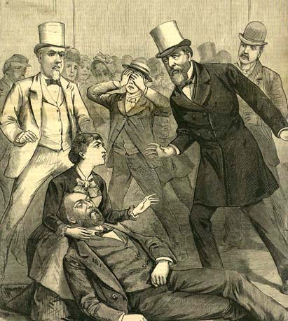
Spoils System
President Garfield was assassinated by an unsuccessful office seeker in 1881 before he could launch his reforms.
Chester A. Arthur succeeded Garfield.
He set up the Civil Service Commission.
This commission set up exams for people who wanted government jobs.

Slide 16
Two Important Changes in
State Governance
Initiative—
  Allowed reformers to circumvent state legislatures by submitting new legislation directly to the voters in general elections
Referendum—
  Provided a method by which actions of the legislature could be returned to the electorate for approval
    (i.e. city budget, school budget, laws that affected residents of the state)

Slide 17
Direct Primary
Direct Primary—
  Took selection of a candidate out of the hands of the party bosses
  Primaries would determine which candidate for a particular political office would run as the party’s candidate
  The South: used direct primaries to regulate/limit black voting and instituted “black primaries”
Notes:
Effort to limit the power of political parties and improve the quality of elected officials

Slide 18
The 17th Amendment
Passed by Congress May 13, 1912. Ratified April 8, 1913.
The Senate of the United States shall be composed of two Senators from each state, elected by the people thereof, for six years; and each Senator shall have one vote. The electors in each state shall have the qualifications requisite for electors of the most numerous branch of the state legislatures.
How did this limit the power of Party Bosses & Political Parties on both the State & National Level? How did this amendment increase the power of the electorate?

Slide 19
Recall
Recall—
  Gave voters the right to remove a public official from office at a special election which could be called after voters collected the required amount of signatures on a petition to recall a governmental official
    Making Connections to today—Due to the failing economy and a general dissatisfaction with the performance of their governor, Californian’s voted in 2004 to hold a special election to determine whether Democratic Governor Gray Davis should be removed from office.
      Who did California voters elect to replace Governor Davis?

Slide 20
Other Political Reforms
Between 1903-1908
  12 states passed laws restricting lobbying of businesses in state legislatures
  22 states banned campaign contributions by corporations
  24 states forbade public officials from receiving free railroad passes
  Is this the same as receiving “Free” Metrocards?

Slide 21
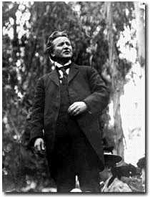
“Laboratory for Democracy”
Robert La Follette—
  Elected governor of Wisconsin in 1900
  Successful in winning support for enacting direct primaries, referendums, and initiatives in Wisconsin.
  Eventually led to success in regulating Rail Roads and Public Utilities in Wisconsin
Photo of Robert M. La Follette (1855-1925)
speaking before an audience of 12,000 in
Los Angeles, 1907

Slide 22
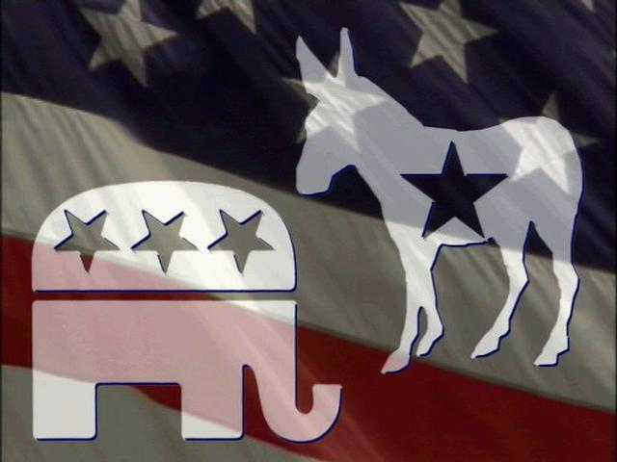
Decline of Influence of Political Parties
Decline in the power of political parties due to the following:
  Low voter turn out
  Successful progressive reforms aimed at corrupt party bosses & political machines
  3rd party power & influence decreased
  Rise of interest groups

Slide 23

Interest Groups
Organizations that emerged outside the party system
Designed to pressure the government to do its members’ bidding and advance its demands on government
  Examples: labor organizations, farm lobbies, particular businesses & industries (steel/oil companies/industries), social rights groups, social workers

Slide 24
Evaluation: How successful were political reforms during the Progressive Era?
What is the significance of reforming city and state governments during the progressive era?
What is the significance of reforming political parties?
In terms of government, voting, and political parties, were the objectives of the progressive reformers met? Explain your answer & provide at least 2 specific examples to support your answer.

