Slide 1
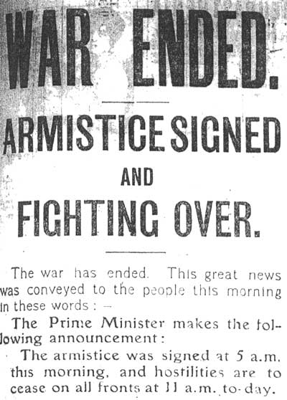
End of World War I
&
The League of Nations
Aim: WHAT WERE THE RESULTS OF WORLD WAR i?
Do Now: Take a quiz – you have
5 minutes.
Mr. Ott @ BETA 2011-12

Slide 2
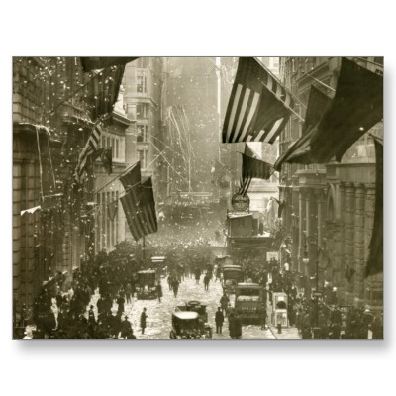
How World War I Comes to an End!
Russia signs the Brest-Litovsk Peace Treaty with Germany pulling out of the war. Russia gave up large territories of land to Germany - Finland, Poland, Ukraine, and the Baltic States.
Austria-Hungary surrendered to the Allies in November of 1917
Germany loses the Western Front
The help of the eager-for-action U.S. doughboys against the low-morale German troops forced them to surrender to end the war on 11/11/11 – Armistice Day.

Slide 3
Wilson’s 14 Points
A plan drawn up by W.Wilson that included 14 specific strategies for ending the war and making peace.
Was very lenient on conquered countries.
Wanted to establish a League of Nations to oversee and enforce the terms of surrender.
1. It would be an international organization with the purpose of preserving peace throughout the world.
2. Every nation would have an equal vote.
3. Every nation in the world would be a member, and each nation would have an equal vote.
4. Any controversy within the League would be turned over to the Central Council: France, Britain, Italy, Japan, the U.S., and five small nations.

Slide 4
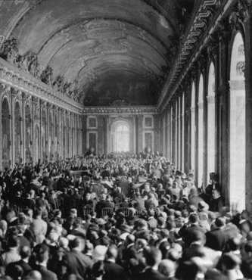
Treaty of Versailles
Wilson would negotiate the treaty in Paris without much input from the new majority Republican Congress.
France and Britain would not approve most of Wilson’s 14 Points. They felt that they were too lenient.
The League of Nations was approved to enforce the terms of the surrender.
It was signed in Paris, France on June 28, 1919 officially ending WWI.
The U.S. Congress did not approve of the treaty or the League of Nations, so they refused to sign it. Why? Because they felt that it did not benefit the U.S.

Slide 5
Congress & The Treaty of versailles
The U.S. Congress did not approve of the treaty or the League of Nations, so they refused to sign it. Why? Because they felt that it did not benefit the U.S.
1. A group of thirty-nine Republican senators led by Henry Cabot Lodge opposed the League of Nations, citing several flaws in its structure.
- Reservationists (Lodge) - willing to pass the treaty if changes are made.
- Irreconcilables - no treaty, no way!
2. The Senators believed that the U.S. should remain “isolationist” after the war.
3. In March of 1920, the Senate defeated the vote for approval of the Treaty of Versailles and the League of Nations.

Slide 6
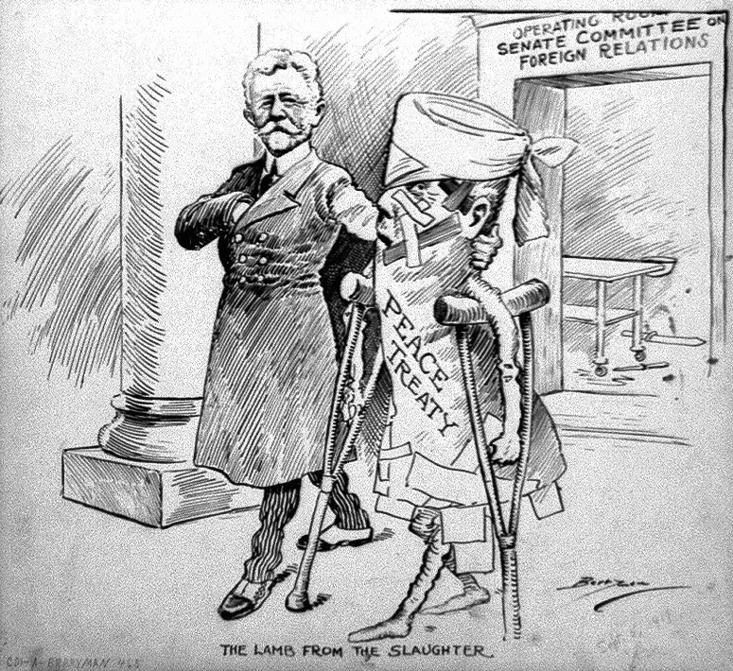
Reasons Why?
- Upset with Wilson for not
including them in making the
treaty.
- Fear of involvement on war without
Congressional declaration of
war.
- Fear of foreign control of military decision-making.
- Questioned using “War to prevent
War.”
- The refusal of Wilson to compromise on Article X (ten) - it made
members promise to protect each other’s territorial integrity against
aggressors. Congressmen did not want to be pulled into foreign
conflicts.

Slide 7
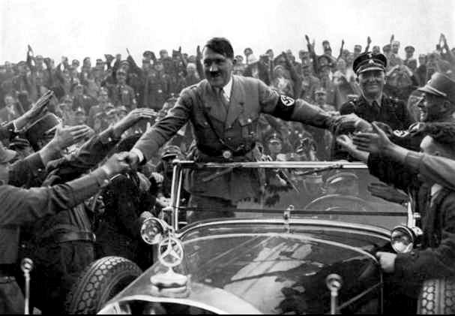
Results of the Treaty of Versailles
A. Kaiser Wilhelm II (German leader) was forced to give up his throne and he fled to Holland for the next 23 years.
B. Germany had to pay back $30 Billion in war reparations.
C. Germany had to break up all Alliances with other countries.
D. Germany had to admit to a “Guilt Clause.”
E. Created a League of Nations.
F. Italy gained very little, refused
to sign a treaty.

Slide 8
Map Changes In Europe
9 New Nations Created:
Nations formed out of Russian Lands
Finland 2. Estonia 3. Latvia 4. Lithuania 5. Poland
Nations formed from Austria-Hungary
1. Czechoslovakia 2. Yugoslavia 3. Austria-Hungary split
From Germany
Lost all conquered territories
Gave Alsace-Lorraine back to France.
* The United States gained nothing!

Slide 9
THE TREATY’S WEAKNESSES
The War Guilt Clause caused all Germans to hate the treaty, and opposition to the treaty was one reason for the rise to power of Hitler.
Russia lost more land than Germany and became determined to regain as much of its former territory as possible.
Ho Chi Minh, a young Vietnamese man, asked Wilson’s help to allow Vietnam to form its own government instead of being controlled by France. Ho was denied his request, so he founded the Indochina Communist Party and led the fight during the Vietnam War.

Slide 10
EUROPE AND THE UNITED STATES
DIFFER OVER THE TREATY
The European leaders were not interested in a just peace. They were interested in retribution. Over Wilson's protests, they ignored the Fourteen Points one by one. Germany was to admit guilt for the war and pay unlimited reparations.
German colonies were handed in trusteeship to the victorious Allies.
No provisions were made to end secret diplomacy or preserve freedom of the seas.
New nations’ borders did not reflect self determination.
Wilson did gain approval for his proposal for a League of Nations.

Slide 11
The League of Nations
Encourage
co-operation
Stop
aggression
AIMS
Disarmament
Improve
social
conditions

Slide 12
Membership
42 members - by 1930’s 59 members
Defeated countries could not join e.g. Germany
Russia excluded because communist
USA did not join - isolation from world affairs
A club for the victorious?

Slide 13
Powers of the League of Nations
If a country ignored the ruling of the League it could:
Put pressure on
Refuse to trade - sanctions
Send in troops - member countries join together

Slide 14
Strengths of the League
Many countries supported it in early days - they wanted peace
Had some early successes:
Settled some land disputes in 1920’s
helped refugees, dealt with spread of disease, fought for better conditions for people

Slide 15
Weaknesses of League
USA didn’t join
No real power - relied on goodwill and persuasion
No permanent army
Disarmament not realistic
Structure a disaster - everyone had to agree before any action taken

Slide 16
