Slide 1
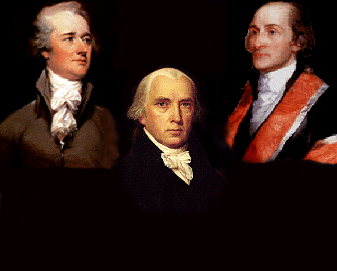
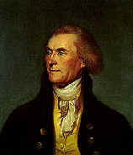
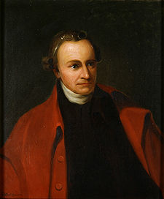
Federalists vs.
Anti-Federalists
Federalists
Anti-Federalists
Alexander
Hamilton
John Jay
Thomas
Jefferson
James
Madison
Patrick
Henry
Aim: To identify the opposing sides in the fight for ratification and describe the major arguments for and against the Constitution
Do Now: Name the 2 Competing Plans and 2 Details of each on the index card provided at the Convention.

Slide 2
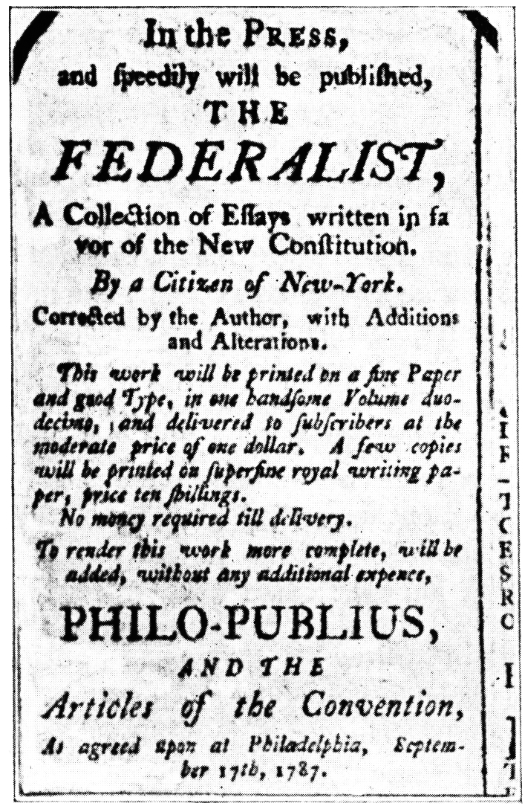
Federalist Papers
The Federalist Papers are a series of 85 articles or essays promoting the ratification of the United States Constitution. Seventy-seven of the essays were published serially in The Independent Journal and The New York Packet between October 1787 and August 1788.
The Structure of the Government Must Furnish the Proper Checks and Balances Between the Different Departments

Slide 3
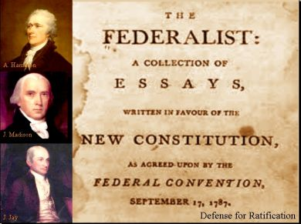
Federalist Papers
The Same Subject Continued: The Insufficiency of the Present Confederation to Preserve the Union – James Madison / Federalist 18-20
The Structure of the Government Must Furnish the Proper Checks and Balances Between the Different Departments – James Madison / Federalist 51
The Same Subject Continued: The Union as a Safeguard Against Domestic Faction and Insurrection – James Madison / Federalist 10
The Executive Department & Role of the President – Alexander Hamilton / Federalist 78
The Judiciary Department & Concept of Judicial Review
– Alexander Hamilton / Federalist 78

Slide 4
Issue | Anti-Federalists Fear | Federalists Response
The Biggest threat to The people | The biggest threat to the people is the tyranny of the government. If a government is too big, it will have too much power, and consolidate, eventually leading to the government being ruled by a powerful elite | The largest threats to the people is having a small government in which those in the minority will never have power. If there is a large government the diverse populations will ensure that a small group of people, a dangerous minority with radical ideas does not gain power.

Slide 5
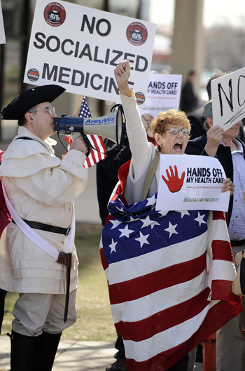
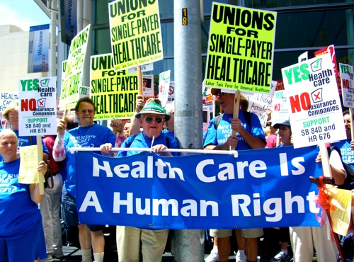
Issue | Anti-Federalists Fear | Federalists Response
Protection of Individual Rights | The rights guaranteed to the people should be included in the Constitution or else they are not guaranteed | The checks and balances are enough to keep the government from taking the rights of the people away.

Slide 6

Issue | Anti-Federalists Fear | Federalists Response
Representation | The government should be run by representatives that are very similar to those who they are representing. This new government will encourage only the well educated elite to be representatives who are using this as an opportunity to gain power | The federal government should be run by well educated and experienced men, the elite. These are the men that are best educated and will be able to make the best decisions.

Slide 7

Threats to the people by the government
Issue | Anti-Federalists Fear | Federalists Response
People will not hold government accountable | A free government requires the active support of the people. The new government would be so large that people would not be involved in government, leading eventually to the government taking too much power. | The central government created cannot take the rights of the people because of the many checks and balances in the Constitution

Slide 8

Threats to the people by the government
Issue | Anti-Federalists Fear | Federalists Response
Power given to the federal government | The limits of the power given to the federal government are not clear and will result in the president becoming a monarch. More limits should be made through a Bill of Rights. | The checks and balances in the Constitution will be effective in restraining the power of the federal government. The president does not have the power to make laws, so he/she cannot become a monarch

Slide 9
Take a moment and reflect….
Do the Anti-Federalists care more about protecting individual rights or promoting the common good?
-or-
Do the Federalists care more about protecting individual rights or promoting the common good?

Slide 10
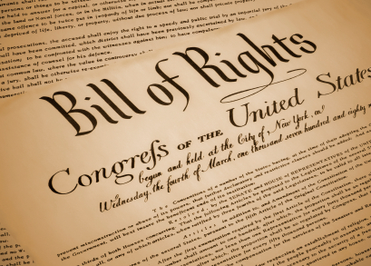
Individual Rights
The Anti-Federalists were more concerned with protecting the rights of the individual people and states, then promoting the pubic good as a whole.

Slide 11

Common Good
The Federalists were more concerned with promoting the common good of everyone then protecting individual rights

Slide 12
Quote Throw down!
You will be shown a quote and you must decide WHO SAID THIS?
  The Anti-Federalists or the Federalists
You will work in groups, and hold up your answer on the correct index card.
Do not show other groups.
You will reveal your answer on the count of three.

Slide 13
Quote #1:
“All communities divide themselves into the few and the many. The first are the rich and well born; the other, the mass of people…. The people are turbulent and changing; they seldom judge or determine right. Give therefore the first class a ….permanent share in the government….they therefore will ever maintain good government.”
Who said it? _______________________

Slide 14
Quote #1
Who said it?
FEDERALISTS

Slide 15
Quote #2:
“It must be by this time evident to all men…that (the Articles of Confederation) is a system so radically vicious and unsound as to admit….an entire change.”
Who said it? _______________________

Slide 16
Quote #2
Who said it?
FEDERALISTS

Slide 17
Quote #3:
“Our country is too large to have all affairs directed by a single government.”
Who said it? _______________________

Slide 18
Quote #3
Who said it?
ANTI-FEDERALISTS

Slide 19
Quote #3:
“The small landowners are the most precious part of the state.”
Who said it? _______________________

Slide 20
Quote #3
Who said it?
ANTI-FEDERALISTS

Slide 21
Quote #4:
“I consider the foundation of the Constitution as laid on this ground – that all powers not delegate (given) to the United States by the Constitution, nor prohibited by it to the states, are reserved to the states, or to the people….”
Who said it? _______________________

Slide 22
Quote # 4
Who said it?
ANTI-FEDERALIST

Slide 23
Quote #5:
“The powers contained in the constitution….ought to be construed liberally in advancement of the public good.”
Who said it? _______________________

Slide 24
Quote # 5
Who said it?
FEDERALISTS

Slide 25
Quote #6:
“I am not among those who fear the people. They, not the rich, are our dependence for continued freedom.”
Who said it? _______________________

Slide 26
Quote #6
Who said it?
ANTI-FEDERALISTS

Slide 27
Quote #7:
"I had rather be a free citizen of the small republic of Massachusetts, than an oppressed subject of the great American empire."
Who said it? _______________________

Slide 28
Quote #7
Who said it?
ANTI-FEDERALISTS

Slide 29
Quote #8:
"I had rather be a free citizen of the small republic of Massachusetts, than an oppressed subject of the great American empire."
Who said it? _______________________

Slide 30
Quote #8:
“Among the numerous advantages promised by a well-constructed Union, none deserves to be more accurately developed than its tendency to break and control the violence of faction.”
Who said it? _______________________

Slide 31
Quote #9
Who said it?
FEDERALISTS

Slide 32
Quote #10:
“An elective [monarchy] was not the government we fought for; but one in which the powers of government should be so divided and balanced among the several bodies of magistracy as that no one could transcend their legal limits without being effectually checked and restrained by the others.”
Who said it? _______________________

Slide 33
Quote # 10
Who said it?
FEDERALISTS

Slide 34
Quote #11:
“When the government fears the people, there is liberty. When the people fear the government, there is tyranny.
Who said it? _______________________

Slide 35
Quote #11
Who said it?
ANTI-FEDERALISTS

Slide 36
Quote #12:
“… the power vested in congress of sending troops for suppressing insurrections will always enable them to stifle the first struggles of freedom."
Who said it? _______________________

Slide 37
Quote #12
Who said it?
ANTI-FEDERALISTS

