Slide 1
Modern Challenges
As the world has become more interdependence, more global issues have emerged
Global Pollution Issues?
  Air Quality, Human Waste, Garbage, Ocean Garbage
Deforestation of Rain Forests (1,827,345 hectares loss 2019)
  Farming, Natural Climate Pattern shift, Climate Change?
Global Population Growth = 7.7 Billion (2019)
  Population Estimates: 8.6b 2030, 9.8b 2050, 11.2b 2100
  Chinese Family Planning Laws?
Can technology and innovation improve these issues?

Slide 2
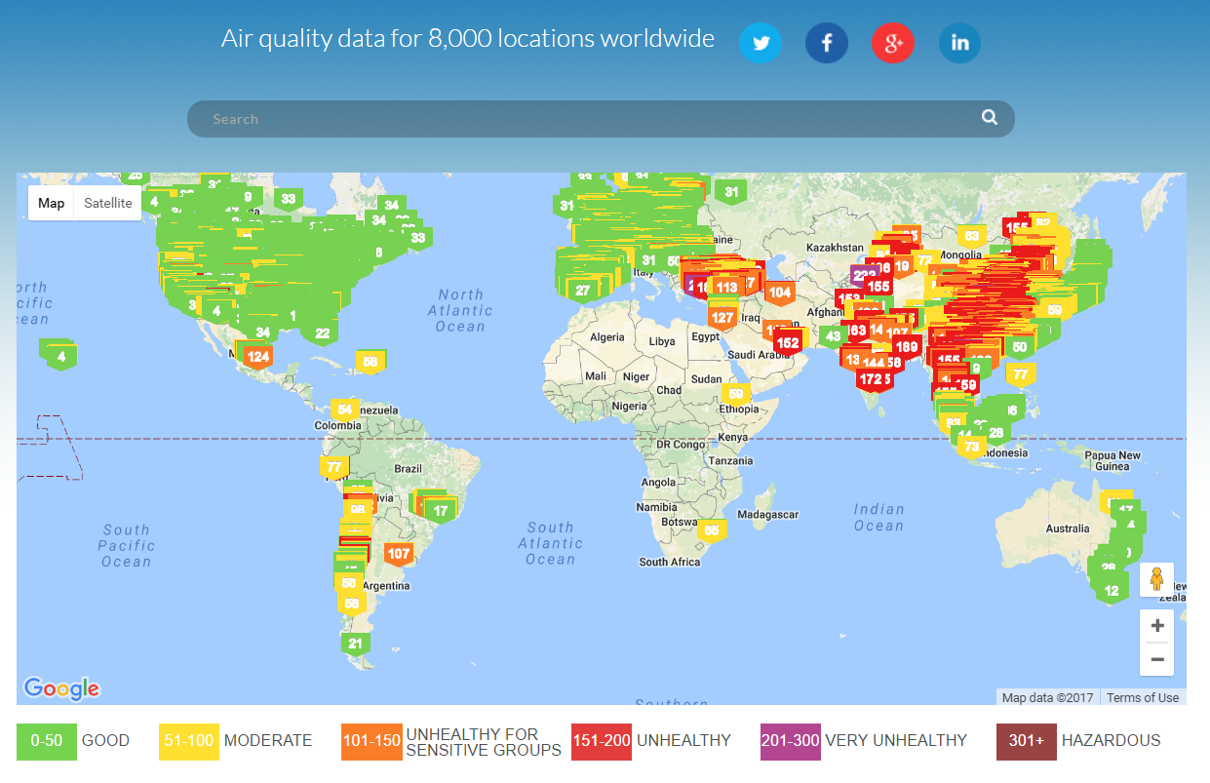
https://www.worldometers.info/

Slide 3
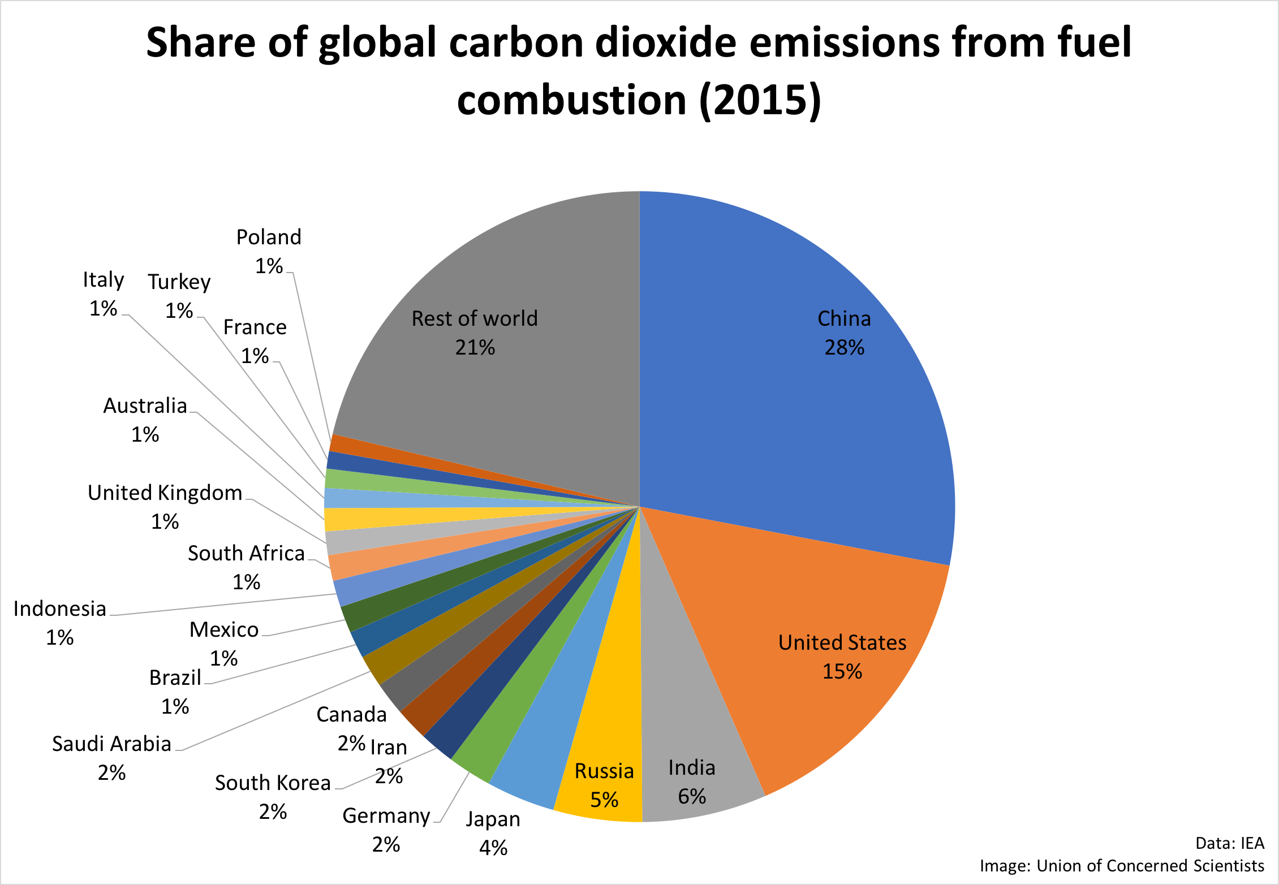

Slide 4


Slide 5
Modern Challenges
As the world has become more interdependence, more global issues have emerged
Global Pollution Issues?
  Air Quality, Human Waste, Garbage, Ocean Garbage
Deforestation of Rain Forests (1,827,345 hectares loss 2019)
  Farming, Natural Climate Pattern shift, Climate Change?
Desertification – Expansion of Deserts
  Sahara Desert (10 percent since 1920)
Global Population Growth = 7.7 Billion (2019)
  Population Estimates: 8.6b 2030, 9.8b 2050, 11.2b 2100
  Chinese Family Planning Laws?
Can technology and innovation improve these issues?

Slide 6
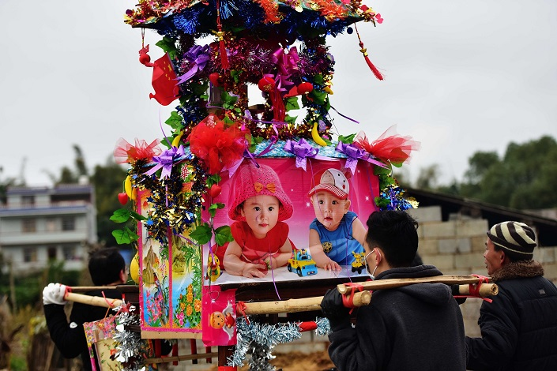
January 1, 2016, the revised Population and Family Planning Law provides that the state advocates that every married couple have two children, and that more children may be allowed where the requirements specified by laws and regulations are met. No Longer have a “One Child” policy.

Slide 7
Modern Challenges
As the world has become more interdependence, more global issues have emerged
Global Pollution Issues?
  Air Quality, Human Waste, Garbage, Ocean Garbage
Deforestation of Rain Forests (1,827,345 hectares loss 2019)
  Farming, Natural Climate Pattern shift, Climate Change?
Global Population Growth = 7.7 Billion (2019)
  Population Estimates: 8.6b 2030, 9.8b 2050, 11.2b 2100
  Chinese Family Planning Laws?
Can technology and innovation improve these issues?

Slide 8
Modern Challenges
As the world has become more interdependence, more global issues have emerged
Urbanization
  Third World Nations
  Impact of Globalization
Disease
  Pandemic (Worldwide, Nationwide) Epidemic (Regional)
  HIV/AIDS, Ebola Virus, Measles?

Slide 9
Third World. The nonaligned nations — which are often from Africa, Asia, and Latin America. They are in a “third” group of nations because they were allied neither with the United States nor with the former Soviet Union.
Cold War is over, is there a better term?
Developing Nations?

Slide 10
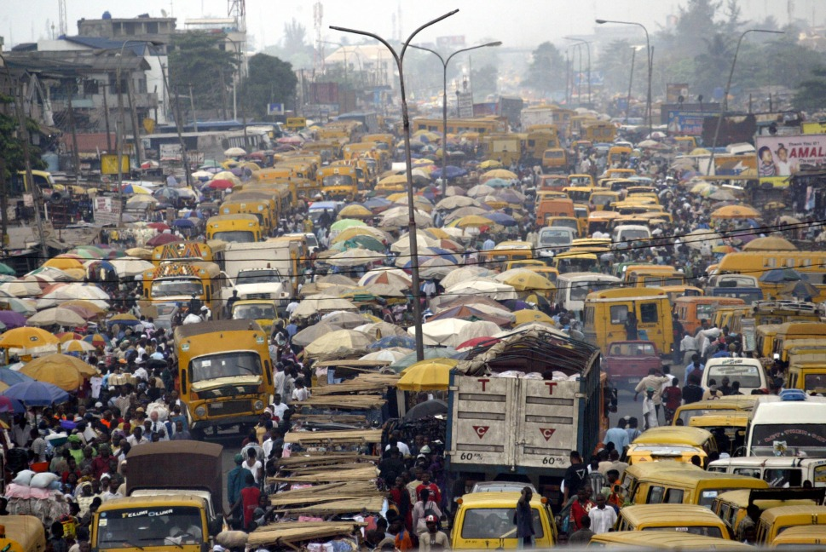

Slide 11
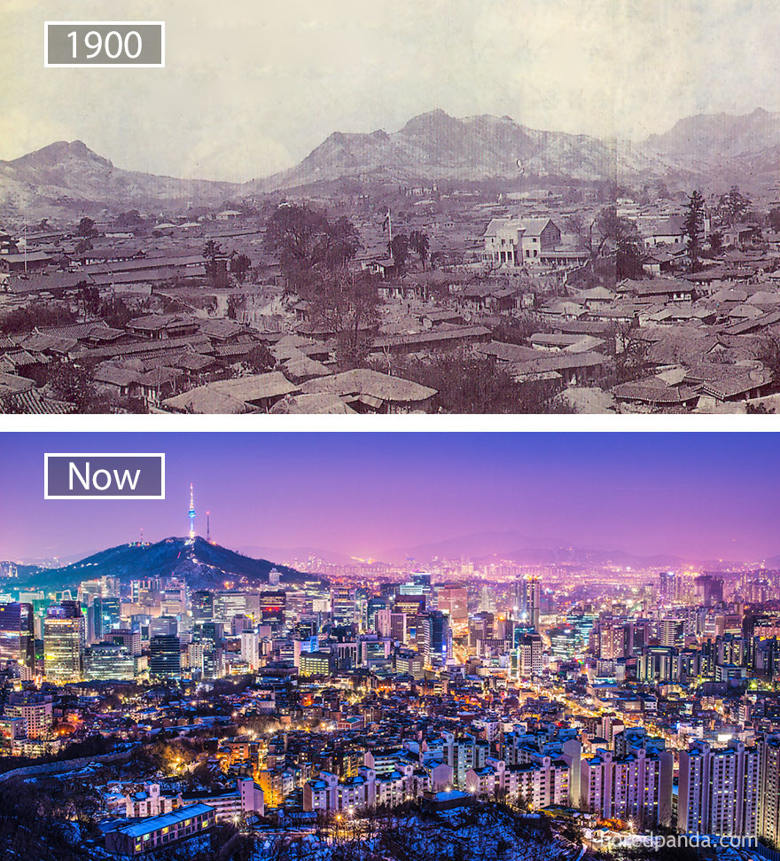
Seoul, South Korea

Slide 12
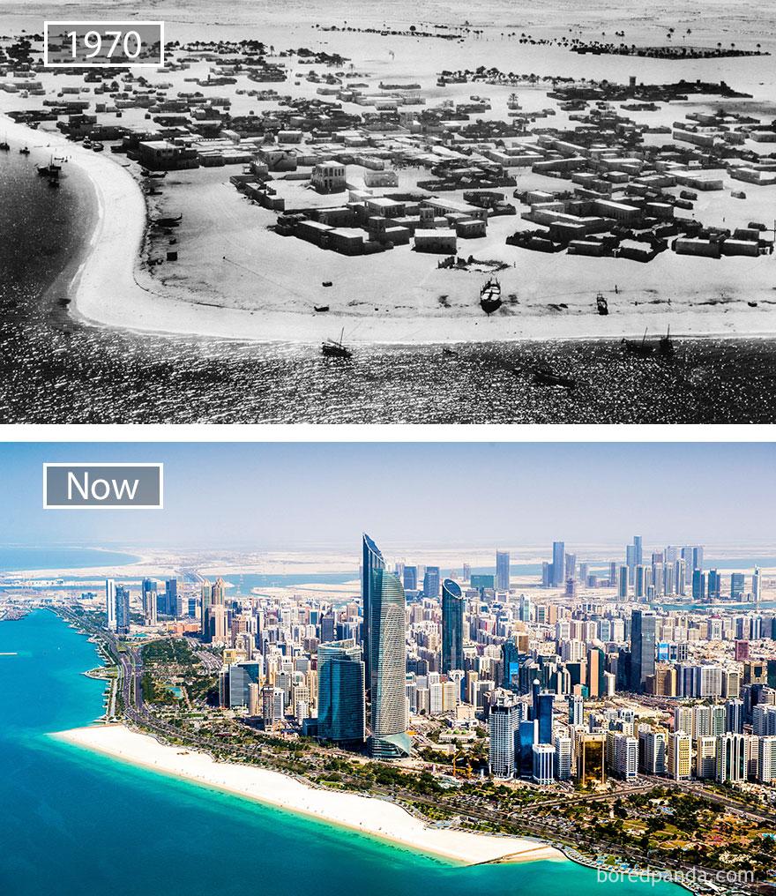
Abu Dhabi, United Arab Emirates

Slide 13
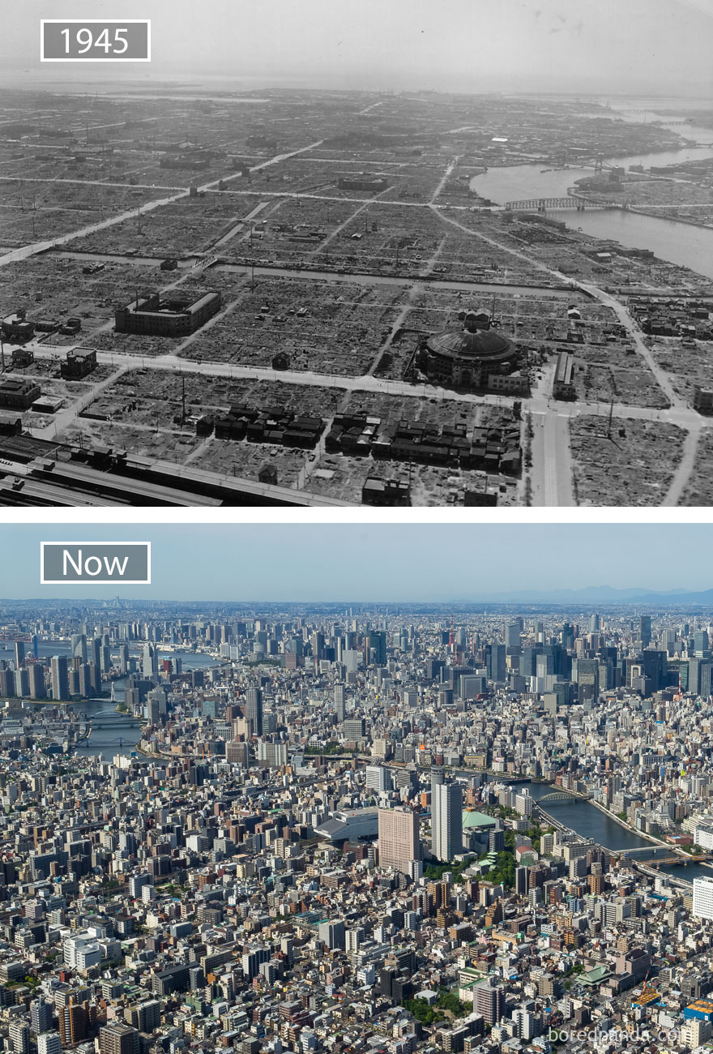
Tokyo, Japan

Slide 14
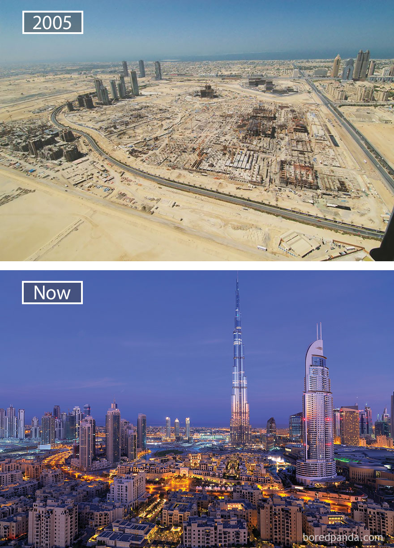
Dubai, United Arab Emirates

Slide 15
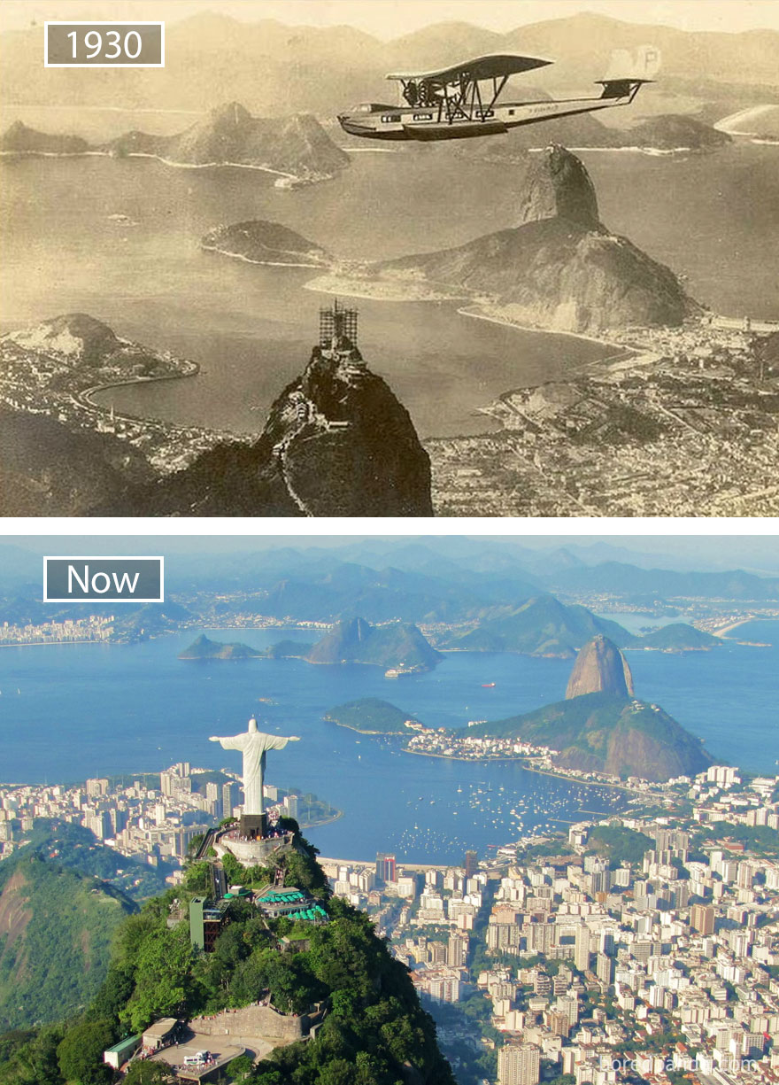
Rio De Janeiro, Brazil

Slide 16
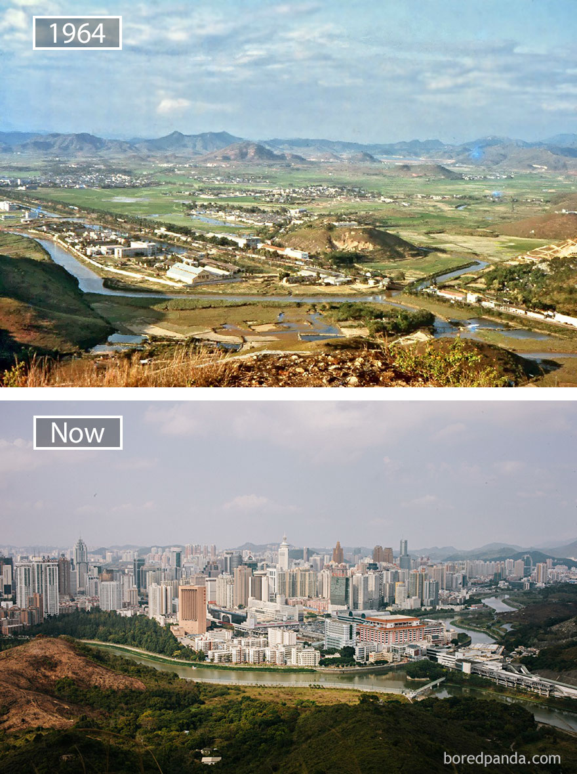
Shenzen, China

Slide 17
Modern Challenges
As the world has become more interdependence, more global issues have emerged
Urbanization of Third World Nations?
  Impact of Globalization
Widespread Disease
  HIV/AIDS, Ebola Virus, Measles?

Slide 18
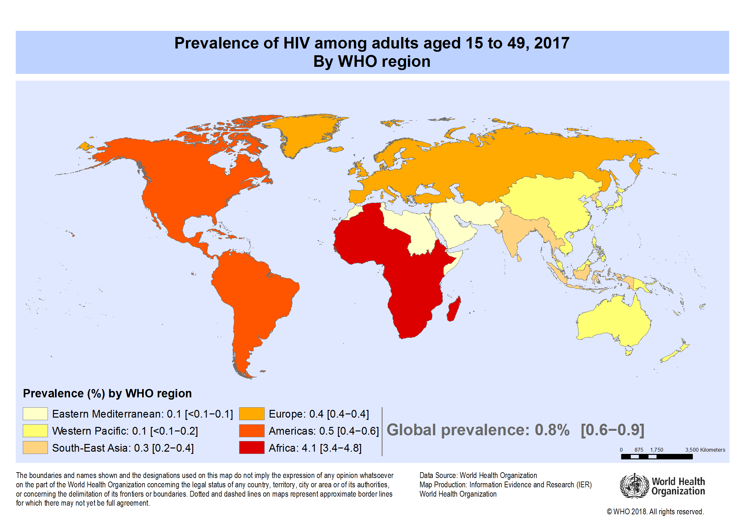

Slide 19
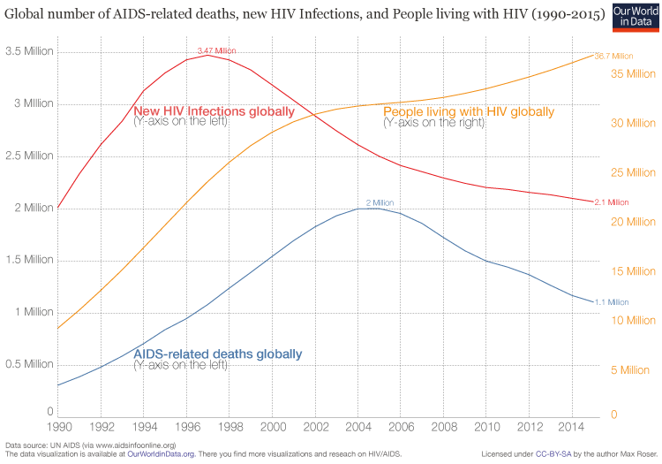

Slide 20
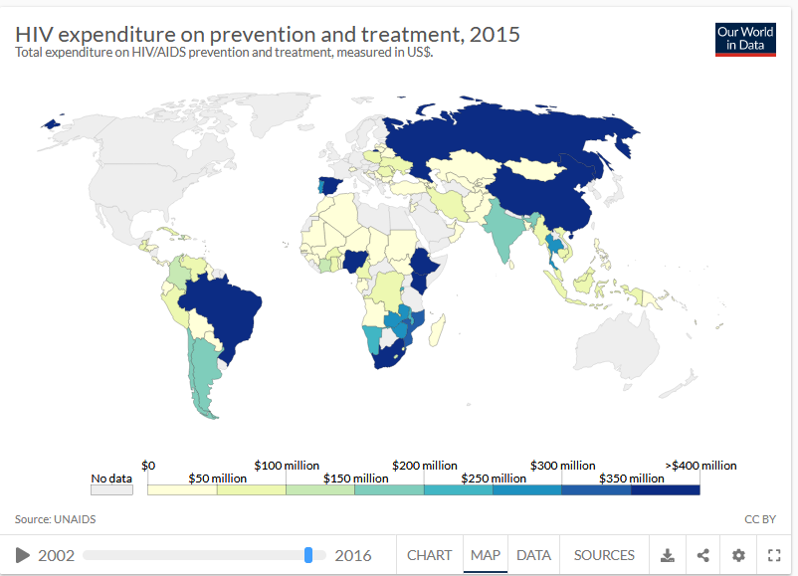

Slide 21
Modern Challenges
As the world has become more interdependence, more global issues have emerged
Nuclear Proliferation
  SALT Treaty (US/USSR)
  Iran/US/EU Nuclear Deal
  North Korea
Green Revolution (1970s)
  More food production for a larger population using pesticides and fertilizers

Slide 22
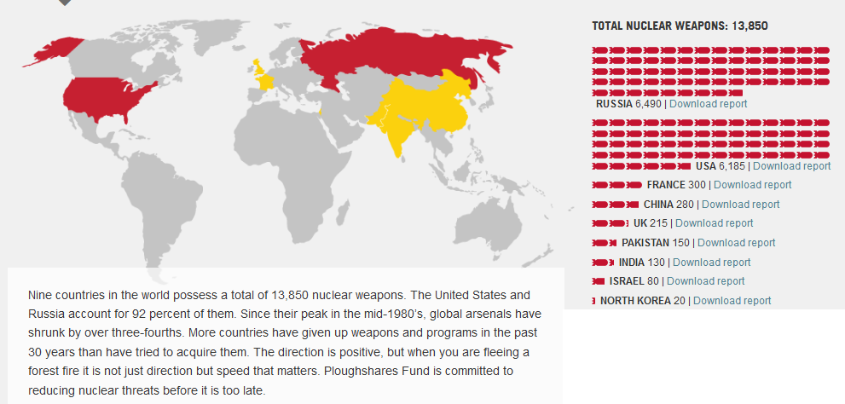
https://www.ploughshares.org/world-nuclear-stockpile-report

Slide 23
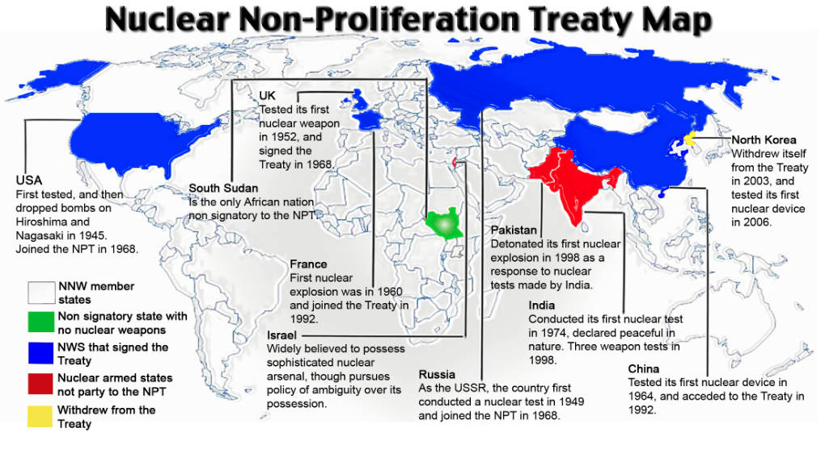

Slide 24
Modern Challenges
As the world has become more interdependence, more global issues have emerged
Nuclear Proliferation
  SALT Treaty (US/USSR)
  Iran/US/EU Nuclear Deal
  North Korea
Green Revolution (1970s)
  More food production for a larger population using pesticides and fertilizers

Slide 25
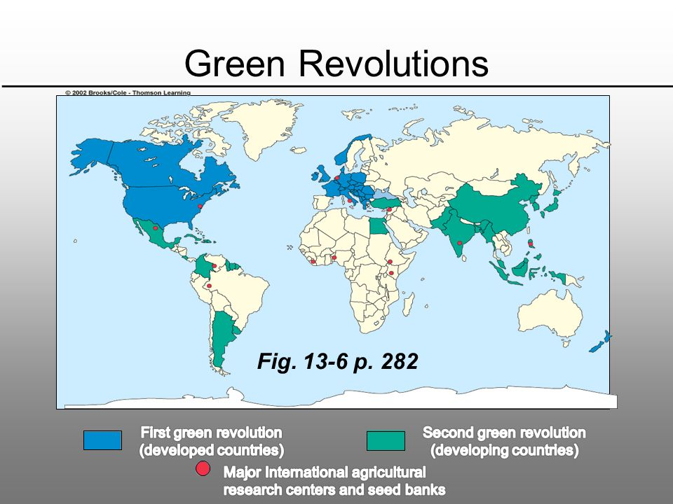

Slide 26
