Slide 1
EIGHT ENLIGHTENMENT THINKERS
Thomas Hobbes (1588 – 1679)
John Locke (1632 – 1704)
Jean-Jacques Rousseau (1712 – 1778)
Baron de Montesquieu (1689 – 1755)
Voltaire (1694 – 1778)
Denis Diderot (1713 – 1784)
Mary Wollstonecraft (1759 – 1797)*
Adam Smith (1723 – 1790)

Slide 2
LETS REVIEW…
What does absolutism mean?
What is divine right?
What was the Scientific Revolution?
List two scientific revolutionists & their accomplishments.
What was the Enlightenment?

Slide 3
EIGHT ENLIGHTENMENT THINKERS
TODAYS COLOR IS WHITE!
IF IT IS WHITE, It’s time to WRITE
IF ANY OTHER COLOR IS REPRESENTED, IT IS OPTIONAL AND YOU CAN RECORD IT AT A LATER DATE by going to the website and reviewing the slides.

Slide 4
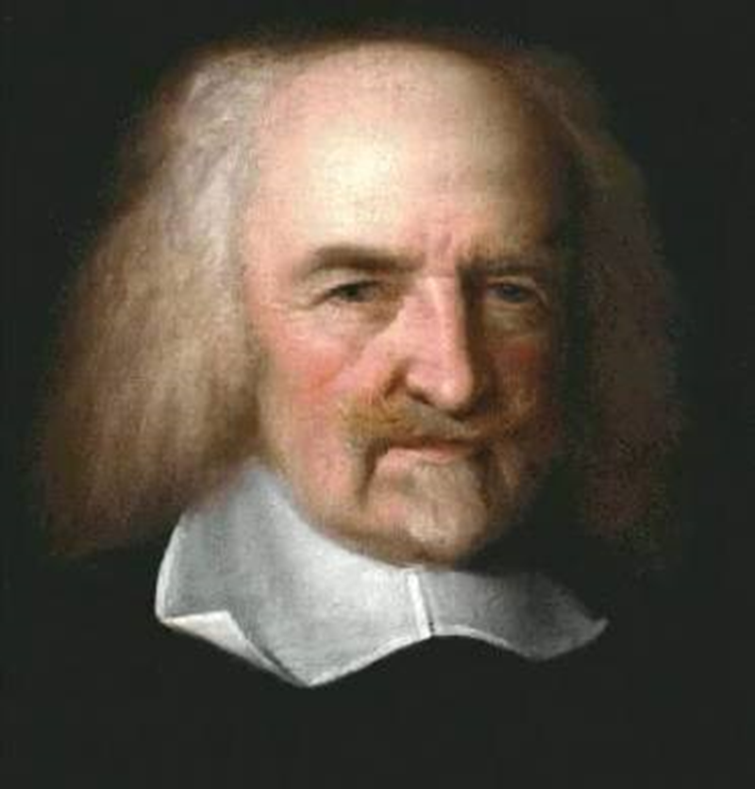
THOMAS HOBBES
view of human nature was negative, or pessimistic.
Beliefs about people:
  cruel, greedy & selfish.
  needed to enter into a social contract:
    give up freedom for the safety of organized society.
EX=a powerful government like an “absolute monarchy” was best for society – it would impose order and compel obedience. (book: Leviathan)
“Life is Nasty, Brutish, and Short.”

Slide 5
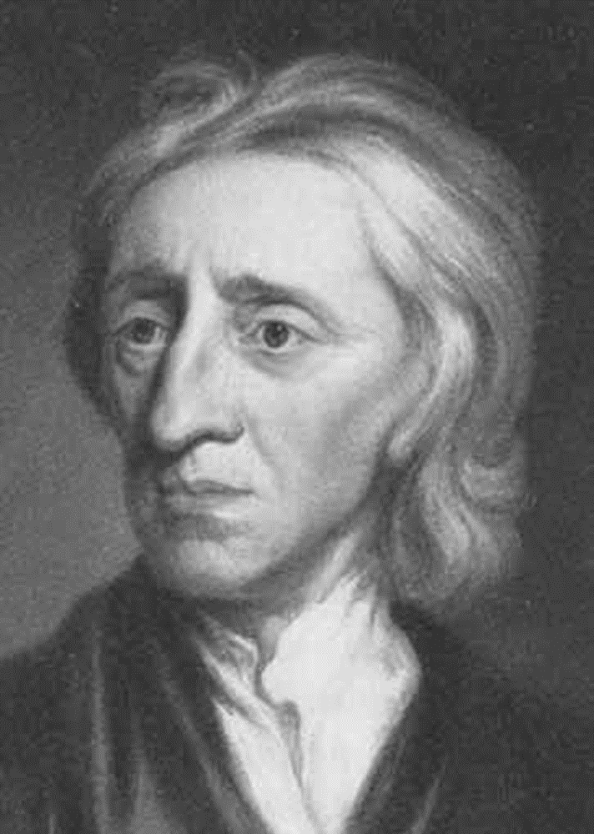
JOHN LOCKE
Believed in:
  natural laws and rights.
  At birth=tabula rasa, a blank slate.
  people have the right to life, liberty, and property.
  Those in charge=obligation to protect the natural rights of the people it governs.
  best government has limited power
“If a government fails in its obligation to protect natural rights, the people have the right to overthrow that government.”

Slide 6
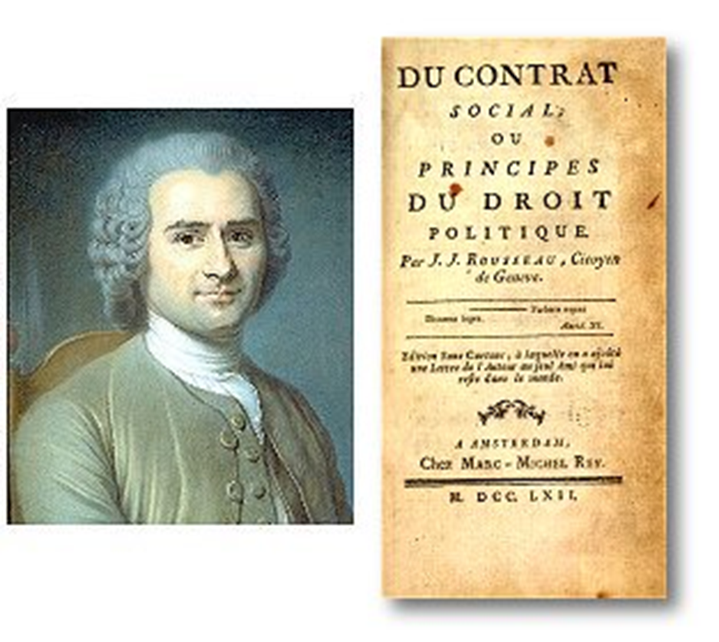
JEAN-JACQUES ROUSSEAU
He believed:
  People are good but become corrupted by society
  Book The Social Contract: people should do what is best for their community.
    *the good of all is more important than one.
      absolute monarchy & religion were bad
      political & economic oppression hurt the masses
“Man is born free, and everywhere he is in chains.”

Slide 7
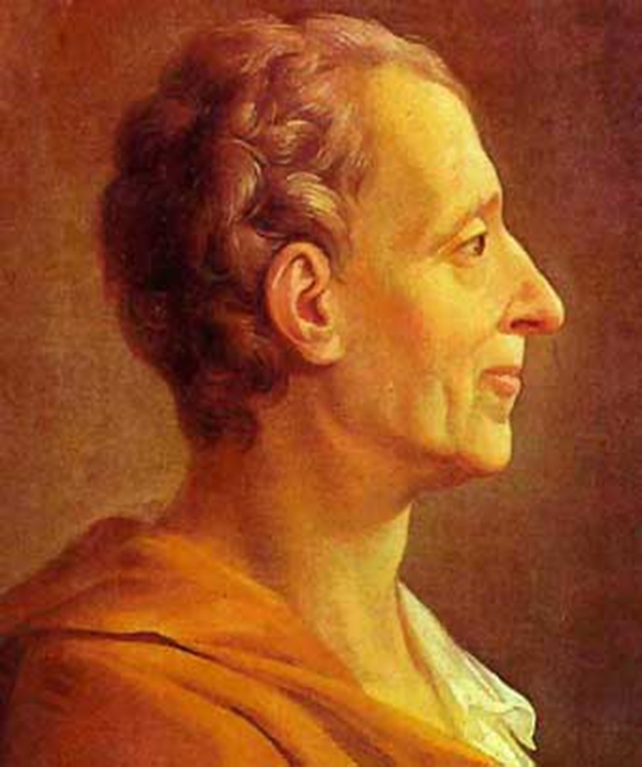
MONTESQUIEU
Believed in:
  Separation of Government Powers -3 branches: legislative; executive; and judicial.
  Checks & Balances – each branch should check (limit) the power of the others.
  Creating balanced power (even) and no one branch would be too powerful.
  Montesquieu’s ‘separation of powers’ and ‘checks and balances’ influenced framers of the US Constitution which are at the core of American government to this day.
“Useless laws weaken
the necessary laws.”

Slide 8
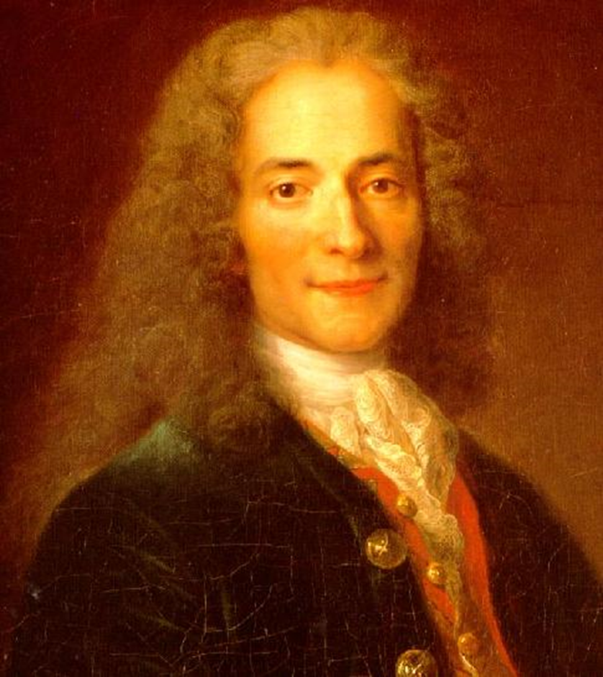
VOLTAIRE
Believed in:
  freedom of thought, speech, politics, and religion.
  Fought against intolerance, injustice, inequality, ignorance, & the slave trade.
expressed views through fictitious characters
  (because he lived in an absolute monarchy in France.)
Wrote the famous novel Candide
used razor sharp humor and cutting sarcasm in his writings.
imprisoned in the Bastille in Paris and exiled because of his attacks on the French government and the Catholic Church.
REAL NAME: Francois Marie Arouet
“I do not agree with a word you say but I will defend to the death your right to say it.”

Slide 9
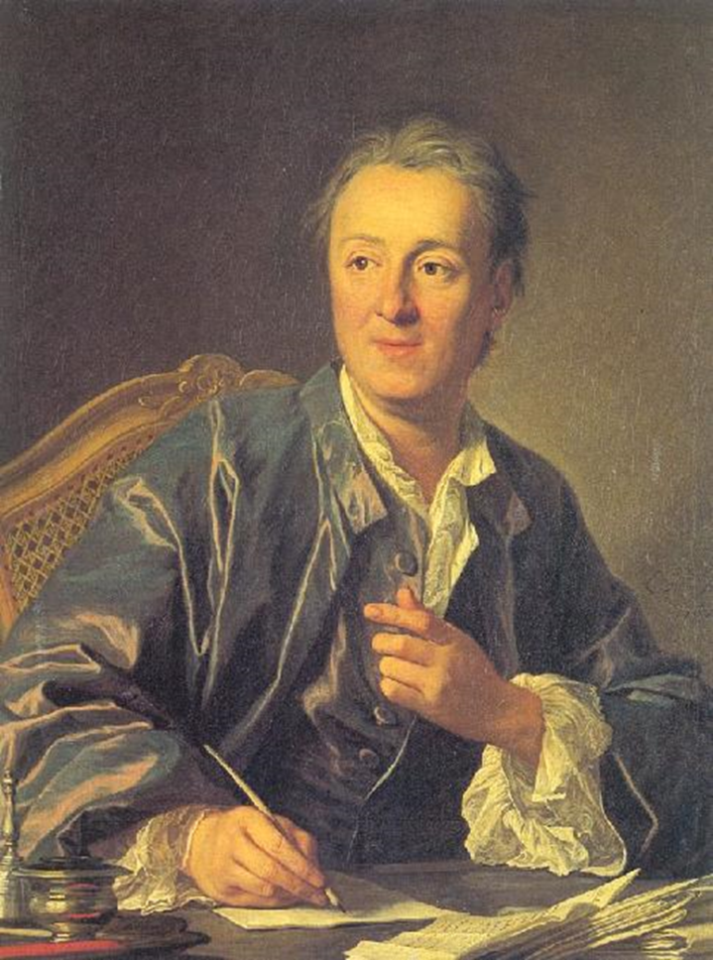
DENIS DIDEROT
worked 25 years to produce the 1st
28 volume Encyclopedia.
The Encyclopedia was intended to change the way people thought.
  Montesquieu, Voltaire, and others wrote articles.
About 20,000 copies were printed between 1751 and 1789 despite efforts to ban the Encyclopedia.
“There is only one passion, the passion for happiness.”

Slide 10
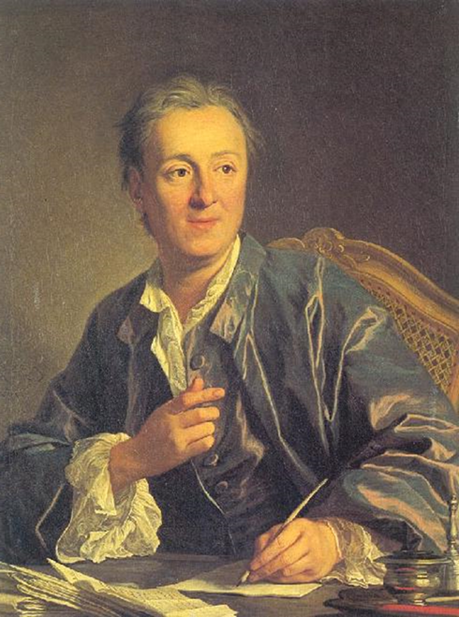
Diderot Cont’d
supported freedom of expression & education for all people.
Challenged “divine-right” theory (of monarchy) along with traditional religions.
The French king said the Encyclopedia was an attack on public morals.
The pope threatened to excommunicate Catholics who bought or read the Encyclopedia.

Slide 11
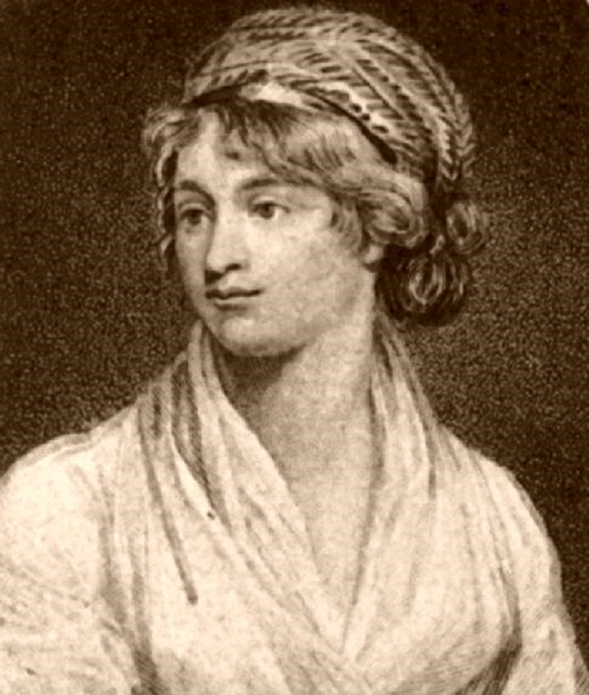
MARY WOLLSTONECRAFT
argued women had been EXCLUDED FROM the Enlightenment or the social contract.
Her arguments were often met with scorn, even from some ‘enlightened’ men.
She wrote A Vindication of the Rights of Women in 1792.
argued a woman’s first duty was to be a good mother. But, her own interests were equally important!
“Strengthen the female mind by enlarging it…Virtue can only flourish among equals.”

Slide 12
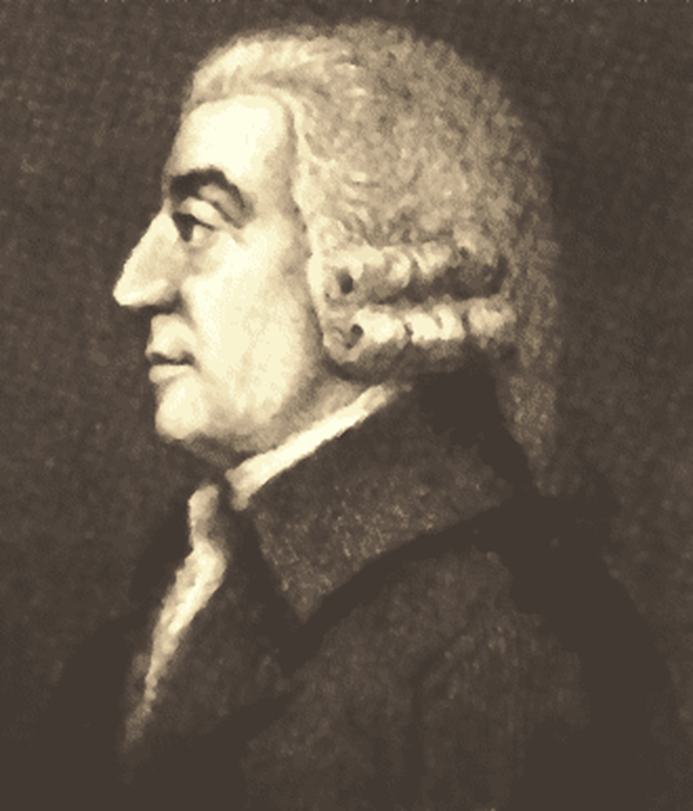
ADAM SMITH
a Scottish economist called the “father of capitalism.”
an advocate of laissez faire (French for ‘let do,’ ‘let go,’ ‘let pass.’ – often referred to as ‘hands off.’).
  business should operate with little or no government interference.
He wrote The Wealth of Nations.
Thought supply & demand should drive economies.
“The propensity to truck, barter and exchange one thing for another is common to all men, and to be found in no other race of animals. No dog exchanges bones with another.”

Slide 13
EIGHT ENLIGHTENMENT THINKERS
** THE LISTED THINKERS ARE ALL OF EUROPEAN DESCENT/HERITAGE.
EXTRA CREDIT- CAN YOU FIND AN ENLIGHTENED THINKER FROM ANOTHER PLACE?
NAME/PLACE/WHY FIT?
ACTIVITY #2- WHAT OUTCOMES MAY ONLY LEARNING ABOUT EUROPEAN THINKERS HAVE ON A STUDENT?**
EXPLAIN/OPINION
ACTIVITY #1
SUPPORT 1 OF the LISTED enlightenment thinkers that’s most influential to you?
How did they impact their time? CHOOSE ECONOMIC, SOCIAL, POLITICAL, OR ENVIRONMENTAL?
**SUPPORT WITH AS MANY AS POSSIBLE!
Thomas Hobbes (1588 – 1679)
John Locke (1632 – 1704)
Jean-Jacques Rousseau (1712 – 1778)
Baron de Montesquieu (1689 – 1755)
Voltaire (1694 – 1778)
Denis Diderot (1713 – 1784)
Mary Wollstonecraft (1759 – 1797)
Adam Smith (1723 – 1790)

