Slide 1
The
Commercial Revolution
Mr. Ott – BETA / Global History & Geography
Aim: What was the Commercial Revolution and what role did economics play in peoples’ lives?
Do Now: Where in the world do your food, clothes, and luxury goods come from?

Slide 2
Do you think the Commercial Revolution had a impact on slavery?
YES
The Commercial Revolution had an enormous impact on slavery since the colonies needed MORE labor to support the mother country by providing the raw materials needed.

Slide 3
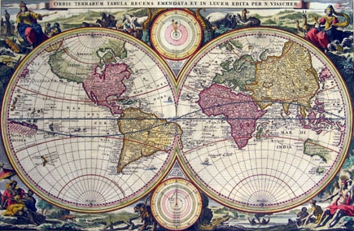
The Commercial Revolution marked an important step in Europe from local economies to a global economy.

Slide 4
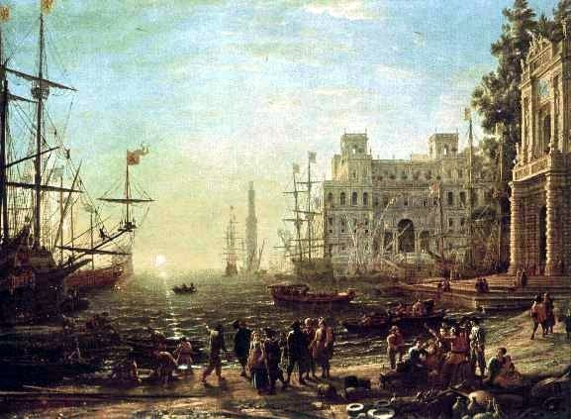
Mercantilism
Mercantilism was the belief that a nation’s power depended on the ownership of gold and silver.
In order to acquire gold and silver, European countries established overseas colonies.
Colonies provided gold, silver and raw materials.

Slide 5
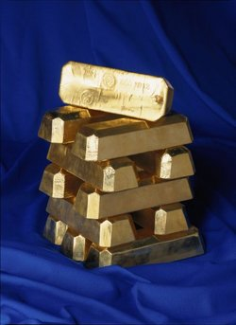
Mercantilists believed that a country’s wealth was based on the amount of gold and silver it acquired.

Slide 6
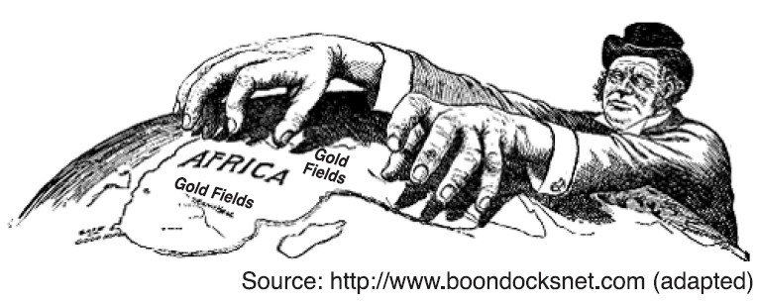
Mother Countries and Colonies
Mother countries were conquerors.
The conquered land was a colony.
In addition to mining for gold and silver, Mother countries imported natural resources or raw materials and exported finished goods.

Slide 7
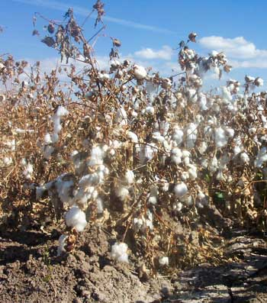
Mother countries imported cheap
raw materials like cotton and
exported more expensive finished
goods like shirts.

Slide 8

Capitalism
Merchants and bankers
laid the foundations for capitalism.
In a capitalist system, business owners risk their capital (money) to start new businesses hoping to make profits.
Individuals formed
joint-stock companies.

Slide 9
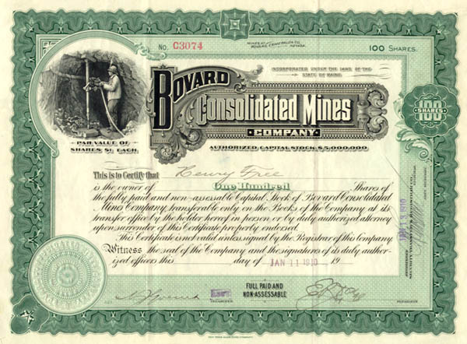
A stock certificate represents partial
ownership in a business.

Slide 10
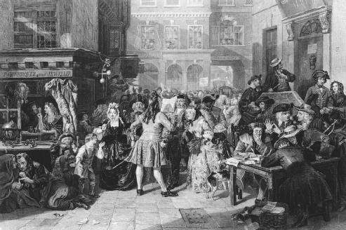
Joint Stock Companies
A Joint stock company is a privately owned company that sells stock or partial ownership in the company to investors.
Investors risk their capital or money when they purchase stock.
If the company is successful, the investor receives his share of the profits.

Slide 11
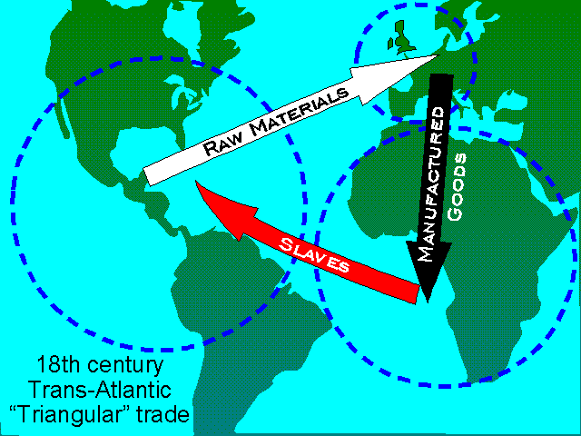
“Triangular” trade made some
continents wealthy
while it impoverished
other continents.

Slide 12
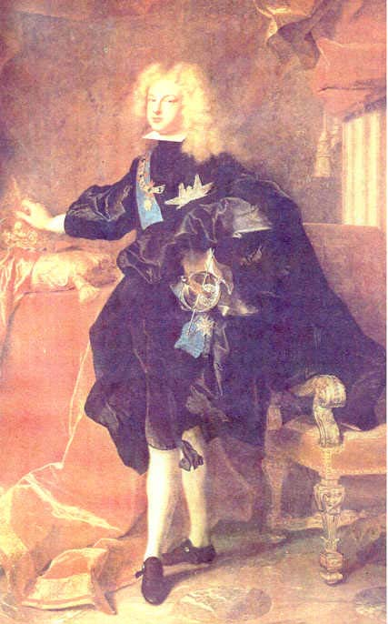
European kings
Increased their
wealth and power
through conquest and
colonization

Slide 13
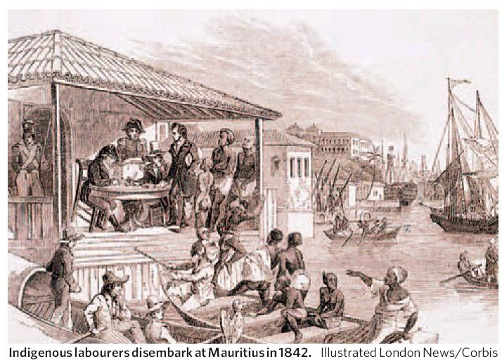
While European Kings and capitalists
increased their wealth, Native American
Indians and Africans were terribly exploited.

Slide 14
What have we learned?
Cause and Effect
Demand for cheap labor to extract raw materials to replace labor that died from disease.
Atlantic Trade to the New World
causes
Manufactured Goods from Europe
Increase for raw materials including gold & silver as well as natural resources.
causes
Raw Materials from Africa & New World
Increase in Manufactured Goods and new markets
causes

Slide 15
Reminder: All Previous Work
Due by Tomorrow - Wed 3/9
Marking Period Ends Tomorrow!

