Slide 1
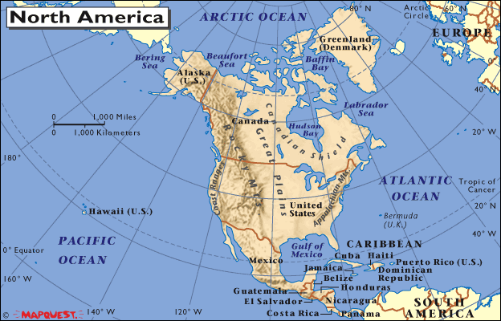
Aim: How did geographic factors influence early
U.S. history?
Use your Review
Packet Map
Do Now: Label each of the following on your map:
Atlantic Ocean
Pacific Ocean
Gulf of Mexico
Mississippi River
Appalachian
Mountains
Great Plains
Rocky Mountains
Great Lakes

Slide 2


Slide 3
Atlantic and Pacific Oceans
Influenced U.S. foreign policy throughout the 18^{th,} 19^{th,} and 20th century.
Oceans on the east & west coasts helped the U.S. maintain
its foreign policy of neutrality during much of the 1800s.

Slide 4

Natural harbors contributed to the development
of commerce throughout colonial America.

Slide 5
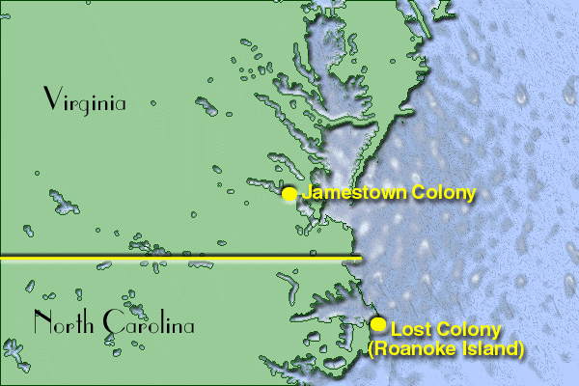
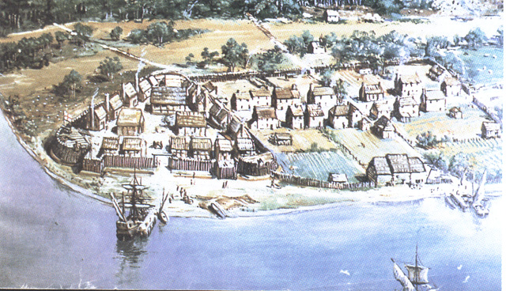
Jamestown (1607)
Early colonial settlements were similar in that each developed near the coast line.
English Colony

Slide 6
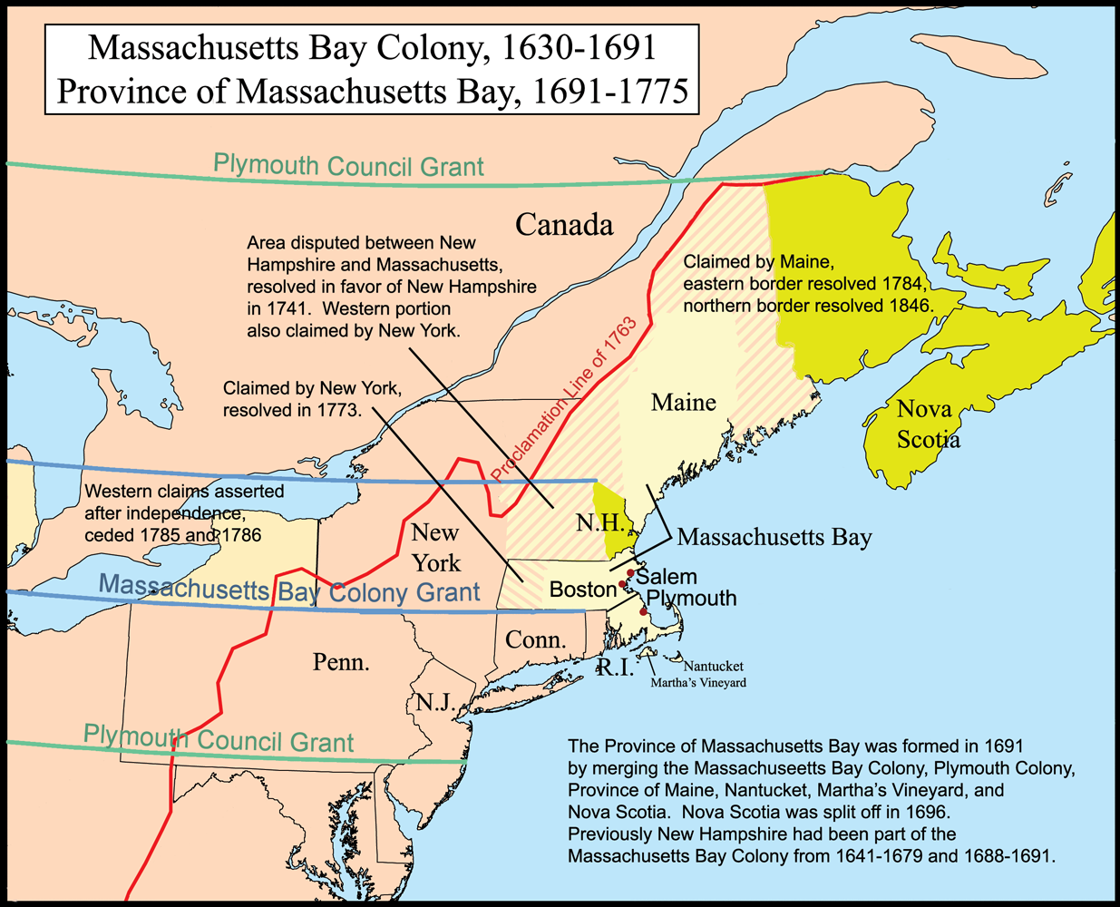
Plymouth (1620)
English Colony

Slide 7
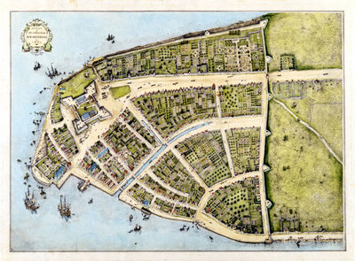
New Amsterdam (1625)
Dutch Colony

Slide 8
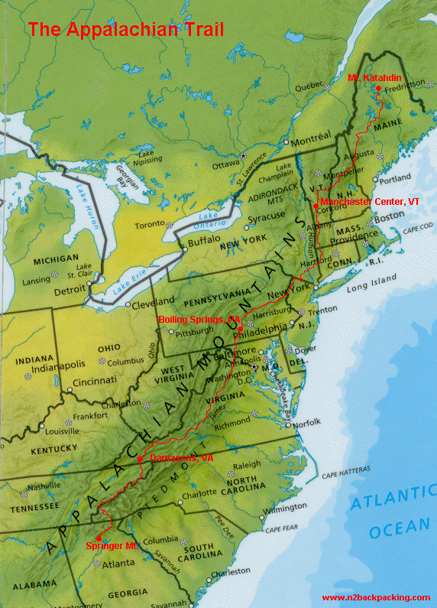
Appalachian
Mountains
Served as the western boundary for British colonial settlements
prior to the Revolutionary War.

Slide 9
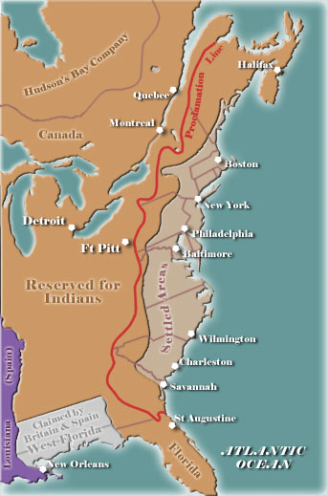
Proclamation Line of 1763- Border established by Great Britain to avoid conflicts between American colonists and Native Americans.

Slide 10
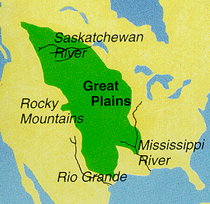
Great Plains
The relatively flat, grassy region of the U.S. between the Mississippi River and the Rocky Mountains is known as the Great Plains.
The states with the largest percentage of land used for agriculture are located in areas with relatively flat terrain.
Known for producing grain crops (aka food).

Slide 11
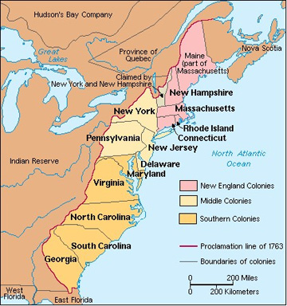
New England Colonies
Influenced by good harbors, abundant forests, rocky soil, and a short growing season.
Geographic factors influenced the economy of New England by promoting the growth of trade and manufacturing.

Slide 12
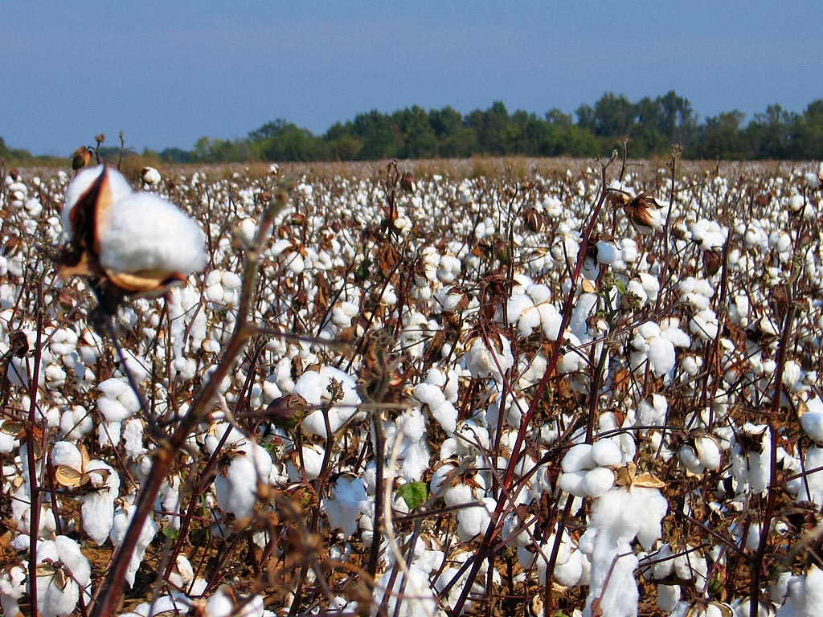
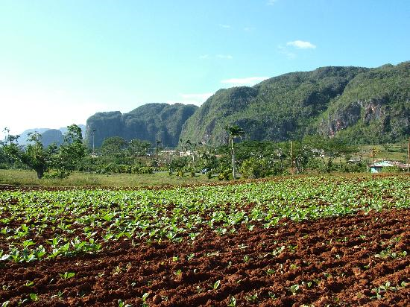
Southern Colonies
Early Crops: Tobacco, Indigo Dye, Rice
Later Crop: Cotton
The climate and topography of the southeastern U.S. had a major impact on the history of the U.S. before 1860 because the region provided agricultural products that were processed in the Northern states and in Europe.

Slide 13
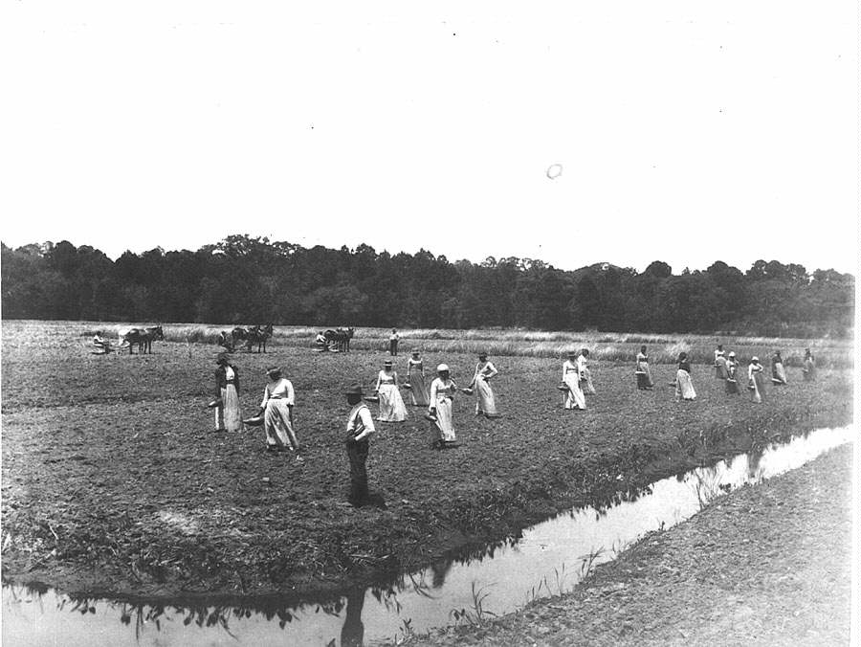

Southern Colonies
Slavery became more widespread in the South than in the North because geographic factors contributed to the growth of the southern plantation system.
Because of fertile land and a long growing season, plantations in the thirteen colonies developed in the South.

Slide 14
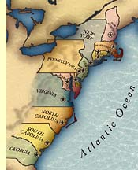
Summary
Based upon your notes and the lesson today;
Write at least one paragraph 5 sentences on how geographic factors influenced early U.S. history?
I will collect this by end of class. It will not be homework!

