Slide 1
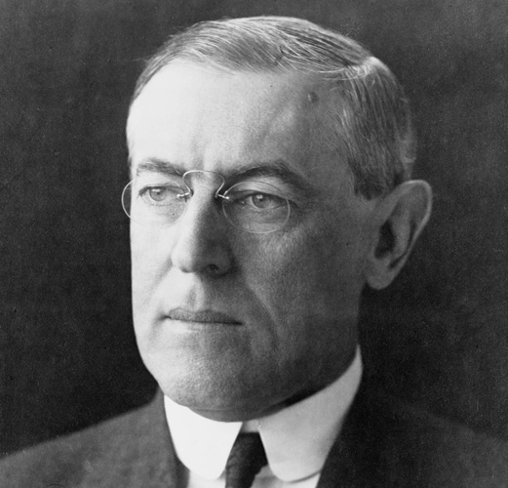
Presidency of Woodrow Wilson
And The Great War!
AIM: What were the results of Wilson’s presidency? How do they affect us today?
Do Now: Take Quiz – You have 5 Minutes

Slide 2
What steps did Wilson take to increase the government’s role in the economy?
Woodrow Wilson used the expanded power of the presidency to promote a far-reaching reform agenda.
Some of Wilson’s economic and antitrust measures are still important in American life today.

Slide 3
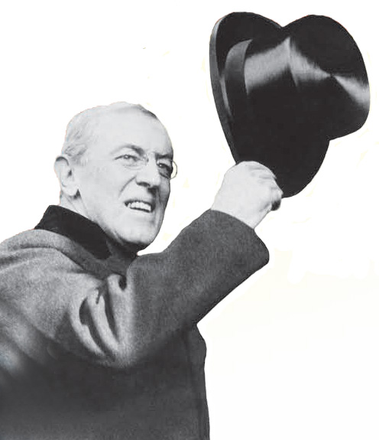
In 1912, the Republican Party was split between Progressives who backed Theodore Roosevelt and those loyal to incumbent William Howard Taft.
The split allowed Woodrow Wilson, the Democrat, to win easily in the Electoral College, though he did not receive a majority of the popular votes.

Slide 4
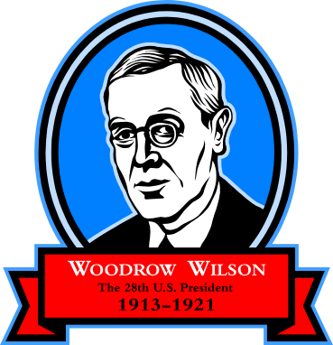
served as a college professor and President of Princeton University
served as Governor of New Jersey with a Progressive agenda
was the first southerner elected President in almost sixty years
Woodrow Wilson

Slide 5
Wilson felt that laws shouldn’t allow the strong to crush the weak. His New Freedom plan was similar to Roosevelt’s New Nationalism. It called for strict government controls over corporations.
Wilson promised to bring down the “triple wall of privilege,” tariffs, banks, and trusts.
In 1913, the Underwood Tariff Act cut tariffs leading to lower consumer prices.

Slide 6
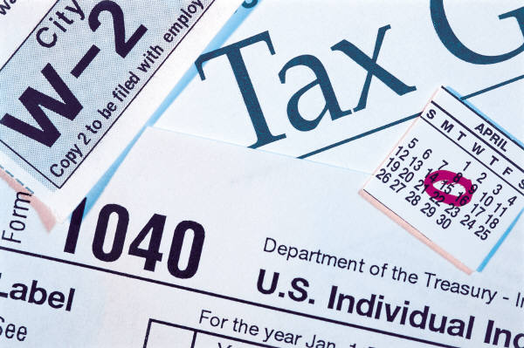
The Underwood Act also provided for the creation of a graduated income tax, first permitted in 1913, under the newly ratified Sixteenth Amendment.
Progressives like Wilson felt it was only fair that the wealthy should pay a higher percentage of their income in taxes than the poor.
Revenue from the income tax more than offset the loss of funds from the lowered tariff.

Slide 7
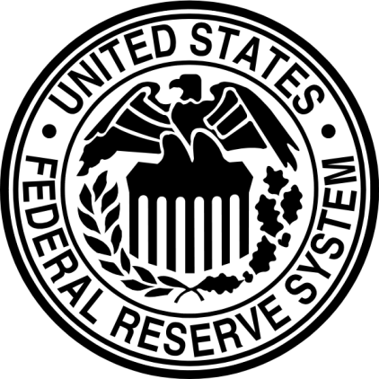
Wilson passed the Federal Reserve Act of 1913. It established a system of regional banks to hold reserve funds for the nation’s commercial banks.
Still in place today, the Federal Reserve protects against any one person, bank, or region from controlling interest rates.
Previously, a few wealthy bankers could manipulate interest rates for their own profit.

Slide 8
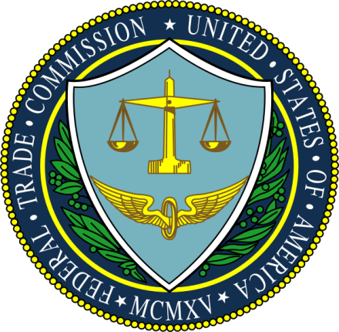
Wilson strengthened antitrust laws. Like Roosevelt, he focused on trusts that used unfair practices.
The Federal Trade Commission was created in 1914 to monitor businesses to prevent monopolies, false advertising, and dishonest labeling.
Still in effect today, the FTC also prosecutes dishonest stock traders and regulates internet sales.

Slide 9

Like Roosevelt, Wilson only opposed trusts that engaged in unfair practices.
The Clayton Act also protected unions from being defined as trusts, allowing them more freedom to organize.
In 1914, the Clayton Antitrust Act defined specific activities in which businesses could not engage.
Notes:
9

Slide 10
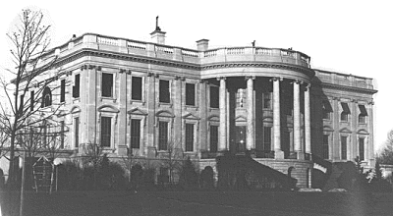
Many issues still remain involving dishonest sellers, unfair employment practices, and problems in schools, cities, the environment, and public health.
Progressives succeeded in establishing the idea that government can take action in these areas.
Notes:
10

Slide 11
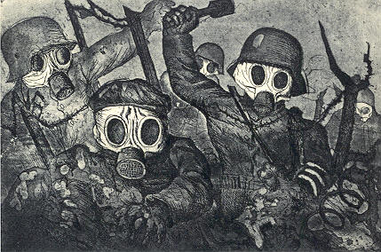
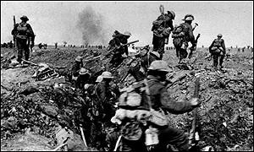
The United States and WWI
Up until 1917, the U.S. remained neutral in the war.
Woodrow Wilson was the President of the U.S. during WWI.
Wilson was re-elected and would serve until 1920.

Slide 12
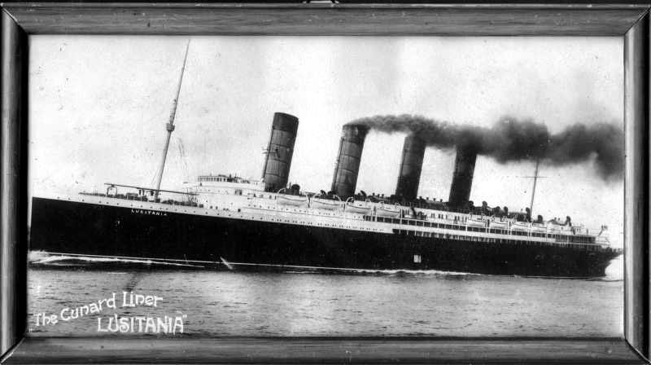
5 Reasons why the U.S. entered WWI
1. Neutrality Rights Violations - President Wilson warned Germany to respect our neutrality rights on the open seas, but they continued to attack and sink our ships.
2. Sinking of the Lusitania - A British passenger ship was sunk by a German
U-Boat killing 1,200 people, including
128 Americans.
Germany pledged not to attack merchant vessels without warning, but they would not honor this pledge.

Slide 13
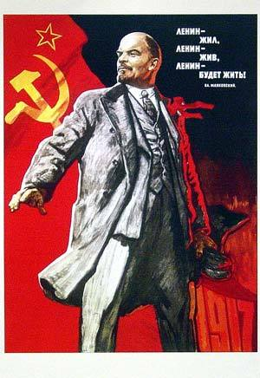
3. The Bolshevik Revolution of 1917 -
Czar Nicholas II of Russia is overthrown by the Bolshevik (Communist) Party led by Vladimir Lenin. Lenin will soon make peace with Germany and pull out of the war.

Slide 14
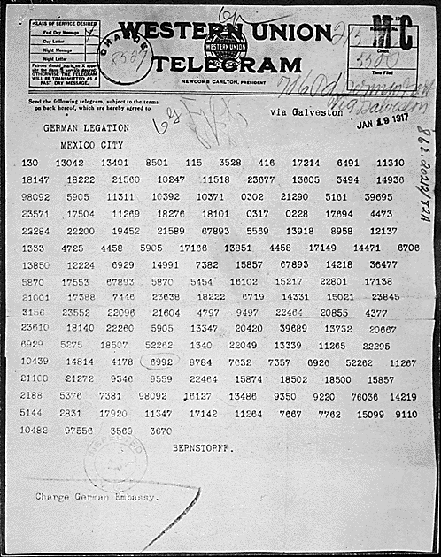
4. Allies Plea - for help from the U.S., because Britain and France need assistance.
5. Zimmerman Telegram -
A secret telegram sent by the German foreign minister Arthur Zimmerman to Mexico in 1917 urging Mexico to attack the U.S. if they got involved in WWI. The telegram was intercepted by the British and given to President Woodrow Wilson.

Slide 15
Terms and People
Woodrow Wilson – Progressive Democrat elected President in 1912
New Freedom – Wilson’s program to place strict government controls on corporations
Sixteenth Amendment – gave Congress the power to impose an income tax
Federal Reserve Act – placed the national banks under the control of a Federal Reserve Board
Federal Trade Commission – group appointed by the President to monitor business practices that might lead to a monopoly
Clayton Antitrust Act – strengthened anti-trust laws by spelling out specific practices in which businesses could not engage

