Slide 1
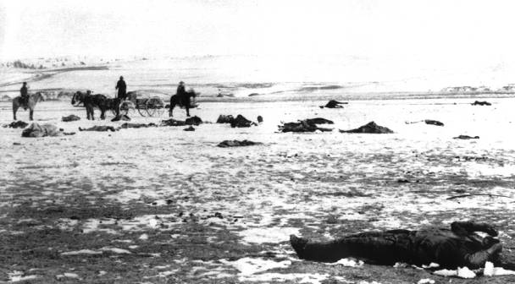
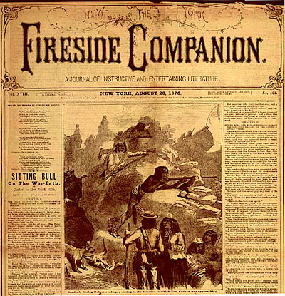
Indian Wars:
The Conquest of the Far West
Do Now: What was the previous Policy regarding American Indians? Name one.
AIM: What policies did the U.S. Government have towards American Indians after the Civil War?

Slide 2
NAMED CAMPAIGNS - INDIAN WARS
Miami | January 1790-August 1795
Tippecanoe | 21 September-18 November 1811
Creeks | 27 July 1813-9 August 1814 and February 1836-July 1837
Seminoles | 20 November 1817 - 31 October 1818, 28 December 1835 - 14 August 1842 and 15 December 1855 - May 1858
Black Hawk | 26 April-30 September 1832
Comanches | 1867-1875
Modocs | 1872-1873
Apaches | 1873 and 1885-1886
Little Big Horn | 1876-1877
Nez Perces | 1877
Bannocks | 1878
Cheyennes | 1878-1879
Utes | September 1879-November 1880
Pine Ridge | November 1890-January 1891

Slide 3
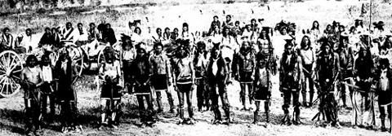
The Sioux wars (1854-90) | The Nez Perce War (1877)
The Southern Plains (1860-79) | Navaho Conflicts (1846-64)
Apache Warfare (1861-1900)
Notes:
The Indian Wars of 1850-1900
The Sioux wars (1854-90)
Minnesota 1862: hundreds of settlers massacred in Sioux uprising.
Wyoming 1868: Red Cloud forces US government to give up three forts.
Montana 1876: Crazy Horse defeats general George Crook (1829-90) at battle of Rosebud.
South Dakota 1876: Crazy Horse and Sitting Bull defeat Custer at battle of Little Bighorn.
North Dakota 1890: soldiers massacre 153 Sioux at Wounded Knee.
The southern plains (1860-79)
Colorado 1864: US army kill peaceful Cheyenne and Arapaho in Sand Creek massacre.
Missouri 1874: in Red River War general Sheridan wins campaign after 14 battles.
The Nez Perce War (1877)
Montana 1877: Chief Joseph leads his people in 1300km retreat while trying to reach Canada.
Navaho conflicts (1846-64)
Arizona 1863-64: Navaho defeated by troops led by Kit Carson.
Apache warfare (1861-1900)
Arizona 1886: Apache chief Geronimo leads one of the last major uprisings against US government.

Slide 4
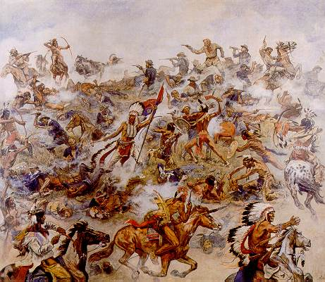
Battle at the Little Bighorn

Slide 5
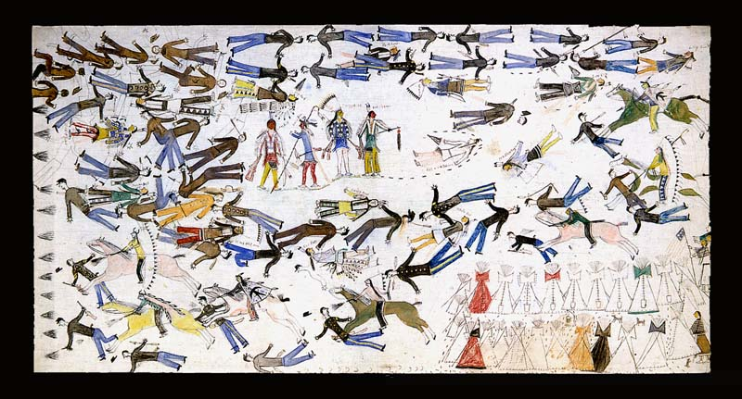
The Laramie Agreement
In late 1875, Sioux and Cheyenne Indians were angered at the whites travelling into their sacred lands in the Black Hills.
Gold had seen many miners entering the sacred land

Slide 6
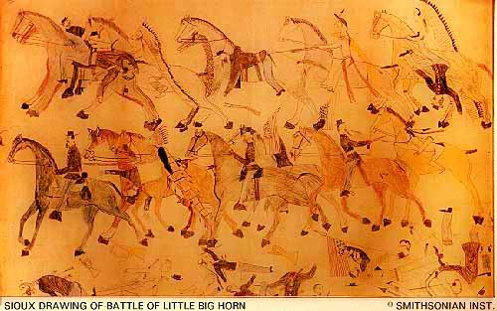
Promises Broken
The US Government had promised Red Cloud that white settlers would not be allowed to settle here. This was part of the Fort Laramie Treaty.
The Sioux gathered with Sitting Bull to fight for their lands.

Slide 7
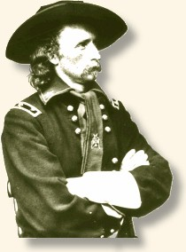
CUSTER
To force the large Indian army back to the reservations, the Army sent Lt. Colonel George Custer and the Seventh Cavalry.
Spotting the Sioux village about fifteen miles away along the Rosebud River on June 25, Custer also found a nearby group of about forty warriors.

Slide 8
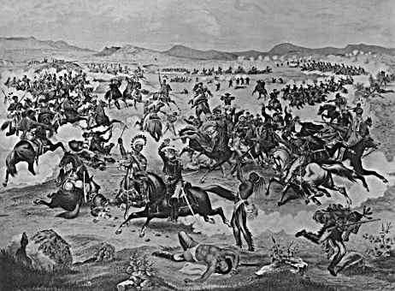
Out Numbered
Ignoring orders to wait, he decided to attack before they could alert the main party.
He did not realize that the number of warriors in the village numbered three times his strength.

Slide 9
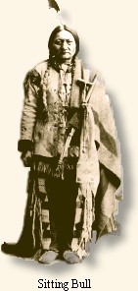
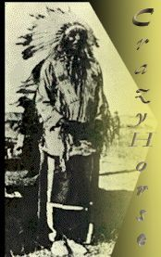
Crazy Horse
Cheyenne and Hunkpapa Sioux together crossed the river and slammed into the advancing soldiers, forcing them back
Meanwhile, another force, largely Oglala Sioux under Crazy Horse's command, surrounded Custer and his men in a pincer move. They began pouring in gunfire and arrows.

Slide 10
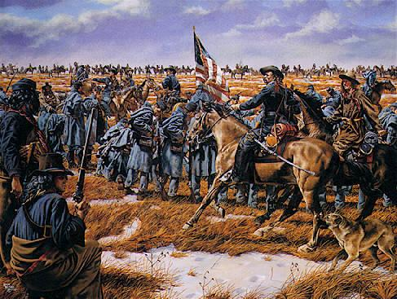
Last Stand
As the Indians closed in, Custer ordered his men to shoot their horses and stack the carcasses to form a wall, but they provided little protection against bullets.
In less than an hour, Custer and his men were killed in the worst American military disaster ever.

Slide 11
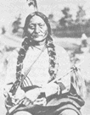

REVENGE
Little Bighorn showed the Indians' power. They had achieved their greatest victory
Outraged over the death of a popular Civil War leader the US Government fought back

Slide 12
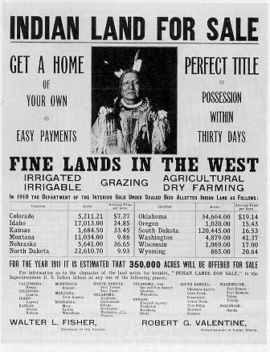
The Conquest of the Far West
The Dispersal of the Tribes
  The Dawes Act (1887)
    Gradual elimination of
    Tribal Ownership
    Separation of Tribes
    Americanization of Indians
    Gave land to White Settlers
Notes:
1990 Census: Official Count of American Indian Population
The 1990 Census counts for 542 federally recognized tribes in the United States.
The census results show that the 10 American Indian tribes
with the highest number of individuals who identified with a tribe are:
Cherokee 308,132
Navajo 219,198
Chippewa 103,826
Sioux 103,255
Choctaw 82,299
Pueblo 52,939
Apache 50,051
Iroquois 49,038
Lumbee 48,444
Creek 43,550
Cherokees were found in 35 out of 50 states.
The highest number of Cherokees were found in Oklahoma; the next, California.

Slide 13
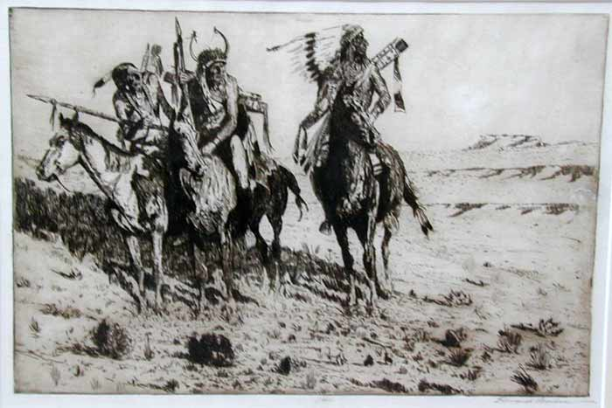
The Wounded Knee Massacre occurred on the banks of
Wounded Knee Creek about twenty five miles west of current day town of Martin, South Dakota on December 29, 1890.

Slide 14
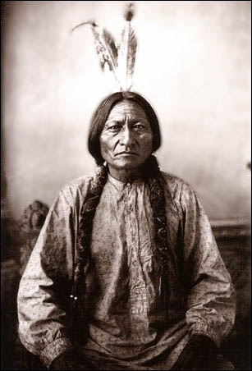
Sitting Bull
Born: 1831 in South Dakota near Grand River
Sioux Indian nominated to be a Hunkpapa Chief in 1866, a warrior, spiritual leader and politician
Died: December 14, 1890 in South Dakota at his Grand River camp
Sitting Bull refused to attend the treaty at Fort Laramie in 1868. Sitting Bull fought the surveyors over the Northern Pacific Railroad in 1872
On June 25, 1876 Sitting Bull fought Custer at the Battle of the Little Big Horn. May of 1877 retreating to Canada Sitting Bull stayed with his tribe until 1881.
Enduring harsh punishment Sitting Bull was detained as a prisoner of war at Fort Randall from '81 - '83
In 1885, Sitting Bull traveled around the world as a star performer with Buffalo Bill Cody and his Wild West Show
In 1890, Sitting Bull was killed by Red Tomahawk who was one of the Sioux police sent by Agent James McLaughlin

Slide 15
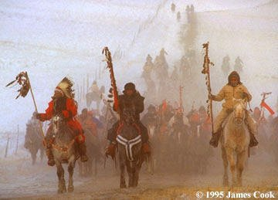
Tension was running high leading up to the Wounded Knee Massacre due to the murder of Sitting Bull on December 15 which caused some of the Miniconjou Sioux Indians and Hunkpapa Sioux Indians to leave the reservations and head toward the Badlands.

Slide 16
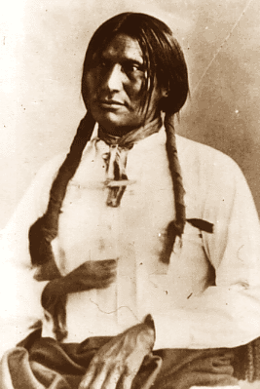
After Sitting Bull's death, Big Foot feared for the safety of his band, which consisted in large part of widows of the Plains wars and their children. Big Foot himself had been placed on the list of "fomenters of disturbances," and his arrest had been ordered. He led his band toward Pine Ridge, hoping for the protection of Red Cloud. However, he fell ill from pneumonia on the trip and was forced to travel in the back of a wagon.

Slide 17
He tried to find safety at the town of Pine Ridge, but the soldiers found him first. Dying of pneumonia, Big Foot surrendered peacefully. He had the misfortune to fall into the hands of the seventh Calvary. They brought the Indians to a campsite near Wounded Knee, already well within the borders of the reservation.

Slide 18
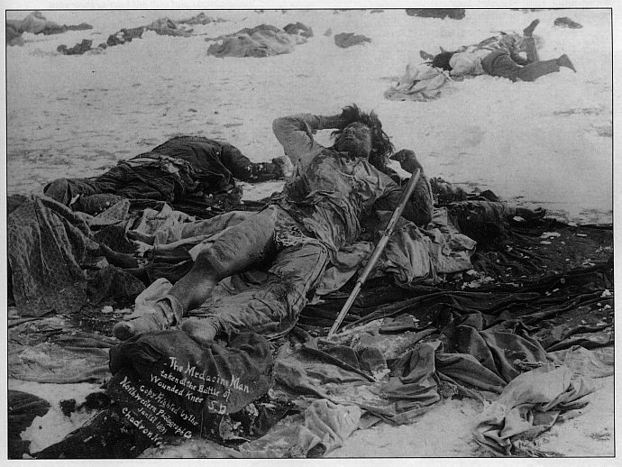
No one knows what caused the disturbance, no one claims the first shot, the Wounded Knee Massacre began fiercely with the Hotchkiss guns raining fragmentation shells into the village at a combined rate of 200 or more rounds a minute. The 500 well armed Cavalry Troopers were well positioned using crossing fire to methodically carry out what is known as the Wounded Knee Massacre.

Slide 19
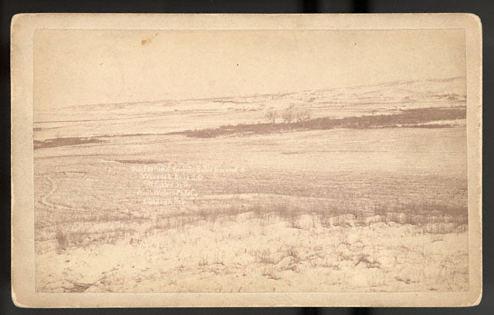
Almost immediately most of the Sioux Indian men were killed. A few Sioux Indians mustered enough strength barehanded to kill 29 soldiers and wound 39 more. The bravery of these people was to no avail for as long as an Indian moved, the guns kept firing. Unarmed Sioux Indian Women and children were mercilessly massacred. A few ran as far as three miles only to be chased by the long knives of the Cavalry and put to death

Slide 20
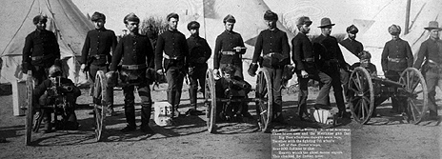
Officers and men were revengeful and trigger-happy.. The Hotchkiss guns were pouring shells into groups of mothers and children.

Slide 21
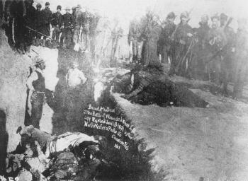
Of the original 350 Indians one estimate stated that only 50 survived. Almost all historical statistics report over 200 Indians being killed on that day. Government figures only reported the Indian dead as 64 men, 44 women and girls, and 18 babies. All of the bodies were buried in one communal grave.

