Slide 1
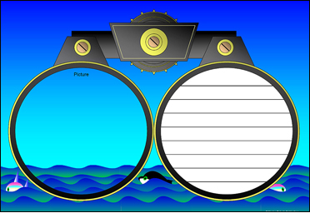
Annotating
Text to Deepen Understanding
Mr. Ott
Ms. Walsh
Mr. Tieri
@ BETA

Slide 2

What is an Annotation?
Annotation is a note of any form made while reading text.
“Reading with a pen/pencil.”

Slide 3
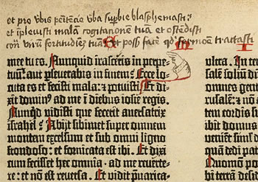
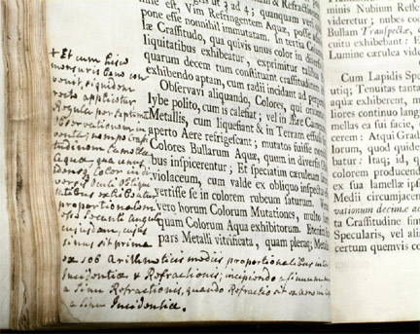
People have been annotating texts since there have been texts to annotate.

Slide 4
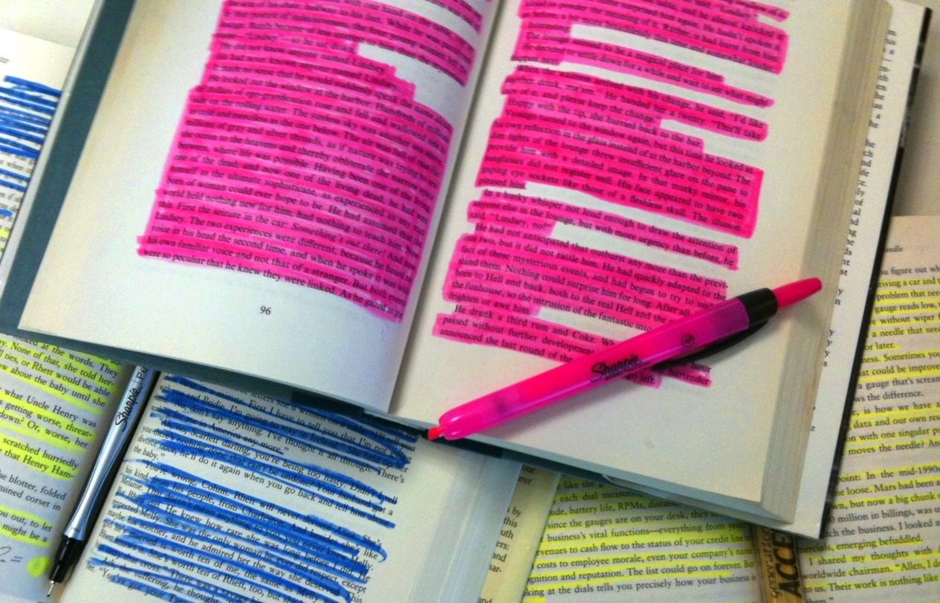
Annotation is not highlighting.

Slide 5

Annotation slows down the reader in order to deepen understanding.

Slide 6
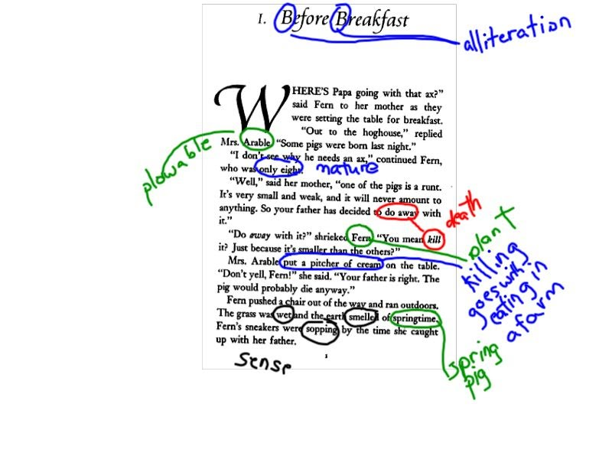
Middle school student’s annotation of connotative meanings in Charlotte’s Web
Notes:
It’s not always about reading difficult texts, but also about reading seemingly simpler texts in more complex ways.

Slide 7
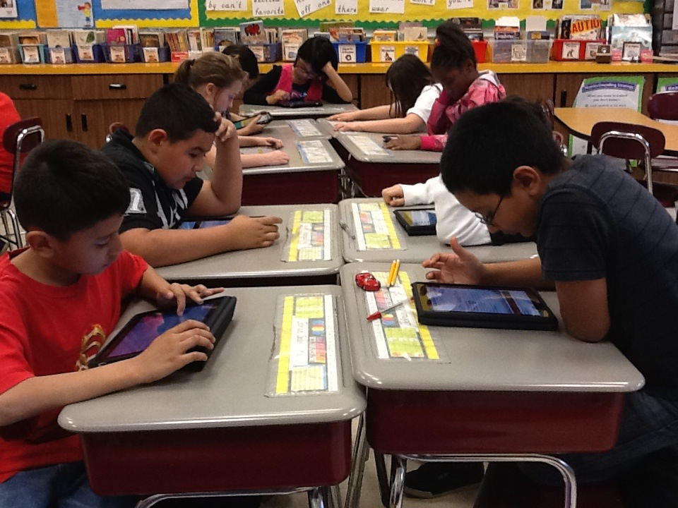
Annotation occurs with digital and print texts.

Slide 8




Annotation Guide
Directions: As you read, use the following symbols to indicate…
What you know
What you didn’t know
What you don’t understand
What you learned by_______

