Slide 1
Manifest Destiny
From Sea to Shining Sea
Aim: What were the causes of Westward Expansion?
Do Now: What did President Thomas Jefferson do to allow for expansion of the United States?

Slide 2


Slide 3
Manifest Destiny
The idea that the United States
should occupy all of the land between the Atlantic and
Pacific Oceans.

Slide 4
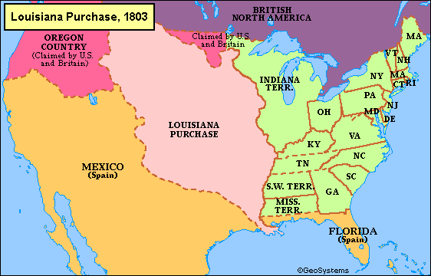
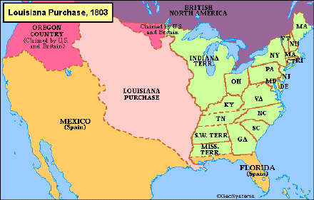
Louisiana Purchase – 1803
Goal: state original goal or goals of project
  List key metrics (items for measuring success)
Actual: summarize what really happened in relationship to goals
  List progress against metrics

Slide 5
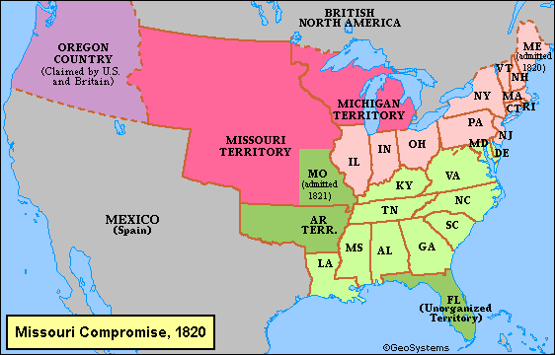
Missouri Compromise - 1820

Slide 6
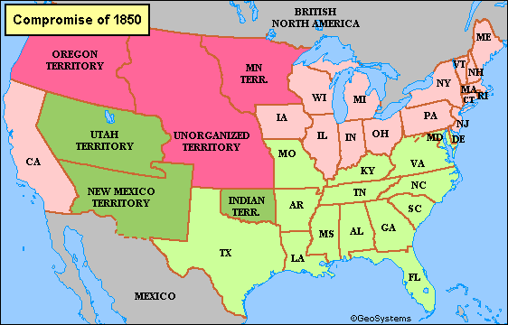
Compromise of 1850

Slide 7
Missouri Compromise 1820
Missouri
Enters Union
as a SLAVE State
Slavery not permitted above 36-30 Parallel Louisiana Territory
Compromise of 1850
California
Enters Union
as a FREE State
Fugitive Slave Law
Could Go & Get Runaway Slaves in the North
Popular Sovereignty
People in New Mexico & Utah Territories could Vote on it when they entered as States

Slide 8
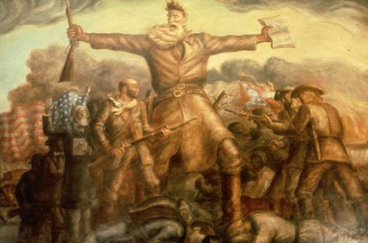
Kansas-Nebraska Act (1854)
Congress decided
to extend popular sovereignty to the unsettled areas of the
Louisiana Purchase, now known as the Kansas and
Nebraska territories.
This act led to violence and a prelude to the Civil War as pro-abolition and pro-slavery forces flooded Kansas to sway the vote, in what became known as Bloody Kansas.

Slide 9
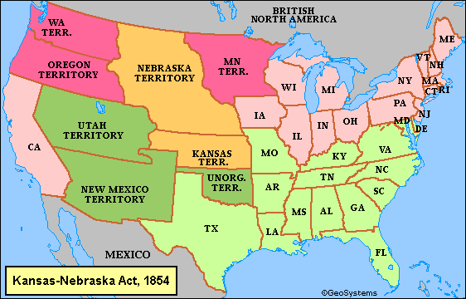
Kansas-Nebraska Act - 1854

Slide 10
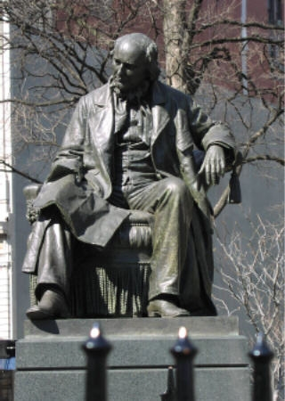
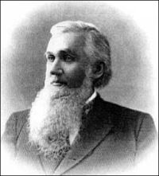
"Go West, young man, and grow up with the country."
The quote first appeared as the title to the 1851, Terre Haute Express editorial written by Mr. Soule.
Along with being wrongly credited to Mr. Greeley, it has also often been misquoted.
Horace Greeley is often credited with a famous
quote actually made by
John B. L. Soule.

