Slide 1
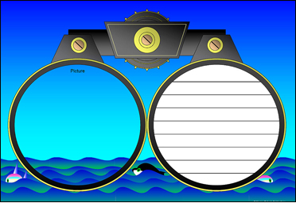
Annotating
Text to Deepen Understanding
Mr. Ott
Ms. Walsh
Mr. Tieri
@ BETA

Slide 2

What is an Annotation?
Annotation is a note of any form made while reading text.
“Reading with a pen/pencil.”

Slide 3
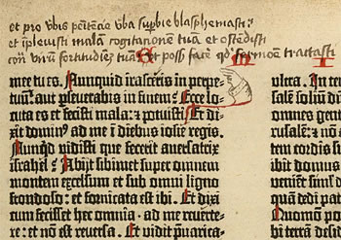
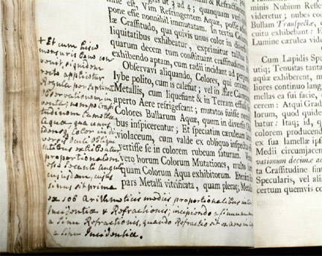
People have been annotating texts since there have been texts to annotate.

Slide 4
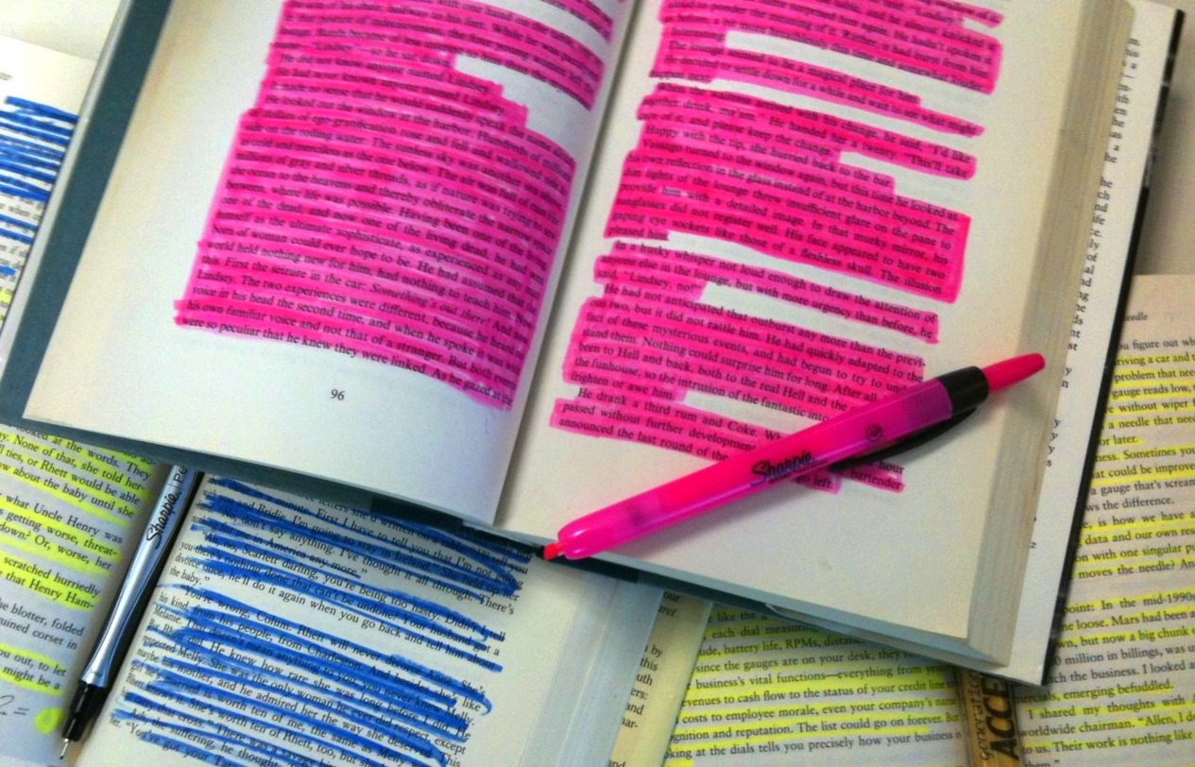
Annotation is not highlighting.

Slide 5

Annotation slows down the reader in order to deepen understanding.

Slide 6
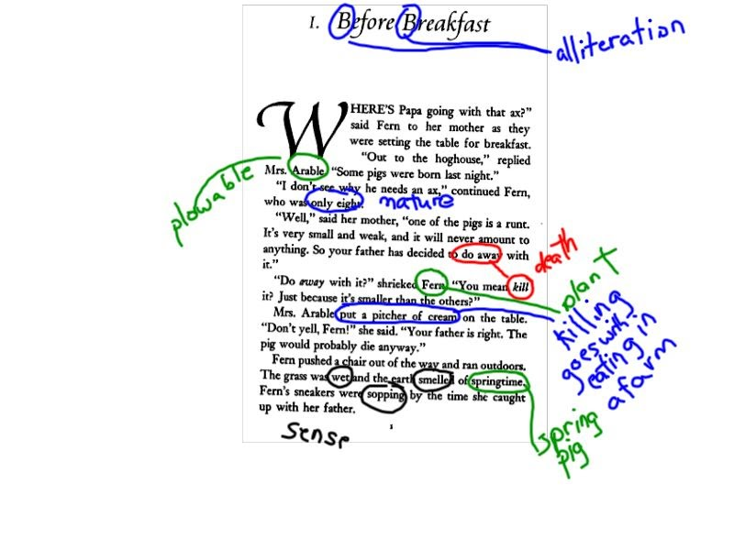
Middle school student’s annotation of connotative meanings in Charlotte’s Web
Notes:
It’s not always about reading difficult texts, but also about reading seemingly simpler texts in more complex ways.

Slide 7
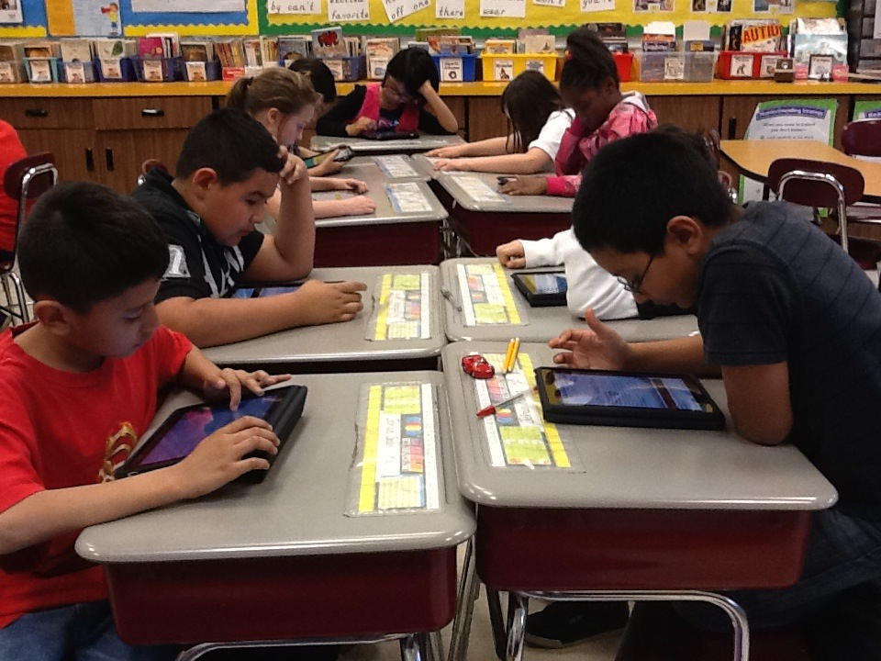
Annotation occurs with digital and print texts.

Slide 8




Annotation Guide
Directions: As you read, use the following symbols to indicate…
What you know
(Information you knew)
What you didn’t know
(New Information)
What you don’t understand
(Questions you have)
What you learned
(Found out)

