Slide 1
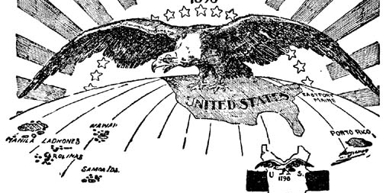
America & The Age of New Imperialism
1867-1920
Aim: How and why did the United States take a more active role in world affairs?

Slide 2
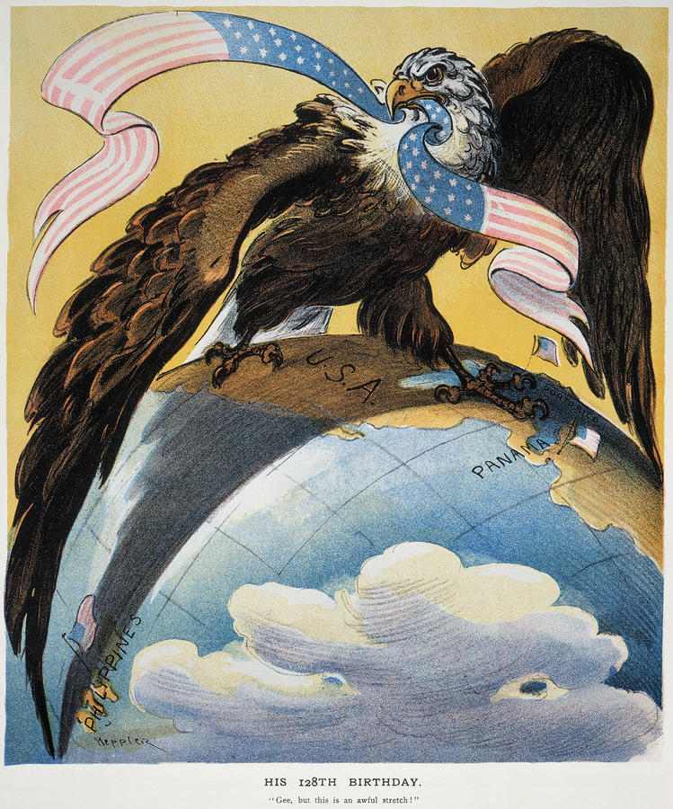
Aim: How and why did the United States
take a more active role in world affairs?
For most of its early history, the United States played a small role in world affairs. But in the late 1800s, some began calling for the U.S. to join the ranks of the world’s major powers.
Eventually, the United States abandoned isolationism and began to acquire influence and territories outside its continental borders.

Slide 3
THE NEW IMPERIALISM
Colonial economies were based on removing raw materials. The imperialist nations built strong armies and navies to protect their interests.
There were strong economic incentives for the U.S. to also adopt a policy of imperialism to obtain raw materials like rubber, iron, and oil.
American entrepreneurs also sought new overseas markets for their manufactured and agricultural products.
Notes:
3

Slide 4
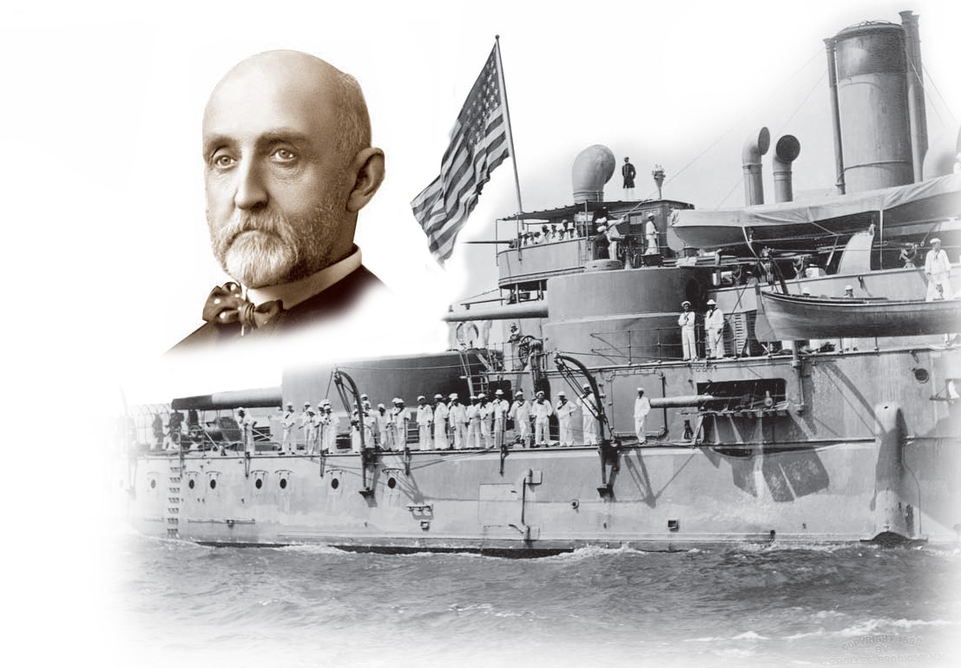
In The Influence of Sea Power Upon History, historian Alfred T. Mahan argued that all great nations owed their greatness to naval power.
He urged construction of a fleet of steel ships, acquisition of overseas bases, and construction of a canal across Central America.
The U.S. eventually followed all of his recommendations.
Notes:
4

Slide 5
THE NEW IMPERIALISM
Imperialists justified their actions based on beliefs about their own racial, national, and cultural superiority.
Social Darwinism applied Darwin’s theories of natural selection to societies. In a competitive world, only the fittest nations survive.
Americans extended their belief in Manifest Destiny overseas, justifying imperialism as God’s will.
Notes:
5

Slide 6
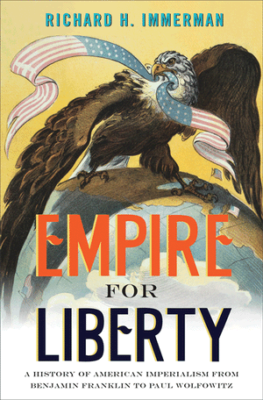
Historian Frederick J. Turner argued that the frontier served as a “safety valve,” siphoning off potential discontent in the U.S.
Turner’s followers urged overseas expansion as America’s next frontier to avert future discontent in the U.S.
Notes:
6

Slide 7
Early U.S. Territories
In 1867, Secretary of State William Seward purchased Alaska from Russia for $7.2 million.
  Critics mocked “Seward’s Icebox” and “Seward’s Folly” as a far off and useless frozen tundra.
  But, valuable resources including gold, timber, and oil were found.
  Alaska also doubled America’s territory.

Slide 8
Early U.S. Territories
  In the 1790s Americans planters established sugar cane plantations in Hawaii.
    In 1887, these planters gained control of the government from King Kalakaua.
    In 1891, Queen Liliuokalani, attempted to regain control of her island.
    In 1893, with the help of U.S. Marines, the Queen was dethroned. President McKinley backed annexation when he took office.
In 1898 Congress voted to annex Hawaii.

Slide 9
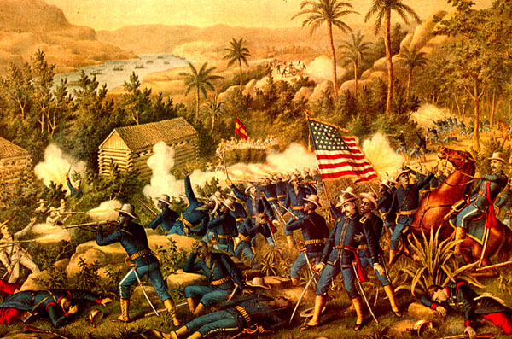
The Spanish-American War

Slide 10
The Cuban Rebellion
Cubans longed for their colonial ruler Spain to leave
Spain smashed and defeated a Cuban rebellion forcing Jose Marti to flee to the U.S. to gather money, arms, and troops
In 1895, Marti returned to Cuba and led a revolt
Many people including Marti died. The rebels burned sugarcane fields hoping to get the Spaniards to leave
The Spaniards retaliated by herding Cubans into concentration camps to separate them from the rebels
Thousands died in the camps from starvation and disease
The Cuban struggle got the attention of U.S. businessmen who wanted to protect their investments and trade with the island
Others were afraid of rebellion so close to the U.S.
President Grover Cleveland opposed U.S. intervention
When William McKinley became President he too looked to keep the U.S. out of the war

Slide 11
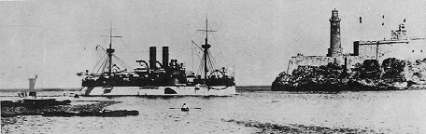
Remember The Maine
After rioting broke out in the Cuban Capital of Havana President
McKinley sent the battleship Maine to protect American citizens
and property.
After three weeks the ship exploded and sunk in Havana Harbor
killing about 260 officers and crew.
American Newspapers blamed the Spanish and the slogan
“Remember The Maine” became a rallying cry for revenge
and war against Spain
When negotiations failed to easy American concerns Congress
recognized Cuban independence
On April 25, 1898 Congress declared war on Spain

Slide 12
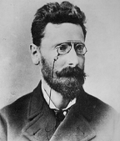
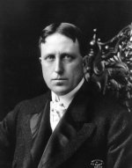
Yellow Journalism
1898, newspapers provided the major source of news in America.
At this time, it was common practice for a newspaper to report the editor's interpretation of the news rather than objective journalism.
If the information reported was inaccurate or biased, the American public had little means for verification.
With this sort of influence, the newspapers wielded much political power.

Slide 13
Yellow Journalism
In order to increase circulation, the publishers of these papers often exploited their position by sponsoring a flamboyant and irresponsible approach to news reporting that became known as "yellow journalism."
The term was used to describe the journalistic practices of Joseph Pulitzer & William Randolph Hearst. Of the two men today, it is Hearst’s name that is synonymous with "yellow journalism. The two men used the practice to help stir the American public to a call for war with Spain

Slide 14
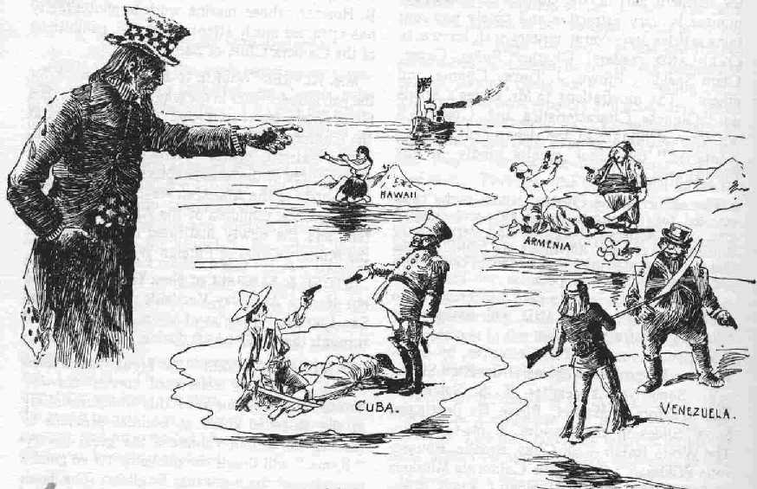
Fighting in Cuba
The Spanish fleet entered the harbor of Santiago in Cuba on
May 19
An American naval force trapped the Spanish in the harbor and blockaded the coast
An American land force of 17,000, one quarter
of which was African American landed near the city
Much of the U.S. force was ill-equipped yet, they joined forces with the Cuban rebels and engaged the Spanish

Slide 15
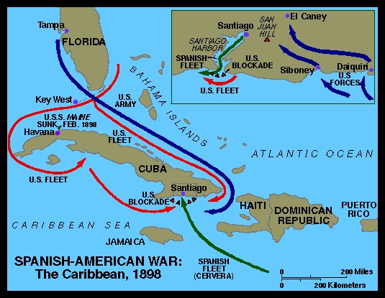

Slide 16
Fighting in Cuba
Teddy Roosevelt had resigned his position as Secretary of the Navy to join the fighting in Cuba. He led the 1^{st.} Regiment of U.S. Cavalry Volunteers known as the Rough Riders
On July 1, the Rough Riders along with African American soldiers of the Ninth and Tenth Cavalries, joined in the Battle of San Juan Hill
The Americans captured San Juan Hill after intense fighting.
This led to a Spanish attempt at retreat by breaking out of the blockade of Santiago, after a four hour battle the Spanish fleet was destroyed. This ended Spanish resistance in Cuba

Slide 17
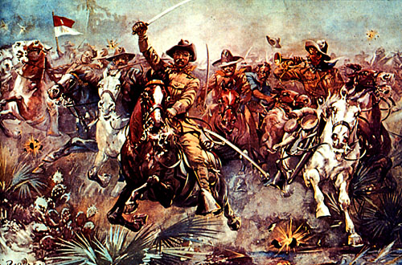
The Rough Riders

Slide 18
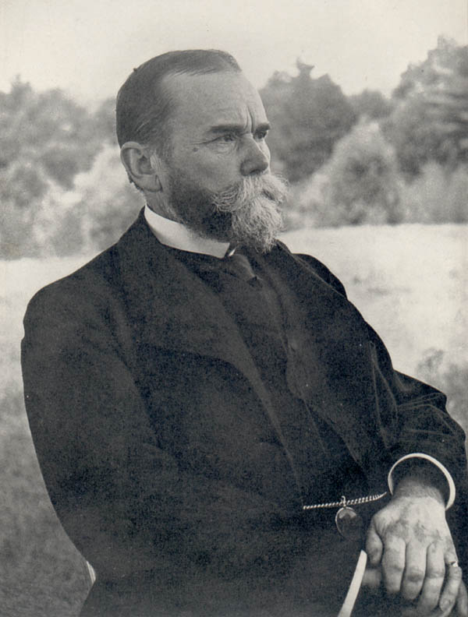
The Spanish American War in the Pacific
“A Splendid Little War”
Although events in Cuba started the War the first military action was seen in the Spanish colony of the Philippines. In 1901 William Howard Taft transferred authority to the Filipinos who gained full independence in 1946.
Secretary of State John Hay called the Spanish American War
“a splendid little war”
The war lasted four months and 400 Americans died.
More than 2000 additional died from tropical diseases like yellow fever and malaria
African Americans faced discrimination and segregation in the military battling alongside the Cuban rebel army where black and white troops fought as equals

Slide 19
American Acquisitions
The U.S. and Spain signed The Treaty of Paris Dec. 10, 1898 marking an end to the war
Cuba became a U.S. protectorate (an independent country under control of another country)
Puerto Rico and Guam became territories of the U.S. Spain also surrendered the Philippines to the U.S. for $20 million
In 1901, the U.S. granted Cuba independence but only if their new constitution included concessions to the U.S. known as the Platt Amendment
The amendment prohibited Cuba from making treaties with other nations and gave America control of the U.S. naval base at Guantanamo Bay. The U.S. could also interfere in Cuban affairs if the countries independence was threatened

Slide 20
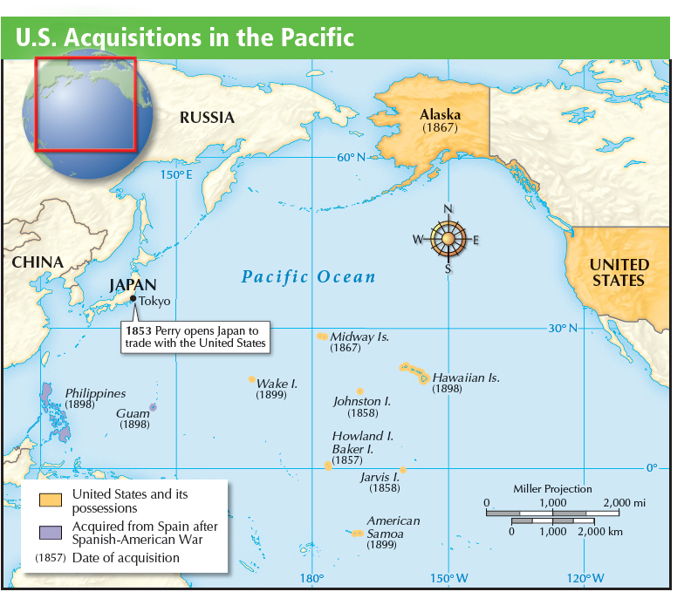

Slide 21
Classwork Activity:
Paragraph Writing.
1. Is the U.S. considered an Imperial power if it expands influence & territory overseas? Use at least 3 examples from the lesson.
2. Define/List any economic influence?
3. Define/List any Social Influence?
4. Define/List any Political Influence?

