Slide 1
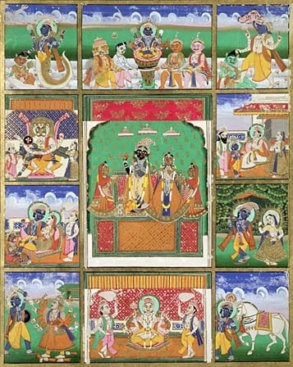
The Caste System

Slide 2
The Caste System
So, the Caste System began in India after the Aryans invaded and established their own rules for governing the society.
The Aryans did not permit marriages between their own people and people of the cultures they conquered.
This was very different from the Romans, who encouraged the people they conquered and the soldiers to marry.

Slide 3
The Caste System
A caste is a division of society based on occupation and family ancestry. The caste system was based on birth. People inherited caste from their parents and passed it on to their children.
Each caste had its own specific place in society. They socialized, ate, married, worked, and worshipped within their own caste. They would never consider marrying or working outside their caste.

Slide 4
The Caste System
The caste system, then, was based upon idea that people are different, so they should have different roles.
From 1000 to 500 BC, four classes of people emerged in India. Really there are 5 groups, however the untouchables are considered so low that they aren’t even counted.

Slide 5
The castes upper class

Slide 6
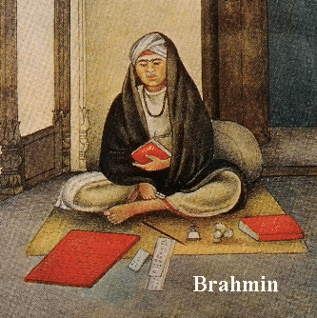
BRAHMAN
Priestly Class (Priests)
Study the Vedas
(sacred scriptures/texts)
Perform rituals for
themselves & others
Men who are between
the gods & people
To have excellent behavior
Pursuit of divine knowledge
Preserve the traditions of
Hinduism

Slide 7
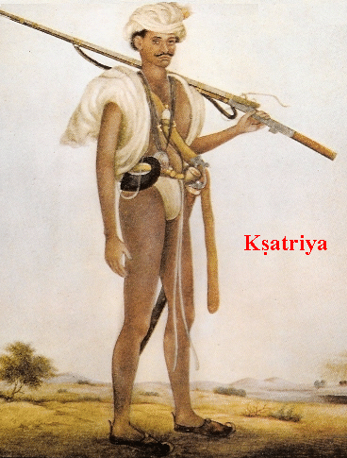
KSHATRIYAS
warrior class
protected the people
give gifts to the Brahmins
offer sacrifices to
gods & ancestors
study the Vedas
dispense justice.
protect the caste system
& social order

Slide 8
The castes middle class

Slide 9
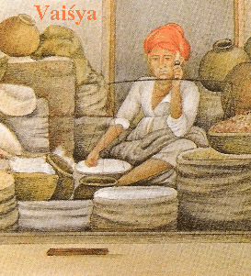
VAISYAS
They are the merchant and peasant classes, who are expected to tend cattle, offer sacrifices, study the Vedas, trade, lend money and farm the land.
They had the right to perform and participate in certain Vedic rituals but they were not allowed to marry women of higher castes.

Slide 10
The castes lowest classes

Slide 11
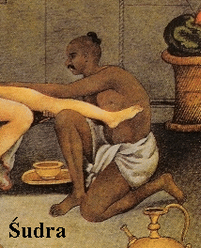
SUDRAS
The are the laboring class, whose only duty is to serve the other three castes.
They were not required to observe any Vedic rituals. They were not allowed to study the Vedas or even hear the sacred chants.
They were not allowed to eat food in the company of higher castes or marry their women.

Slide 12
SUDRAS
HARIJAN also called
Untouchables
The lowest of the sudras were called harijan or the untouchables. They were outside of the caste system because of their religious practices, rites and unclean habits.
In ancient times they were not allowed to enter a village or city during day time or walk in the same street where men of other castes walked.

Slide 13
SUDRAS
HARIJAN also called
Untouchables
Even their shadow was considered impure and seeing an untouchable was considered bad luck.
So they lived mostly on the edges of society, unknown and uncared for, and working in graveyards or as hunters, butchers and professional cleaners of human waste.

Slide 14
Varna
Social Hierarchy
Brahmins
Kshatriyas
Vaishyas
Shudras
Outcasts [Harijan] → Untouchables

Slide 15
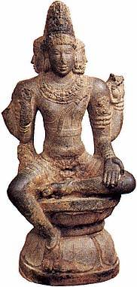
Varna
WHO IS…
Brahmins
The mouth?
The arms?
The legs?
The feet?
Kshatriyas
Vaishyas
Shudras

