Slide 1
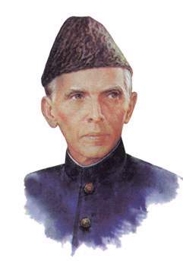
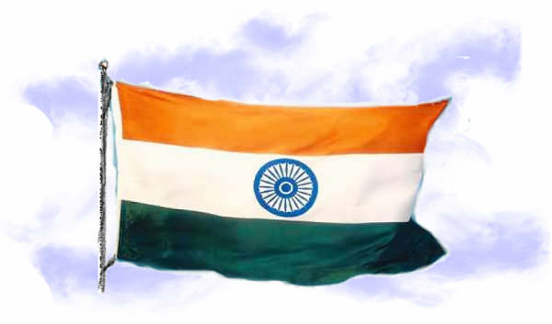
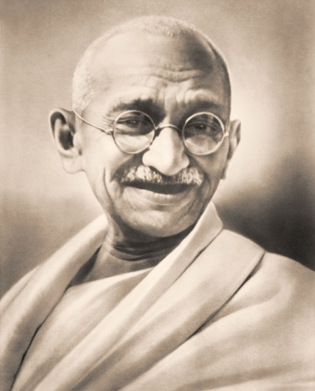
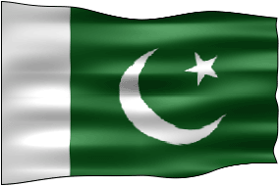
Indian Independence and Partition

Slide 2
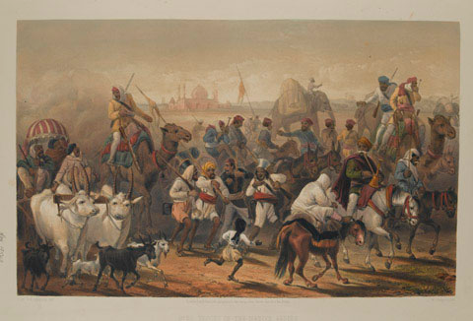
Sepoy Rebellion 1857-1859
  A mutiny arose by Indian troops stationed in Delhi.
  Results
    1.) British and Indian attitudes changed towards British rule of India
    2.) Year long insurrection
    3.) Dissolution of the British East India Company
    4.) Beginning of British Raj, when Great Britain ruled India directly

Slide 3
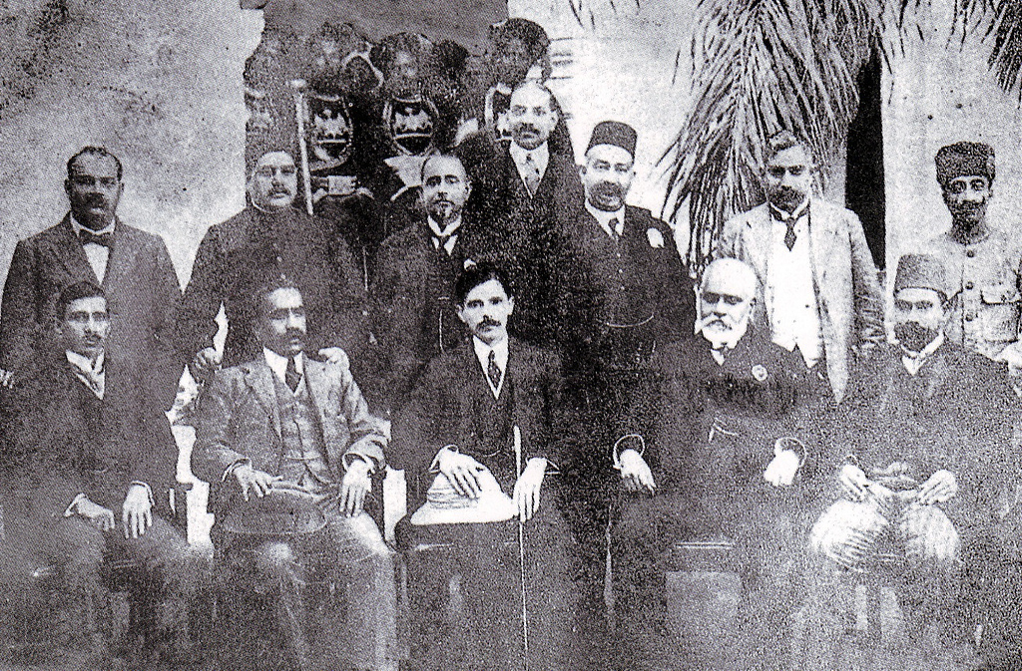
India: Indian National Congress
Goals: Democracy, Local Self-Rule, Prevent mass peasant uprising (like China) by keeping power centered on middle class leaders.
Notes:
Formed in 1885 - Claimed to represent all Indians.
Members were middle class professionals, western educated elite Indians. Growth of Indian nationalism - presented grievances to the British.

Slide 4
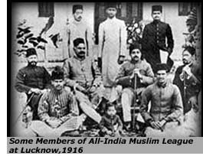
India: The Muslim League Forms, 1906
Goals:
Protect the interests, liberties and rights of Muslims
Promote an understanding between the Muslim community and other Indians - discourage violence.
Muslims mistrusted Hindu domination of the INC.
Notes:
Formed in 1906 – concerned about the future of Muslims, minority group in India; Muslims mistrust Hindu domination in the Congress Party

Slide 5
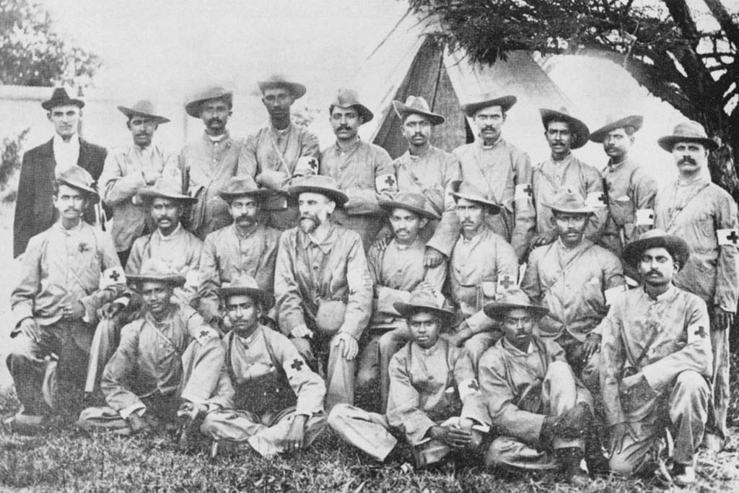
Major Events
WWI: 1914-1919
  Britain promises India self-rule if they help fight in the war
  Gandhi supports war effort in hopes of achieving self-rule for India
  When war ends, Britain made a few reforms and refused to grant India self-government
Notes:
Gandhi was a stretcher-bearer with the Ambulance Corps. This picture is in South Africa, 1899 during the Boer War.

Slide 6
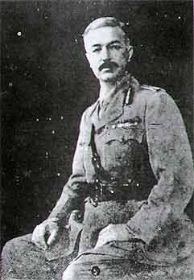
Major Events
The Amritsar Massacre of 1919
How did the Amritsar massacre change the attitude and goals of the Indian National Congress and Muslim League?
General Dyer
Notes:
British general banned public meetings in the city of Amritsar
Many people ignored the order and conducted an independence meeting
The General and his troops opened fire of the crowd killing 379 and wounding 1100

Slide 7
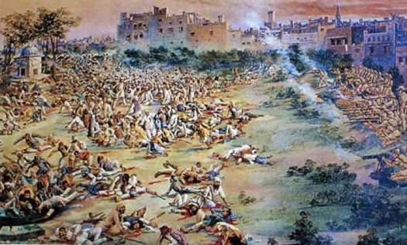
Gandhi said, “Cooperation in any shape or form with this satanic government is sinful.”

Slide 8
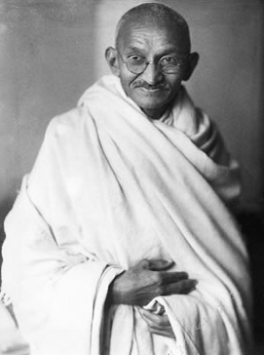
Mohandas Gandhi
Mohandas Gandhi (1869-1948) was one of the major spiritual and political figures in the move for Indian independence
For years, Gandhi struggled to keep the Muslims active in Congress so India would not have to suffer the consequence of separation and losing unity.
Not only did Gandhi use non-violent and non-cooperative methods, but he also repudiated much of the hatred that some Indians felt towards Hindus and Muslims.
"Leave India to God. If that is too much,
then leave her to anarchy."
--Gandhi, May 1942
Above: Mohandas Gandhi pictured in 1930
Notes:
Main Details of Partition

Slide 9

Mohandas K. Gandhi,
The “Mahatma” or Great Soul
Civil Disobedience is the refusing to obey unjust laws and purposely breaking them
Passive resistance is non-violent protests using two major aspects:
  Satyagraha (“truth or soul force”)
  Ahimsa (causing no harm to any living thing)
“Satyagraha is a weapon of the strong; it admits of no violence under any circumstance whatsoever; and it ever insists upon truth.”
Notes:
Gandhi emerges as spiritual leader for Indian Independence
Satyagraha = “soul force” Opponents must be weaned from error by patience and compassion
Ahimsa = “Love for all”

Slide 10
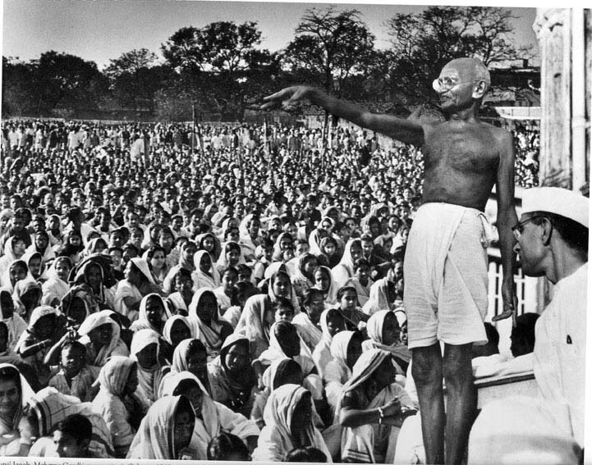
Message to the Masses
According to Gandhi, what are his three goals to win independence from Great Britain?
1. Hindu-Muslim Unity
2. Must end “untouchability”
3. Must defy the British – Not through violence

Slide 11
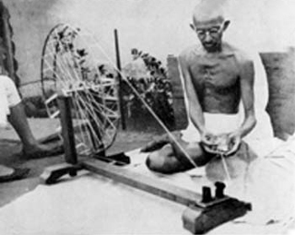
Gandhi Leads Non-Violent Protests
Boycotts British goods
Goes on Hunger strikes in prison and to stop violent protests.
Notes:
– especially textiles. He encouraged homespun clothing and wore a dhoti, simple white garment traditionally worn by villagers.

Slide 12
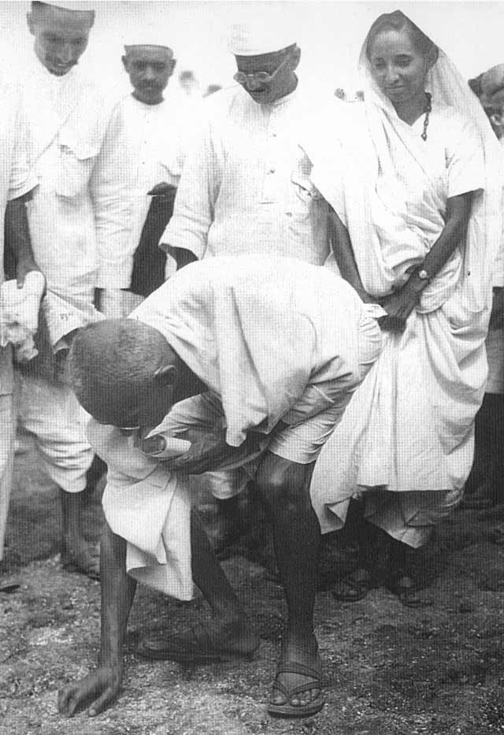
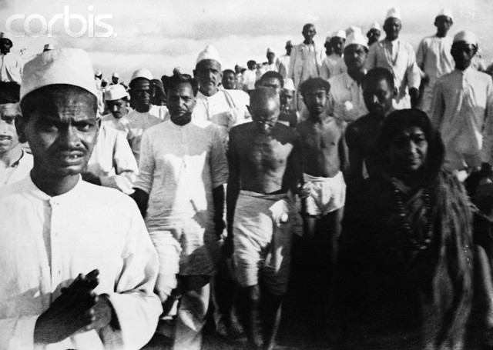
The Salt March
British law claimed that the British had sole right to produce and sell salt in India
Gandhi wrote to Viceroy stating his intent to break the law
With 78 followers he marched 240 miles to the sea. By the time he reached the sea, thousands of people had joined the march

Slide 13
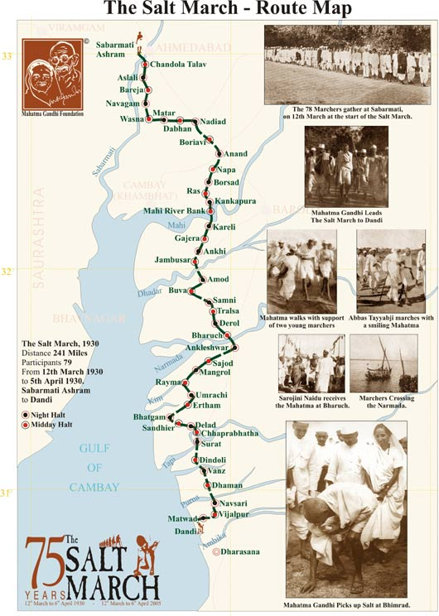
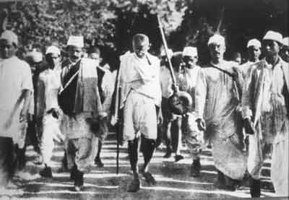
The Salt March
4. Gandhi and others harvested salt from the sea and were arrested
5. Reporters around the world reported the incident. The event embarrassed the British government who prided themselves on their democratic traditions.
March 12, 1930, Gandhi and 78 male satyagrahis started their 23-day-long journey

Slide 14
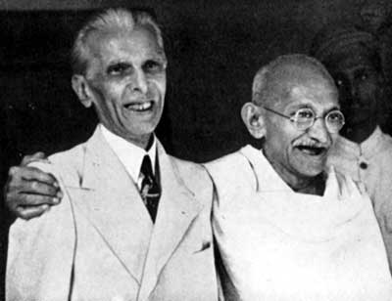
Muhammad Ali Jinnah
A. Middle Class lawyer educated in Britain
B. First supported Hindu-Muslim Unity – called “Ambassador of Hindu-Muslim Unity”
C. Proposed Lucknow Pact
Notes:
In 1947, the Indian subcontinent won its independence from Great Britain, creating the world’s largest democracy with over one billion people. However, Muslim League leader Muhammad Ali Jinnah insisted that Muslims have their own state.
Lucknow Pact –
Would have given Indians self-government, more parliamentary freedoms, equality in the army, and remain a part of the British Commonwealth
Congress and Muslim League agreed to give voice to areas where each was a minority
Rejected by the British due to World War I – No time to deal with India

Slide 15
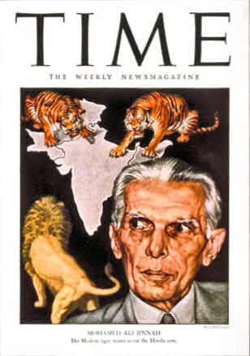
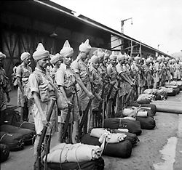
Muhammad Ali Jinnah
D. Disagreement with Gandhi led to Muslim- Congress split
E. Jinnah began to fear Hindu domination of Congress – A “Hindu Raj”
F. Began to support the idea for an independent Muslim homeland, Pakistan or “land of the pure”.
Notes:
All Independence talks were postponed for duration of war
Britain declares war for India without consulting them
Many members in Congress, start a non-cooperation campaign to protest war – Muslims support British for equal say at independence negotiations

Slide 16
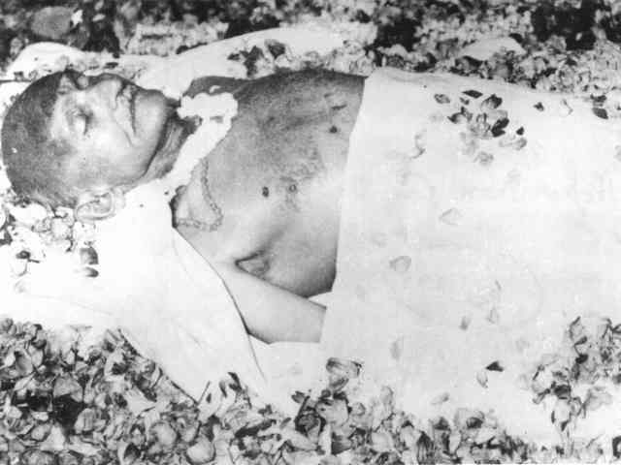
Gandhi Dies
Gandhi was assassinated in 1948
It was the 6th attempt on his life
Assassin was angry at Gandhi for preaching peace with Pakistan

Slide 17
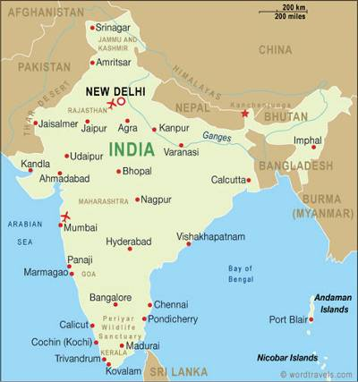
What is the Partition of India?
The partition of India is the
separation of India on Aug. 14,
1947 and Aug. 15, 1947 into the
states of the Dominion of Pakistan
and the Union of India, respectively.
India was separated on the day of
gaining independence from British,
due to tensions between the Hindus
and the Muslims living in the country.
India gained independence after 350
years of British presence in the
country.
Above: A current day map of India
Notes:
Main Details of Partition

Slide 18
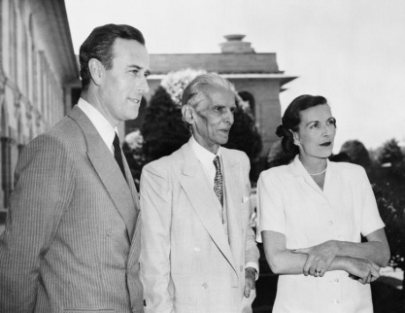
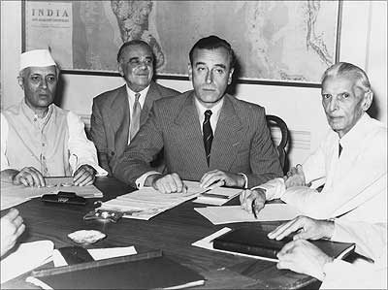
India Independence and Partition
Grants full Independence to India in 1947
Partitions India by creating East and West Pakistan to avoid religious conflict – Gandhi not pleased
Jinnah planned to say a joke when he met Lady Mountbatten when he said, “A rose between two thorns.” However, he thought she would be in the middle.
Jinnah was able to get equal say at negotiations and refused to accept living under “Hindu Rule.”

Slide 19
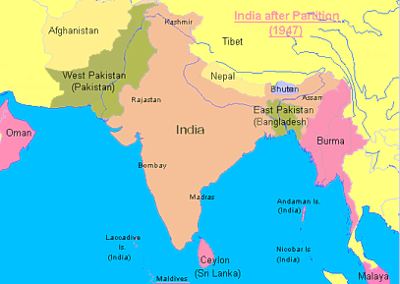
Indian Independence and Partition
India was, therefore, partitioned into two nations: India in the center and Pakistan to the west and east. Burma (Myanmar) and Ceylon (Sri Lanka) became independent the following year.

Slide 20
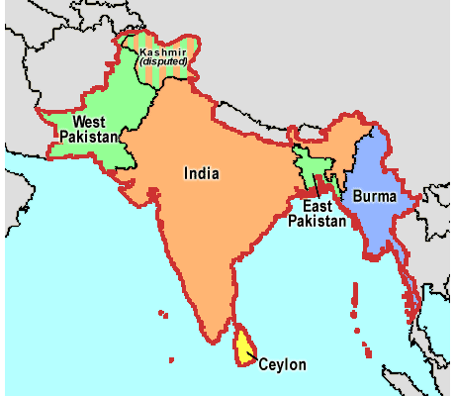
India Independence and Partition
Why was Pakistan created with such odd borders?
12.5 Million people displaced
500,000 killed or injured in riots and religious attack
Muslims
Hindus
Hindus
What do you think will happen with the Muslims in India and the Hindus in Pakistan?
Muslims

Slide 21
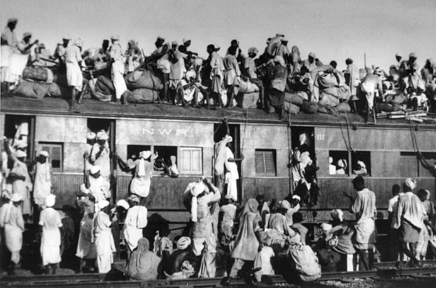
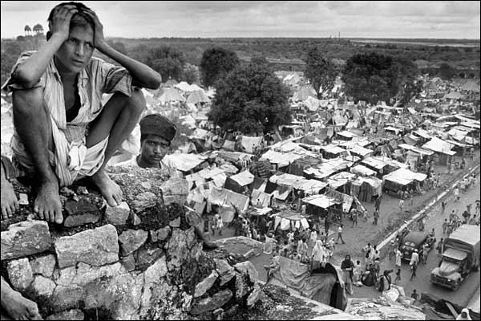
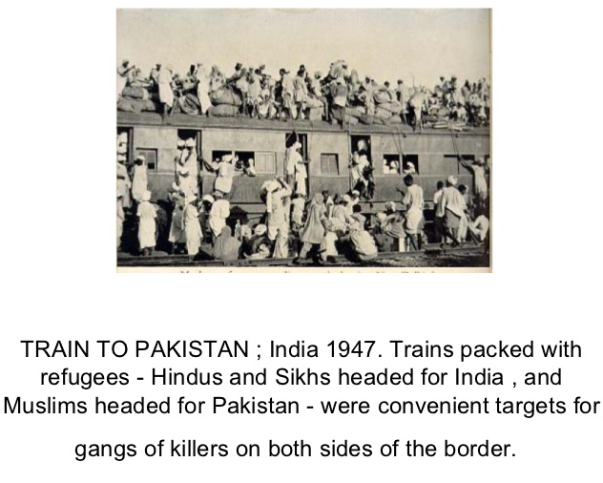
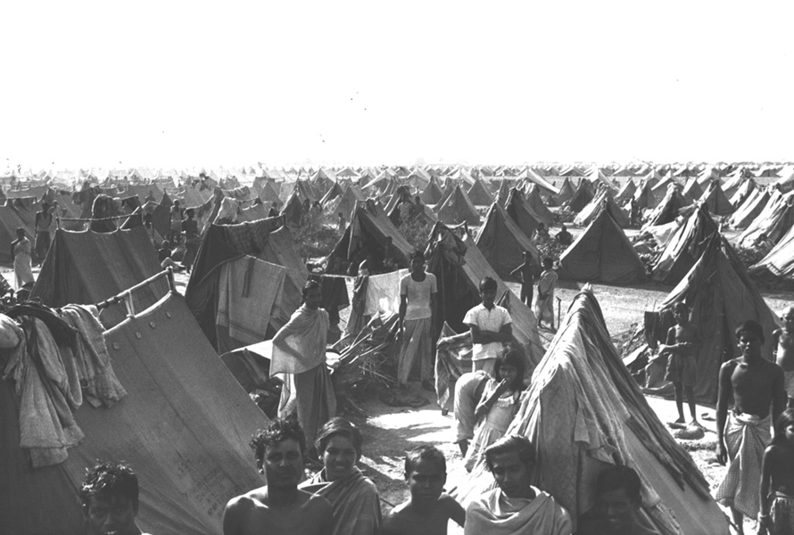

Slide 22
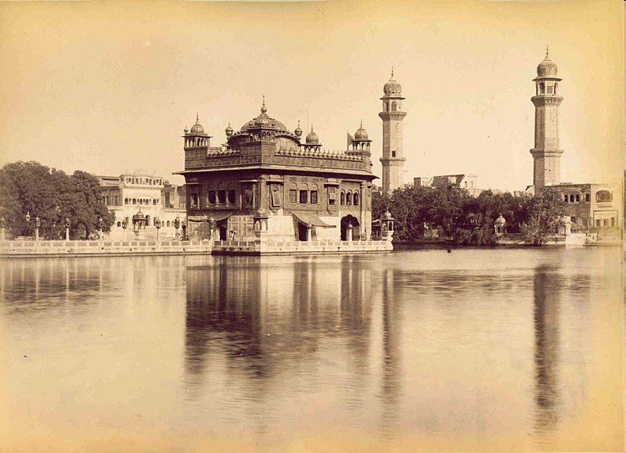
Golden Temple of the Sikhs
Notes:
Sikhs were caught in the middle of the partition area – the Punjab.

Slide 23
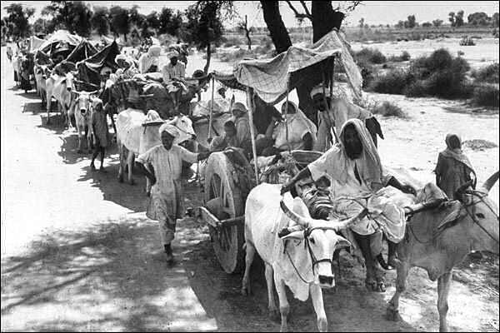
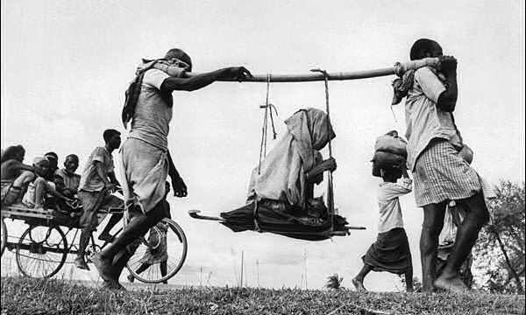
Indian Independence and Partition
Due to this Hindu-Muslim split, a Great Migration occurred where Hindus in Pakistan and Muslims in India left their homes in an attempt to go where they felt accepted. Unfortunately, this led to horrendous violence that killed millions of people.
Notes:
Gandhi opposes violence and fasts to make the horrors stop
Gandhi becomes a victim when he was assassinated on January 30, 1948 by a Hindu extremist who thought Gandhi was too protective of Muslims

Slide 24
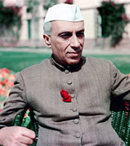
Indian Independence and Partition
Nehru led the developing nations in practicing Non-alignment with the Superpowers and thus, received enormous aid from both the U.S. and the U.S.S.R.
Notes:
Jawaharal Nehru was India’s first Prime Minister. He introduced a Western-style secular government based on universal suffrage, religious freedom, social equality and the abolition of the caste system. The Indian economy successfully combined government-run industry with Private enterprise.

Slide 25
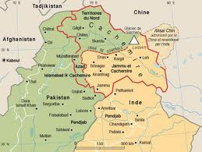
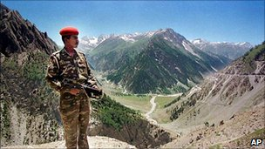
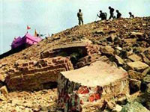
Indian Independence and Partition
Kashmir Region
Muslim majority with Hindu Maharaja
Conflict starts immediately after Maharaja is forced to flee.
India goes to war with Pakistan over control of Kashmir in October of 1947
UN negotiates a line of control and cease fire but no peace is reached.
Both countries claim all of Kashmir

Slide 26
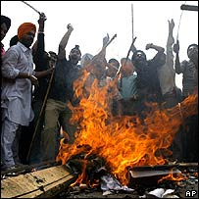
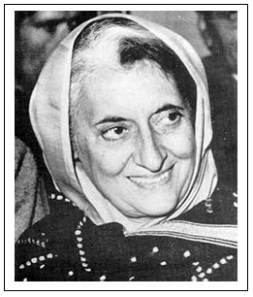
Indian Independence and Partition
Religious and political conflict remained a problem. In the 1980s, Sikhs demanded an independent state of Punjab and assassinated Prime Minister, Indira Gandhi (Nehru’s Daughter) in 1984.

Slide 27
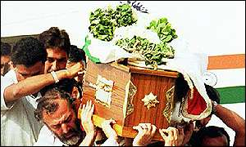
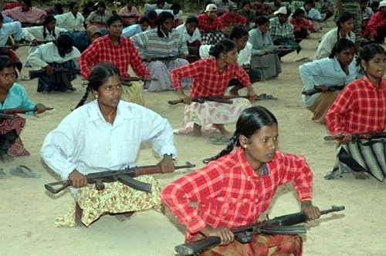
Indian Independence and Partition
Other Developments in the region: After fierce fighting, Bangladesh (East Pakistan) split from West Pakistan in 1971. In 1983, an endless war erupted in Sri Lanka with Hindu Tamils, the minority who wanted their own independent nation, fighting against the majority Buddhist Sinhalese. In the first of these clashes, India sent troops to restore order. As a result, the Terrorist group known as the Tamil Tigers assassinated Prime Minister Rajiv Gandhi (Indira Gandhi’s son) in 1991. Terrorism continues there today.

Slide 28
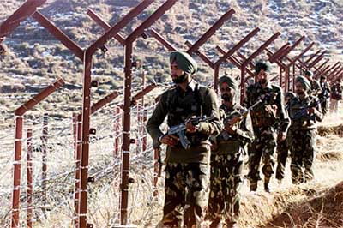
Indian Independence and Partition
Relations between Pakistan and India remain tense. Both nations want to control the Jammu and Kasmir regions near the Pakistan-India border. Tensions based on religious and ethnic claims continued to increase after both India and Pakistan tested nuclear weapons in 1998.

Slide 29
