Slide 1
The 30 Years’ War
1618-1648
AP European History
Mr. Ott @ Park East High School

Slide 2
Historical Background
Because of the execution of Jan Hus in 1415, Bohemia was a hotbed of contention between Protestants and Catholics. (Bohemia consisted of Bohemia, Silesia, Moravia and Lusatia).
By 1600, Protestants outnumbered Catholics in Bohemia but the Protestants were fragmented into denominations or sects
Emperor Rudolph II issued a Letter of Majesty granting some limited freedoms and tolerance to Protestants but Rudolph died before Protestants fully enjoyed the limited freedoms
Catholics forbade Protestants to build churches in towns where Protestant churches did not already exist
Ferdinand II was to be the new King of Bohemia and Protestants feared for the worst

Slide 3
The Defenestration of Prague
Protestants set up a meeting with Catholic officials in Prague on May 23, 1618.
Meeting went badly, the Protestants seized two Catholic officials and tossed them out the window; for kicks they tossed a secretary, too.
This event is known as The Defenestration of Prague. The word defenestrate comes from Latin word for “window” and means “out the window”
Survived the fall because they landed in a dungheap or ditch; Catholics claimed angels saved them
This was the spark that ignited the 30 Years’ War

Slide 4
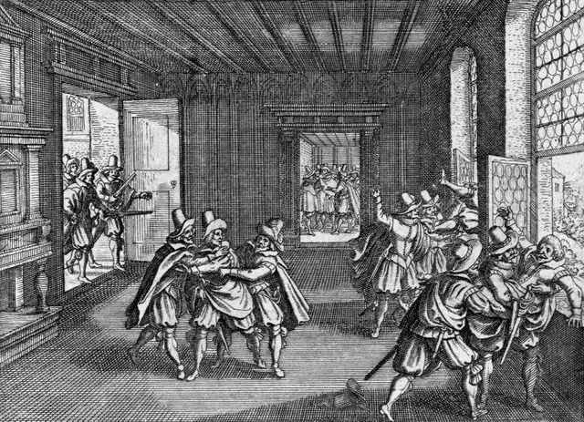
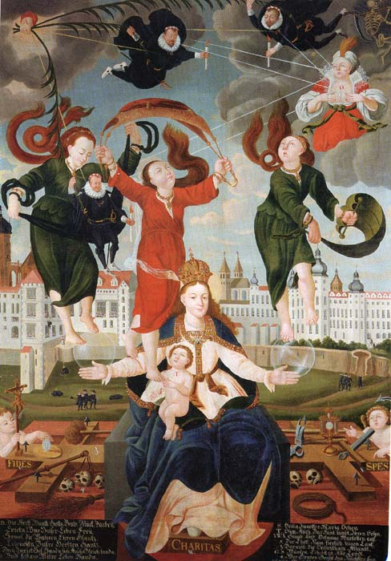
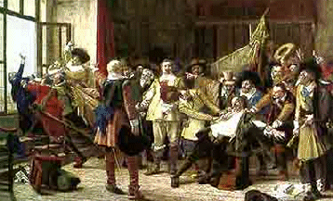
Defenestration of Prague

Slide 5
The 30 Years’ War
Four Phases of the 30 Years’ War:
  The Bohemian Phase
  The Danish Phase
  The Swedish Phase
  The French Phase

Slide 6
The Bohemian Phase (1618-1625)
Fighting between Catholics and Protestants began soon after the Defenestration in 1618
The Protestants used a force made up mostly of Czechs and deposed Ferdinand, King of Bohemia; they chose Frederick V to take his place
The Holy Roman Emperor, Ferdinand II, used funds from the Catholic League and the Spanish Habsburgs to build an army
The Catholic forces crushed the Protestants at the Battle of White Mountain and the Jesuits attempted to win over those Protestants who weren’t inclined to fight
The defeat and the propaganda had a different effect than intended

Slide 7
The Bohemian Phase (1618-1625)
As the fighting went on, mercenaries joined the fray looking to make some money in the war
Albrecht von Wallenstein, born a Czech Protestant, offered his services to the Emperor
Reluctantly the Emperor commissioned Wallenstein and his 125,000 soldiers
Wallenstein and his men unleashed destruction on Germany
The Emperor had no control over Wallenstein or his men, though
During the fighting in Bohemia, the Spanish attacked the holdings of Frederick along the Rhine River
Frederick and the Protestants had their hands full already and could not win back the land from Spain

Slide 8
The Danish Phase (1625-1630)
Habsburg enemies all over Europe were horrified at Wallenstein’s antics
King Christian IV of Denmark decided to enter the war to help the Protestants turn the tide in Germany
Wallenstein proved to be too much for Christian
Feeling confident after Wallenstein’s successes, the Emperor issued the Edict of Restitution in 1629
The Edict outlawed all sects of Christianity other than Catholicism and Lutheranism
Lutheranism took a hit, though, because the Edict restored Protestant-held once-Catholic lands to the Church, effectively undoing the Peace of Augsburg

Slide 9
The Danish Phase (1625-1630)
The Habsburgs reached the pinnacle of their power by 1630
Also by 1630, the Emperor felt pressure from across Europe to control Wallenstein because he had become too powerful and unpredictable
The Emperor made Wallenstein back off

Slide 10
The Swedish Phase (1630-1635)
Protestantism on the continent seemed to be in trouble so King Gustavus Adolphus of Sweden entered his 100,000-man army in the contest
Gustavus Adolphus hoped to help the Protestants in Germany but he also hoped to exert his influence in the region
The French, at the urging of Cardinal Richelieu, subsidized the Swedish forces
France hoped to undermine the Habsburgs by aiding the Habsburg enemies
Gustavus Adolphus experienced success in the North so the Emperor reluctantly requested the services of Wallenstein once again

Slide 11
The Swedish Phase (1630-1635)
Gustavus Adolphus suffered a wound in battle in 1632 and died
By 1634, the Swedes were at the point of defeat
Things looked very bad for Protestants in Germany until…

Slide 12
The French Phase (1635-1648)
Wallenstein had been so angry at the Emperor at his dismissal, he turned on the Emperor in hopes of creating his own empire
In response, the Emperor had Wallenstein’s own troops murder Wallenstein
Some of the Protestant Princes jumped ship and joined forces with the Emperor
France couldn’t stand to watch the Habsburg power increase so the French officially entered the war on the side of the Protestants
Neither side possessed the power to knock out the other so the fighting dragged on until 1643

Slide 13
The Peace of Westphalia (1648)
The 30 Years’ War officially ended in 1648 with the Peace of Westphalia
The treaties recognized the sovereignty of the 300+ German princes
The treaties disallowed papal meddling in German religious affairs
The treaties upheld the Peace of Augsburg, added Calvinism to the list of religions allowed in German states and nullified the Edict of Restitution

Slide 14
Immediate Results of the
30 Years’ War
After the Peace in 1648, the northern states in Germany remained primarily Protestant while the southern states in Germany remained primarily Catholic
The United Provinces and Switzerland won recognition as independent states
German princes won the right to form alliances and sign treaties as long as they didn’t declare war on the Holy Roman Empire
Sweden won cash and land in the Baltic region
France won the region of Alsace

Slide 15
Political Fallout from the 30 Years’ War
Because Spain lost territory and France gained territory, France stood alone as the most powerful nation on the continent
France also benefited from the fragmentation of the Holy Roman Empire and the weakening of the Habsburg family influence
PoW=
  the political power of the Holy Roman Empire faded into oblivion;
  the Habsburg family remained wealthy and strong, though, and would go on to rule the Austro-Hungarian Empire later

Slide 16
The Aftermath in Germany
Though Germans seemed to win politically and religiously, the Germans lost in other ways
German homes, businesses and farms were destroyed en masse during the war
The German population took a major hit (millions dead from battle, disease and starvation over the course of the war and the years immediately following) and the German population decreased by as much as 20% according to some sources

Slide 17
Aftermath in Germany (continued)
Food shortages plagued Germany and worsened the suffering of Germans who survived
Inflation crushed the German economy; food shortages and rising prices coincided with the massive influx of gold and silver into Spain
Trade routes in and around Germany virtually disappeared
Ironically, a very few towns grew as refugees moved in for safety

Slide 18
Things You Must Remember
The 30 Years War began as a war of religion and developed into an international war of politics
While the war started as a religious war, the war healed no religious wounds
France proved that international politics would be more important in the coming centuries than religion
No participant in the 30 Years War possessed a large enough army to knock out its opponents; Louis XIV would learn from this

Slide 19
You must remember this …
Continued)
The Alsace region would be hotly contested even as late as World War II
The Holy Roman Empire historically had more influence in Germany than anywhere else in Europe; therefore, the sovereignty of the German princes essentially meant the end of the Holy Roman Empire
Because the vast majority of the fighting took place in Germany, the German states suffered more than any other participants

