Slide 1
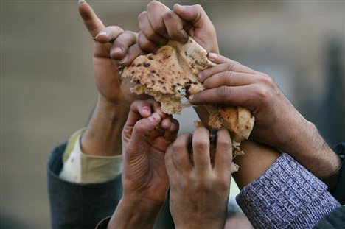
Egypt in the 21st Century
Egypt: Key Ally in the Middle East
Mr. Ott @ BETA 2010-11
Aim: Why is Egypt politically, socially and economically important?
Do Now: Where is Egypt located?

Slide 2


Slide 3
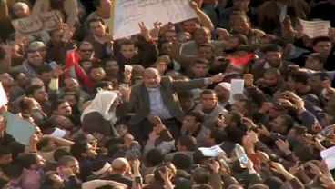

Slide 4
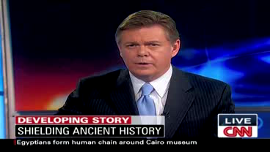

Slide 5
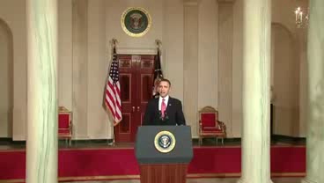

Slide 6
Objectives
Part 1:
  Brief history of modern Egypt
  Political & economical realities in Egypt
  US-Egypt relationship & the region
  The future of Egypt & what it may mean for US
Part 2:
  Q& A
  Discussion

Slide 7
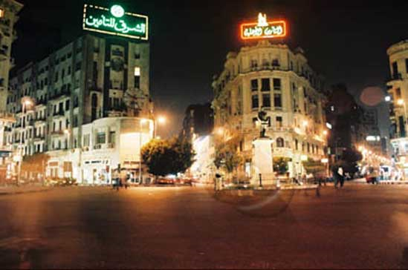
Modern Egypt: a brief history!
“As Egypt goes,
so go the Arabs”
Intellectual & cultural
center of Arab world
Birth place of modern Arab nationalism
Largest Arab population
(80+ million) 17 Million in Cairo
Largest army in Arab world
Second largest economy in Arab world
Beneficial geographical location
( Suez Canal, Nile, Mediterranean, etc.)
Educational, political, cultural, etc. influence
over the Arab world

Slide 8
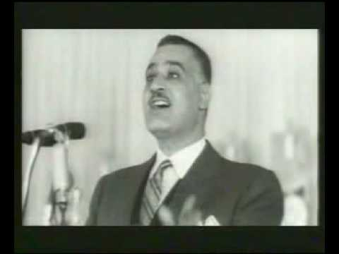
Modern Egypt: a brief history!
1952 dissatisfied Army
Officers overthrew
King Farouk
(British Installed & supported)
Gamal Abdel Nasser
(President 1956-1970)
  Charismatic leader
  Champion of Arab nationalism & Arab Socialism
  Suppressed all political oppositions (including the Muslim Brotherhood)
  Kept a tight control on the economy and political life (nationalized most private businesses)
  1967 war with Israel
  Economy went from bad to worse under Nasser
  Now, Nasser is a cult figure through the Arab world & Africa

Slide 9
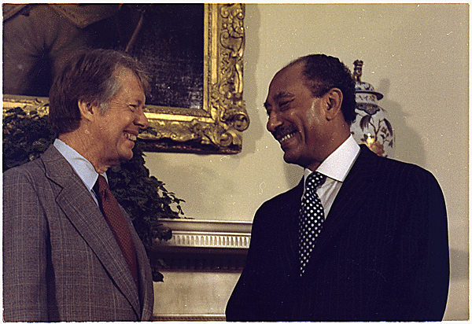
Modern Egypt: a brief history!
Anwar Al Sadat (1970-1981)
  Lived in the shadows of Nasser
  1973 war with Israel
  Peace agreement with Israel
  Improved the economy slightly (“the opening”- open Egypt to private and international investments)
  Lessen the strong hold on political life
  Tolerated some political oppositions (such as Muslim Brotherhood)
  Considered a friend of the US & the west.
  Assassinated by a fringe group of the Muslim Brotherhood
  One of the members who was jailed for the plot was Ayman Al Zawahiri (later to become the right-arm man of Bin Laden)

Slide 10
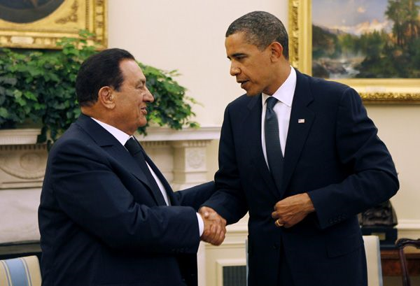
Modern Egypt: a brief history!
Hosni Mubarak (1981- Present)
  Put a strong hold & control over
  political oppositions & the press
  Supported the gulf war (1991), but, opposed the Iraq war (2003)
  Refrained from making major economic changes at the beginning
  Worsening economic situation & failings of government functions & services has led to extreme poverty
  & dissatisfaction
  Publically, Mubarak is critical of Israel and US policy in the region
  Resistance to reform (especially political reform)- Egypt has been under emergency rule since 1981

Slide 11

Egypt: today
Economic Life
  Movement toward privatizations
  High unemployment & lack of
  suitable jobs for workers made
  redundant due to privatization
  Deterioration of state institutions
  & public services
  (e.g. education, health care, transportation, environment, etc.)
  Declining Standards of living for the average citizen & extreme poverty
  Egyptians remain uncertain about their future

Slide 12
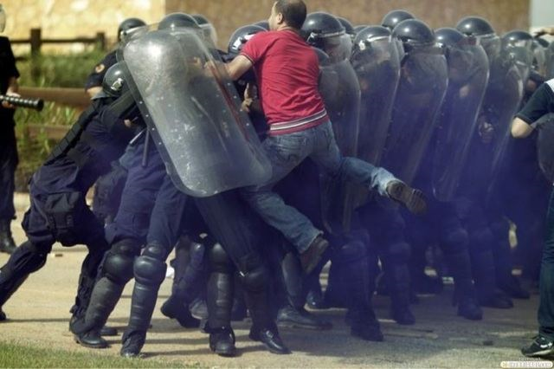
Egypt: today
Political Life
  Severely restricted
  Voter Fraud & unfair
  regulations
  Labor unions controlled
  & manipulated
  Restriction on the press
  Violations of human rights
  There is some hope as small and independent newspapers emerge, internet, satellite access to international TV/press, etc.

Slide 13

Political Alternatives
Muslim Brotherhood (MB) 1.0
  Founded in 1928 by Hassan al-Banna
  (Sayidd Qutb was the intellectual leader)
  Carried attacks against the government & British interests
  Aided Nasser (then fell out of favor with him very quickly as a result of a failed assassination)
  Nasser jailed & killed many of its leaders and followers
  Sadat tried to befriend the MB
  Mubarak has outlawed the MB (later put severe constraints on the MB political activities)

Slide 14
Muslim Brotherhood 2.0
The MB emerges with a peace-making tune to:
  Christians
  Secular Egyptians
  Advocating democracy & political engagement
In contradiction to other declarations
  Limiting rights of women and Copts
  Hardline on social & economic issues
Government crack down & ban
The MB has popular support throughout Egypt

Slide 15
US & Egypt
Egypt on Iraq
  Opposes the war
  Believes the war created more active radical movements in the region
Egypt on Iran
  Sees Iran as a real threat with a desire to expand
  Wants to limit Iran’s influence in the region
Egypt on Israel
  Supports an independent& viable Palestine state
  Does not see the US as an honest broker in the conflict
  Sees the conflict as a source of instability in the region

Slide 16
The Future is Uncertain
After Mubarak
  Who will be next? (Gamal Mubarak or Omar Suleiman or the army???)
  Free speech & free press?
  Economy- would reforms continue?
  Politics- future of democracy in Egypt?
  US- hands-off policy?
  What would become of Egypt-US-Israel relationship?
  Will the MB become even more popular?

Slide 17
Discussion
How important to have Egypt as an ally in the middle east & to the success of the US policy in the region?
How do you view the relationship between
US-Egypt, & US-and other countries in the region?
What should be on the priority list of the US when it comes to Egypt;
  Democracy? Human rights? Economic reform?
How could the US address the raise of radical Islamic groups & terrorism?

Slide 18
Discussion
Should the US support lifting of restrictions on opposition groups in Egypt?
Should the US engage directly with opposition groups in Egypt (which may include the MB)?
How should the US deal with the Arab-Israeli conflict in the light of the importance of Egypt to the US?
How could the US address the raise of radical Islamic groups & terrorism?

