Slide 1
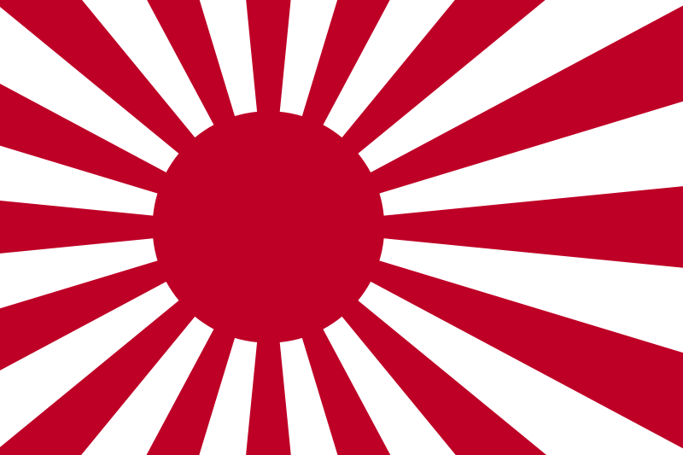
World War II:
The War in the Pacific
Aim: How did the Allies fight back in the Pacific against Japan to victory?
Do Now: Quiz

Slide 2
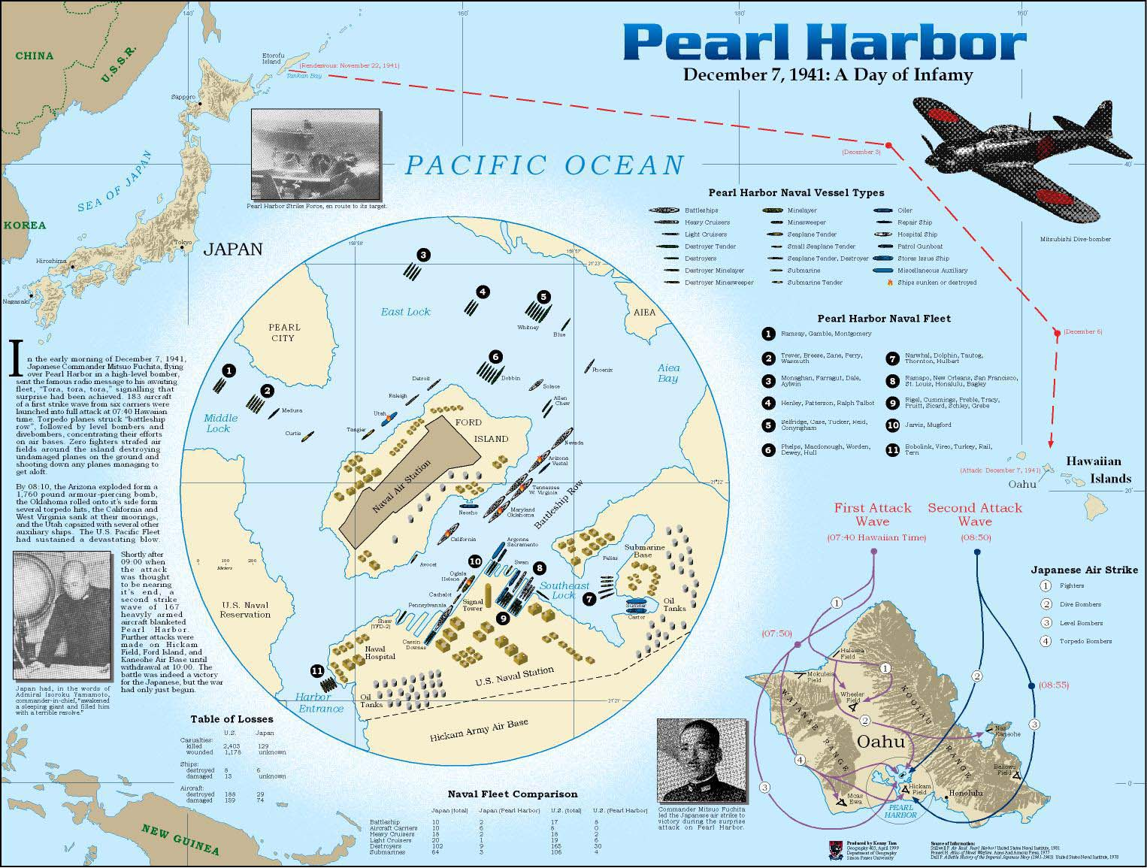

Slide 3
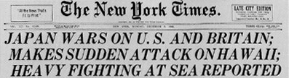
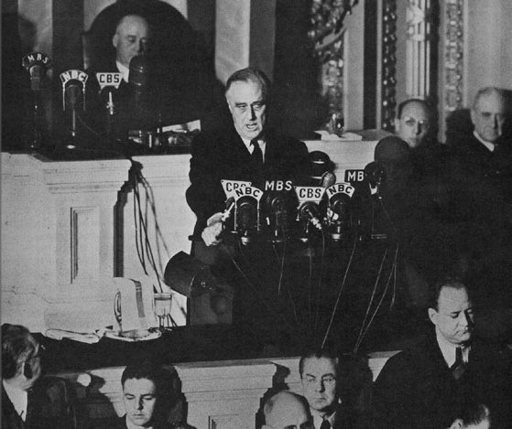


Slide 4
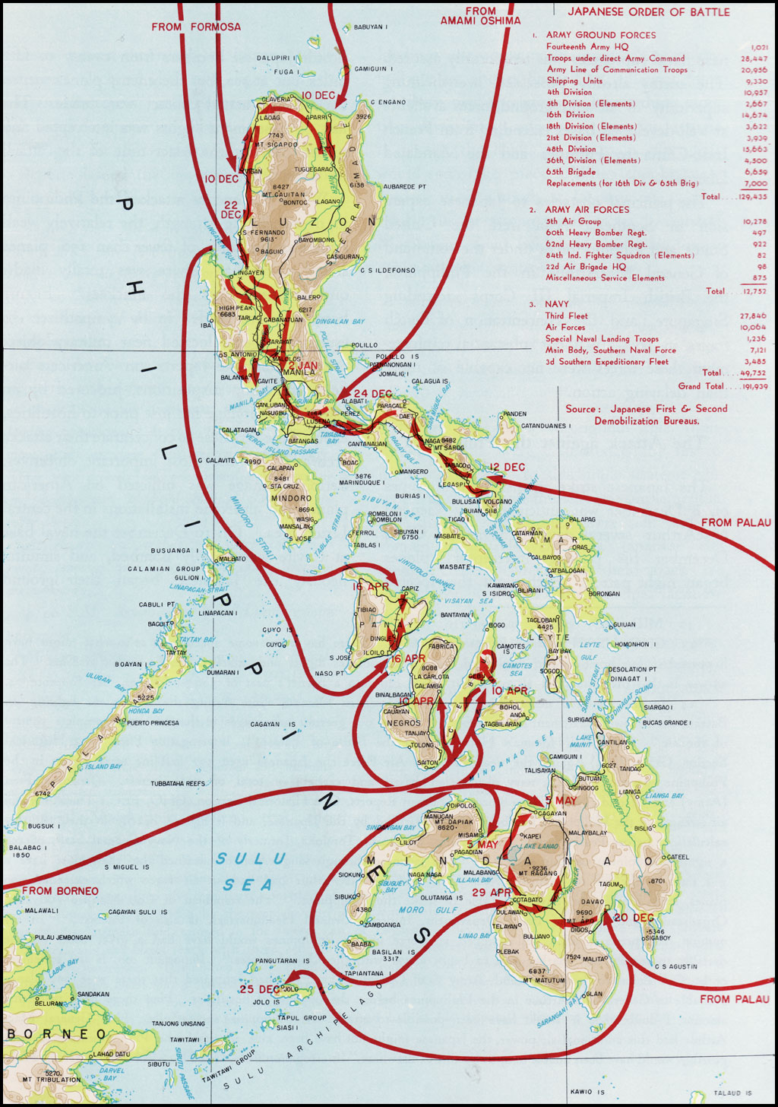
Philippines
When: 12/7/41-4/9/42
Who: Japanese vs. Filipino and American troops—MacArthur
What: 12/7/41—Japanese strike and quickly take Manila (capital)
  Allies must retreat to the Baatan Peninsula
  Allies surrender 4/9/42

Slide 5
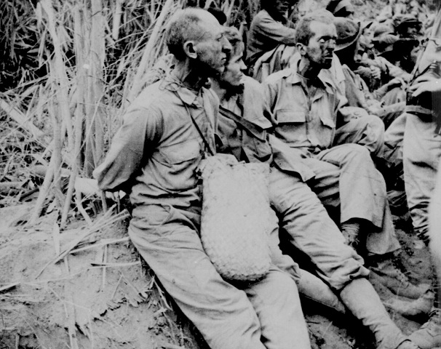
Philippines
After 4 months of fighting, the Filipino and American soldiers surrendered to the Japanese
76,000 soldiers became prisoners of war and were marched 60 miles to a prison camp, at least 20,000 died along the way in the famous “Bataan Death March”

Slide 6
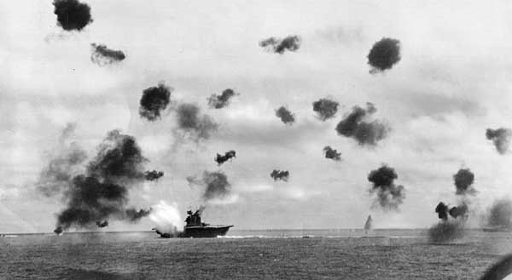
Battle of Coral Sea
May 7, 1942
Strategic Allied victory—halted the Japanese advance on Australia
First naval battle carried out entirely by aircraft.
The enemy ships never even came into contact with each other

Slide 7
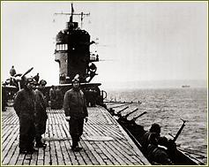
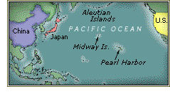
BATTLE OF MIDWAY
JUNE 3-6, 1942
CONSTANT 2-DAY BATTLE
First major Japanese defeat
OVER 185 JAPANESE SHIPS lost

Slide 8
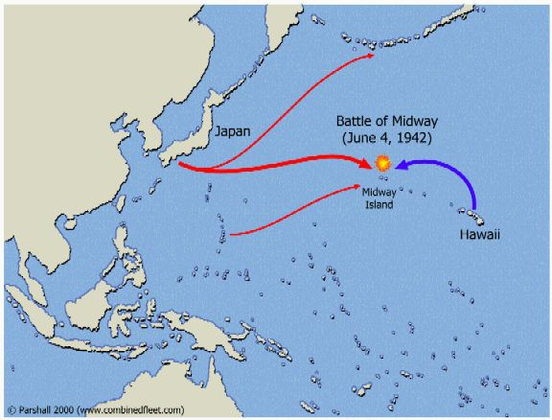
Battle of Midway
What: a strategic attempt by
Japan to shut off US supply lines
Results: US stopped the Japanese
and changed the direction of the war
  U.S. loses only 2 ships
  Protects Hawaii
  US takes offensive

Slide 9
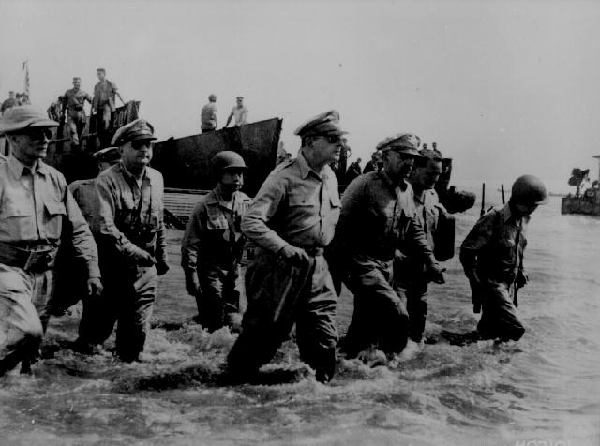
Mac Arthur returning to Philippines

Slide 10
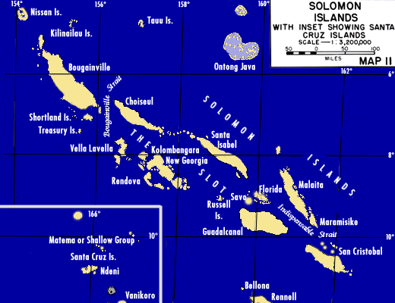
"Island Hopping"

Slide 11
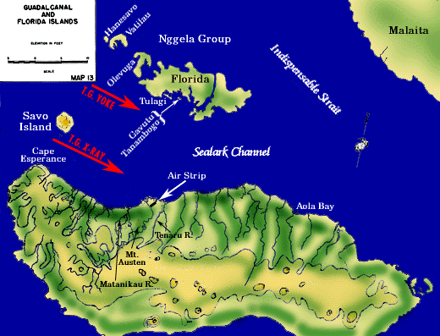
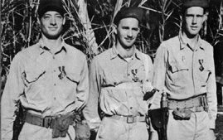
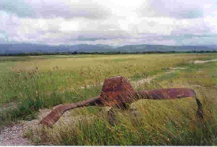
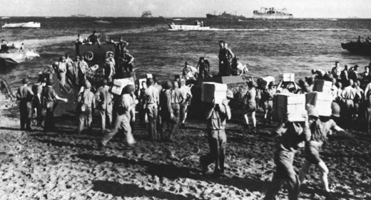
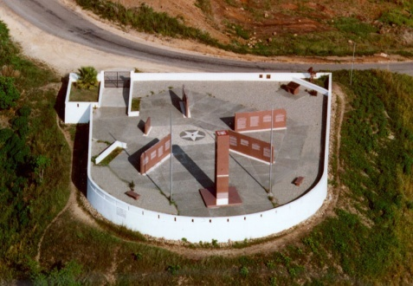
Guadalcanal—8/42-2/43
Who: US vs. Japan
Where: Island near Australia—
one of Solomon Islands
What: One of the most vicious campaigns
  Japanese put up a fierce resistance
  US has superior air and naval power
Results:
  First time US land troops defeat Japanese
  Americans are able to secure the island

Slide 12
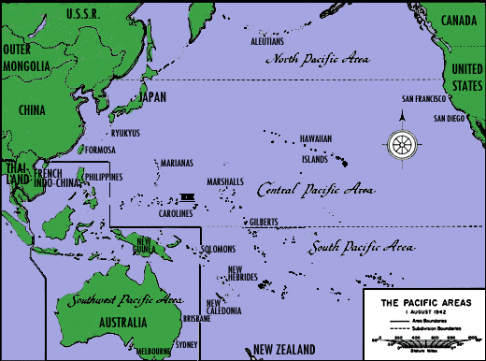

Slide 13
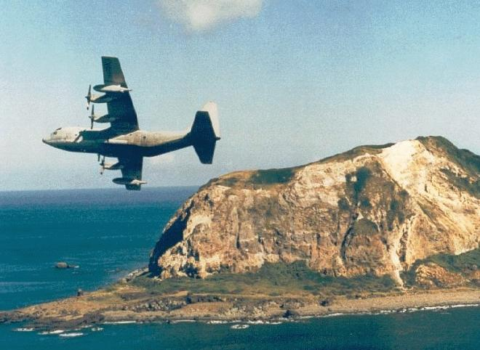
Iwo Jima
February-March 1945
Island off the coast of Japan
(Japanese soil)
  Longest sustained aerial offensive
  of the war
  More marines sent than in any
  other battle
  100,000 men fighting on an
  island the 1/3 the size of Manhattan
  Japanese fought from below
  ground—Allies rarely saw a soldier
  The battle was won inch-by-inch
Volcanic island
deeply entrenched

Slide 14
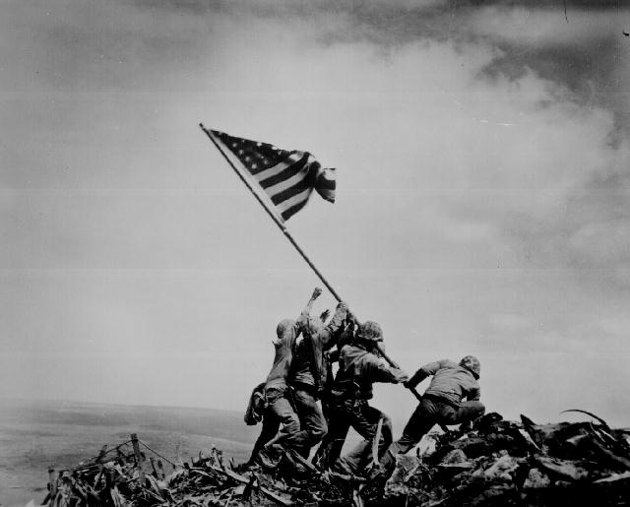
Iwo Jima
Results: US win
  Provides a link in the chain of bomber bases
  By the war’s end, 2,400 B-29 bombers and 27,000 crewmen made emergency landings.
  “4 marines raising US flag”

Slide 15
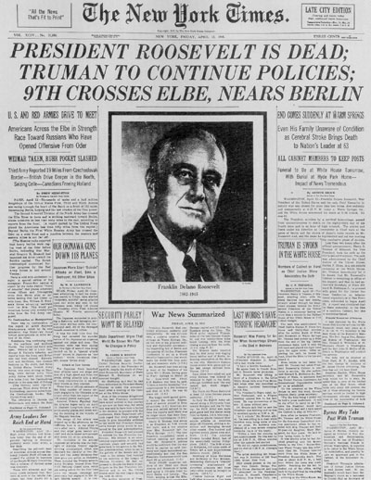

Slide 16
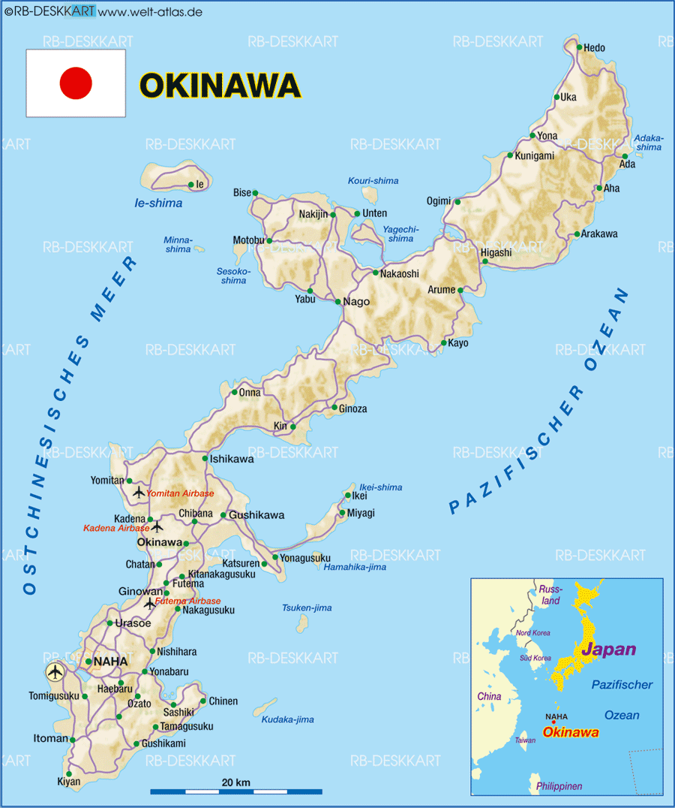
Okinawa
Casualties
  US—12,500 killed; 36,000 wounded
  Japan—93,000 troops killed; 94,000 civilians killed
  (many killed themselves)
Kamikazes—suicide pilots
  Crashed planes loaded with explosives
  Sank 30 US vessels
High U.S. Causalities convince President Truman that an invasion of Japanese Mainland would cause over 1 million U.S. servicemen deaths

Slide 17
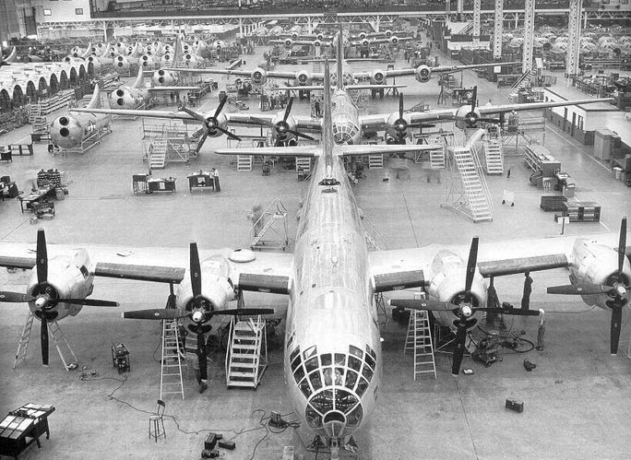
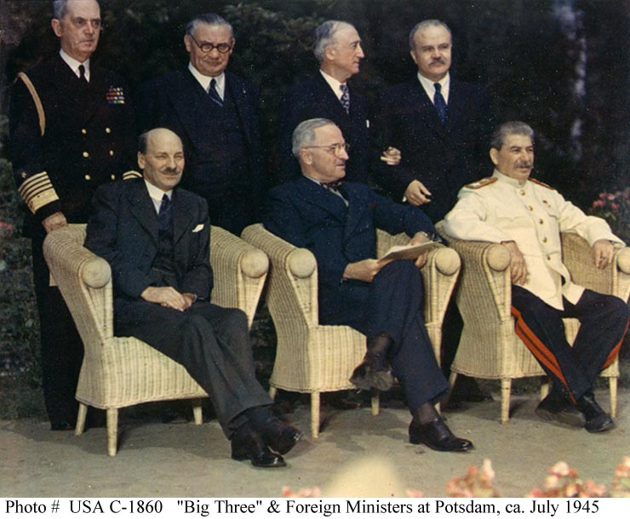
The End of the War in the Pacific
With most of Japan’s air force and navy destroyed, B-29’s pounded Tokyo and other cities
Japanese refuse to surrender
Potsdam Declaration issued:
  If you don’t surrender you face “prompt and utter destruction”

Slide 18
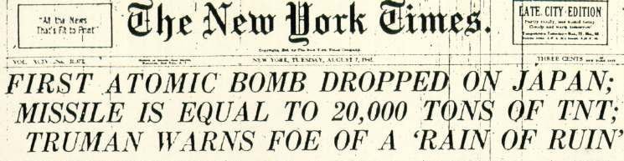
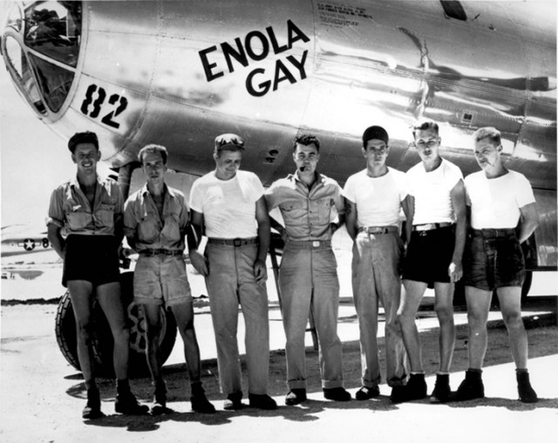
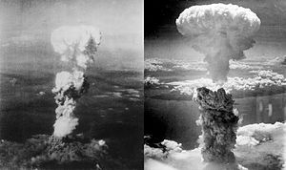
August 6, 1945 Enola Gay drops uranium bomb on Hiroshima
August 9, 1945 Plutonium bomb dropped on Nagasaki
Hiroshima
Hiroshima | Nagasaki
70,000 killed | 40,000 killed
Thousands more die from Radiation
Nagasaki

Slide 19
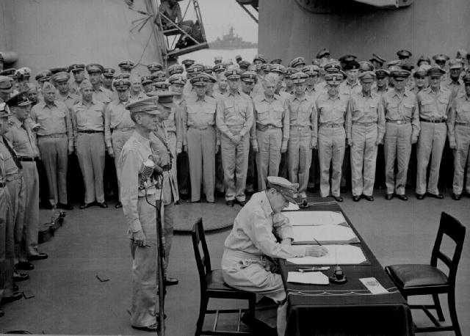
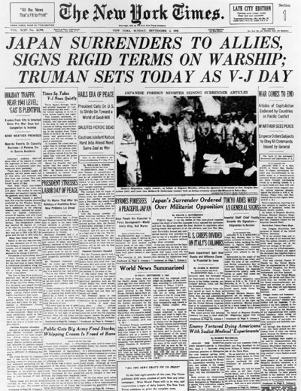
V-J DAY
VICTORY IN JAPAN
Japanese surrender aboard U.S.S. Missouri
Sep 2nd, 1945

Slide 20
Costs of the War
40 million died
American casualties
  332,000 dead;
  800,000 wounded
Soviet Union
  Over 20 million deaths

