Slide 1
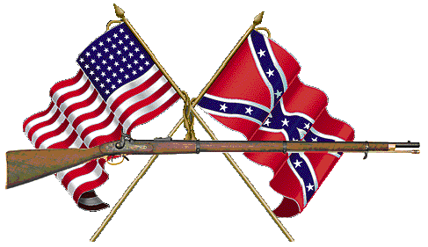
The Blue & the Grey
The U.S. Civil War
Aim: How was the Emancipation Proclamation important to the North and the South?
Do Now: Take a map quiz. You have 5-7 Minutes.

Slide 2

Dixie
I wish I was in the land of cotton,
old times there are not forgotten,
Look away, look away, look away,
Dixie land.
In Dixie land where I was born in, early on a frosty mornin',
Look away, look away, look away, Dixie land.
(Chorus)
Then I wish I was in Dixie, hooray! Hooray!
In Dixie land I'll take my stand, to live and die in Dixie,
Away, away, away down south in Dixie,
Away, away, away down south in Dixie.
Daniel Decatur Emmett – Adopted (1861)
The Battle Cry of Freedom
Oh, we'll rally round the flag, boys,
we'll rally once again,
Shouting the battle cry of freedom,
We will rally from the hillside,
we'll gather from the plain,
Shouting the battle cry of freedom!
(Chorus)
The Union forever! Hurrah, boys, hurrah!
Down with the traitor, up with the star;
While we rally round the flag, boys,
rally once again,
Shouting the battle cry of freedom!
We are springing to the call of our brothers gone before,
Shouting the battle cry of freedom!
And we'll fill our vacant ranks with a million free men more,
Shouting the battle cry of freedom!
George F. Root - 1862
Notes:
DQ: What factors made it almost impossible for the South to win the Civil War?

Slide 3
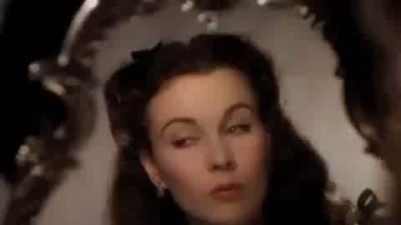
Setting: 12 Oaks, a plantation in Georgia just after the first shots of the Civil War.
Rhett Butler – A Southern Businessman.
Ashley Wilkes – His family owns 12 Oaks who is having a Southern BBQ party.
Mr. O’Hara – Scarlet’s father and plantation owner of Tara.
Scarlett O’Hara – Daughter of Mr. O’Hara, and in love with Ashley Wilkes who is engaged to Melanie Howard.
What was Rhett Butler saying about the South?

Slide 4
In Order to Defeat The South, The North Needs to Stop the Factors/Means of Production
Land
Capital
Labor
Entrepreneur

Slide 5
Demographics of the North & the South
 | Union | CSA
Total population | 22,000,000 (71%) | 9,000,000 (29%)
Free population | 22,000,000 | 5,500,000
1860 Border state slaves | 432,586 | NA
1860 Southern slaves | NA | 3,500,000
Soldiers | 2,200,000 (67%) | 1,064,000 (33%)
Railroad miles | 21,788 (71%) | 8,838 (29%)
Manufactured items | 90% | 10%
Firearm production | 97% | 3%
Bales of cotton in 1860 | Less than .5 % | 4,500,000
Bales of cotton in 1864 | Less than .5 % | 300,000
Pre-war U.S. exports | 30% | 70%

Slide 6

Manassas, VA – 1st Bull Run - July 21, 1861 – 1st Major Battle
Union Loss

Slide 7

Major Civil War Battles
Battle | Northern Victory | Southern Victory
1st Battle of Bull Run, VA - July 21, 1861 |  | X
2nd Battle of Bull Run, VA - August 27-30, 1862 |  | X
Battle of Antietam, MD - September 17, 1862 | X
Battle of Fredericksburg, VA - December 13, 1862 |  | X
Battle of Chancellorsville, VA - May 1-4, 1863 |  | X
Battle at Gettysburg, PA - July 1-3, 1863 | X
Battle of Vicksburg, MS - July 4, 1863 | X
Battle of Chattanooga, TN - October 17, 1863 | X
Battle of Cold Harbor, VA- June 1864 |  | X
Battle of Petersburg, VA - June 15-April 3, 1865 | X
Lincoln wanted a clear decisive Union Victory before Issuing the Emancipation Proclamation

Slide 8
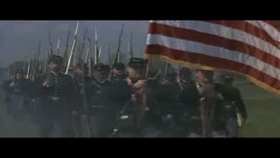
What are Shaw’s social views on slavery? (Remember he comes from Boston)
Why would he mention Emerson? What is the term we use for people who wrote and read Emerson?

Slide 9
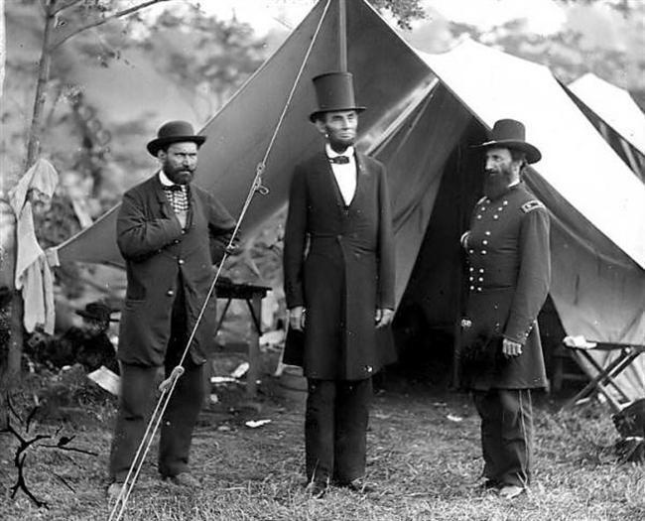
Lincoln at Antietam 1862

Slide 10

Emancipation Proclamation
Freed All Slaves in the States in Rebellion
(All the Confederate States)
Not any Union States
The first one, issued September 22, 1862, declared the freedom of all slaves in any state of the Confederate States of America that did not return to Union control by January 1, 1863.
The second order, issued
January 1, 1863, named the specific states where it applied.

Slide 11
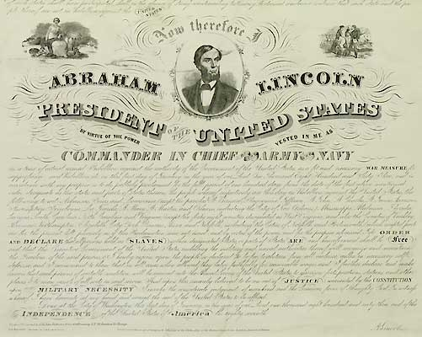
And by virtue of the power, and for the purpose aforesaid,
I do order and declare that all persons held as slaves within said designated States, and parts of States, are, and henceforward shall be free; and that the Executive government of the United States, including the military and naval authorities thereof, will recognize and maintain the freedom of said persons.

Slide 12
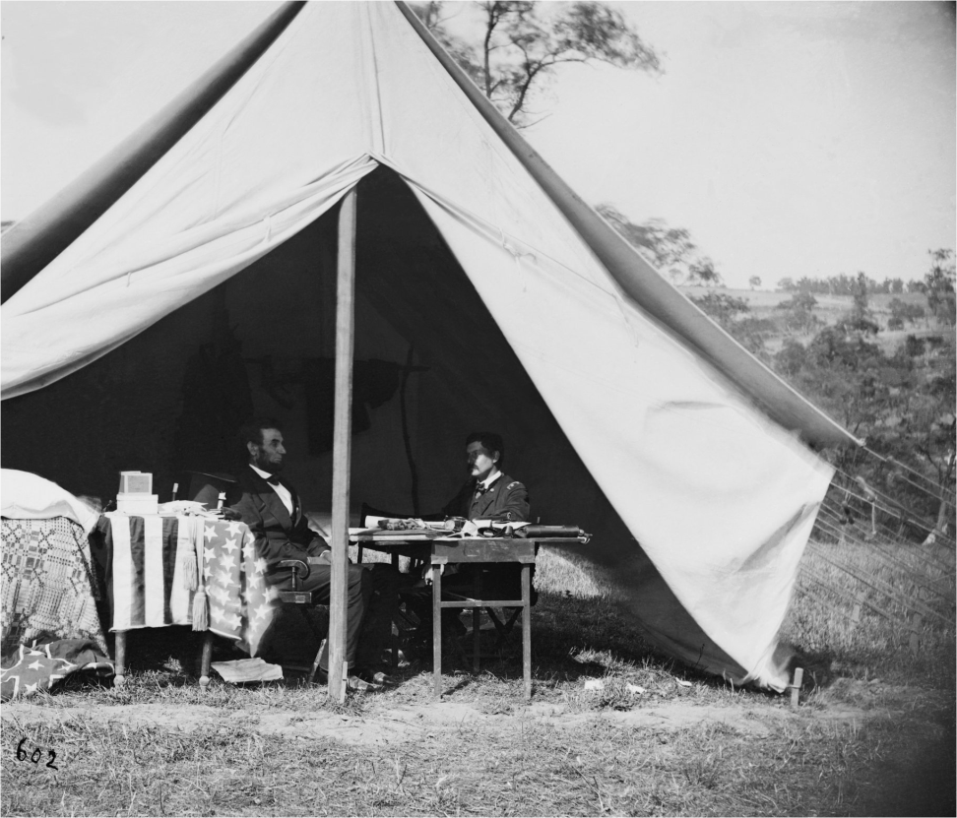
Activity:
Read the background and decisions Lincoln had to make.
Answer the questions on your worksheet
It will be collected and graded.

