Slide 1
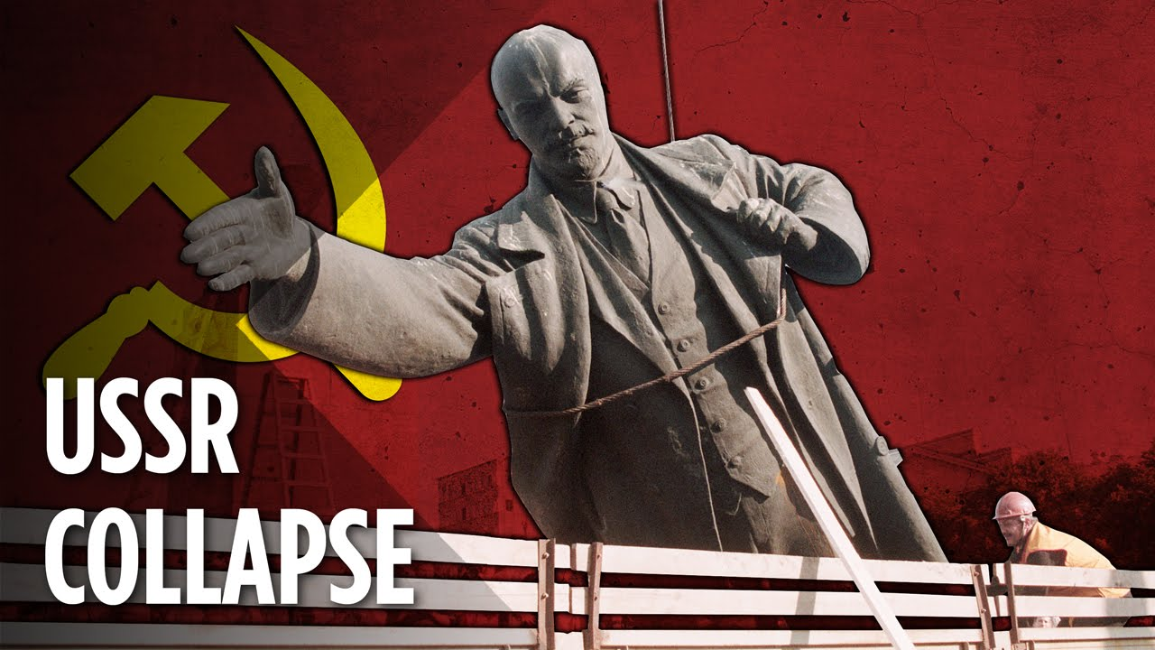
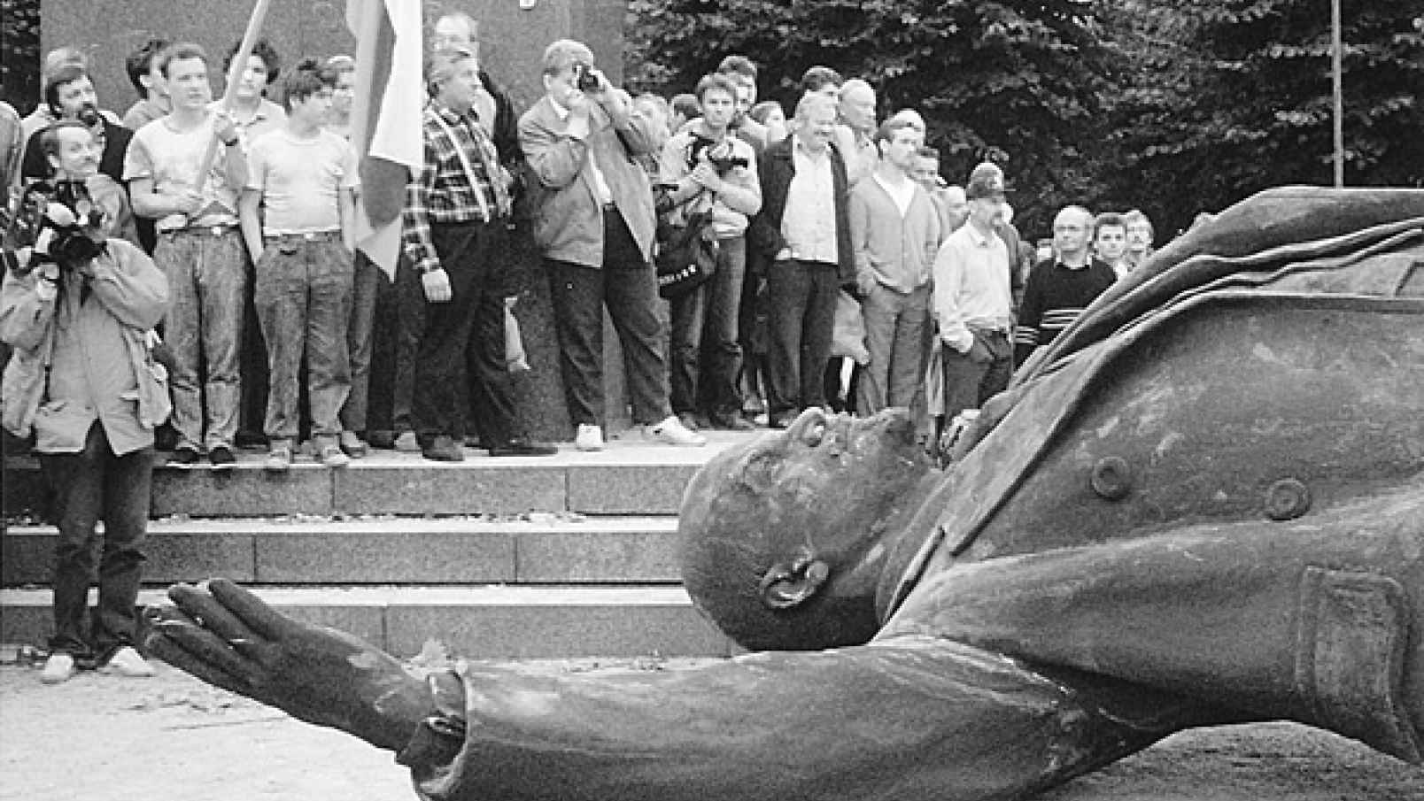
Fall of the Soviet Union
EQ: What were the causes of the fall of the Soviet
Union?
Do Now: What type of government existed before
the Soviet Union and Who was its leader?
E

Slide 2
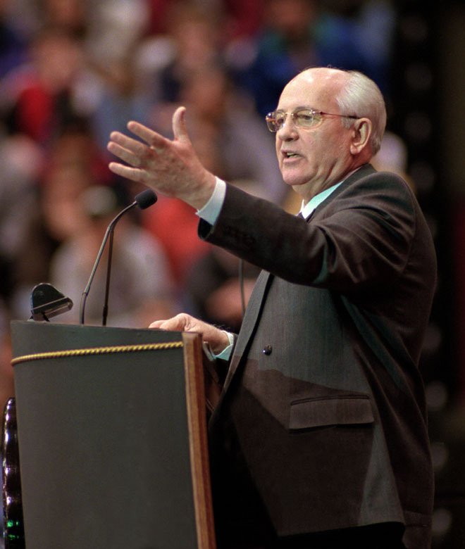
Mikhail Gorbachev
Became leader of the USSR in 1985.
Eager to reform the government and its inefficiencies, but also wanted it to remain a communist nation.
Foreign Policies: Renounced the Brezhnev Doctrine, signed treaties with the US to control the arms race, and pulled Soviet troops out of Afghanistan.

Slide 3
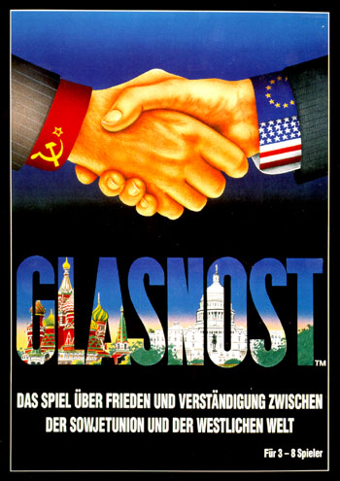
Glasnost = openness; policy of being open to non-Communist policies; instituted by Gobachev in the 1980’s
Perestroika = restructuring of the Soviet and economy in the 1980’s. (Allowed some private ownership of businesses, but wanted to keep the essence of communism).

Slide 4


Slide 5
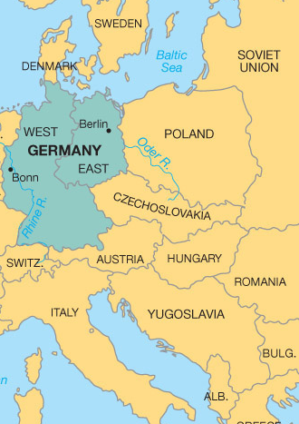
1989: Fall of the Berlin Wall
1990- East and West Germany reunited into one Germany
1981: Workers strike for better pay, freedom for religious groups, & right to strike
1989: First free elections since 1947
1989: Mass demonstrations
1990: Multiparty elections
1991: Splits into Czech Republic and Slovak Republic
1991: Multiparty elections
91-92- War between Croats and Serbs
1992: Fighting begins between Serbs and Bosnian Muslims
1992: First multiparty elections
1996: First non-communist government

Slide 6
The Collapse of Communism in Eastern Europe
Most of the ‘satellites’ of the USSR began to revolt and break away following a similar pattern:
Giving into public pressure, the old Communists would step down in favor of younger ‘reform-minded’ Communists
These new leaders would agree to let other political parties to exist and compete for seats in the country’s legislature
In free, multiparty elections, member of non-Communist parties would win over Communist party members
By 1989 the first two stages of this process were peacefully accomplished in Hungary, Bulgaria, East Germany, and Czechoslovakia

Slide 7
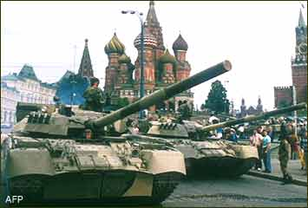
Unexpected Results:
  Rapid changes brought about by glasnost and perestroika brought about economic turmoil
  Some leaders spoke out against Gorbachev, while others called for even more democratic and capitalist reforms.
  In 1991 hard-line communists tried to overthrow Gorbachev in a military coup; the coup failed but it weakened his rule.
  By the end of 1991, most of the republics in the USSR had declared their independence and the USSR ceased to exist.

Slide 8
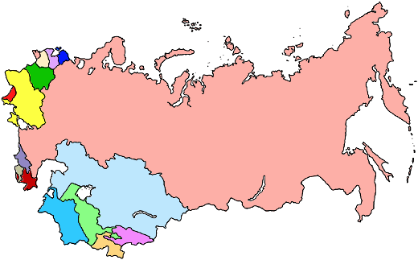
THE USSR is broken up into 15 independent republics
RUSSIA
1-Russia 2-Estonia 3-Latvia 4-Lithuania 5-Belarus 6-Ukraine 7-Moldova 8-Georgia 9-Armenia 10-Azerbaijan 11-Turkmenistan 12-Uzbekistan 13-Tajikistan 14-Kyrgyzstan 15-Kazakhstan.

Slide 9
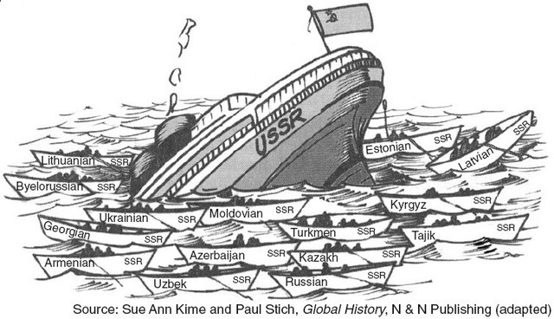

Slide 10
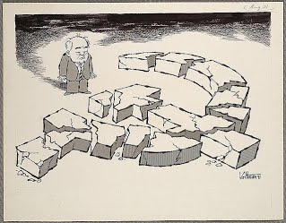

Slide 11
