Slide 1
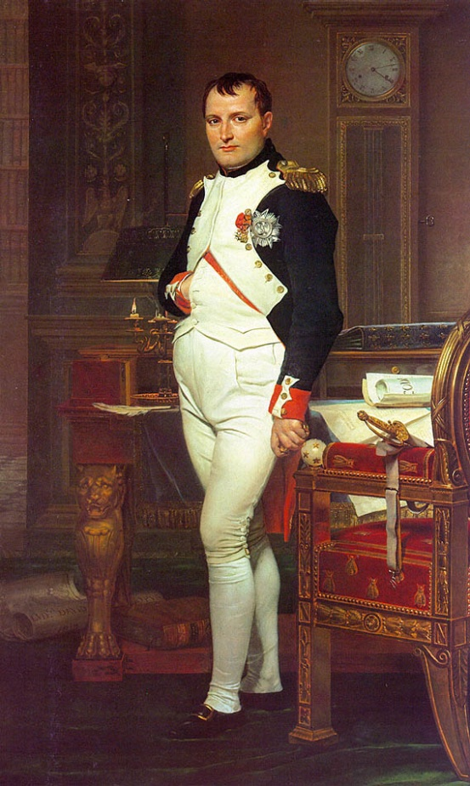
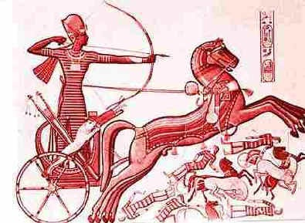

Do Now:
WHAT IS History?
(2 min)
Write one sentence
of what you think history is?
“History is the version of past events that people have decided to agree upon.”
Napoleon Bonaparte

Slide 2
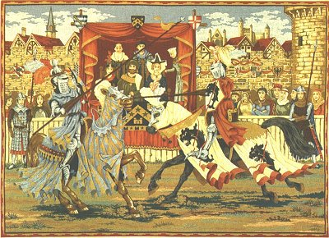
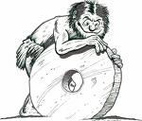
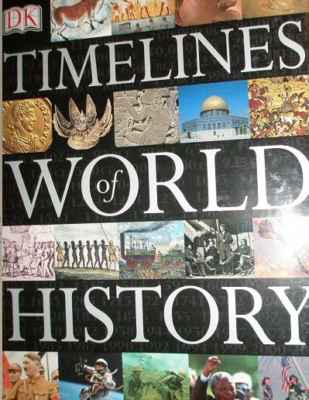
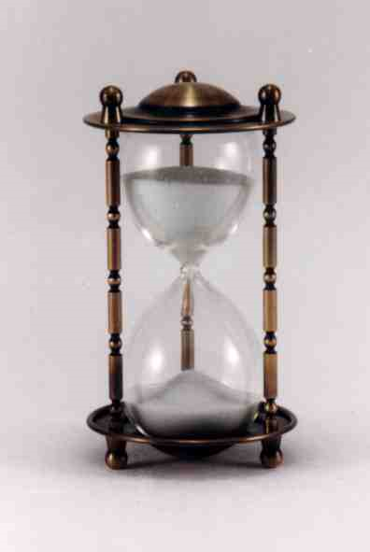
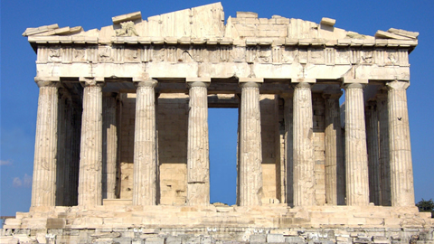
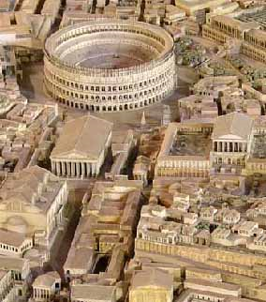
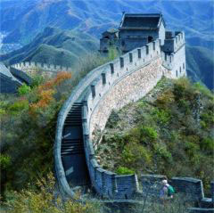
History & Artifacts
Cultural Possessions:
Past & Present

Slide 3
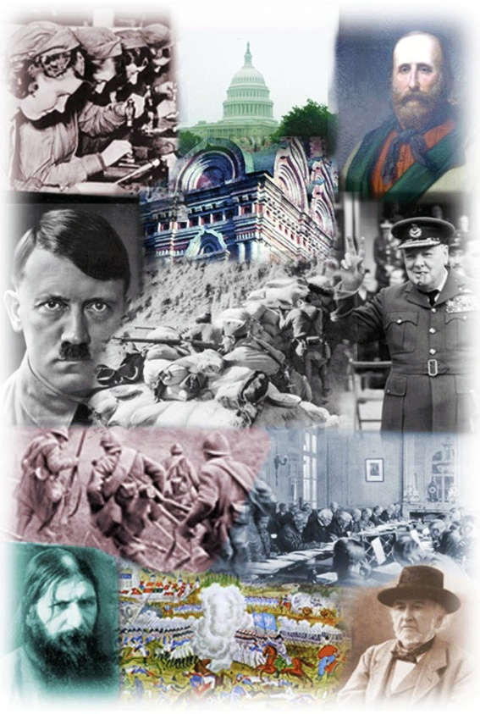
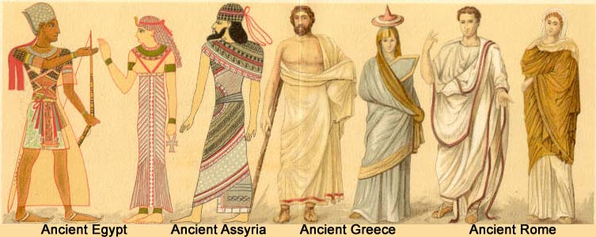
What is History?
History
is the study of the past
Writing
Recorded History
Geography = Interactions of Earth & People
History = Recorded Interaction of People
Over Time
Notes:
How is HISTORY different than Geography?

Slide 4
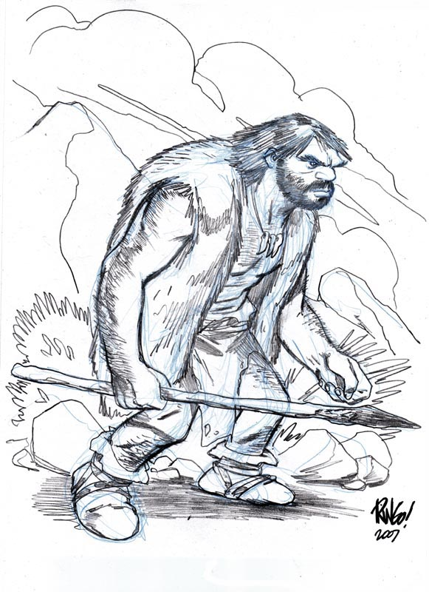
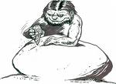
What is Pre-History?
Oral
Tradition
PRE-History
is the study
of the past
before writing
Notes:
How is HISTORY different than Geography?

Slide 5
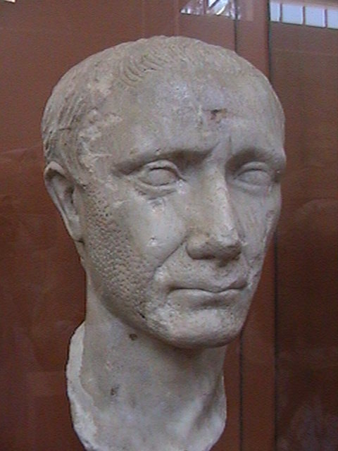
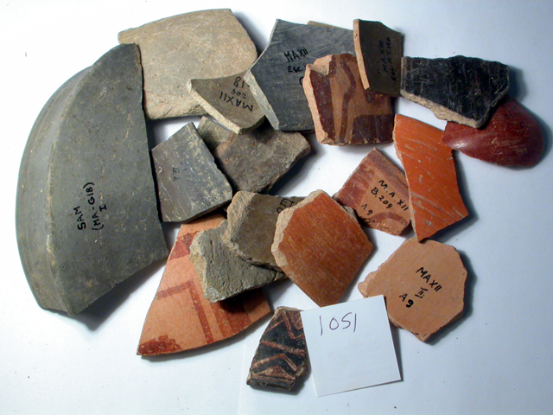
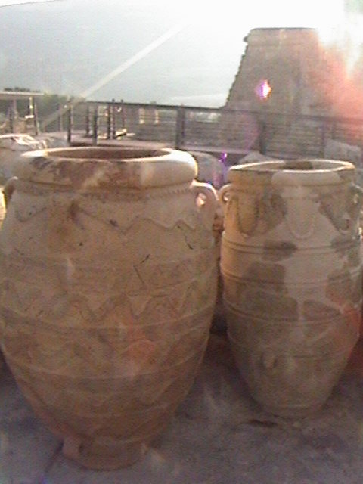
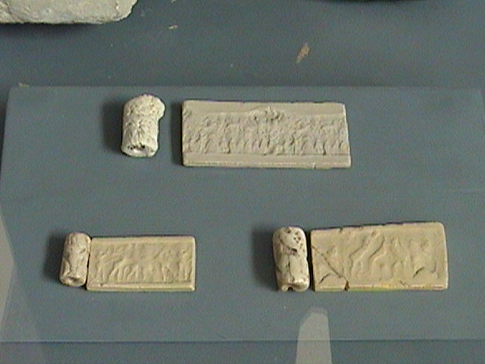
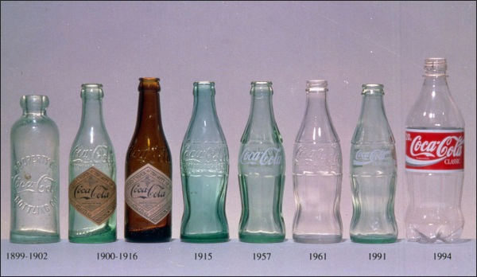
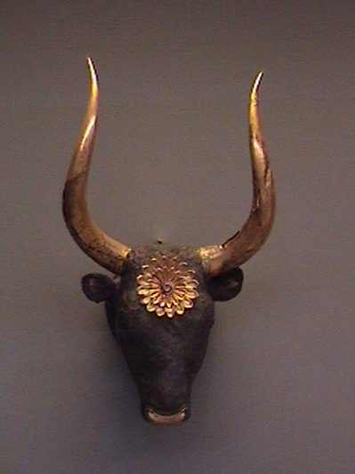
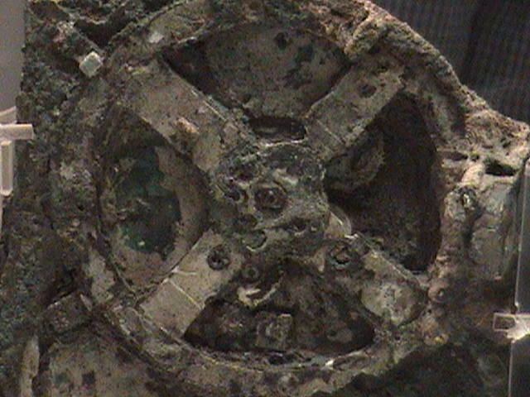
What is an Artifact?
Objects
People
Made

Slide 6
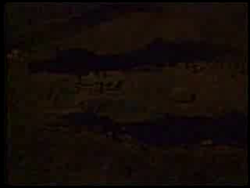
ARTIFACTS
What is Archaeology?

Slide 7
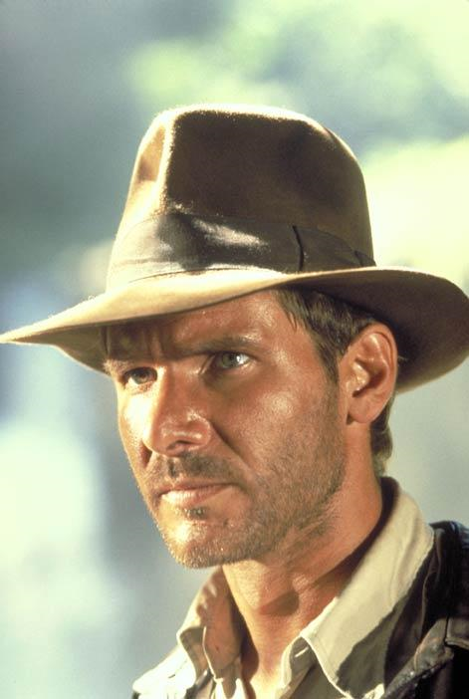
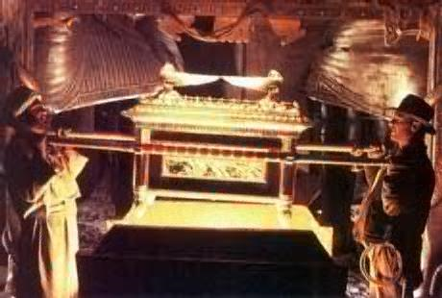
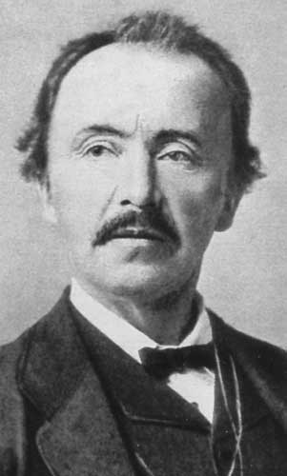
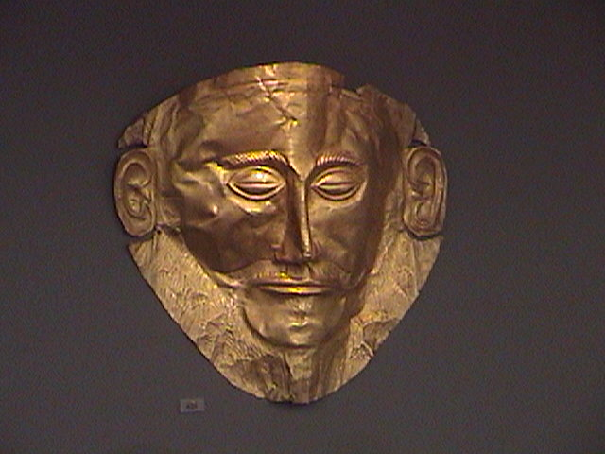
What is an Archaeologist?
A Person who studies the remains of past cultures.

Slide 8
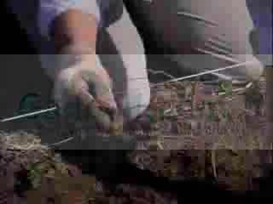
What is an Excavation?

Slide 9
Discovery OF Ancient Relics!
A Full, True, and Interesting Account of that Remarkable and Important Discovery made yesterday in taking down the old houses in the Castle-hill, when there was found a box containing several Ancient Coins, a Gold Ring, an old fashioned Dirk, and a Wonderful Prophecy (prediction for future) made in the year 1550, respecting great events which are to happen this present year.
Source: Broadside (advertisement) published in Edinburgh, Scotland,1831 (adapted)
June 2008
NYS 10th
Grade
Global History Regents
Question
This advertisement in the newspaper is about?
a. fossils c. artifacts
b. icons d. replicas

Slide 10
Objectives Learned:
History
Pre-History
Artifacts
Archaeology – Archaeologists
Excavation

