Slide 1
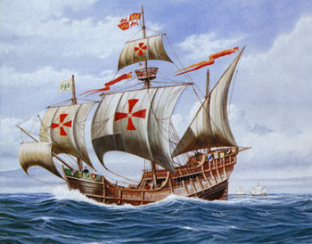

European Exploration: Technology
AIM: Why did Europeans want to go out and explore the world?
Do Now: Technology Worksheet
BETA: Mr. Ott
Global History & Geography

Slide 2
AIM: Why did Europeans want to go out and explore the world?
God- Europeans see themselves as superior to others and feel the need to spread Christianity throughout the world, especially the “Heathens”
Glory- What better way to “show off” than to go out and be the first to discover something new.
Gold- By controlling trade routes to the east, Europeans could cut out the middle men. Also, they could try to find Gold in the new land.
Technology- New technology such as the caravel, astrolabe, and compass.
3 “G’s”
and
a
“T”

Slide 3
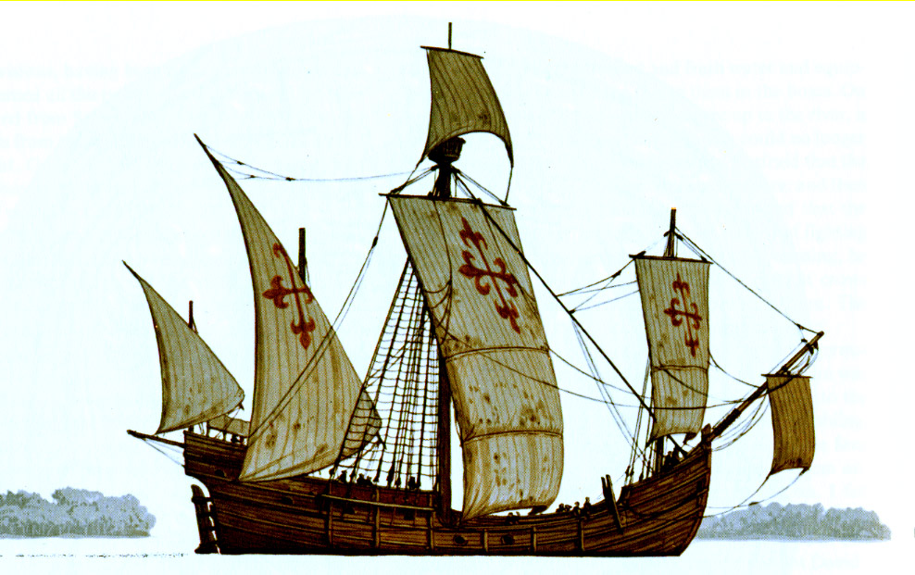
Caravel
Technology
Fast and popular ship
design during exploration
Nina and Pinta were both caravels
(Columbus’ Ships)
Most had triangular sails that allowed them to tack or sail on a zig-zag course which made them go faster.

Slide 4
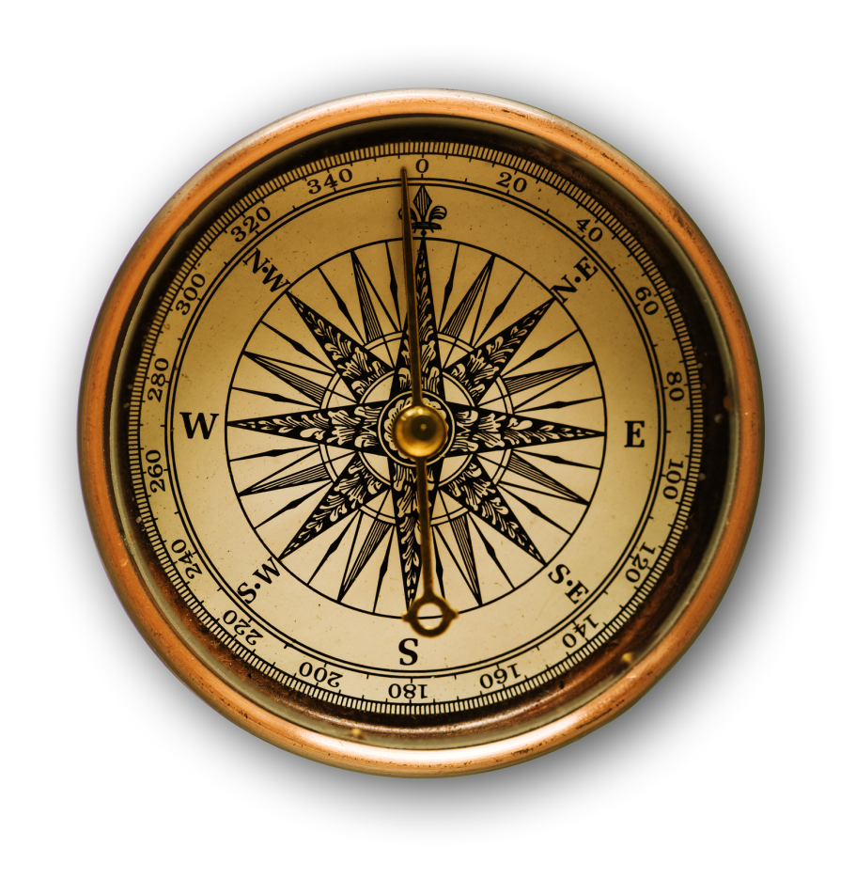
Compass, Astrolabe and Sextant
More Technology
Compass
Uses the Earth’s magnetic field to find direction
Invented in China about 259BC
Used by Europeans during exploration

Slide 5

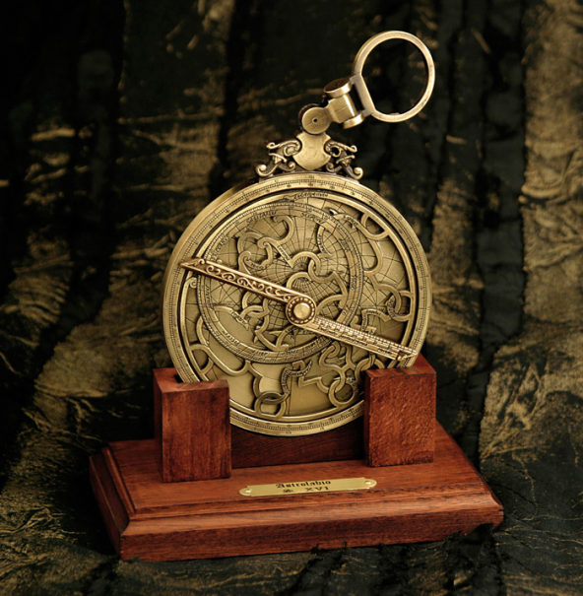
Compass, Astrolabe and Sextant
More Technology
Sextant
Instrument used to measure the altitude of a celestial body
Astrolabe
Ancient astronomical computer
Astrolabes are used to show how the sky looks at a specific place at a given time

