Slide 1
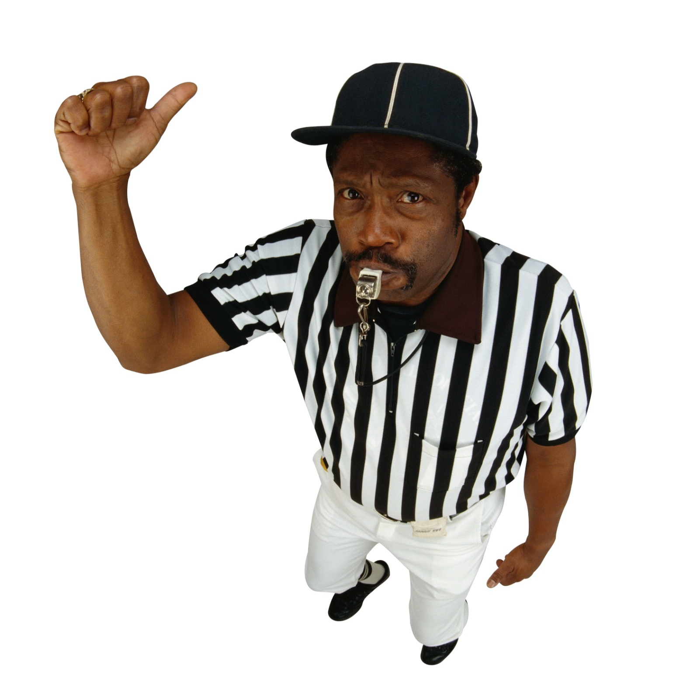
DRED SCOTT DECISION- 1857
Aim: What were the legal reasons why Dred Scott should be freed or remain a slave?
Scott v. Sanford
Do Now: What Federal Law allows Dred Scott to be brought back to his owner?
YOU
BE THE JUDGE!

Slide 2
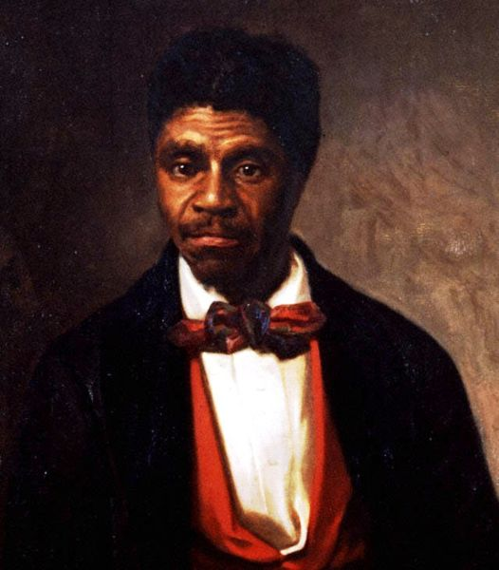
Dred Scott – (1799-1858)
Scott travelled with his master from a slave state to a free state and a free territory.
Scott never made a claim for freedom while in these two free areas.
Notes:
Scott seek freedom for himself and his wife. First he offered to buy his freedom from Emerson's widow, Irene Emerson — then living in St. Louis — for $300. The offer was refused, leaving Scott to seek freedom through the courts.

Slide 3
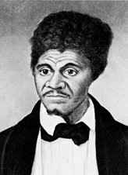
Scott sought freedom for
himself and his wife.
The offer was refused, leaving
Scott to seek freedom through
the courts.

Slide 4
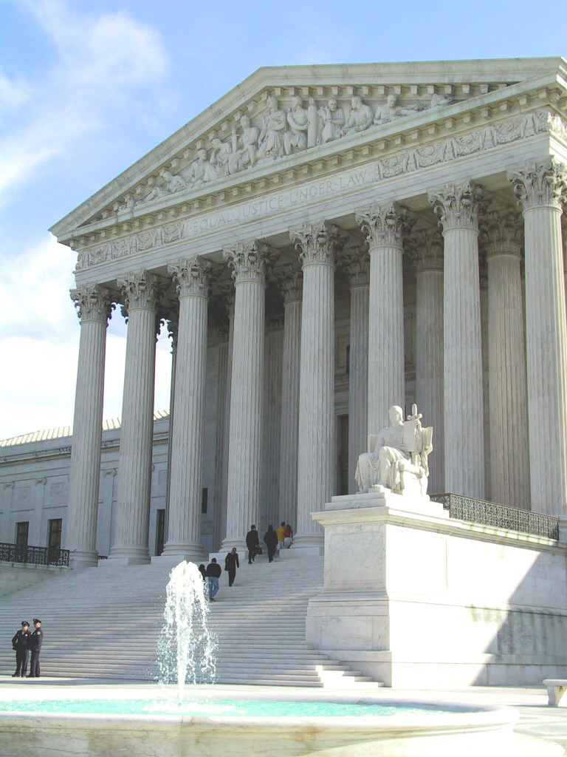
Scott v. Sanford 1857
The case worked its way through State and Federal Courts with decisions going for and against Scott each time the case was heard in a court.
In 1852, the Missouri Supreme Court struck down the lower court ruling, saying, "Times now are not as they were when the previous decisions on this subject were made.“
In 1856 the case was heard at the Supreme Court in Scott v. Sanford
Notes:
Scott filed suit to obtain his freedom in 1846 and went to trial in 1847 in a state courthouse in St. Louis. Scott lost the first trial, but the presiding judge granted a second trial because hearsay evidence had been introduced. Three years later, in 1850, a jury decided that Scott and his wife should be freed. The widow, Irene Sanford Emerson, appealed. In 1852, the Missouri Supreme Court struck down the lower court ruling, saying, "Times now are not as they were when the previous decisions on this subject were made." The Scotts were again returned to their masters.
With the aid of new lawyers (including Montgomery Blair), the Scotts sued again in federal court. They lost and appealed to the United States Supreme Court in Dred Scott v. Sandford. In 1857, Chief Justice Roger B. Taney delivered the majority opinion, that:
Any person descended from black Africans, whether slave or free, is not a citizen of the United States, according to the Declaration of Independence.
The Ordinance of 1787 could not confer freedom or citizenship within the Northwest Territory to black people.
The provisions of the Act of 1820, known as the Missouri Compromise, were voided as a legislative act because the act exceeded the powers of Congress, insofar as it attempted to exclude slavery and impart freedom and citizenship to Black people in the northern part of the Louisiana cession.^{[2]}
In effect, the Court ruled that slaves had no claim to freedom; they were property and not citizens; they could not bring suit in federal court; and because slaves were private property, the federal government could not revoke a white slave owner's right to own a slave based on where he lived, thus nullifying the essence of the Missouri Compromise. Taney, speaking for the majority, also ruled that since Scott was an object of private property, he was subject to the Fifth Amendment to the United States Constitution which prohibits taking property from its owner "without due process".

Slide 5
DRED SCOTT DECISION
NOW YOU
BE THE JUDGE!

Slide 6

















Notes:
Using this PowerPoint break timer
This PowerPoint slide uses images, custom animation, and timing to provide a countdown timer that you can use in any presentation. When you open the template, you’ll notice that the timer is set at 00:00. However, when you start the slide show, the timer will start at the correct time and count down by 1-minute intervals until it gets to 1 minute. At that point, it will count down in two 30-seconds intervals to 00:00.
To insert this slide into your presentation
Save this template as a presentation (.ppt file) on your computer.
Open the presentation that will contain the timer.
On the Slides tab, place your insertion point after the slide that will precede the timer. (Make sure you don't select a slide. Your insertion point should be between the slides.)
On the Insert menu, click Slides from Files.
In the Slide Finder dialog box, click the Find Presentation tab.
Click Browse, locate and select the timer presentation, and then click Open.
In the Slides from Files dialog box, select the timer slide.
Select the Keep source formatting check box. If you do not select this check box, the copied slide will inherit the design of the slide that precedes it in the presentation.
Click Insert.
Click Close.

Slide 7

Did Scott have the right to sue?
Was Scott free as a result of living in a state and territory where slavery was illegal?
Was it Constitutional for Congress to limit slavery in the territories?

Slide 8
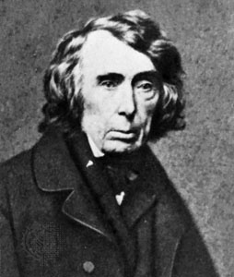
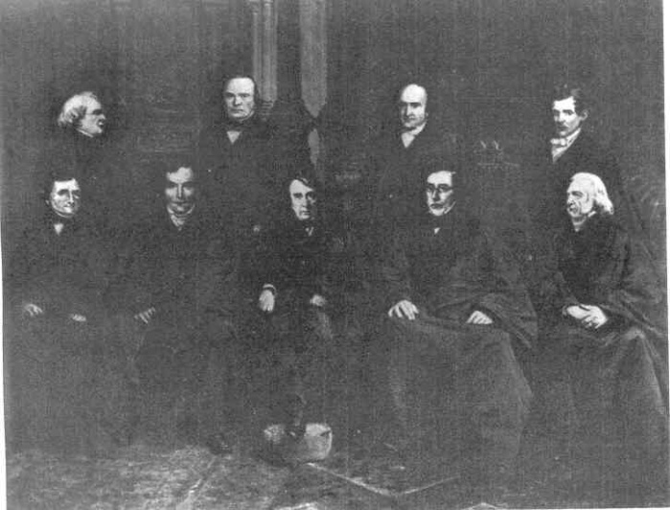
The U.S. Supreme Court. In Scott v. Sanford the Court states that Scott should remain a slave, that as a slave he is not a citizen of the U.S. and thus not allowed to bring suit in a federal court, and that as a slave he is personal property and thus has never been free.
The court further declares unconstitutional the provision in the Missouri Compromise that permitted Congress to prohibit slavery in the territories
Effect:
The decision in Scott v. Sanford greatly alarms the antislavery movement and intensifies the growing division of opinion within the United States. The newly-formed Republican Party, which opposes the expansion of slavery, criticizes the decision and the court.
Chief Justice
Roger Taney
Notes:
After the ruling, with Sanford in an insane asylum, Scott was returned as property to Irene Emerson. However, in 1850, Emerson had remarried to an abolitionist, Calvin C. Chaffee, who shortly thereafter was elected to Congress. In a bizarre turn of events, Chaffee was apparently unaware that his wife owned arguably the most prominent slave in America until a month before the Supreme Court decision. Too late to intervene, the severely criticized Chaffee proceeded to have Emerson return Scott to his original owners, the Blow family, who, as Missouri residents, could emancipate him. Scott was formally freed on May 26, 1857 and worked as a porter in St. Louis for less than nine months before he died from tuberculosis in September 1858. He was survived by his wife and his daughter Eliza Scott (born 1838).

Slide 9
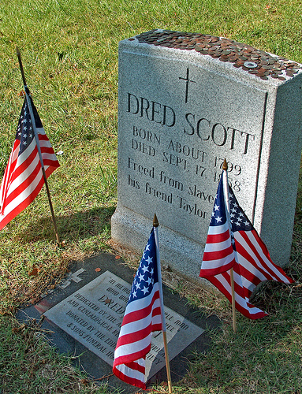
After the Decision & Death
1857 – Dred Scott was Freed
1858 - Dred Scott dies of tuberculosis and is buried in St. Louis
"DRED SCOTT BORN ABOUT 1799 DIED SEPT. 17, 1858 DRED SCOTT SUBJECT OF THE DECISION OF THE SUPREME COURT OF THE UNITED STATES IN 1857 WHICH DENIED CITIZENSHIP TO THE NEGRO, VOIDED THE MISSOURI COMPROMISE ACT, BECAME ONE OF THE EVENTS THAT RESULTED IN THE CIVIL WAR"
Notes:
1860
Abraham Lincoln is elected president in a political contest dominated by the discussion of slavery. South Carolina secedes from the Union, and the Civil War

