Slide 1
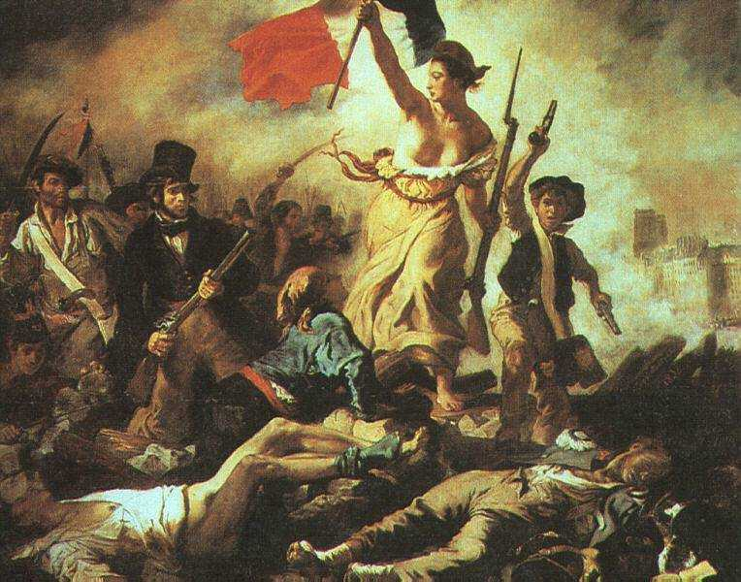
French Revolution
AIM: What were the phases of the French Revolution?
Do Now: Is a revolution always violent?
"Liberty Leading the People“
(Eugene Delacroix, 1830).

Slide 2

Is a revolution always violent?

Slide 3



Revolution
A dramatic and wide-reaching change in the way something works or is organized or in people's ideas about it. (Usually non-violent)
Neolithic Revolution
Scientific Revolution
Commercial Revolution
Industrial Revolution
Information Revolution
A forcible overthrow of a government or social
order in favor of a new
system (usually violent)
American Revolution
French Revolution
Russian Revolution
Velvet Revolution

Slide 4

French Revolution – 3 Stages
1st Stage - Estates General Meets, Municipal Gov’t, Storming of Bastille Prison
2nd Stage – Radical, Reign of Terror, King & Queen Executed with Guillotine
3rd Stage - Directory Governs, Napoleon asked to become consul.

Slide 5
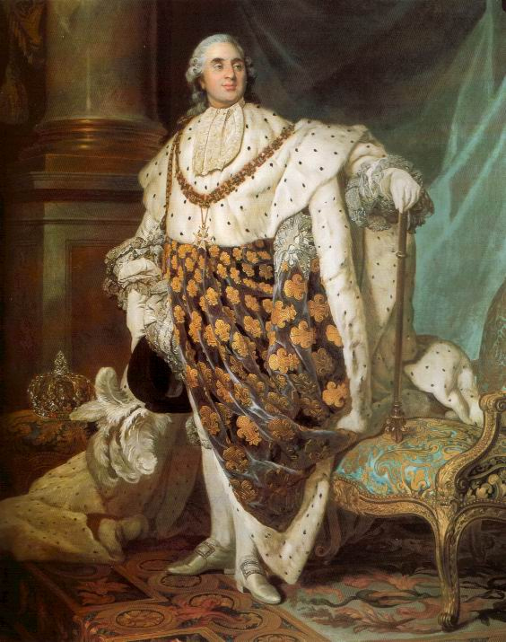
Causes and Attitudes
The Enlightenment
The American Revolution
French system’s lack of change
  Louis XVI clung to Absolutism
  King’s response to the poor
  Class resentment
  Economic problems

Slide 6
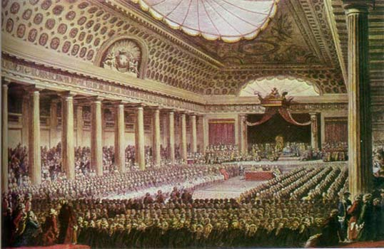
First Stage (1789-1793)
King desired new tax to stabilize economy
King called the Estates General
(3 estates – 3 Classes)
  Not met for 150 years
  Needed to meet
  Certified by Parliament (high court)
  Election in early 1789
Finally met in Spring 1789
  3rd Estate walked out

Slide 7
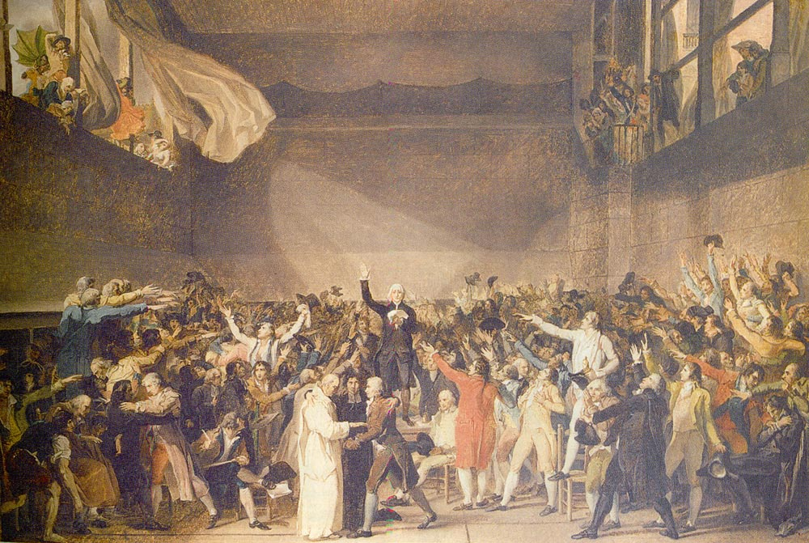
First Stage
National Assembly (1789-1793)
  3rd estate met in indoor tennis court
  Resolved to stay in session until constitution could be written
  King couldn't get money
  King instructed 1st and 2nd estates to meet with National Assembly
  3rd estate doubled their numbers
  1st and 2nd sat on right, 3rd sat on left
  Formed municipal (city) government

Slide 8
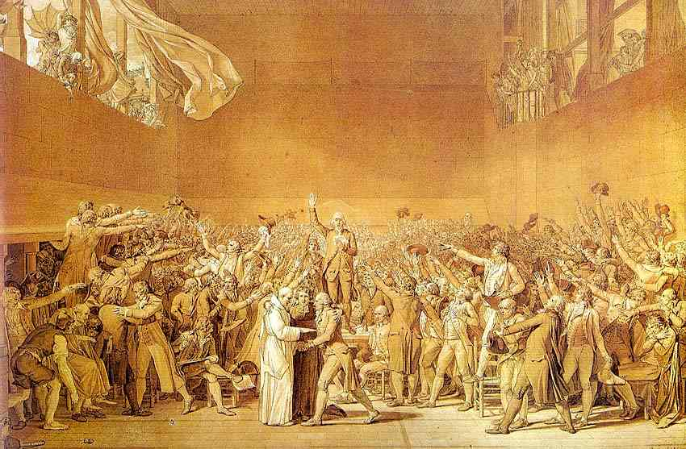

Slide 9
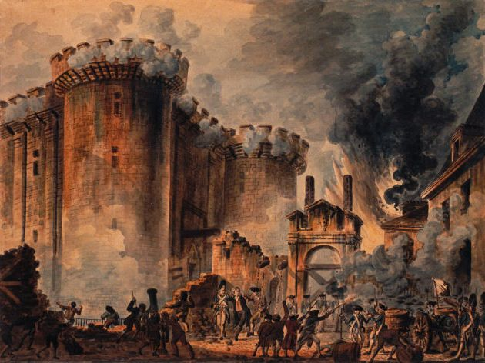
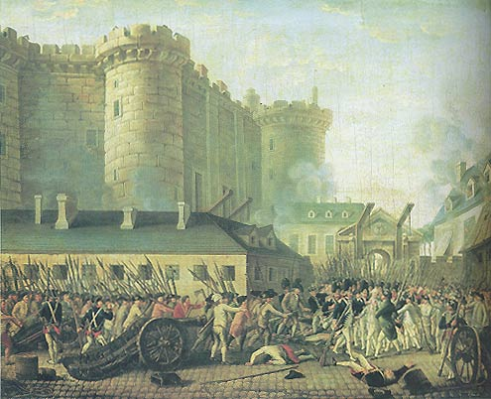
First Stage
Events at Bastille
Prision
  July 14, 1789
  Municipal government trying to get arms
Revolts in the countryside

Slide 10
Actions of the
National Assembly
Destruction of privilege (nobility)
Declaration of the Rights of Man
Secularization of the church
New Constitution

