Slide 1
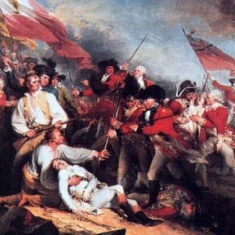
The American Revolution
1776- 1783

Slide 2
The Revolutionary Era
“No Turning Back:” 1774-1776
Declaration of Independence, 1776
The Contenders
Early Years of War
Turning Points
War and Society
Conclusions, 1783

Slide 3
The Road To War
The Sons of Liberty organized chapters across the north, opposed what they considered British abuses
Broke “salutary neglect”
Differences: high taxes and abuses vs. payment for war, not following rules, cost of government
Boston Massacre, 1770
Committees of Correspondence
Tea Tax and Boston Tea Party, 1773

Slide 4
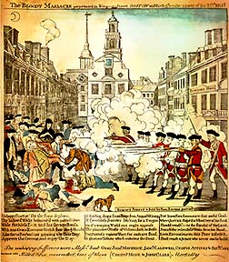
Boston Massacre, 1770

Slide 5
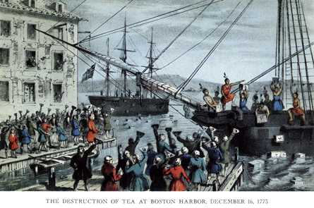
Boston Tea Party, 1773

Slide 6
No Turning Back, 1774-6
-British reacted to Boston Tea Party
A). “Intolerable Acts” 1774
1). Mass. Charter; Boston Port;
2). Gen. Thomas Gage in Mass
3). Quebec
-1st Continental Congress, 1774
A. Did not want war
B. Committed crown
C. Boycotts & Unity

Slide 7
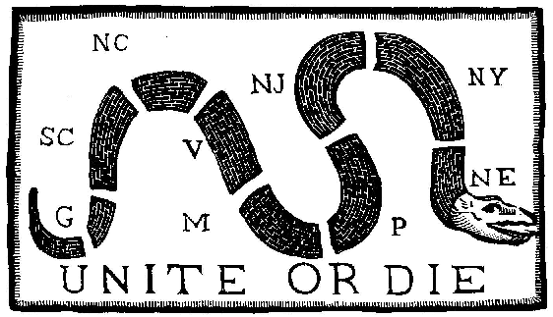
Colonial Nationalism
Common Experiences
Military Service
British troops
Print Media
Socio-cultural
Anti-Indianism
“Americanism”

Slide 8
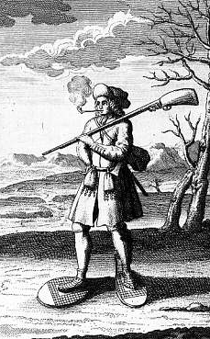
Social Differences
Weak Aristocracy
  Less power
More “open” land
  Geographical mobility
Immigration
Indian-fighting
Generations of “Americans”

Slide 9
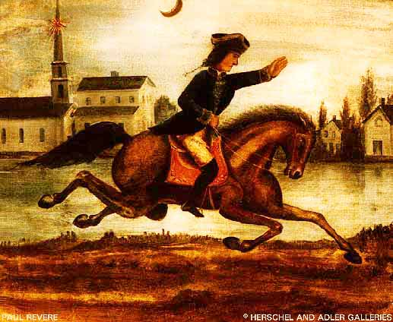
No Turning Back, 1774-6
-Minutemen
-Loyalists and Whigs
-Lexington & Concord
-April 1775 “shot heard ‘round the world’”

Slide 10
No Turning Back, 1774-6
-The Second Continental Congress, 1775
A). “National Gov’t”
B). Olive Branch Petition
C). “Declaration of the Causes and Necessity of Taking up Arms”
D). George Washington

Slide 11
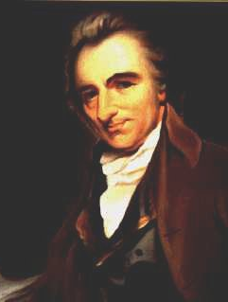
Revolutionary Propaganda
-Thomas Paine, 1776
A). Common Sense
B). Argument for rebellion & independence
British seized American ships
---1776---

Slide 12
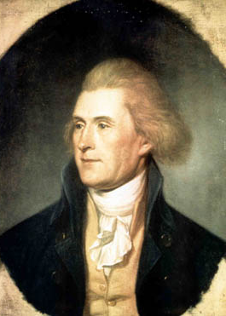
Declaration of Independence
Central ideas
A. Abuses
B. “Self-evident” truths
C. Equality
D. Rights
E. Consent
F. Right to overthrow
G. Locke, Enlightenment

Slide 13
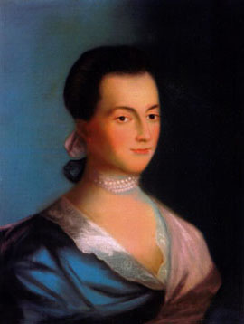
Limitations
What about slavery?
Elite white males
Not the poor
Excluded women
Written secretly
←Abigail Adams

Slide 14
The Contenders
Britain
-Wealth
-Confidence
-Professional Army
-Firepower
-Navy
-Distance & supplies
Colonists
-Home turf
-Defensive War
-French
-Dispersed population
-Size of region
-Local noncombatants

Slide 15
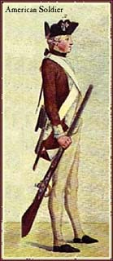
The Soldiers
I). Continental Army
A). Washington trained them
B). Lower classes, peasants,
landless, workers
C). Underpaid & fed,
occasional mutinies

Slide 16
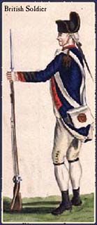
The Soldiers
II). British “Redcoats”
A). Hunger, disease,
infection, amputation
B). Harsh Discipline
C). Lower classes
III). German Mercenaries
--Hessians

Slide 17
A Poor Man Fights a Rich
Man’s War
Committees of Correspondence ordered townsmen to register for the Continental Army
Refusal resulted in imprisonment
Elites could buy their way out of service for themselves, their sons and friends
John Adams: 30% oppose and 30% do not care about the Revolution

Slide 18
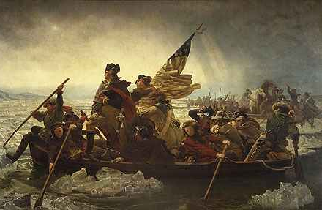
Part One: The North, ’76-77
I). BR reluctance and
Washington’s victories
A). The Howe Brothers
-Army & Navy
B). Trenton & Princeton
-Swift attacks
-Element of surprise

Slide 19
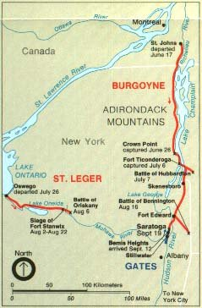
Saratoga, NY 1777
-British retaliated
-Uncoordinated attacks in the North
-Battle of Saratoga Oct, 1777
A). Defeated Gen. Burgoyne
B). Boosted morale and
convinced French

Slide 20
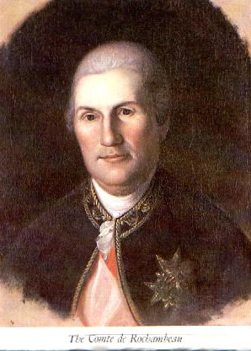
The French & Spanish
I). French assisted in 1778
A). Curb British power
B). Trade
II). Spanish assist in 1779
A). Navy
III). Multi-National alliance against Britain

Slide 21
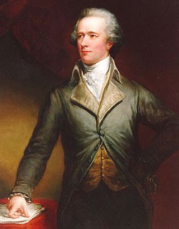
Alexander Hamilton, Treasury
“…our countrymen have all the folly of the ass and all the passiveness of the sheep…They are determined not to be free…If we are Saved, France and Spain must save us.”

Slide 22
Part Two: South & West,
1778 - 81
I). The South
A). Tory support
B). British victories
1). Replaced Howe with Henry Clinton
2). Charleston, S.C. (Dec. 1779)
a). Biggest American defeat
b). Try to control south

Slide 23
Part Three: The End, 1781-83
I). General Clinton in the South
-Concentrated British troops
II). Gen. Nathaniel Greene attacked Cornwallis at Cowpens (SC), Jan ’81
-Fake surrender & surprise attack
III). British failed to hold rural areas
-Supply lines
-American defensive war

Slide 24
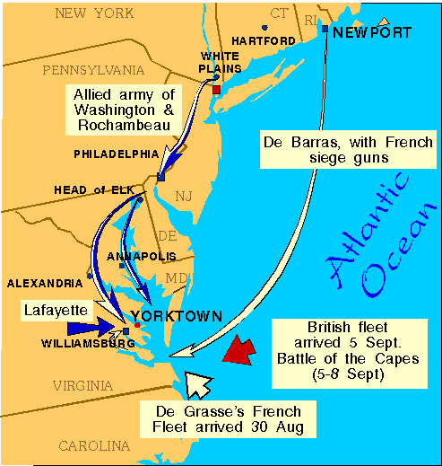
Battle of Yorktown, 1781
IV). Cornwallis targeted Virginia
-Wanted to hold the war there
V). Americans plan a fake attack in North
-Link up with French
-Trap Cornwallis at Yorktown

Slide 25
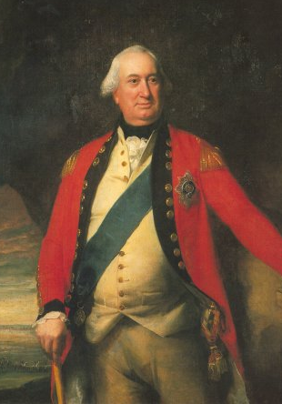
Surrender of Cornwallis
I). Surrounded
A). October 1781
II). King George
continued fighting
III). Peace of Paris, 1783

Slide 26
Peace of Paris, 1783
I). B. Franklin, J. Adams, John Jay
A). Accept Independence
B). Boundaries (181)
C). SP gained FL
D). Forfeit land & property (except Lord
Fairfax)
E). Fishing rights
II). Indian Nations
A). Inside U.S. & Indian policy

Slide 27
How did it happen?
British arrogance
Leadership
French assistance
Distance
Familiarity
Non-combatants
Defensive War
Dispersed population

Slide 28
Joseph Plumb Martin, 1830
“When we engaged in the service we were promised the following articles for a ration . . . But we never received what was allowed us. Oftentimes I had gone one, two, three and even four days without a morsel. We were also promised six dollars and two thirds a month, and how did we fare in this particular? It was scarcely enough to procure a dinner.”
Was he just a whiner, or did he have a valid complaint?

Slide 29
Continued…
“The country was rigorous in exacting my compliance to my engagements, but equally careless in performing her contracts with me; and why so? One reason was because she had all the power in her own hands, and I had not. Such things ought not to be.”
Did the country owe him anything, or was he supposed to be fighting for his own independence, too?

Slide 30
“I now bid farewell to the service. When those who engaged to serve during the war enlisted, they were promised a hundred acres of land each. When the country had drained the last drop of service it could screw out of the poor soldiers, they were turned adrift like old worn-out horses, and nothing said about land to pasture them upon. The truth was, none cared for them; the country was served . . . and that was all that was deemed necessary.”
If he was correct, what problems might the new government have with citizens who felt abused?

Slide 31
Rebellions Within the Rebellion
December 1781: over 400 Penn militia marched on Congress in Philadelphia to protest lack of pay, hunger, treatment.
1782: 200 New Jersey militia protested, Washington sent 600, hanged two
Near civil war in Maryland, Delaware, North and South Carolina, Georgia

Slide 32
Women & African Americans
Worked in camps on the lines
Molly Pitcher
Spies, messengers
Promises of freedom
5,000 for U.S., workers, few soldiers
Rarely armed
South feared of rebellions

Slide 33
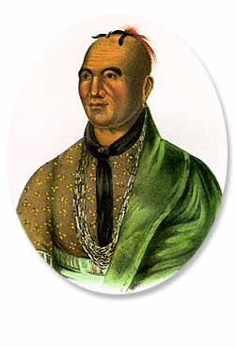
Significance for Indians
200,000 east of Miss
Wanted neutrality
Most helped BR
“Five Tribes” pro-BR
Iroquois split
Joseph Brandt, Mohawk
Catawbas pro-U.S.

Slide 34
Legacy for Indians
Generally thought it was not their war
War for liberty and independence took liberty and independence away from Indians
War against colonial oppression led to colonization and oppression of Indians by the U.S. government
Soldiers paid with Indian land, not free land
Indians erased from history due to Paris Peace Treaty and the idea that the war was fought ONLY between colonists and British

Slide 35
General Conclusions
70% of those signing the Declaration held offices in British colonial government
Class dimensions during War
Shift from British control to control by new American elites
Strengthened southern slavery
War for political ideals, philosophy
Created—slowly—possibilities for groups to express their grievances and struggle for equality

