Slide 1
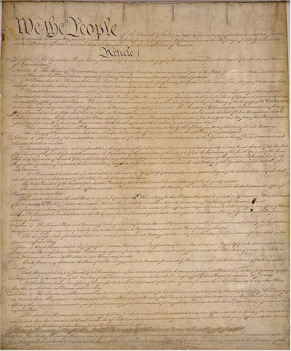
The Principles of the
United States Constitution
AIM: What are the guiding principles of the U.S. Constitution?
Do Now: Map Quiz

Slide 2
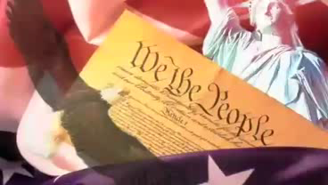

Slide 3
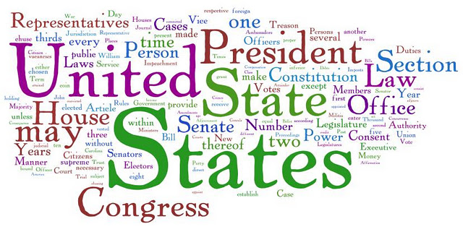
The United States Constitution
The Constitution is our plan for government.
It contains the Preamble
It contains seven (7) Articles or Topics
It contains the Amendments (27) in total – Last one in 1992

Slide 4
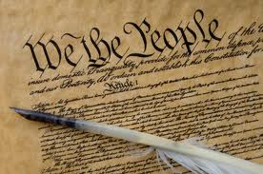

I. Popular Sovereignty
The U.S. is a Federal Republic
The people hold the ultimate authority
A representative democracy lets the people elect leaders to make decisions for them.

Slide 5

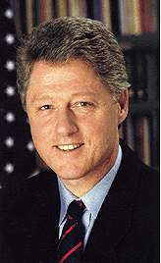
II. Limited Government
Framers wanted to guard against tyranny
Government is limited to the power given them in the Constitution.
The Constitution tells how leaders who overstep their power can be removed. Called Impeachment & Removal

Slide 6
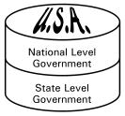
III. Federalism
The division of power between State and National Governments
Some powers are shared
The National Government has the “supreme power”

Slide 7
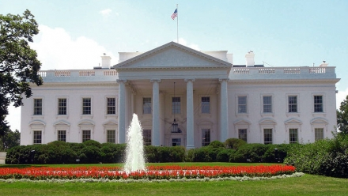
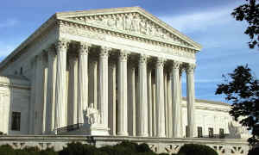
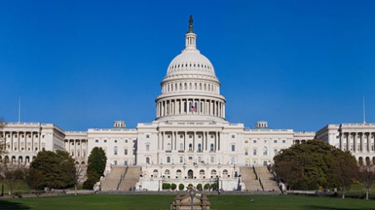
IV. Separation of Powers
No one branch holds “too much” power
Legislative branch makes the laws
Executive branch carries out the laws
Judicial branch interprets the laws

Slide 8
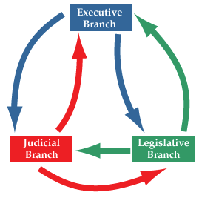
V. Checks and Balances
Prevents the abuse of power in government
Each branch can check each other branch

Slide 9
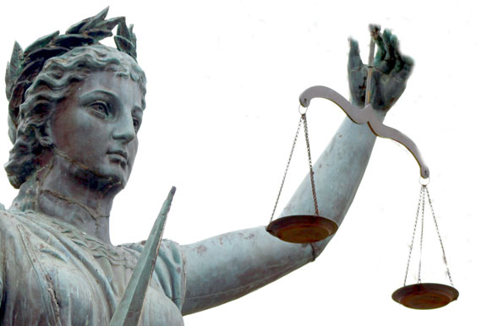
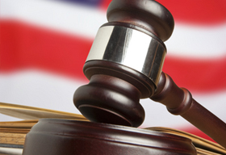
VI. Judicial Review
The role of the Judicial branch is to determine whether or not a law is constitutionally acceptable.
That means that any laws that the government creates cannot break/violate any of our constitutional rights such as freedom of speech
Judicial review is the power to declare unconstitutional, illegal, null, and void of a government action that violates some provision in the Constitution.

