Slide 1
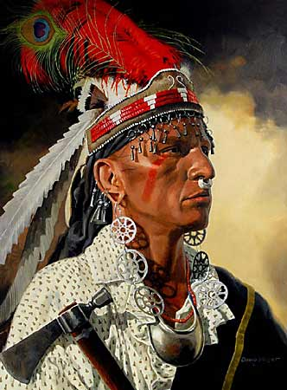
The French and Indian War
“You and the French are like two edges of a pair of shears, and we are the cloth that is cut to pieces between them.”
– Native American to an English man
Do Now:
1. Name the thirteen original colonies?
2. What was the name of the Mother country?
AIM: Why was the French & Indian War so important to the future development of the United States?

Slide 2
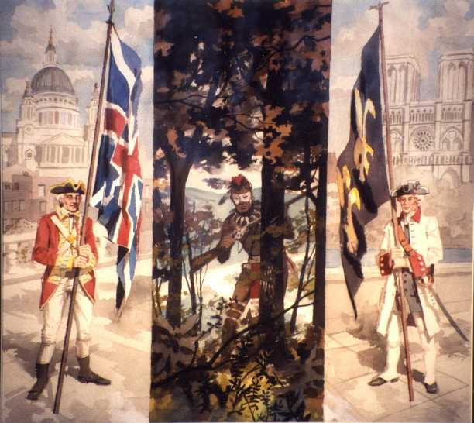
France Claims Western Lands
French exploring interior of America
Late 1600’s – France had claimed the Ohio River Valley, the Mississippi River Valley, and the great lake region.
Louisiana (La Salle) stretched from the Appalachian Mountains to the Rocky Mountains

Slide 3
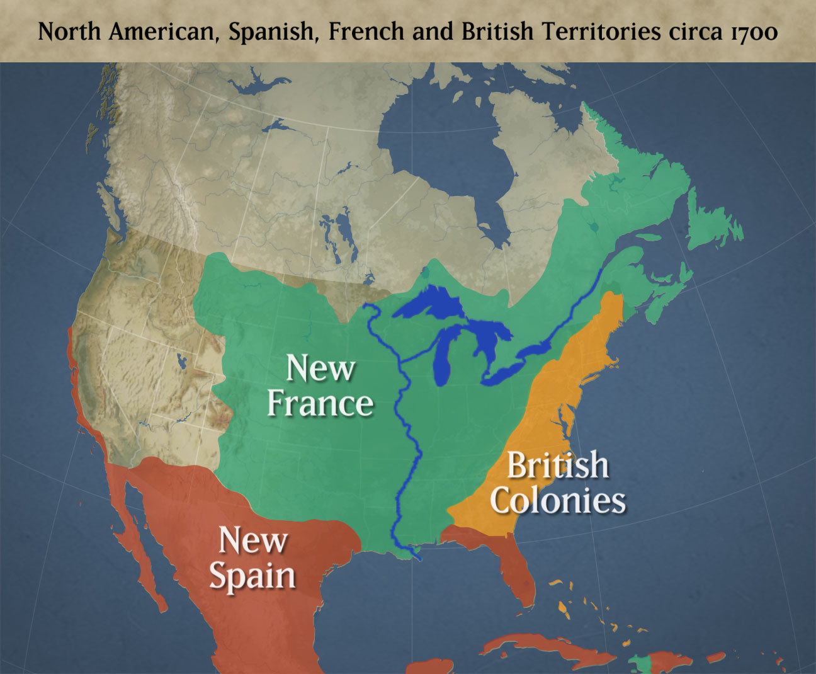

Slide 4
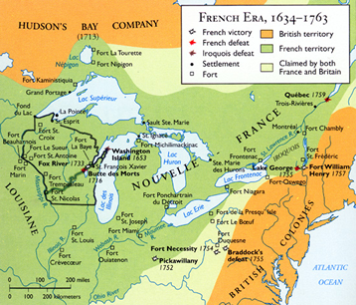

Slide 5
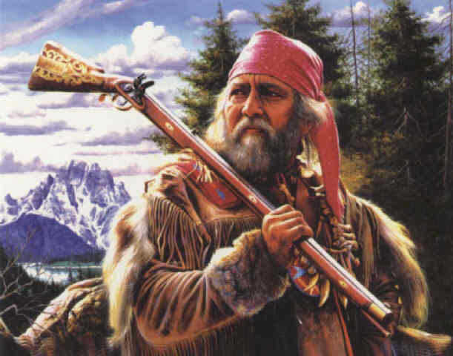
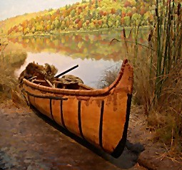
French were mostly fur trappers who traded with the Natives
Furs, guns, knives, iron pots, etc.

Slide 6
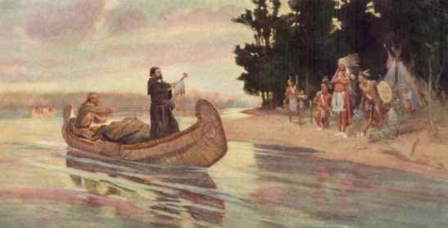
Native American Alliances
English competed with the French for furs
Native American groups competed to supply Europeans with furs

Slide 7
Native American Alliances
The fur trade created economic and military rivalries and alliances between the Native Americans and the Europeans.
These alliances between the Natives and Europeans led to their involvement in the war.
Native Americans were divided between the French and the British, but most sided with the French since it profited them more.

Slide 8
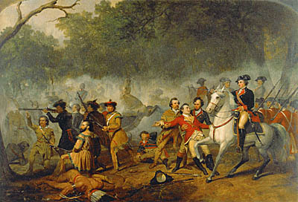
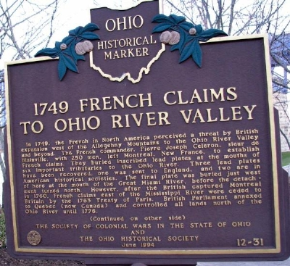
Causes of French & Indian War
Competition between English & French for trade
Native Americans taking sides
British start trading in Ohio River Valley (disputed territory in which the French claim.

Slide 9
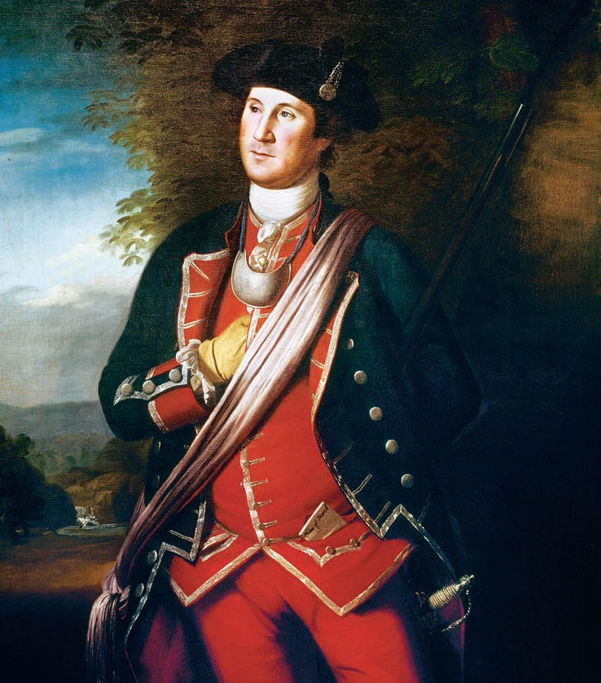
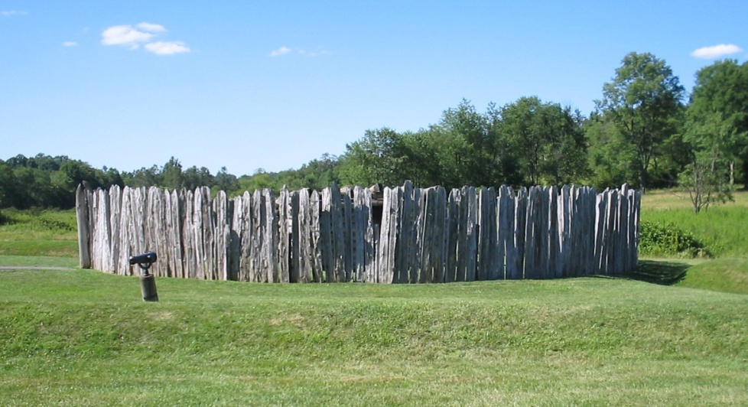
Fort Necessity
Colonel George Washington was on his way to Fort Duquesne when he heard of its surrender
Instead, he built a small fort but was attacked by the French and forced to surrender
(July 3, 1754)

Slide 10
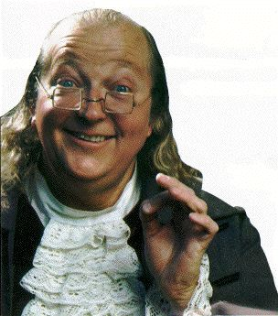
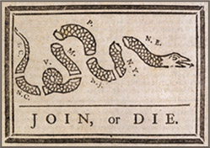
Albany Plan of Union
While the fighting was beginning, representatives were trying to get the Iroquois to fight with the colonists (English)
Ben Franklin was trying to get the colonists to join together for defensive purposes – Join or Die
  Council that could collect taxes, make treaties, raise an army, and make new settlements.

Slide 11
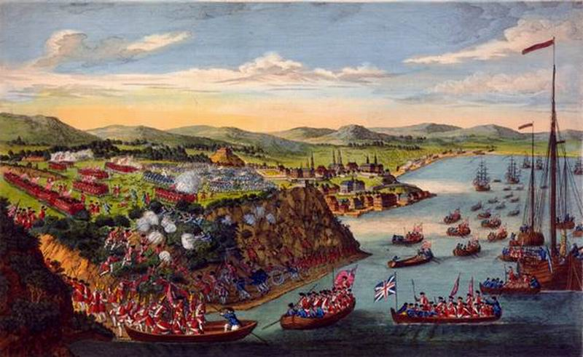
Turing Point - Quebec
At night fall 4,000 British snuck up the cliff and waited
Surprised the French in
the morning
Montreal falls within the year

Slide 12
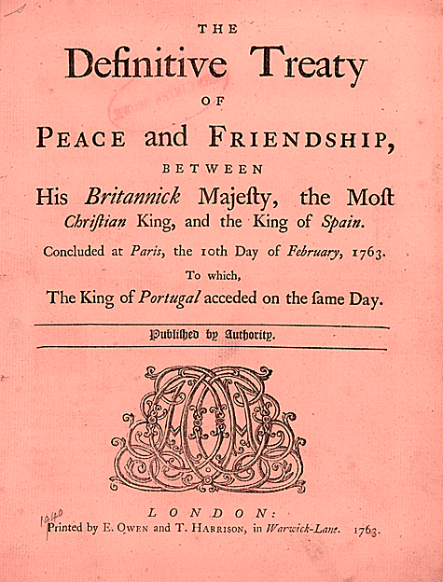
Treaty of Paris (1763) – Results of War
Britain received all land east of the Mississippi
Spain received all land west of the Mississippi and New Orleans for its help
Britain received Florida from Spain
Treaty ended the war as well as French power in North America

Slide 13
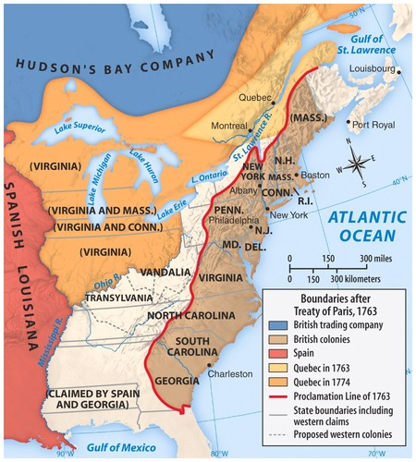
Proclamation of 1763
Proclamation line of – forbid colonists to settle west of Appalachian Mountains
  Because new they couldn’t protect them against Natives or French
  Colonists are not happy about this; feel it is their right to settle the land

Slide 14
Classwork
Write a paragraph:
Explain how the French and Indian War could be a cause for the 13 colonies to think about independence. Think about the groups involved, the disputed land, trade, and the treaty.

Slide 15
Homework
  Start working on your Map Packet
  First State Quiz – Friday 10/7/11
  Hint: 13 Original Colonies
  Map Packet Due: Tue 10/11/11

